Slide 1
Doing More with Less
An Introduction to the world of Azure Functions - Napoleon “Ike” Jones TWITTER: @ikethedev EMAIL: napoleon.i.jones.3@gmail.com Web: https://ikethe.dev

Slide 2
What is azure functions
A serverless compute service that enables you to run code on-demand without having to explicitly provision or manage infrastructure.

Slide 3



“Serverless still runs on servers”

Slide 4

“COOL STORY BRO”

Slide 5
Serverless is an architecture that relies heavily on abstracting away the host environment to focus on code. It can be thought of as less server
- Serverless Apps: Architecture, Patterns, and Azure Implementation
Notes:
Serverless provides a clear separation between the code and its hosting environment. You implement code in a function that is invoked by a trigger. Its another level of abstraction higher than PaaS.

Slide 6
A miracle for anyone who’s ever dealt with manual enterprise resource provisioning
- Me

Slide 7
Advantages
Cost
Elasticity
Productivity
Notes:
Cost, Azure Functions are

Slide 8
Cost
Consumption Based
1 Million Executions & 400,000GB-s FREE
No Over/Under Provisioning
Notes:
For a personal project, I was paying about $70/month for an app service. I rewrote the backend in Azure Functions and my cost is now ZERO.

Slide 9
Cost
Pwned Passwords (https://haveibeenpwned.com/Passwords)
500,000 Requests Per Month
7,000 GB-s Per Month
$0.00

Slide 10
Cost
Pwned Passwords Without Caching
140,000,000 Requests Per Month
2,000,000 GB-s Per Month
Under $60

Slide 11
Elasticity
On-Demand Auto-Scaling Based on Volume
No Need to Provision or Deprovision
No Under/Over Provisioning

Slide 12
Productivity
Abstraction of Infrastructure, OS, & Services (IIS)
Ease of Development, Single Responsibility Principle
Faster Time to Market
Notes:
IAAS – Virtualized Pre-configured Hardware, YOU PROVIDE THE OS AND ANY OTHER SOFTWARE
PAAS – Includes the OS and Application Services
Serverless/FAAS – Includes every thing but your code.

Slide 13
Disadvantages
Stateless
Vendor Lock-In
Initial Performance Costs (Cold Start)
Long Running Processes

Slide 14

Azure Functions Specifics

Slide 15
Hosting Plans
Consumption
Premium
Azure App Service

Slide 16
Supported Languages
.NET
node.js
Java
Python

Slide 17
Triggers
HTTP
Timer
CosmosDB
Blob
Queue

Slide 18
Triggers
Event Grid
Event Hub
Service Bus Queue
Service Bus Topic
Notes:
Event Grid – Automated Routing Based on Events from any source
Event Hub – Real-Time Data Ingestion Service
Service Bus Queue –
Service Bus Top – One to Many Subscription Service

Slide 19
Common Bindings
HTTP/Web Hooks
BLOB Storage
Storage Queues
CosmosDB
SignalR

Slide 20
Common Architectures/Patterns
Full Serverless Backend
Starving the Beast (Monolith)
Function Chaining
Monitoring (Timer Trigger)

Slide 21
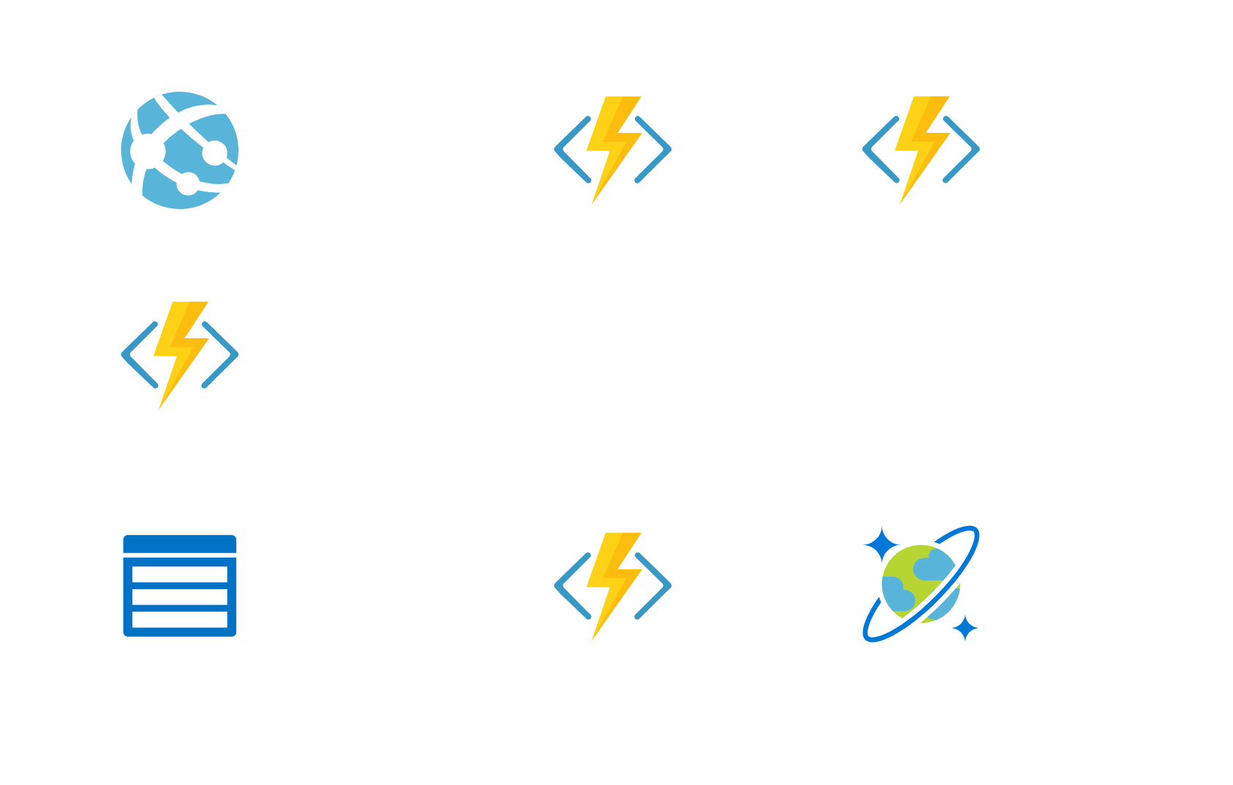
Another Demo?

