Slide 1

Art Tokenization Platform
BLOCK.ART
Art tokenization platform

Slide 2
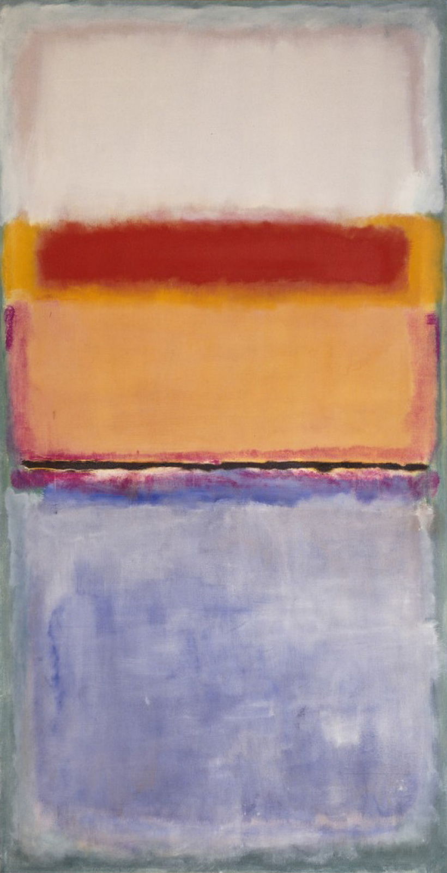
Why we’re need this today
Art are one of the most major asset types of alternative investment, market is a Euro 2 trillion asset class with potential to growth to Euro 2.7 trillion in the next ten years
However, art investment has always been a privilege of only a few, and there has never been a way to make investment in art transparent and accessible to wide range of investors and bring liquidity to the market
According to the latest researches, questions of provenance, transparency, attribution, and ownership issues are considered to be key challenges in the art market
Blockchain technology could revolutionize the art industry by resolving these questions

Slide 3
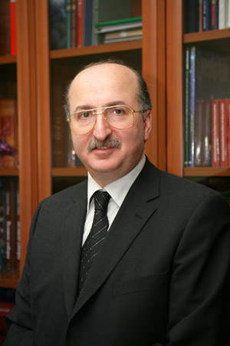
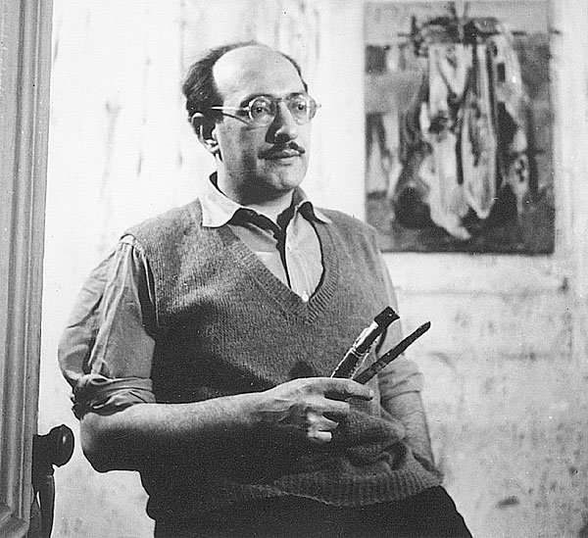
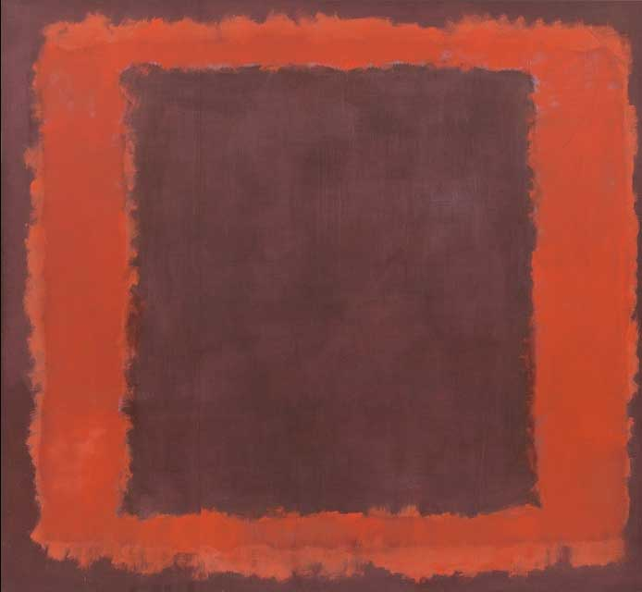
Art tokenization framework
Origination
SPV
Tokenization
(Legal entity)
Transfer ownership Sell shares in artwork
Purchase of shares in artwork
Purchase of shares in artwork
Art Owner
Art Management Company
Investors
Originator: Asset owner
SPV: Art Management Company
Underlying Assets:
Investor: Tokenholders
Tokenization: Issuance of shares of artworks that are represented by ERC-20 Tokens
Process:
- Verification (KYC/AML)
- Purchase of SPV shares
- Token generation
- Distribution of tokens
Assets Equity Transfer of assets SPV issues shares from originator to to investors
Art & Collectibles
Process:
- Market Value Appraisal
the SPV
- Authenticity verification
Process:
- Digital copy creation
- SPV registration
- Ownership transfer
- Private placement of common shares
4

Slide 4
Platform roadmap 2Q 2020 3Q – 4Q 2020
1Q – 2Q 2021
MVP Development
Desktop Platform Development Mobile App Development
Admin Dashboard
Investor Dashboard
Crypto Wallet
Payment in crypto/fiat
Asset digital copy
General information about asset
Art manager Dashboard
Statistics and reports
Smart-contract for online auction
Secondary market for tokens
Bid/Ask matching
Dividend distribution
Open API
Investor Dashboard
Primary Market
Secondary Market
Buying/Selling Tokens
Payment in fiat & crypto
Graphs and other statistics
5

Slide 5
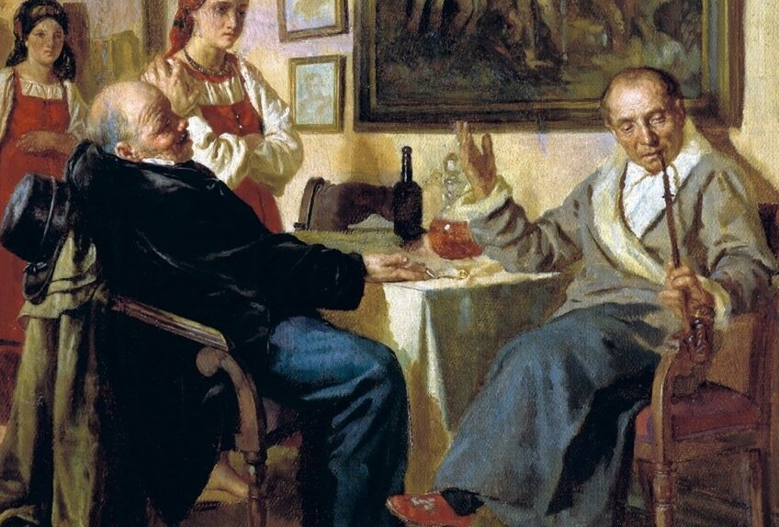
Why us
the unique experience of our team
art owners are looking for new distribution channels
everyone is very tired of art fakes
transactions for the sale of art are very complicated and confusing and go offline, and this greatly increases the cost of the transaction
why can you buy a bag of Louis Vuitton, but not a picture of Mark Rothko? The time has come!

Slide 6
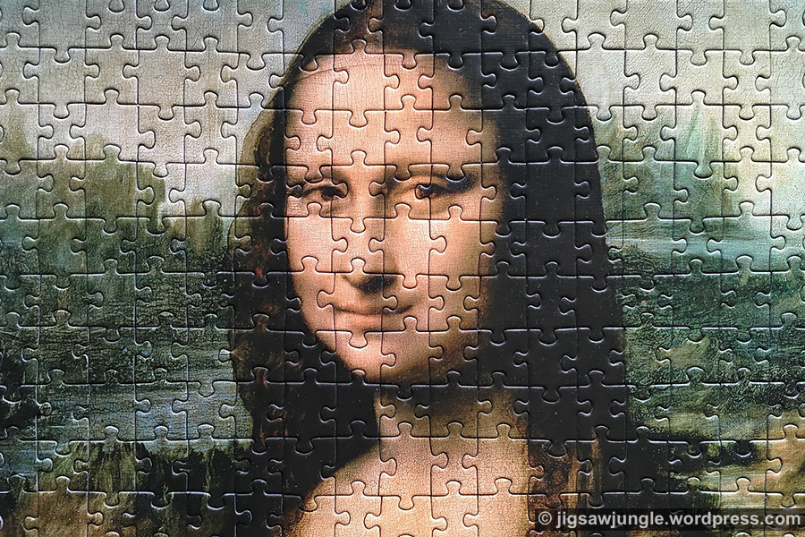
Still thinking in what to invest your 10000 $? Why not in genuine classical art?!
Just imagine, you can buy the Mona Lisa!
Do you think it’s impossible? Now you can!
We’re creating the instrument –
digital token.
This token like a part of a puzzle, representing the part of all Mona Lisa.
More good that you can buy it sitting on the beach! From 100$!
Magic? Not – science!

Slide 7
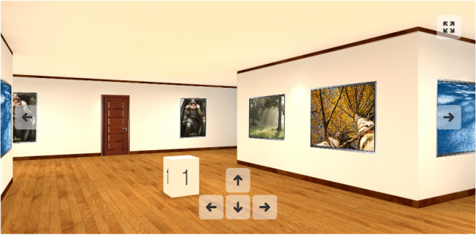
Do you want to sell your art? Come to our platform!
Call to us
We’ll bring to you our local partner
We’ll authenticate your art
Sign the agreement with us
We’ll start the tokenization process
Well done, you’re in our platform!
Sell fast, to any in the world!

Slide 8
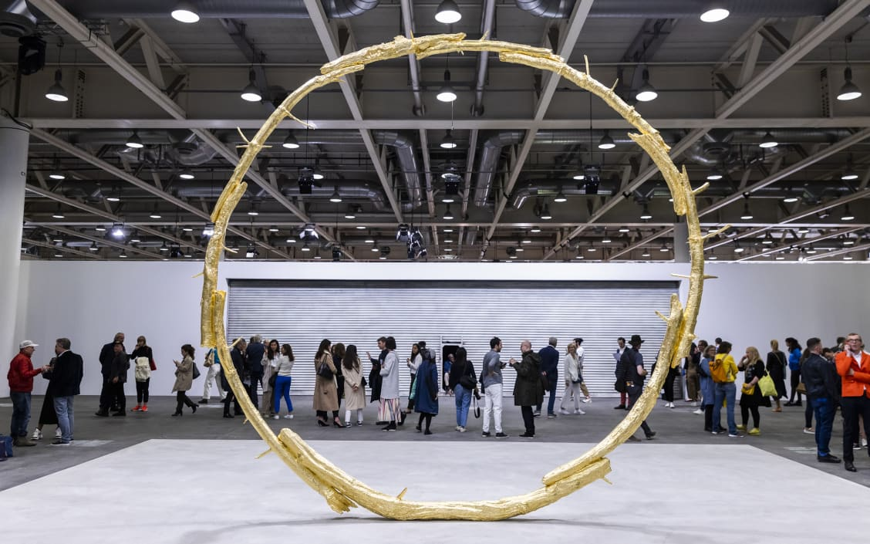
Do you still offline?? Ok, we’re coming!
Meet us in top offline events:
Art Basel(Miami,Abu Dhabi)
Venetian Biennale
Frieze Art Fair,UK
Affordable Art fair Hong Kong
Australian Biennale

Slide 9
Make money with us!
Are you art-dealer?
Our placement commission is from 2 to 5% from price of any art, yours is 30%
From each deal of your clients, we taking 1.5%, yours is 0.5%
Are you gallery?
Plus 20% to every commissions above!
Are you MoMA or Christie?
Just call us!

Slide 10
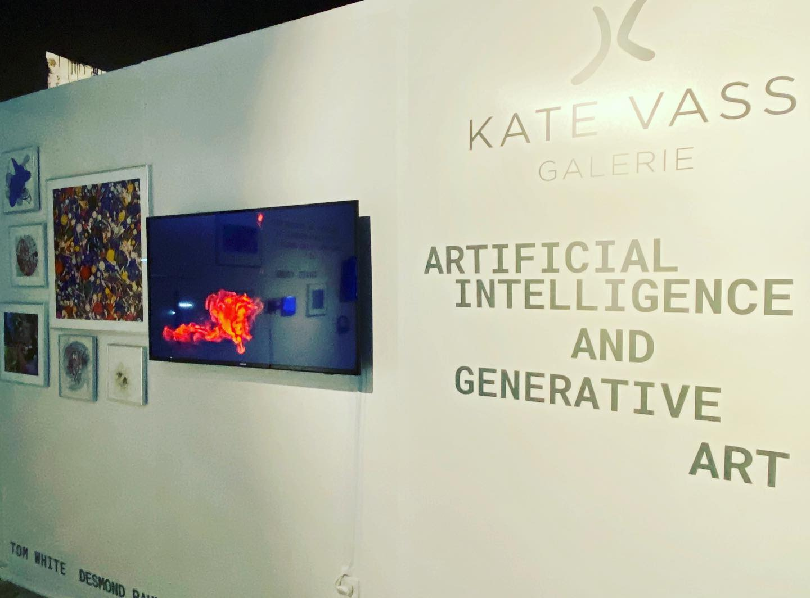
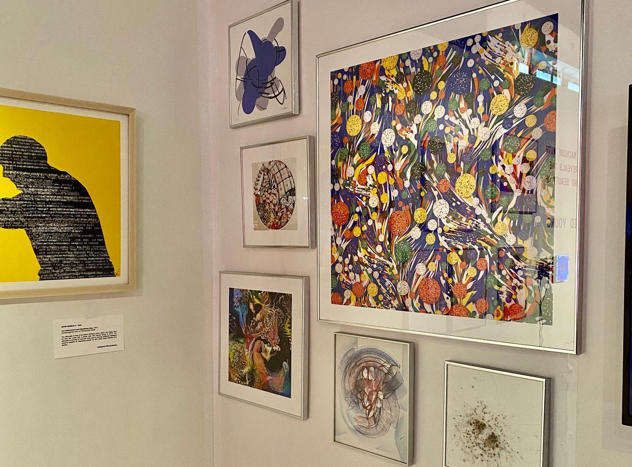
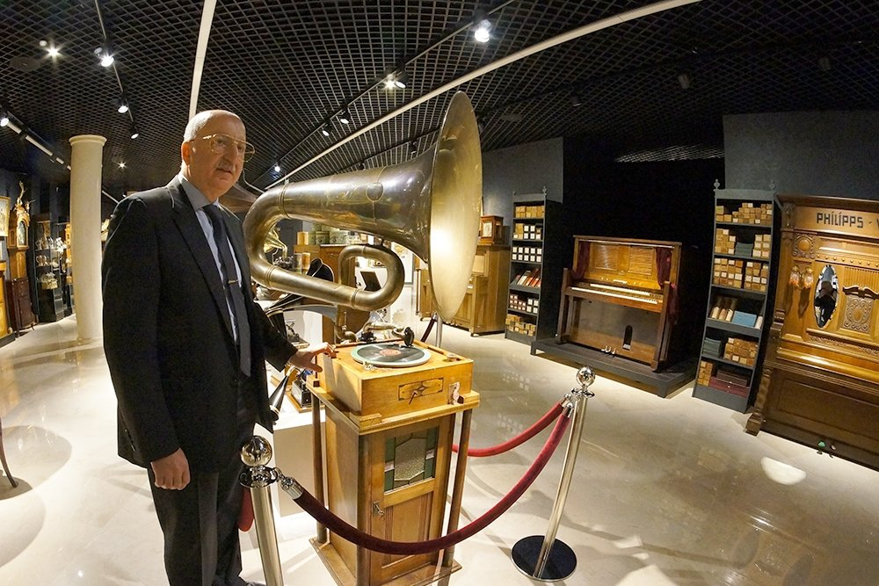
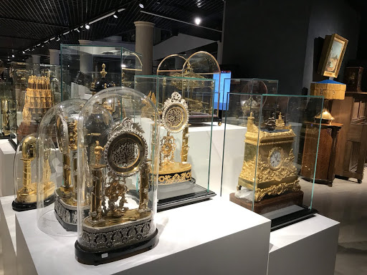
Our perspective clients
Kate Vass Gallery,
art-gallery of modern art,
located in Zurich
David Yakobashvili, big investor,
owner of his museum of classical art,
located in Moscow

Slide 11
Market of art
Offline 2,7 trln $
Online
200 mln $
Here we are 10 mln $

Slide 12
Our numbers
 | 2 Q2020 | 3Q2020 | 4Q2020 | 1Q2021 | 2Q2021 | 3Q2021 | 4Q2021 | 1Q2022
Salaries($) | 60.000 | 80.000 | 100.000 | 120.000 | 150.000 | 180.000 | 210.000 | 240.000
Marketing | 50.000 | 60.000 | 80.000 | 100.000 | 120.000 | 140.000 | 160.000 | 180.000
Other | 10.000 | 12.000 | 15.000 | 18.000 | 22.000 | 25.000 | 30.000 | 35.000
Clients | 3 | 20 | 40 | 70 | 110 | 150 | 200 | 300
Investors | 100 | 300 | 700 | 1200 | 1700 | 3000 | 5000 | 9000
Tokenization commission | 50.000 | 120.000 | 180.000 | 240.000 | 320.000 | 480.000 | 640.000 | 950.000
Deal commission | 10.000 | 20.000 | 40.000 | 70.000 | 120.000 | 280.000 | 450.000 | 850.000
Loss/Profit | -60.000 | -12.000 | -25.000 | 72.000 | 148.000 | 415.000 | 690.000 | 1.345.000

Slide 13
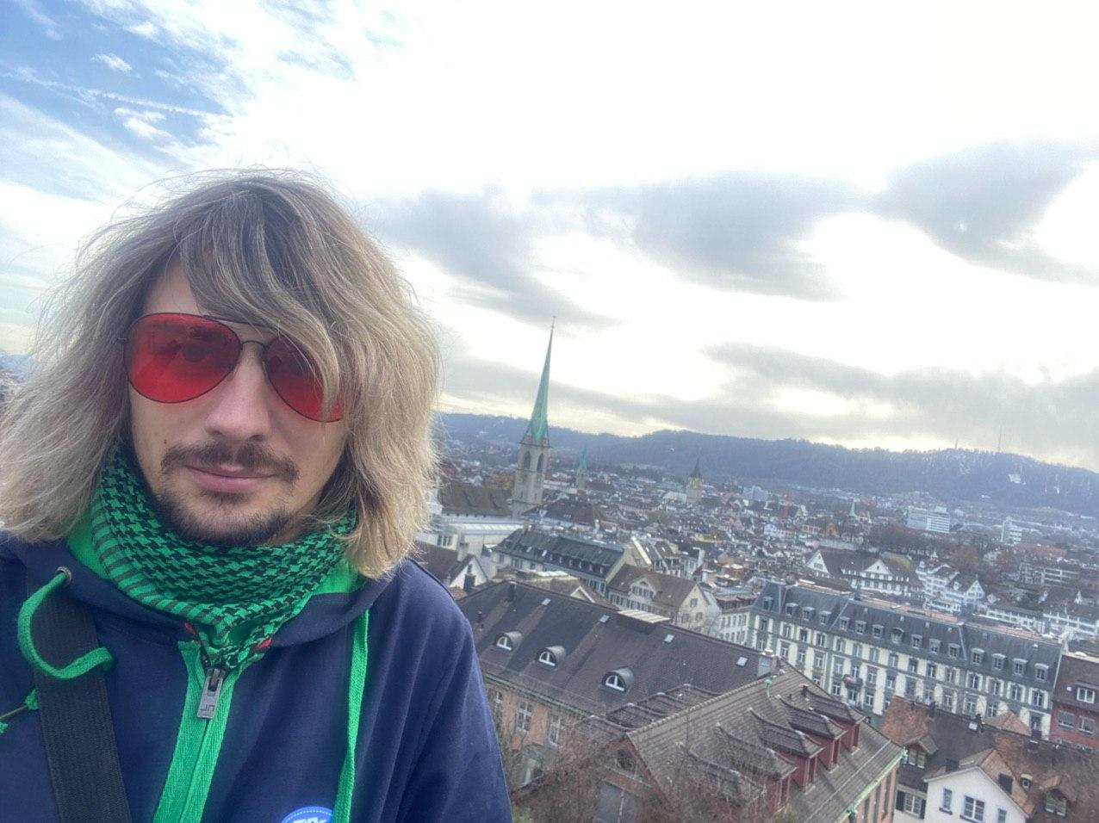
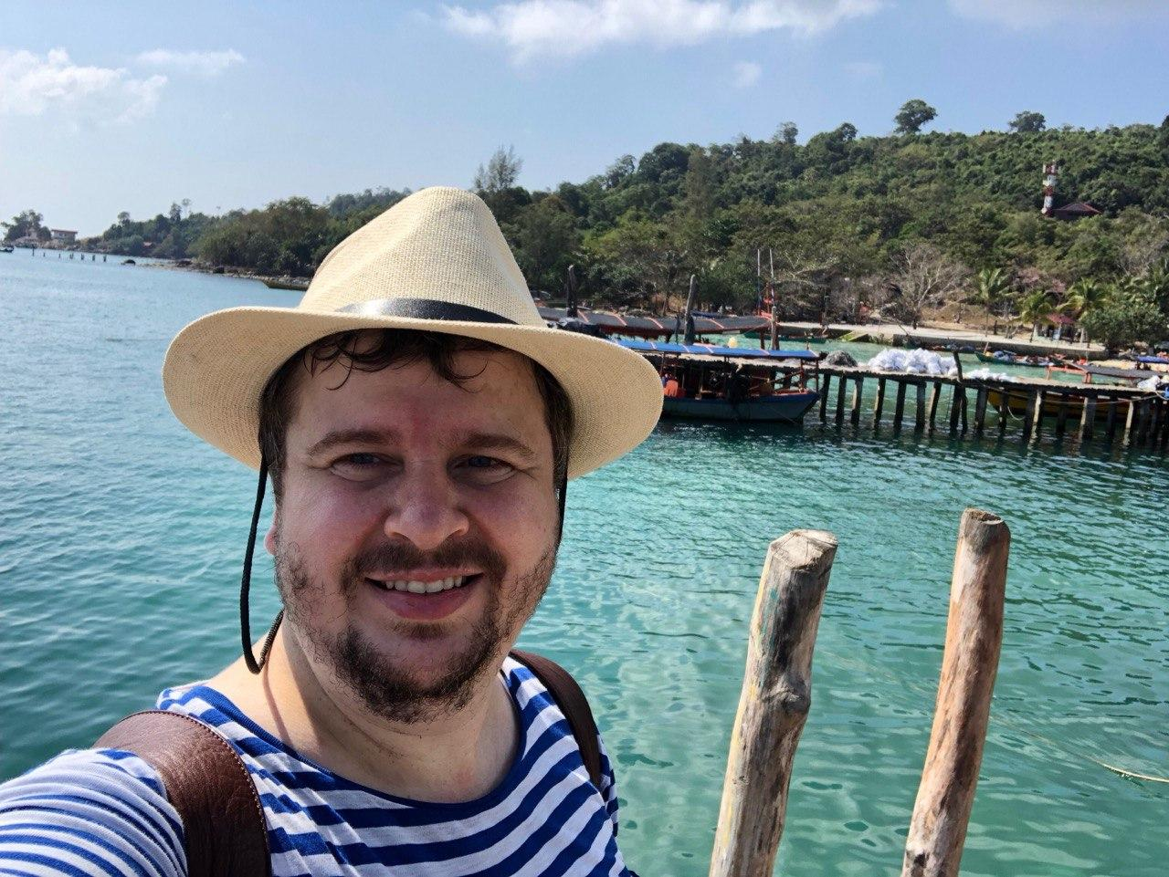
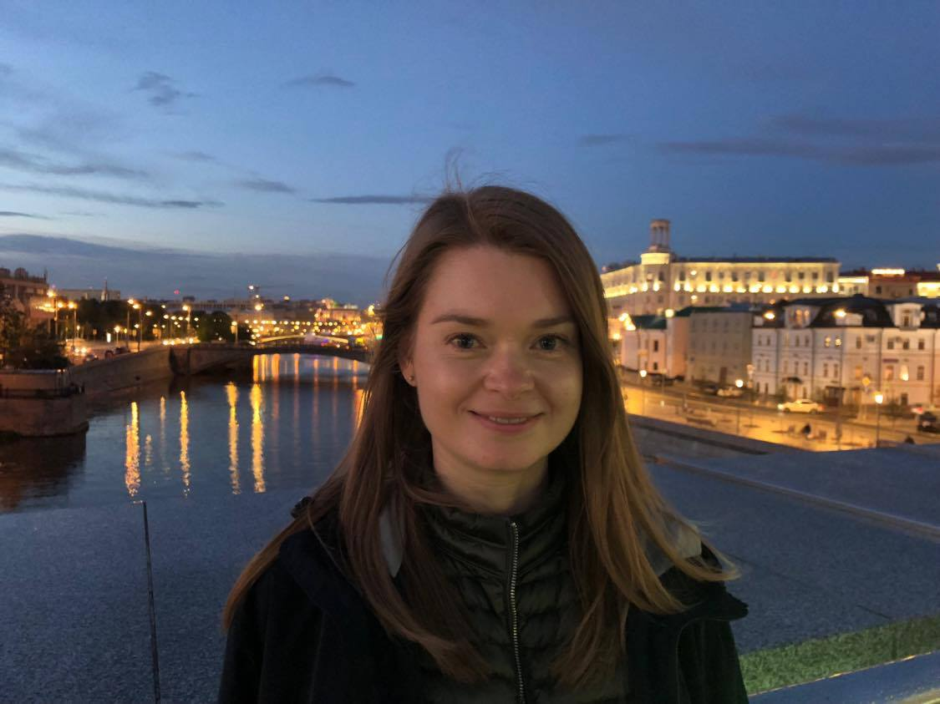
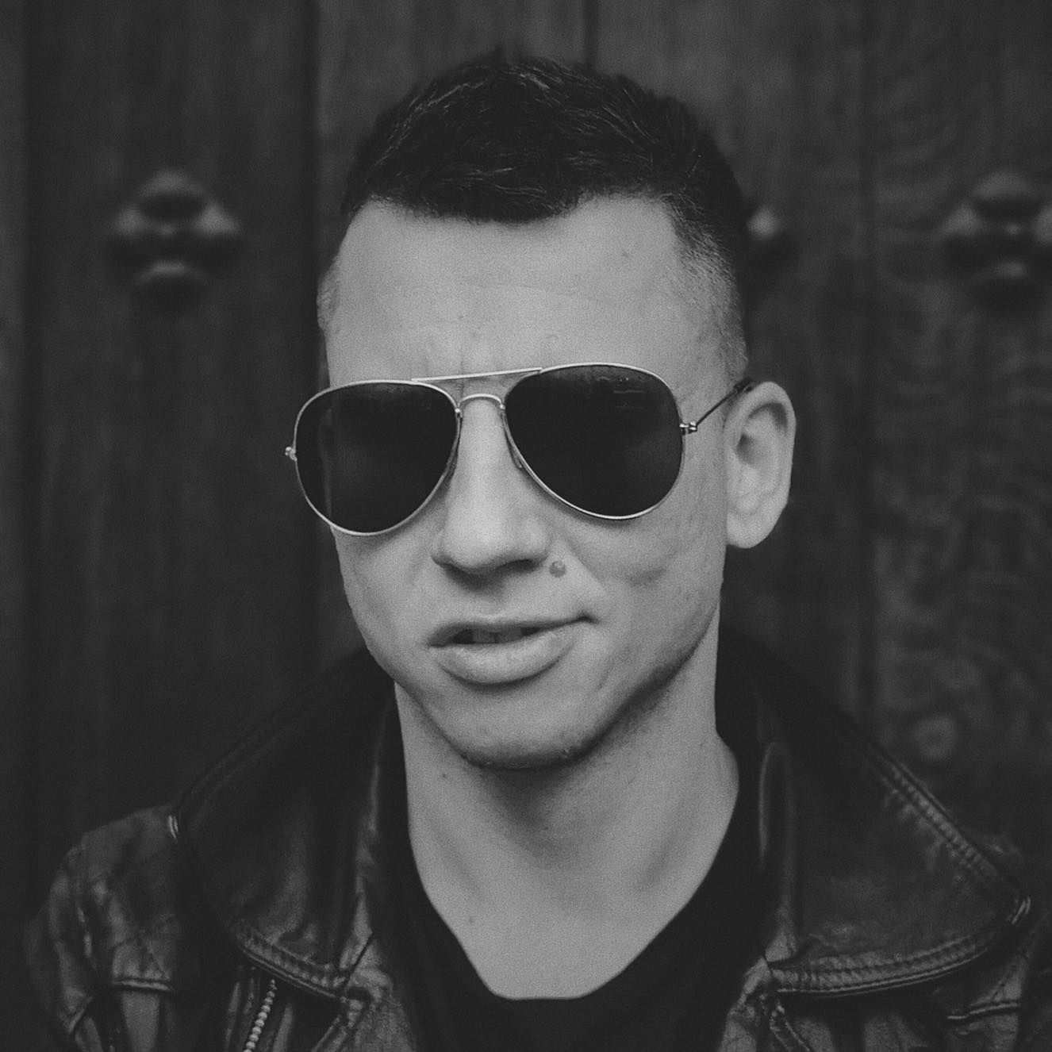
Team
Arsenii Pechenkin,
CEO, Co-founder
Pavel Fedorov
CBDO, Co-founder
Svetlana Karepina,
COO,Co-founder
Alex Pospekhov,
CMO,Latvia

Slide 14
Contacts
Arsenii Pechenkin

