Slide 1

Odyssey: Agile application-aware adaptation for mobility
Brian Noble
M. Satyanarayanan
Dushyanth Narayanan
James Tilton
Jason Flinn
Kevin Walker
Carnegie Mellon University
Rui Pereira, 70600
Pedro Bráz, 73991
METI IST
24/03/2015

Slide 2
Motivation
A tourist with a wearable computer is walking in the streets of Lisbon;
He interacts with his device through a speech recognizer software;
There is a wireless overlay network.

Slide 3
Goals
Dynamic adaptation: change according to resources;
Concurrent application execution;
Support variaty of applications and data types;
Fast adaptation.

Slide 4
Related work
Odyssey is the first system to simultaneously address adaptation for mobility, application diversity and application concurrency.

Slide 5
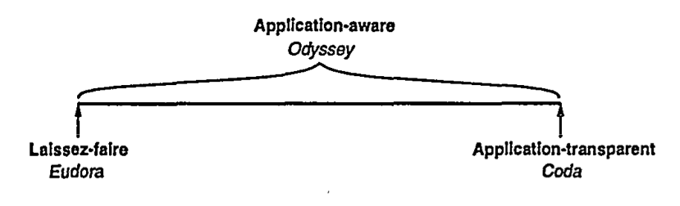
Models of adaptation
Who is responsible for adaptation?
Individual applications (Eudora);
The system (Coda);
Both (Odyssey);

Slide 6
Properties
Fidelity: the degree to which data presented at a client matches the reference copy at the server.
Concurrency: ability to execute multiple independent applications on a mobile client concurrently.
Agility: detect and respond to change quickly.

Slide 7
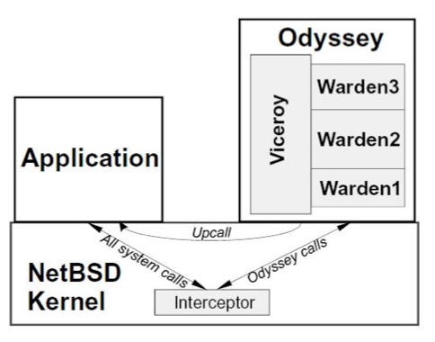
Odyssey architecture

Slide 8
Vicery and Wardens
Wardens: each one support an individual data type. System-level data differenciation;
Vicery: type independent, single and central component responsibe for all resource allocation.

Slide 9
Example applications
Video player;
Web browser;
Speech recognizer.

Slide 10
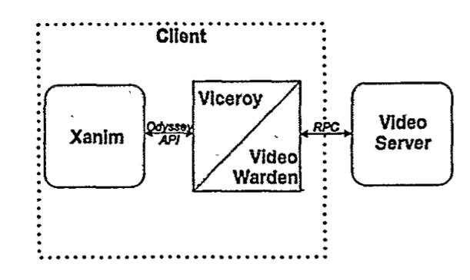
Video player

Slide 11
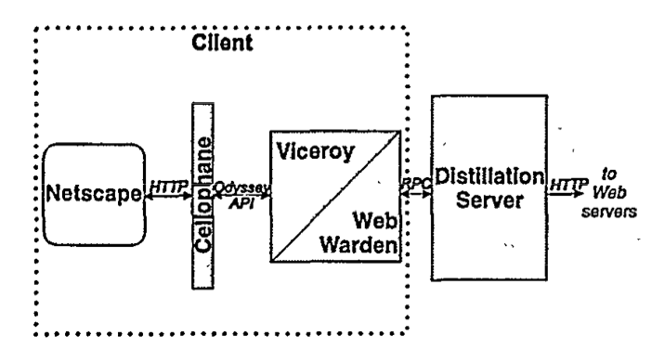
Web browser

Slide 12
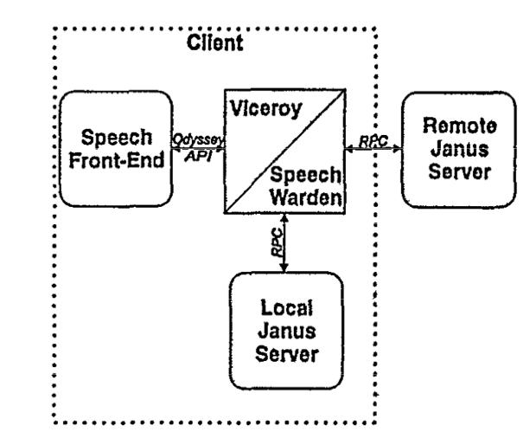
Speech recognizer

Slide 13
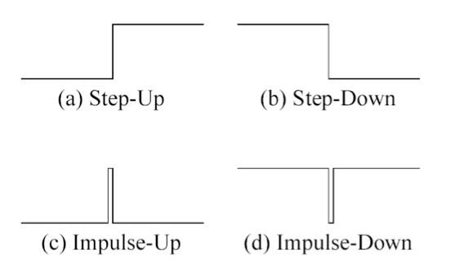
Evaluation
Changes in bandwith;
Reference waveforms.

Slide 14
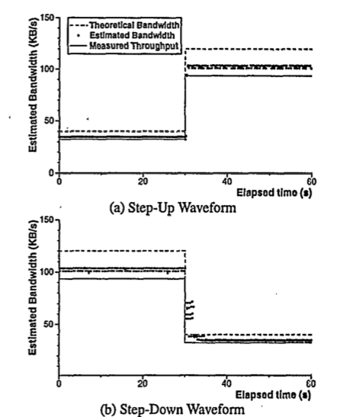
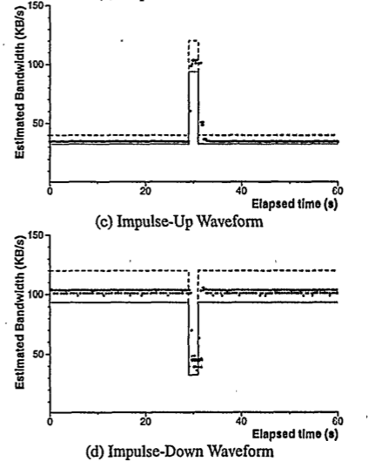
How agile is odyssey?

Slide 15
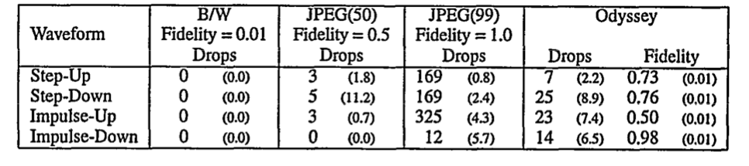
Video player performance

Slide 16
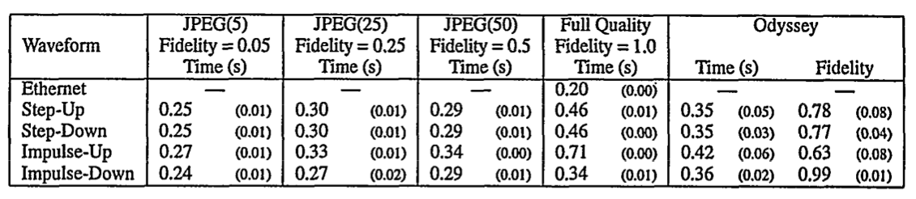
Web browser performance

Slide 17
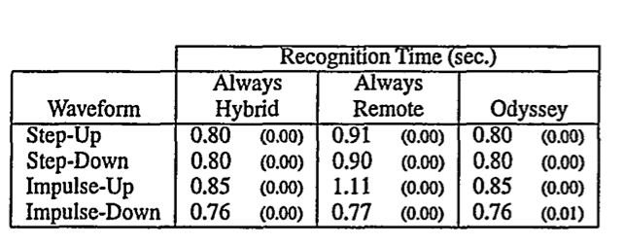
Speech recognizer performance

Slide 18
Conclusion
Partnership between application and system;
Application-aware adaptation is superior to static strategies.

Slide 19

Q&A

