Slide 1

Odyssey: Agile Application-Aware Adaptation for Mobility
Brian Noble
M. Satyanarayanan
Dushyanth Narayanan
James Tilton
Jason Flinn
Kevin Walker
Carnegie Mellon University
Rui Pereira, 70600
Pedro Braz, 73991
METI IST
24/03/2015

Slide 2
Motivation
A tourist with a wearable computer is walking in the streets of Lisbon;
The device can detect multiple wireless networks and switch automaticaly;
The user is aware of applications changing their behaviour without having to participate;

Slide 3
Objective
Odyssey: Application changing according to resources
Concurrent application execution;
Support variety of applications and resource types;
Fast adaptation.
Notes:
que queremos para este sistema?
Objectibo principal
Outros objectivos passam por bal

Slide 4
Related work
Odyssey is the first system to simultaneously address adaptation for mobility, application diversity and application concurrency.

Slide 5
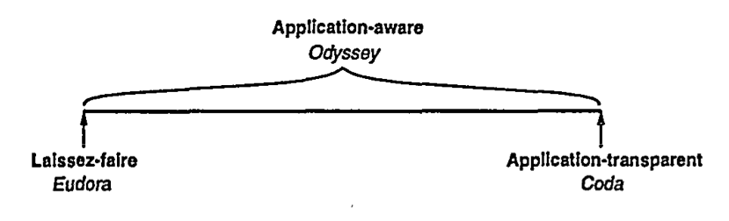
Models of adaptation
Who is responsible for adaptation?
Individual applications (Eudora);
The system (Coda);
Both (Odyssey);
Notes:
Logo a solução deste sistema passa por um modelo application aware
Lado direito: As aplicações não podem decidir o que fazer face à escassez de recursos

Slide 6
Properties
Fidelity: the degree to which data presented at a client matches the reference copy at the server.
Concurrency: ability to execute multiple independent applications on a mobile client concurrently.
Agility: detect and respond to change quickly.

Slide 7
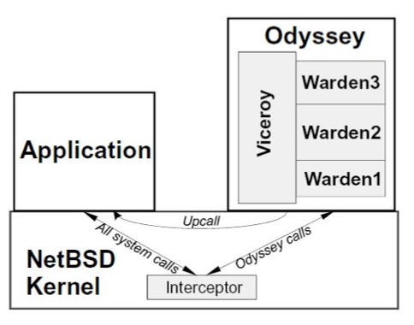
Odyssey architecture

Slide 8
Viceroy and Wardens
Wardens: each one supports an individual data type. System-level data differenciation;
Viceroy: type independent, single and central component, responsible for all resource allocation and monitorization.

Slide 9
Example applications
Video player;
Web browser;
Speech recognizer.

Slide 10
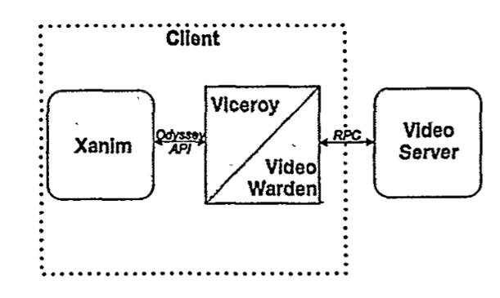
Video player

Slide 11
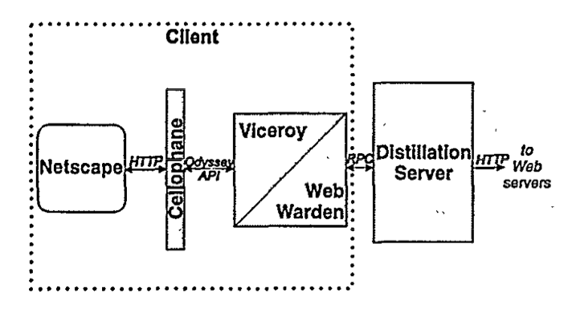
Web browser

Slide 12
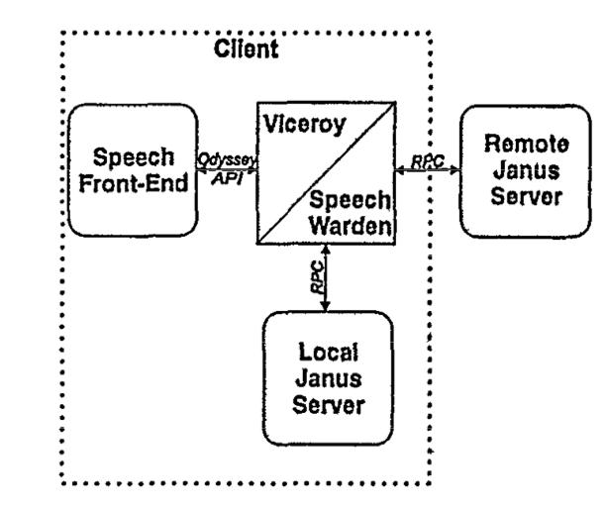
Speech recognizer

Slide 13
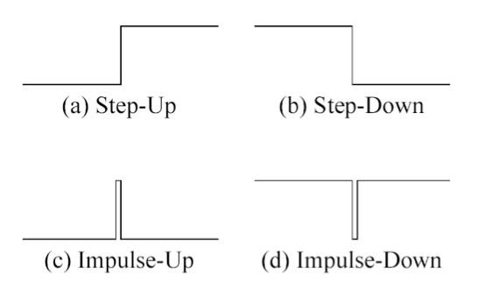
Evaluation
Changes in bandwith;
Reference waveforms.

Slide 14
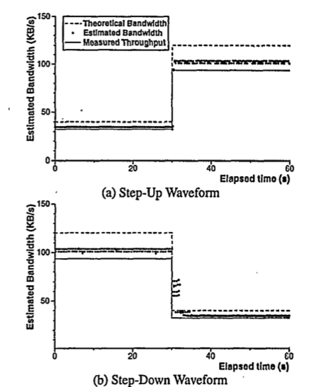
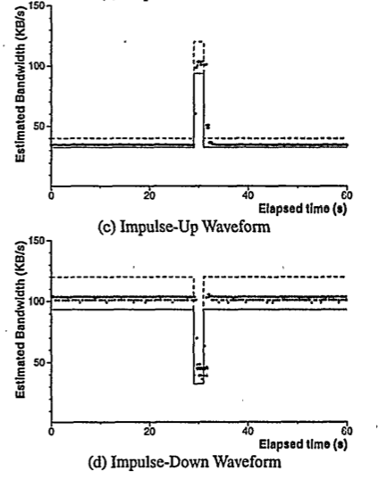
How agile is odyssey?
Notes:
Para fazer com que as aplicações se comportassem como as formas de onda descritas atrás, foi preciso gerar descontinuidades na largura de rede. Para isto foi usado uma técnica chamada de trace modulation.

Slide 15
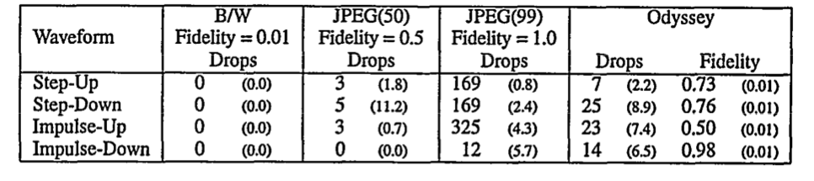
Video player performance

Slide 16
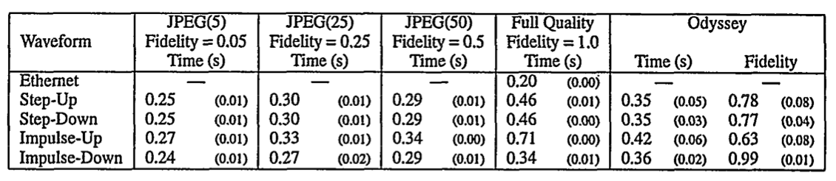
Web browser performance

Slide 17
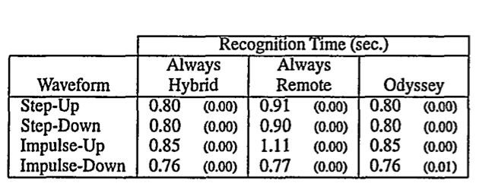
Speech recognizer performance

Slide 18
Conclusion
Partnership between application and system;
Application-aware adaptation is superior to static strategies.

Slide 19

Q&A

Slide 20

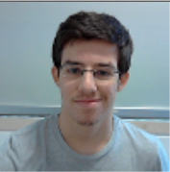
Speakers
Rui Pereira 70600
Pedro Braz 73991

