Slide 1

Odyssey: Agile application-aware adaptation for mobility
Brian Noble
M. Satyanarayanan
Dushyanth Narayanan
James Tilton
Jason Flinn
Kevin Walker
Carnegie Mellon University
Rui Pereira, 70600
Pedro Bráz, 73991
METI IST
24/03/2015

Slide 2
Motivation
A tourist with a wearable computer is walking in the streets of Lisbon;
He interacts with his device through a speech recognizer software;
There is a wireless overlay network.

Slide 3
Goals
Dynamic adaptation: change according to resources;
Concurrent application execution;
Support variaty of applications and data types;
Fast adaptation.

Slide 4
Related work
Odyssey is the first system to simultaneously address adaptation for mobility, application diversity and application concurrency.

Slide 5
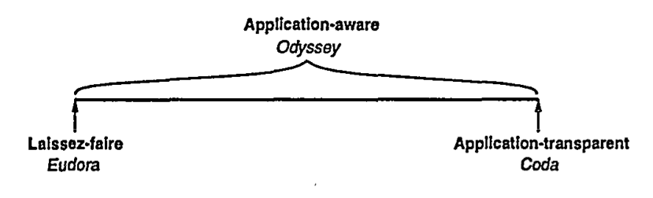
Models of adaptation
Who is responsible for adaptation?
Individual applications (Eudora);
The system (Coda);
Both (Odyssey);

Slide 6
Properties
Fidelity: the degree to which data presented at a client matches the reference copy at the server.
Concurrency: ability to execute multiple independent applications on a mobile client concurrently.
Agility: detect and respond to change quickly.

Slide 7
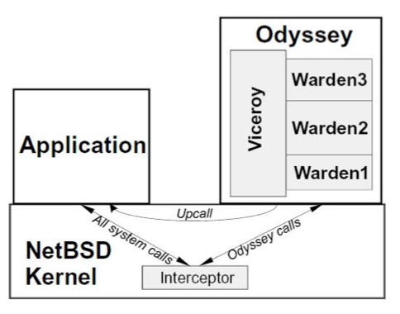
Odyssey architecture

Slide 8
Vicery and Wardens
Wardens: each one support an individual data type. System-level data differenciation;
Vicery: type independent, single and central component responsibe for all resource allocation.

Slide 9
Example applications
Video player;
Web browser;
Speech recognizer.

Slide 10
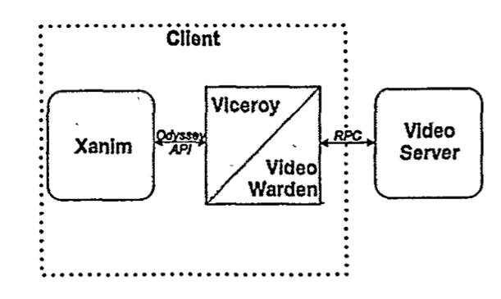
Video player

Slide 11
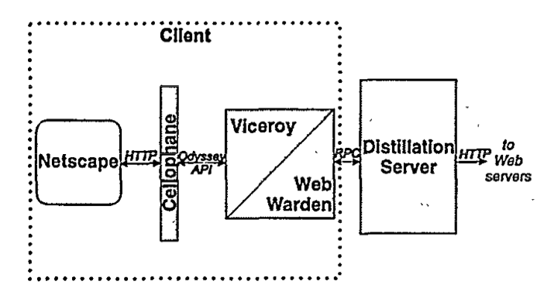
Web browser

Slide 12
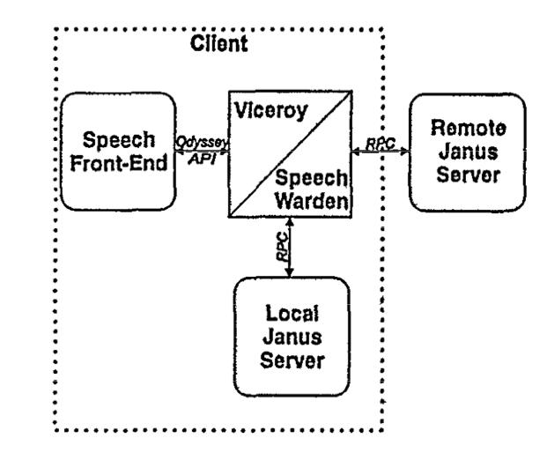
Speech recognizer

Slide 13
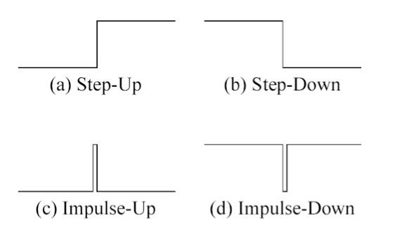
Evaluation
Changes in bandwith;
Reference waveforms.

