Slide 1

Sparrow: Distributed, Low Latency Scheduling
Kay Ousterhout
Patrick Wendell
Matei Zaharia
Ion Stoica
University of California, Berkeley
Ricardo Wagenmaker,73810
Rui Pereira, 70600
Pedro Braz, 73991
METI IST
**/04/2015

Slide 2
Motivation

Slide 3
Objective

Slide 4
Related work
Centralized task schedulers: Quincy
Two level schedulers: YARN

Slide 5
Challenges
Millisecond Latency;
Fault tolerant;
High throughput;
Quality placement.

Slide 6
Sparrow
Stateless distributed scheduler;
Uses a decentralized, randomized approach;
Support for constraints;
Response times within 12% of an ideal scheduler.

Slide 7
Decentralized approach
Existing randomized approaches;
Batch Sampling;
Late Binding;

Slide 8
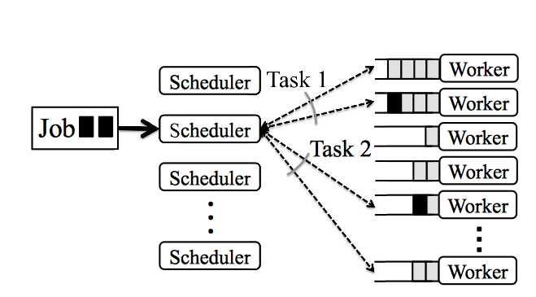
Existing approach: Per-task sampling
Power of two choices

Slide 9
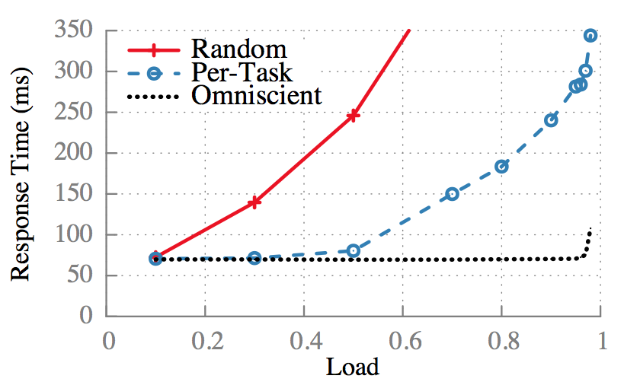
Simulated results
Omniscient: infinitely fast centralized scheduler

Slide 10
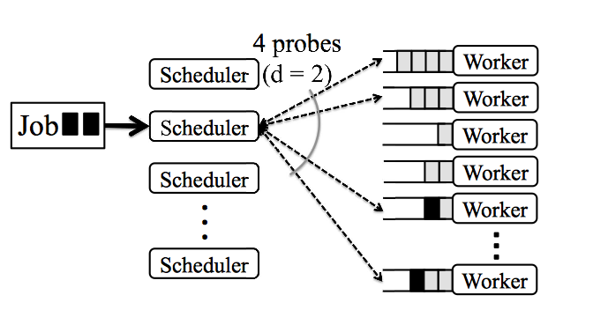
Batch Sampling

Slide 11
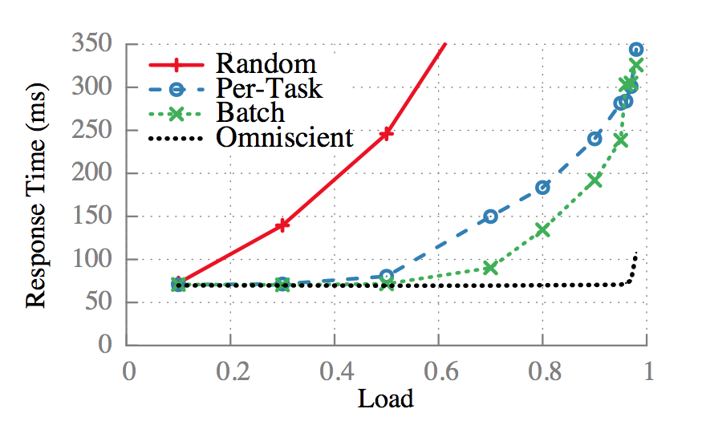
Simulated results

Slide 12
Batch Sampling problems
Schedulers place tasks based on queue length;
However, queue length ≠ wait time;
Multiple schedulers concurrently placing tasks on a worker that appears lightly loaded;
Solution: Late Binding.

Slide 13
Late Binding
Workers do not reply immediately to probes;
Instead, they place a reservation for the task at the end of an internal queue;
When the reservation reaches the front of the queue, the worker sends an RPC to the scheduler;
Only then the scheduler assigns the job’s task to the worker.

Slide 14
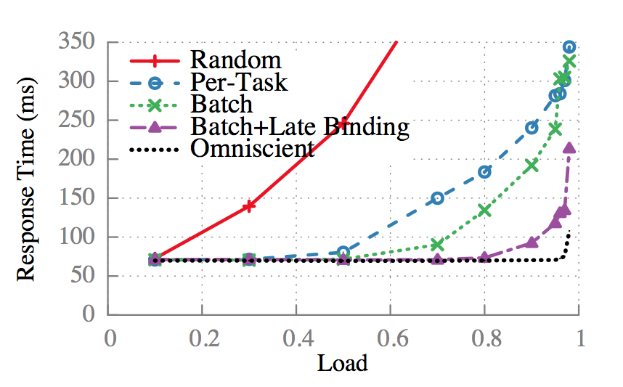
Simulated results

Slide 15
Policies and Constraints
Per task: Constraints that limit tasks to run on machines where some special data is located;
Per job: Sparrow selects workers from the subset of workers that satisfy the constraint.

Slide 16
Evaluation

Slide 17
Conclusion
Sparrow supports fault tolerance;
Global visibility is not necessary to provide good performance;
Sparrow presents a viable alternative to centralized scheduling for low latency parallel worlkloads.

Slide 18

Q&A

