Slide 1

Sparrow: Distributed, Low Latency Scheduling
Kay Ousterhout
Patrick Wendell
Matei Zaharia
Ion Stoica
University of California, Berkeley
Ricardo Wagenmaker,73810
Rui Pereira, 70600
Pedro Braz, 73991
METI IST
**/04/2015

Slide 2
Motivation

Slide 3
Objective

Slide 4
Challenges
Millisecond Latency;
Fault tolerant;
High throughput;
Quality placement.

Slide 5
Sparrow
Stateless distributed scheduler;
Uses a decentralized, randomized approach;
Support for constraints and fair sharing;
Response times within 12% of an ideal scheduler.

Slide 6
Properties
Batch Sampling;
Late Binding;
Policies and Constraints.

Slide 7
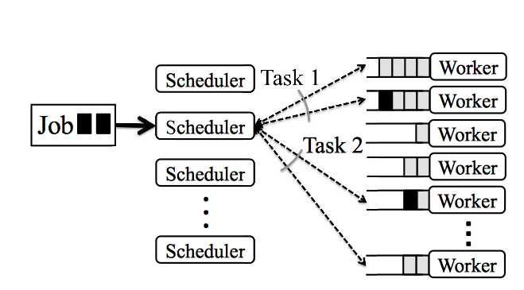
Existing approach: Per-task sampling
Power of two choices

Slide 8
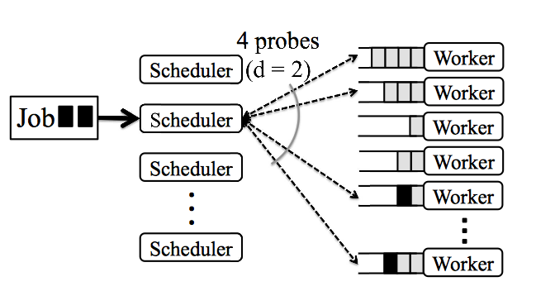
Batch Sampling

Slide 9
Batch Sampling problems
Schedulers place tasks based on queue length;
However, queue length ≠ wait time;
Multiple schedulers concurrently placing tasks on a worker that appears lightly loaded;
Solution: Late Binding.

Slide 10
Late Binding
Workers do not reply immediately to probes;
Instead, they place a reservation for the task at the end of an internal queue;
When the reservation reaches the front of the queue, the worker sends an RPC to the scheduler.

Slide 11
Policies and Constraints

Slide 12
Evaluation

Slide 13
Conclusion
Sparrow is resilient to diferent probe ratios and distributions tasks durations;
Global visibility is not necessary to provide good performance;
Sparrow presents a viable alternative to centralized scheduling for low latency parallel worlkloads.
They assume zero network latency. Is it acceptable for their analysis?!

Slide 14

Q&A

