Slide 1
Hydrological & Morphological Assessment of the Brahmaputra River
Multi-Temporal Channel Migration Mapping & Comparative Scour Depth Analysis

Slide 2
HYDROLOGICAL ASSESSMENT
Methodology & Theoretical Framework
1. GIS & Remote Sensing Workflow
• Satellite Source: Sentinel-2 Multispectral Instrument (MSI) Harmonized Level-2A surface reflectance data.
• Temporal Windows: Comparative analysis between Winter 2019-2020 and Winter 2023-2024 to map seasonal low-flows.
• Water Extraction: Normalized Difference Water Index (NDWI) thresholding (>0) to extract active channel limits.
• Channel Cleaning: Connected pixel count filter (>=100 pixels / 1 ha) to remove isolated ponds, agricultural noise.
• Migration Analysis: Map Algebra subtraction (2023 - 2019) to isolate stable channel, erosion, and accretion zones.
2. Scour Depth Formulations
• Lacey's Regime Scour: Relies on discharge per unit width (q) and silt factor (f). Evaluates general scour in uniform alluvial channels.
• Blench's Method: Introduces a bed factor (Fb) to represent bed sediment characteristics, separating it from side shear factors.
• Flow Multipliers: Normal scour depth (R) is adjusted based on local reach geometries to find maximum scour (R_max):
• - Straight Stable Reach: 1.27R
• - Moderate Bend: 1.50R
• - Severe Bend / Erosion Zone: 2.00R

Slide 3
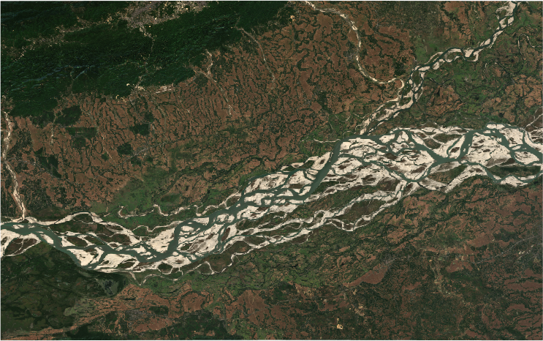
MORPHOLOGICAL PARAMETERS
Problem 1: River Morphological Parameters
Quantitative Morphological Changes
• Surface Water Area: Water surface area within the 80 km reach decreased from 248.75 km² in 2019 to 222.75 km² in 2023 (a 10.45% reduction).
• Average Channel Width: The reach-averaged width contracted from 3109.34 meters to 2784.38 meters.
• River Condition: The satellite data represents winter low-flow conditions, showing that during the dry season, the active water corridor contracted.
• Hydrological Significance: This contraction highlights significant sediment deposition (sandbar growth) and lateral shifting of braided channels during low-flow cycles.
Parameter | Winter 2019 | Winter 2023
Water Area (km²) | 248.75 | 222.75
Avg Width (m) | 3109.3 | 2784.4

Slide 4
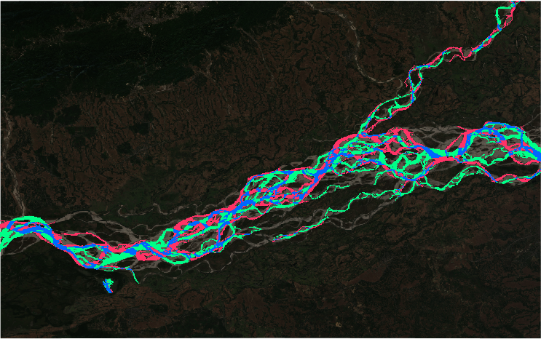
MIGRATION ANALYSIS
Problem 2: Multi-Temporal Channel Migration
Mapping Migration Dynamics
• Stable Channels (Blue): Shows the persistent, deep main channels of the Brahmaputra River that remained flooded in both years.
• Accretion Zone (Green): Highlights areas where water changed to land. These are newly formed or expanded sandbars (chars) due to deposition.
• Erosion Zone (Red): Indicates bank collapse and channel shifting where land became water. This occurs primarily on outer bends.
• Dynamic Nature: The map illustrates high channel lateral mobility, reflecting the braided nature of the Brahmaputra, which has high sediment loads and highly erodible banks.

Slide 5
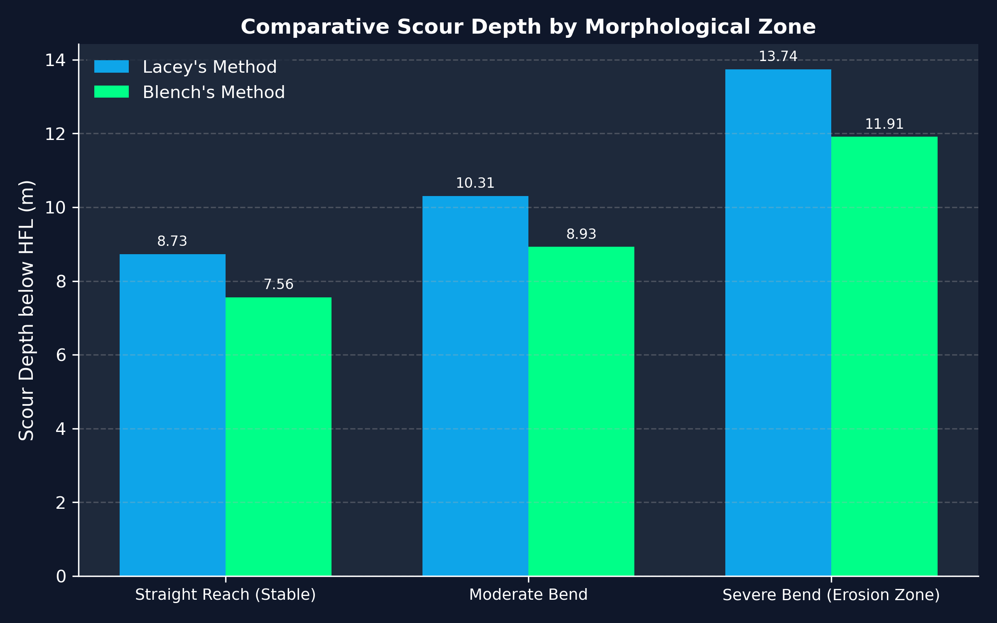
SCOUR DEPTH ANALYSIS
Problem 3: Comparative Scour Depth Estimation
Scour Estimations (Design Q = 30,000 m³/s)
Note on multipliers:
• Severe Bends experience a 2.0x multiplier on normal scour depth due to helicoidal flow structures that concentrate shear stress.
• Blench's method results in 13-15% lower scour estimations than Lacey's method across all zones.
Zone | Lacey Scour (m) | Blench Scour (m)
Straight Reach (Stable) | 8.73 | 7.56
Moderate Bend | 10.31 | 8.93
Severe Bend (Erosion Zone) | 13.74 | 11.91

Slide 6
CRITICAL EVALUATION
Critical Evaluation of Estimations
Lacey's Regime Method - Conservatism & Code Standards
Lacey's method remains the standard in Indian practice (IRC:89, IS:13757). It assumes an idealized regime channel with constant discharge and uniform silt factor. By yielding higher scour depth estimates (e.g., 13.75m vs. 11.91m in severe bends), Lacey provides a conservative safety margin for bridge foundation design, which is essential given the unpredictable, highly turbulent flood flows of the Brahmaputra.
Blench's Method - Physics & Side Factors
Blench's method separates the bed factor (Fb) and side factor. It is physically more realistic for sand-bed rivers with cohesive banks because it acknowledges that bed and bank materials do not behave identically. However, Blench requires detailed bank materials data to estimate side factors, making it harder to calibrate, whereas Lacey's single silt factor requires only d50.
2D Morphological Integration
Scour calculations are traditionally 1D approximations. Integrating 2D morphological data from Sentinel-2 allows us to locate severe outer bends (erosion zones) and apply spatial safety multipliers. Standard 1D calculations should not be used in isolation; they must be guided by temporal satellite mapping to locate active migration hotspots.

Slide 7
RECOMMENDATIONS
Conclusions & Engineering Recommendations
Spatial Targeting of Protection Works
Guide bunds, bank revetments, and spurs should be dynamically targeted at the red 'Erosion Zones' mapped during satellite analysis, rather than uniformly along the reach, yielding huge cost savings.
Adaptive Foundation Depth for Structures
For any proposed bridges or river crossing structures, foundations must be designed using the severe bend scour depth (13.75 m below HFL using Lacey) rather than the straight reach value (8.73 m), as lateral channel migration can turn a straight reach into a bend over a few monsoon cycles.
Continuous Satellite Monitoring
Due to the highly dynamic nature of the sandbars (chars) mapped in green, annual low-flow satellite imagery should be analyzed to update the migration map and anticipate new bank erosion hotspots before the monsoon floods occur.

