Slide 1

Group Partition and Group Information based Multi-agent Consensus Systems
Peixin Ma, Junzheng Zheng, Xiaoyun Bi, Xintong Liang, Yujie Xie, Jian Hou
Presenter: Peixin Ma, Zhejiang Sci-Tech University

Slide 2
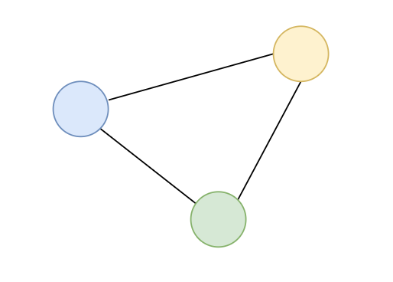
Introduction
Consensus is a fundamental issue in distributed multi-agent systems, and utilizes the inter-agent relative state to update the state of each agent, so as to achieve global synchronization.
Motivated by some scenarios such as privacy-preserving constraints, system measurement error, that the inter-agent relative states are not available, a novel strategy is required to achieve consensus.
Notes:
As a fundamental concern,consensus problem aims to achieve global agreement with only local interaction among agents.

Slide 3
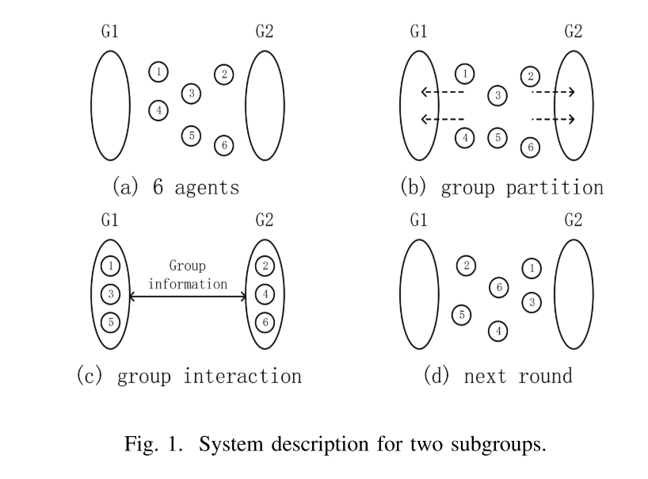

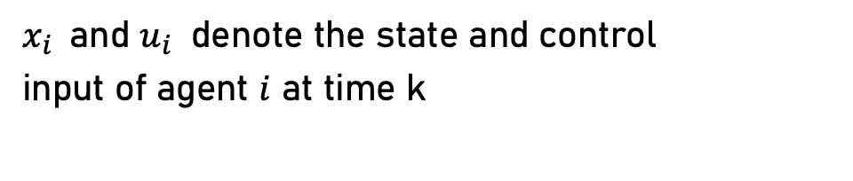
Model system
Consider n agents with a discrete-time model
$x_{i}$and $u_{i}$ denote the state and control
input of agent $i$ at time k
Notes:
As a fundamental concern,consensus problem aims to achieve global agreement with only local interaction among agents.

Slide 4
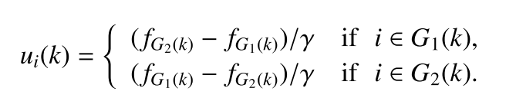
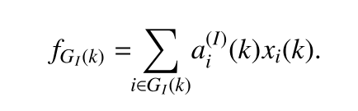

Subgroup number m = 2
The scenario that only two subgroups G1 and G2 are involved, The control law is given as :
$f_{G_{I}}(k)$ denote the convex combination of states for all the agents in subgroup $G_{I}$, that is:
Notes:
As a fundamental concern,consensus problem aims to achieve global agreement with only local interaction among agents.

Slide 5
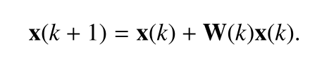
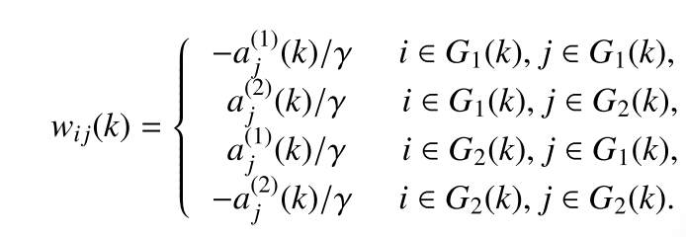
Subgroup number m = 2
Thus, we could obtain the overall system as :
Notes:
As a fundamental concern,consensus problem aims to achieve global agreement with only local interaction among agents.

Slide 6
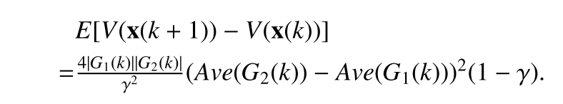
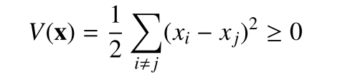

Subgroup number m = 2
Theorem 1: When all the agents are divided into two subgroups, the system under control law achieves consensus in mean if and only if γ > 1.
Proof：
Notes:
As a fundamental concern,consensus problem aims to achieve global agreement with only local interaction among agents.

Slide 7
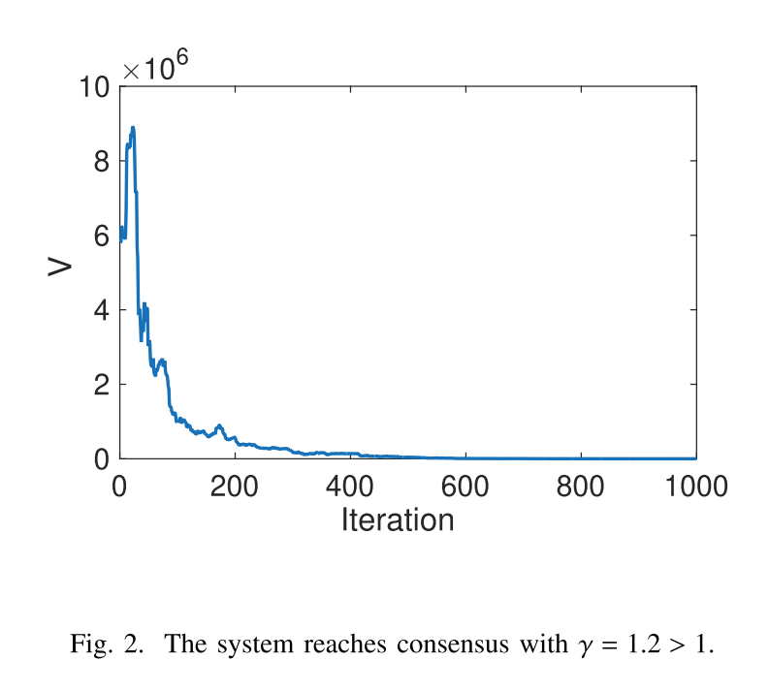
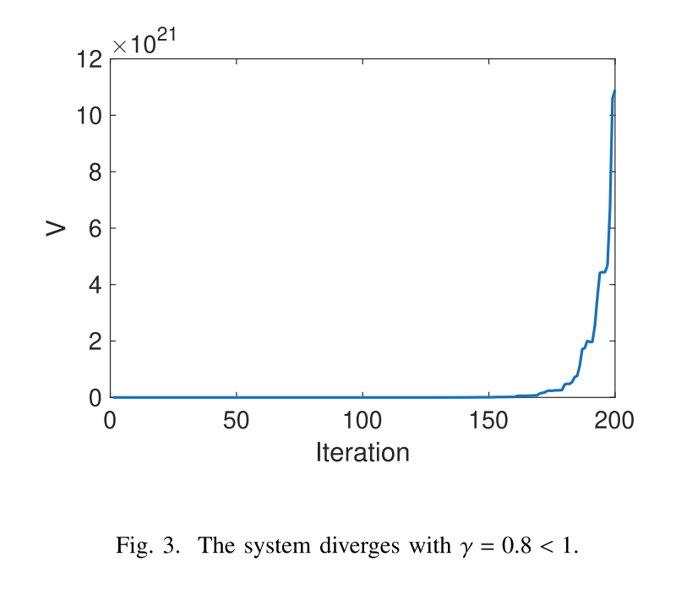
Subgroup number m = 2
Notes:
As a fundamental concern,consensus problem aims to achieve global agreement with only local interaction among agents.

Slide 8
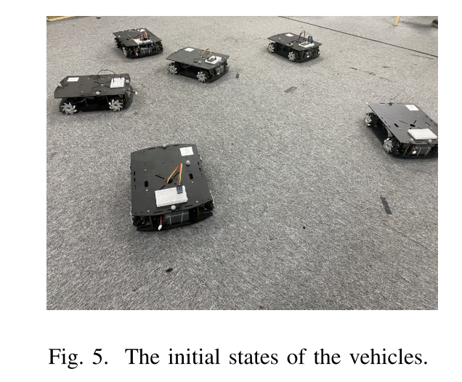
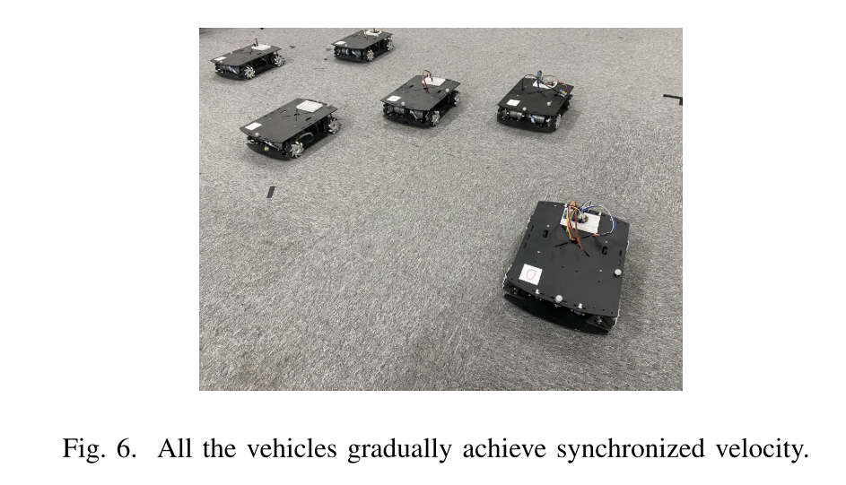
Subgroup number m = 2
Notes:
As a fundamental concern,consensus problem aims to achieve global agreement with only local interaction among agents.

Slide 9
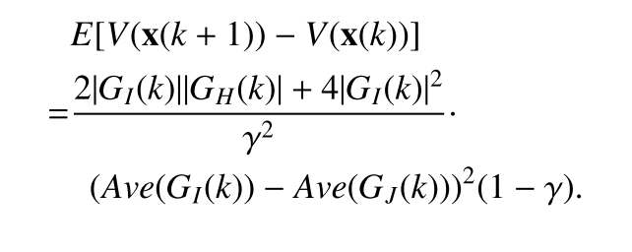
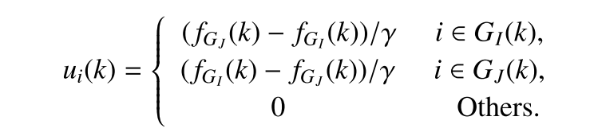
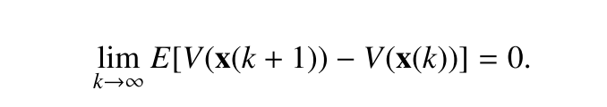
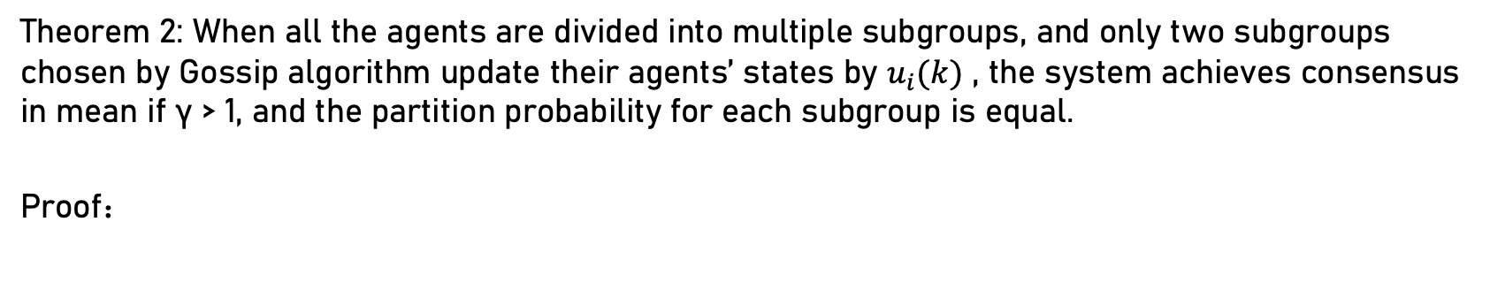
Subgroup number m > 2
Theorem 2: When all the agents are divided into multiple subgroups, and only two subgroups chosen by Gossip algorithm update their agents’ states by $u_{i}(k)$ , the system achieves consensus in mean if γ > 1, and the partition probability for each subgroup is equal.
Proof：
Notes:
As a fundamental concern,consensus problem aims to achieve global agreement with only local interaction among agents.

Slide 10
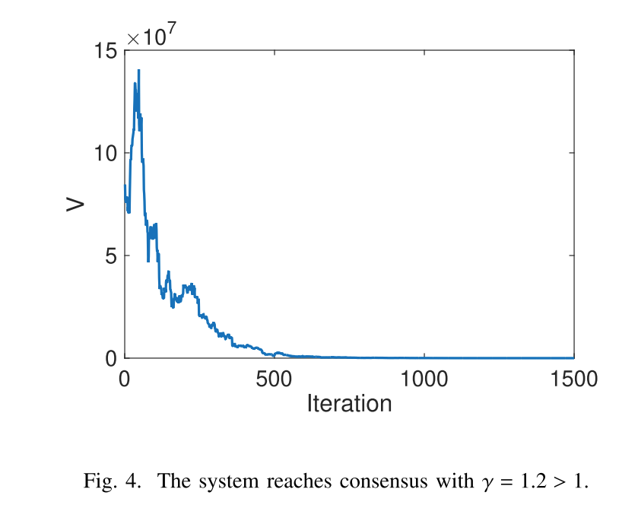
Subgroup number m > 2
Notes:
As a fundamental concern,consensus problem aims to achieve global agreement with only local interaction among agents.

Slide 11
Thanks
Notes:
As a fundamental concern,consensus problem aims to achieve global agreement with only local interaction among agents.

