Slide 1

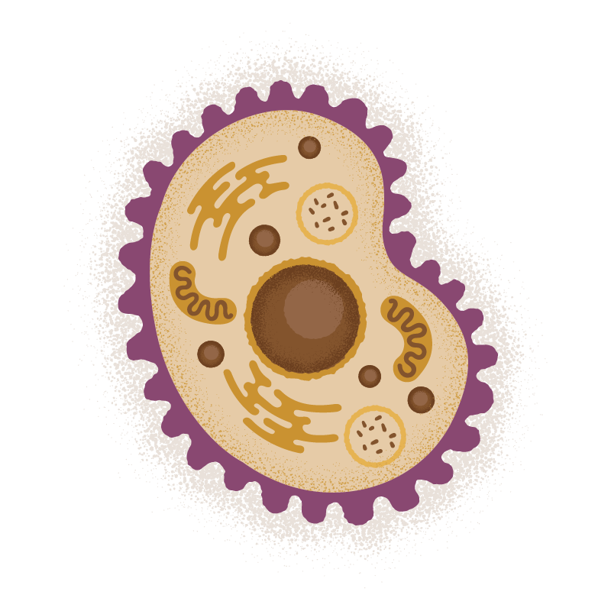

Protein-Proteins Interactions in the Gut Microbiome

Slide 2
Introduction
The gut microbiome plays a crucial role in human health.
Protein-Protein Interactions (PPIs) influence disease mechanisms.
PPIs within the gut microbiome could help predict diseases.
This study explores the use of machine learning for disease classification.

Slide 3
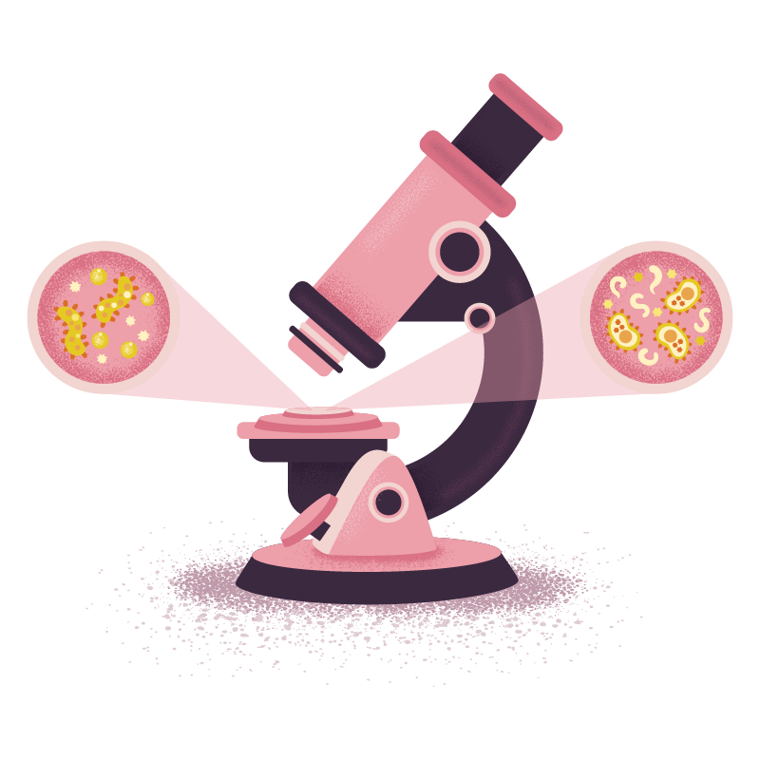
Problem
Can Microbiome-associated PPIs provide meaningful disease insights?

Slide 4
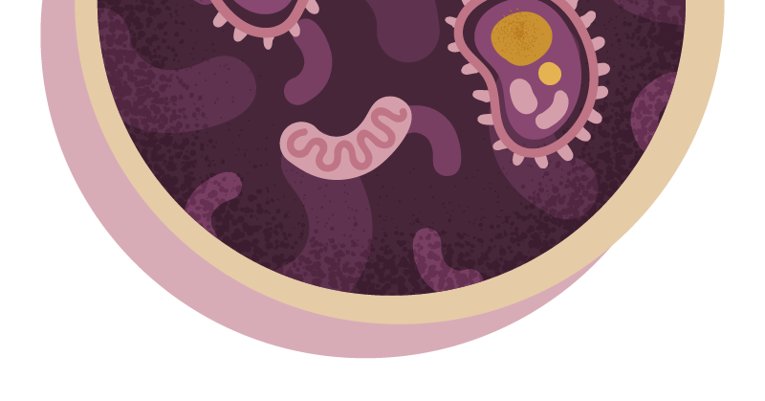
Challenges
01
02
03
Availability of reliable PPI data
Ensuring real-world applicability
Bridging biology and machine learning

Slide 5
Methodology
OTU Data Experiment
PPI Dataset Experiment
AI-generated microbiome classification.
Evaluated ML models on existing PPI data.
Gut Microbiome Proteome Exploration
Augmented OTU Dataset
Identified key microbioal proteins
Added metadata for improved classification

Slide 6
Key Results
Tree-based models performed best
Deep Learning Models
XGBoost, Random Forest were overall best performing.
Deep Learning models struggled with unstructured PPI data.
Synthetic Data
Lack of Interactions
No interactions were found between gut microbiome proteins and human proteins
Synthetic data led to overfitting and over-synthetization problems.

Slide 7
Future Directions
Data
Experimental Studies
Acquire real-world microbiome and PPI datasets
Validate computational predictions with experimental studies
Machine Learning
Expand
Enhance Machine Learning Methods (Improve feature selections, hybrid models)
Expand applications to other diseases beyond Type 2 Diabetes

Slide 8
Conclusions
Conclusion 1:
Machine Learning can aid microbiome-based disease classification
Conclusion 2:
Data quality and biological validation remain key challenges
Conclusion 3:
Future research should integrate real-world PPI data and improve ML techniques
Conclusion 4:
Interdisciplinary collaboration (with biologists, for example) is essential for success

