Slide 1
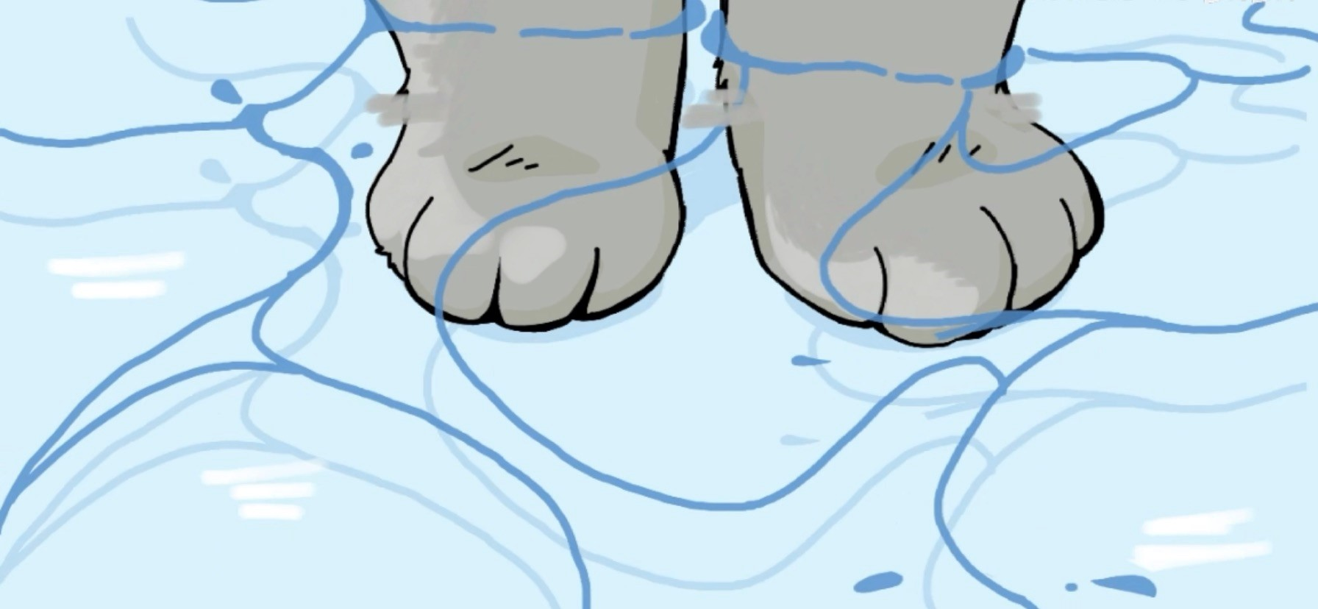
Pleistocene glacial terminations triggered by synchronous changes
in Southern and Northern Hemisphere insolation:
The insolation canon hypothesis
K.G. Schulz and R.E. Zeebe
*********
A Literature Review

Slide 2
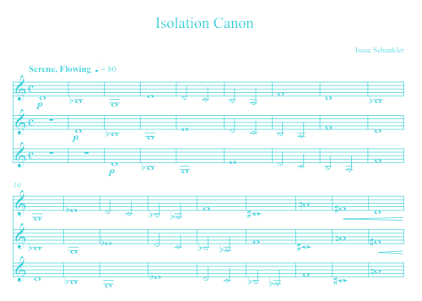
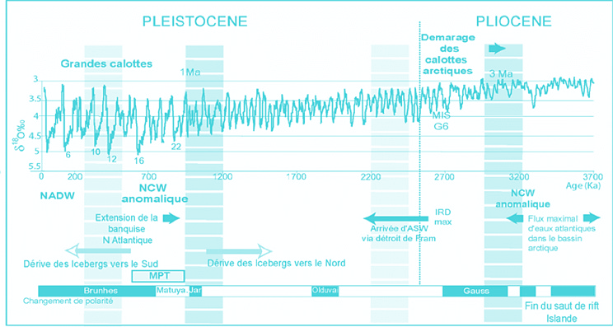
Background
Introduction
Methods
Results and discussion
- The overlaps
- The insolation canon
- Origin of overlaps
- The three classical problems
- Leads and lags around a termination: Phase
differences between NH and SH?
- Possible feedback mechanisms
- The future
Summary and conclusions
Background

Slide 3
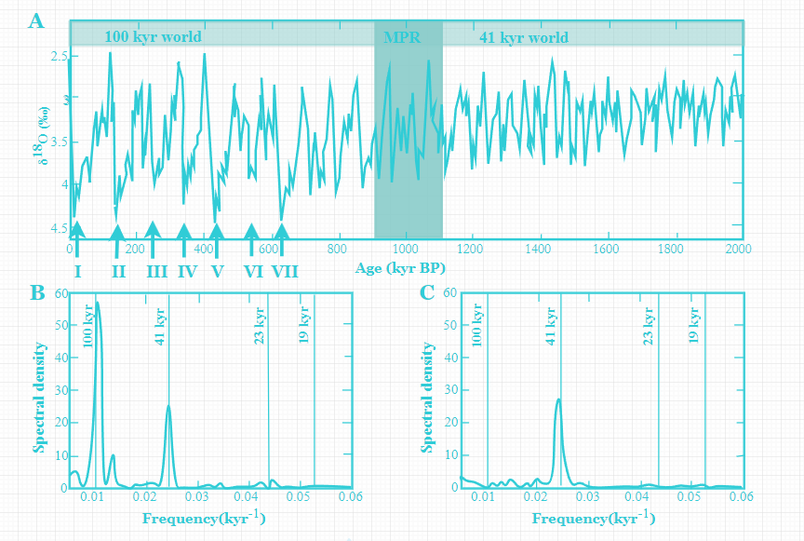
Introduction
Comparison of climate variability in the Late Pleistocene (100 kyr world) and the Early Pleistocene (41 kyr world).
Earth has gone through large climatic shifts during the Late Pleistocene, with seven major glaciations
A 41 kyr periodicity from the Early Pleistocene, marking the Mid Pleistocene Revolution (MPR).
100 kyr glacial/interglacial cycles
The seven glacial terminations

Slide 4
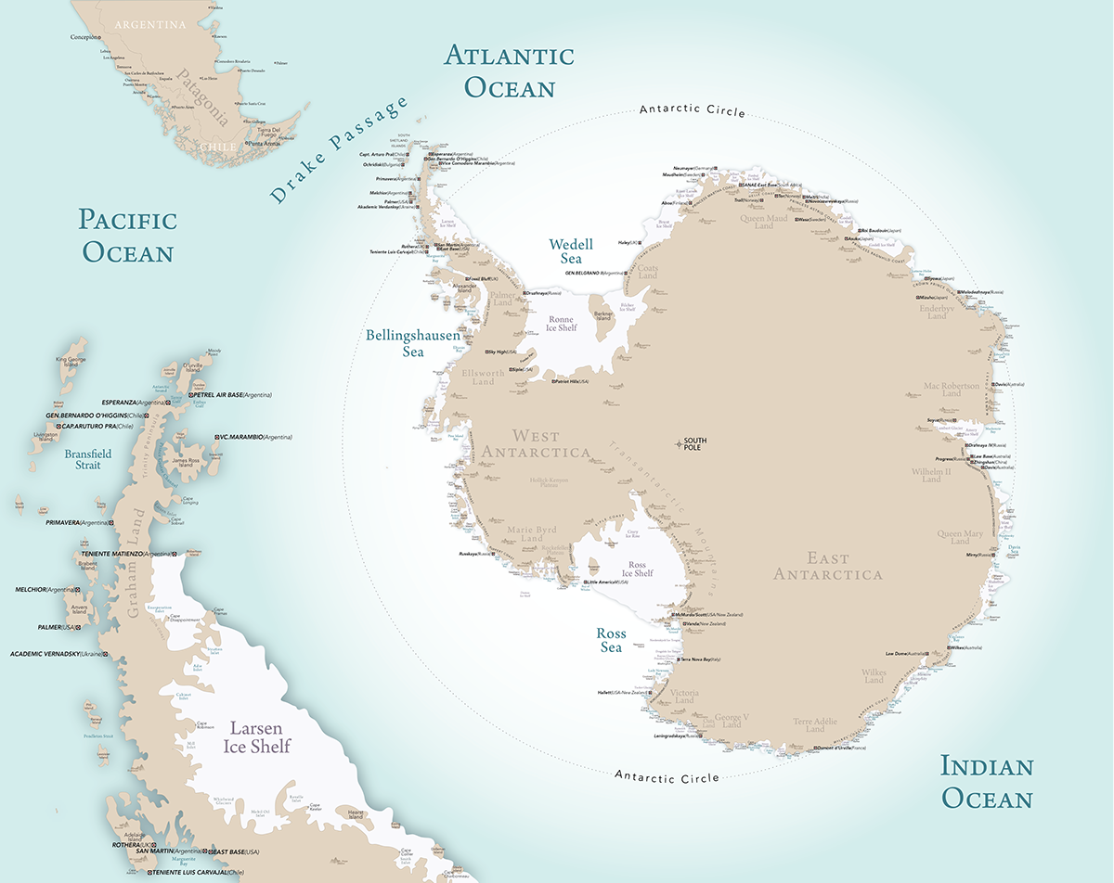
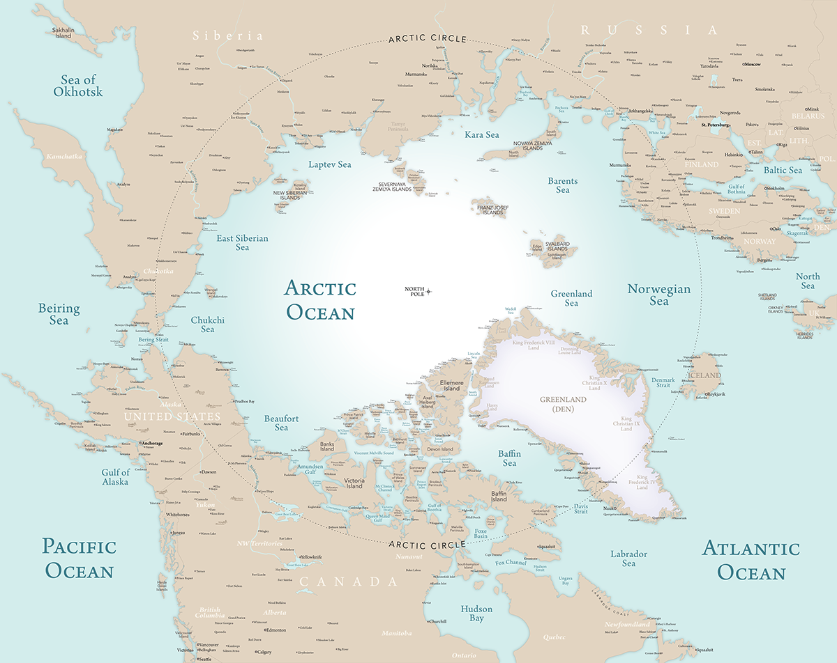
Methods
65° latitude in both hemispheres

Slide 5
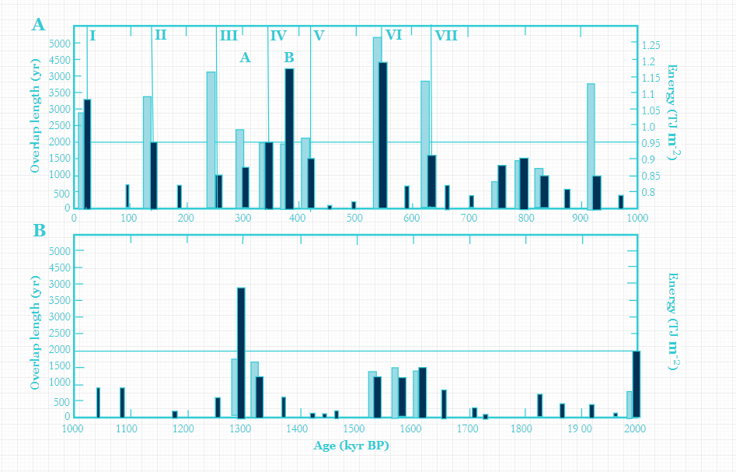
Results and discussion: The overlaps
The length of an overlap
The total energy supply
The geologic record the insolation in both hemispheres is increasing simultaneously and that the SH increase leads the NH, a feature refer to as ‘overlap’ .

Slide 6
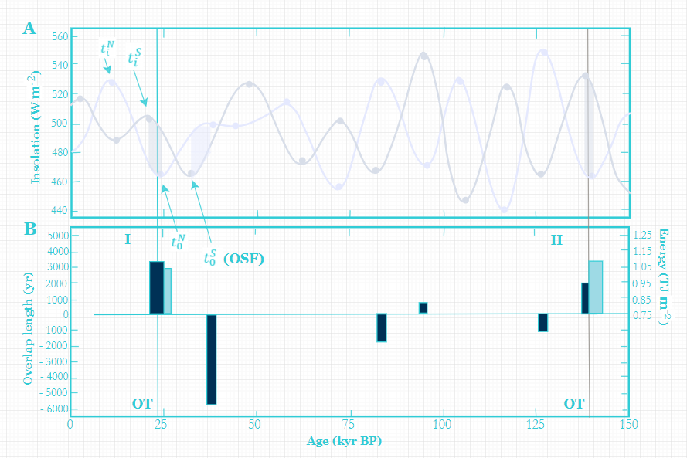
Results and discussion: The overlaps
Northern midsummer insolation at 65 °N
Its extrema
Southern midsummer insolation at 65 °N
Its extrema
The overlaps during SH and NH insolation increase, the insolation canon
The overlap during SH and NH insolation decrease, ‘negative’ insolation canon
The length of an overlap
The total energy supply

Slide 7
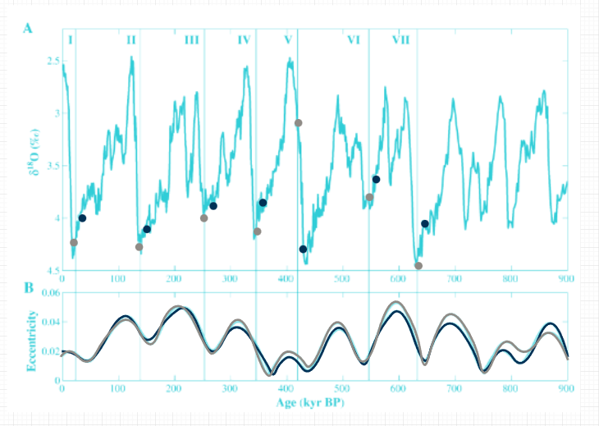
Results and discussion: The insolation canon
The overlap has to be equal to or longer than 1000 yr
Total energy supplied during the increase of southern and northern midsummer insolation has to exceed a threshold of 0.95 TJ m–2
The resulting OTs perfectly match the geologic record, coinciding with marine δ18O maxima, which to a first approximation reflect maxima in ice sheet extension100 ky glacial/interglacial cycles
the time intervals between our onsets of terminations (terminations VII–VI, VI–V, V–IV, IV–III, III–II, II–I) agree very well with intervals between midpoints of terminations in marine δ18O records, independent of the dating method applied
Terminations

Slide 8
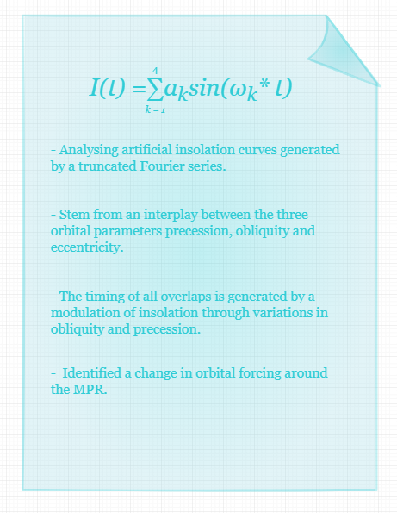
Results and discussion: Origin of overlaps
SAO/NASA Astrophysics Data System (ADS)
I(t) being the insolation at time t
Kicking frequency $ω_{k}$= 2π/$T_{k}$
Tk being the oscillation periods of 100 kyr, 41 kyr, 23 kyr and 19 kyr
Fourier coefficients $a_{k}$ were set to 0.1, 0.7, 1, 1 for NH insolation
and to 0.1, 0.7,−1,−1 for SH insolation

Slide 9
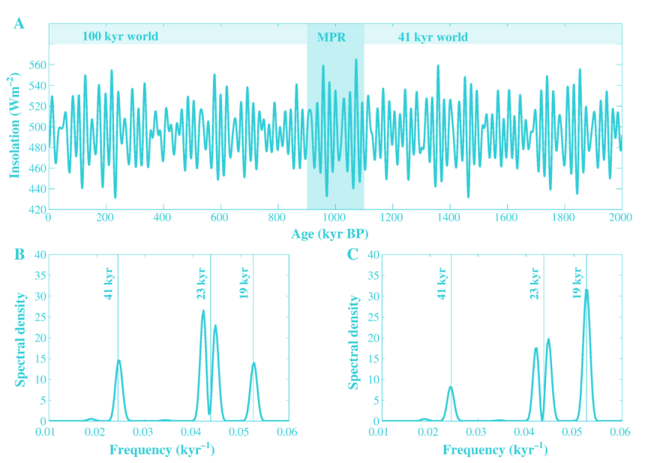
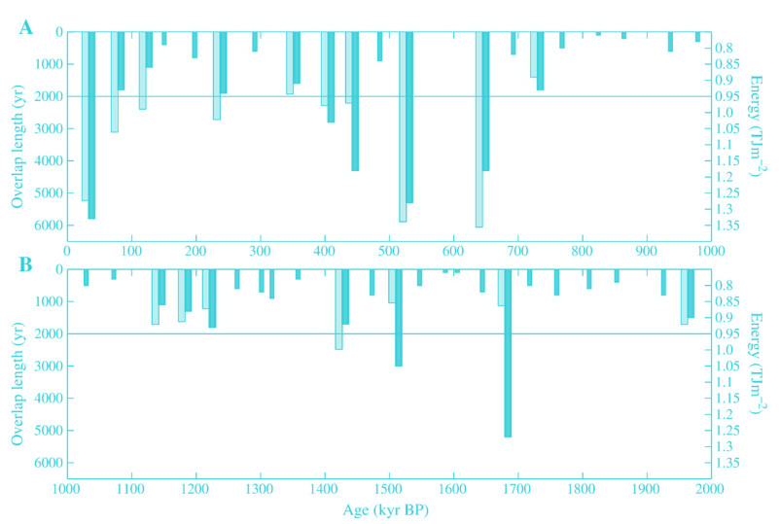
Results and discussion: The three classical problems
‘100 kyr problem’
‘Late Pleistocene transition’
‘stage 11’

Slide 10

Results and discussion: Leads and lags around a termination - Phase
differences between NH and SH?
Although the insolation canon identified by our analysis encompasses both hemispheres, it originates in the SH as the increase in midsummer insolation at 65 °S occurs about 10 kyr prior to its NH counterpart.
Hence, we would expect that around a termination changes of δ18O or δD, proxies for local temperature, in Antarctic ice would precede those in Arctic ice.
Unfortunately, direct comparison of Antarctic and Arctic climate records is difficult as uncertainties arise from translating core depth to calendar age and synchronizing NH and SH records to a uniform time scale.
Nonetheless, the SH origin of the insolation canon suggests that, if there are phase differences between NH and SH warming around a termination, it would rather be SH lead than a lag.

Slide 11
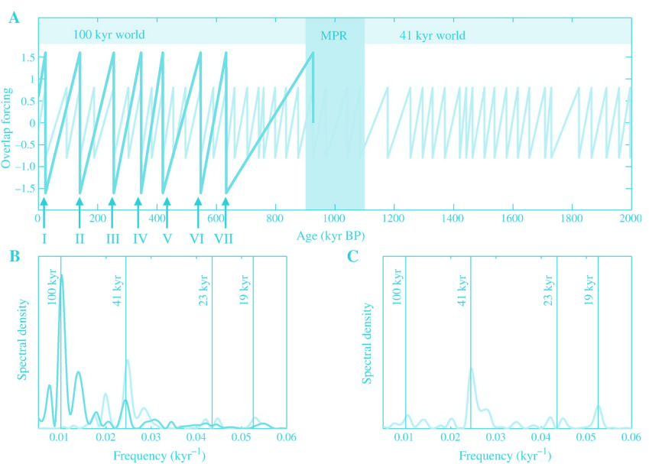
Results and discussion: Possible feedback mechanisms
The mathematical analysis presented can identify all seven Late Pleistocene glacial terminations.
However, the two thresholds of time and energy, suggest the involvement of particular feedback mechanisms.
A dominant role of the SH during the initiation of deglaciation, However, only the simultaneous increase in high latitude midsummer insolation in both hemispheres can push Earth's climate out of glacial conditions.
SH decrease in insolation always amplifies the NH warming forcing by insolation because SH and NH insolation changes are almost completely anti-phased.
During overlaps both hemispheres would warm in parallel, triggered by this insolation canon.

Slide 12
Summary and conclusions
Changes in SH and NH midsummer
insolation (65°) during the entire Pleistocene
Introduction
Methods
Results and discussion
- The overlaps
- The insolation canon
- Origin of overlaps
- The three classical problems
- Leads and lags around a termination: Phase
differences between NH and SH?
- Possible feedback mechanisms
- The future
Summary and conclusions
The insolation analysis performed on the astronomical solution for Earth's orbital parameters
Obliquity/Precession/Eccentricity
The overlaps are involved in initiating global ice volume oscillations in the past, and that the insolation canon is the trigger of the Late Pleistocene glacial terminations.

Slide 13
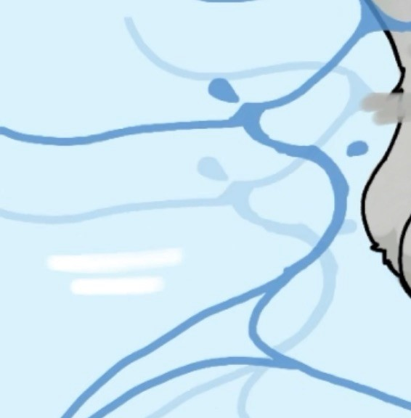


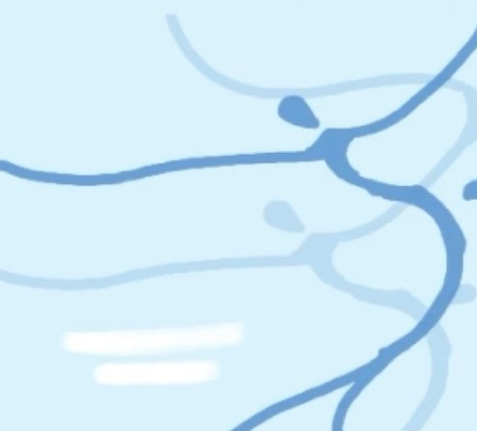
Discussion
Canon

