Slide 1
Hospital Readmissions
Team 6
Akeem Anderson, Drew Middleton, Asmae B, Pamala Cox

Slide 2

Introduction
This project explores the significance of hospital admissions/readmissions as it relates to patients with diabetes.
Objectives of the analysis:
Understand the scale of hospital admissions and readmissions.
Identify the frequency of diabetes-related diagnoses in admissions.
Examine the correlation between diabetes and readmission rates.

Slide 3

Data Overview
Data set included history of Hospital Admissions and readmissions including physician specialty, patient’s age and diagnoses
Source of the data (https://www.kaggle.com/code/iabhishekofficial/prediction-on-hospital-readmission)
Key columns used in the analysis
Readmitted
diag_1, diag_2, & diag_3
Age group of the patient
Outpatient visits 1 year preceding admission

Slide 4
Total Hospital Admissions
Total number of readmissions: 11754
Number of diabetes-related readmissions: 4089
Likelihood of diabetes being a factor in readmissions: 34.79%

Slide 5
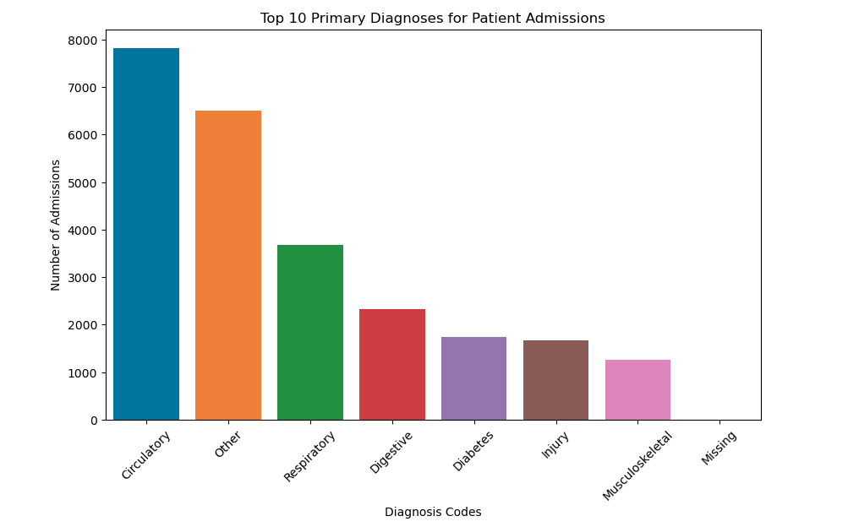
Admissions by Primary Diagnosis

Slide 6
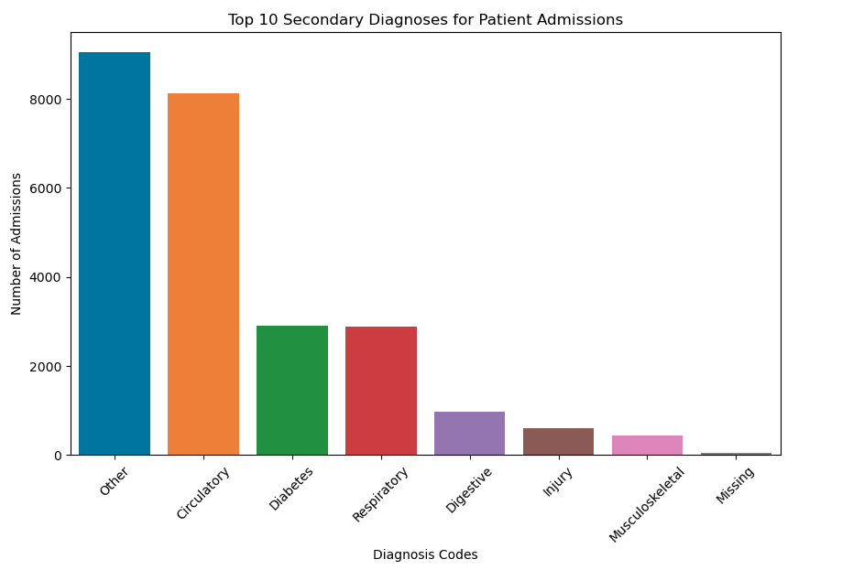
Admissions based on Secondary Diagnosis

Slide 7
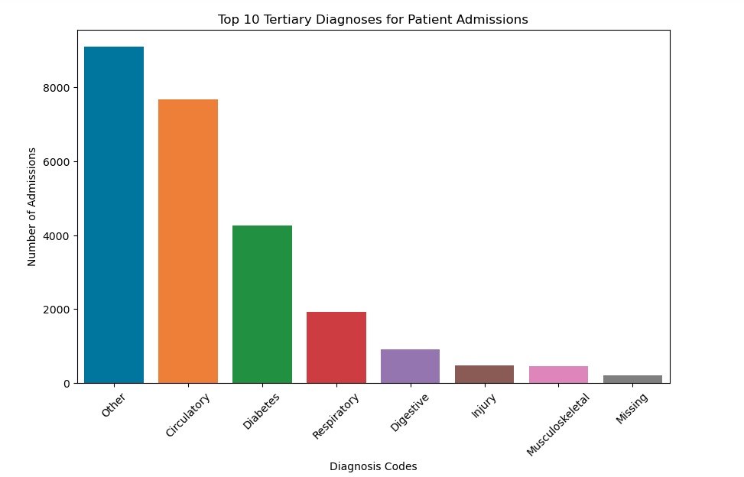
Admissions based on Tertiary Diagnosis

Slide 8
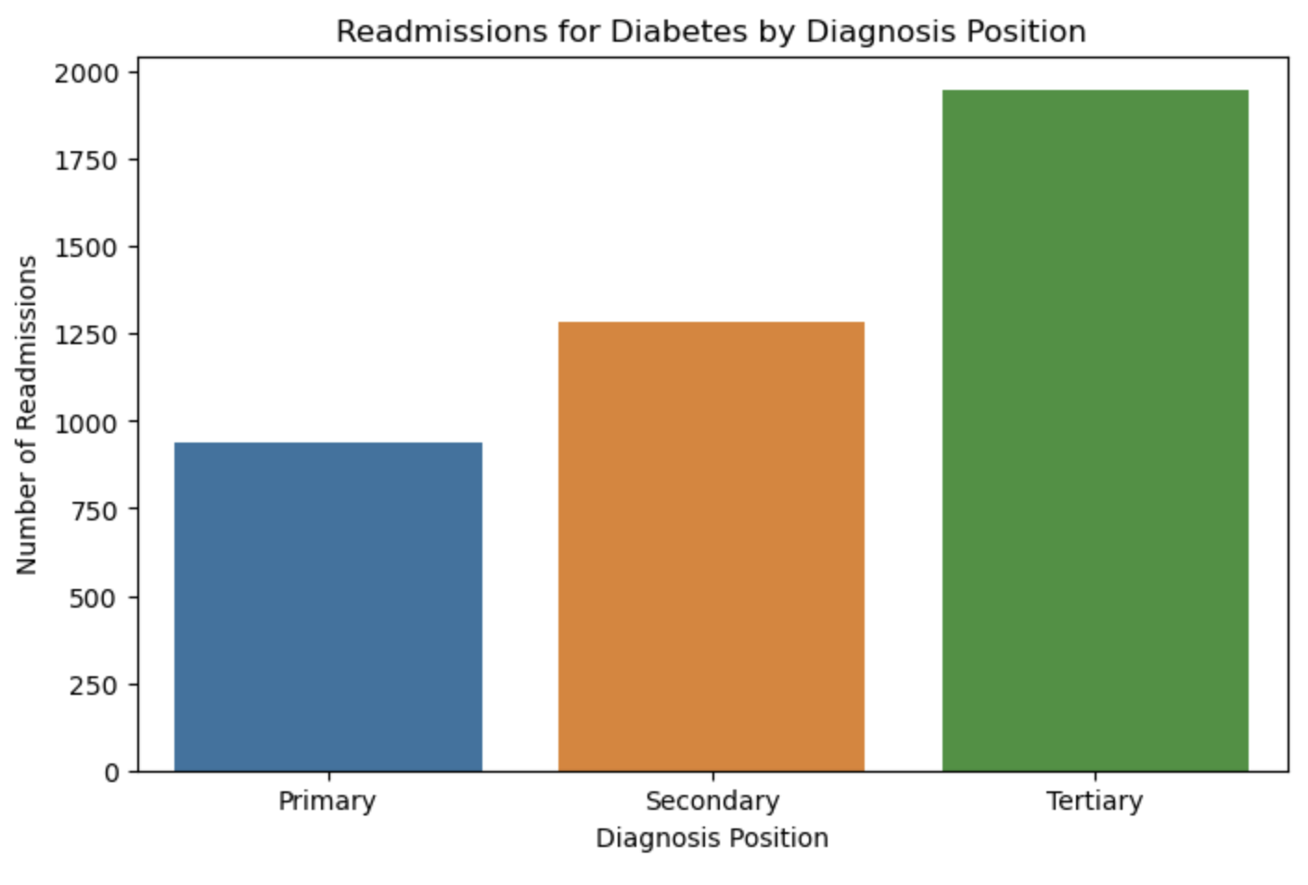
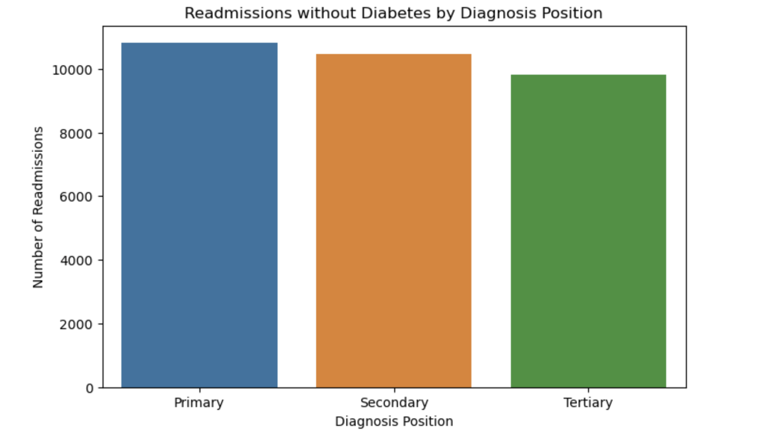
Readmissions for Diabetes Diagnoses vs Without
With Diabetes
Without Diabetes
Primary Diagnosis 937
Secondary Diagnosis: 1283
Tertiary Diagnosis: 1947
Primary Diagnosis w/o Diabetes: 10817
Secondary Diagnosis w/o Diabetes: 10471
Tertiary Diagnosis w/o Diabetes: 9807
VS
Notes:
Number of readmissions with diabetes as a primary diagnosis: 937 Number of readmissions with diabetes as a secondary diagnosis: 1283 Number of readmissions with diabetes as a tertiary diagnosis: 1947

Slide 9
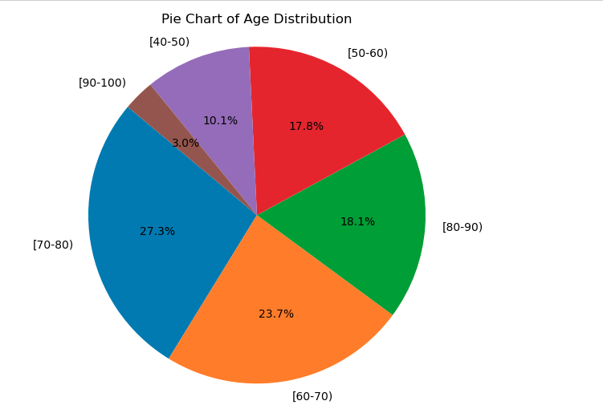
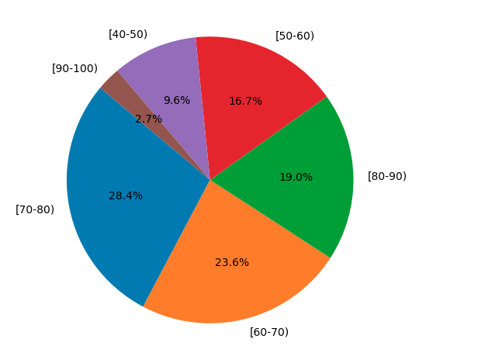
Age Impacts
Distribution of Admission by Age
Distribution of Readmission by Age

Slide 10
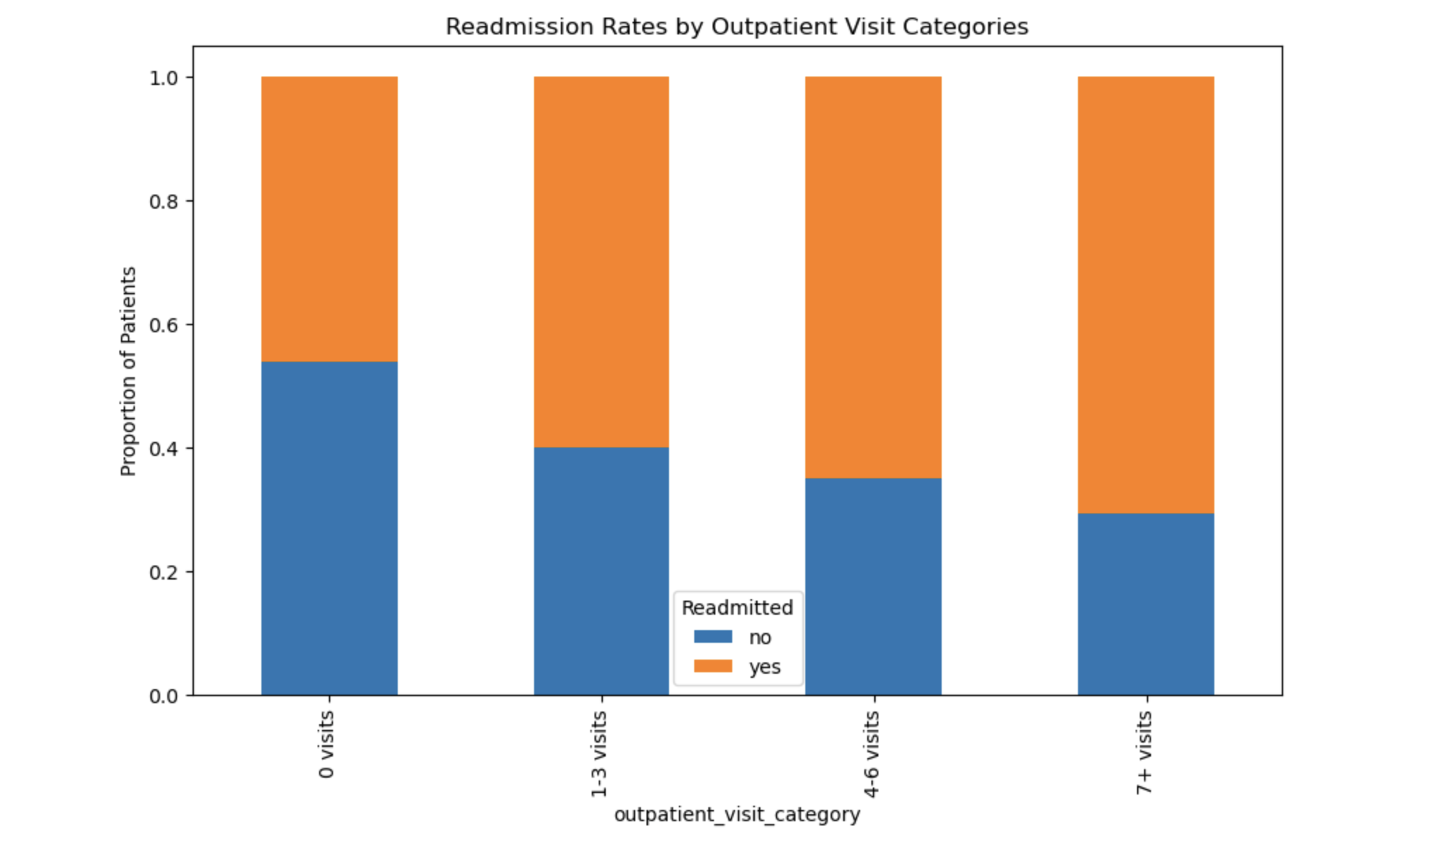
Outpatient Visits preceding Re-Admission For patients with Diabetes

Slide 11
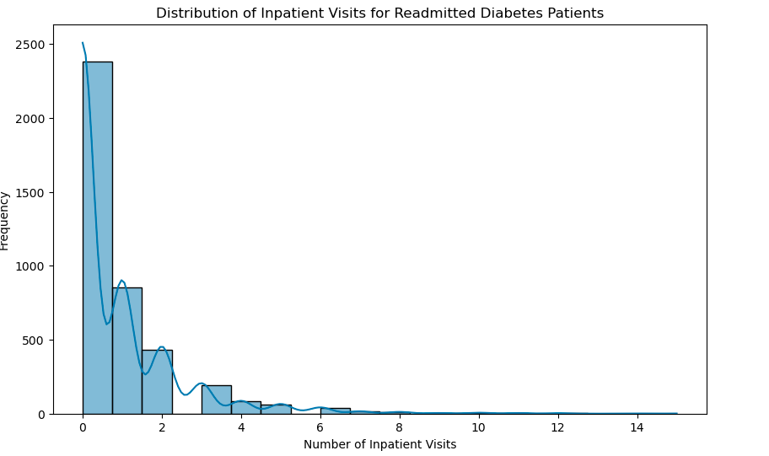
Distribution of Inpatient Visits for Readmitted Diabetes Patients
Notes:
Inpatient Admissions for patient with diabetes, did not seem to affect the potential of readmission

Slide 12
Conclusion
Summary of key findings:
Having a diagnosis of diabetes, whether primary, secondary or tertiary resulted in a 34.79% potential of being readmitted.
Age was not a contributing factor as expecting
Number of outpatient visits the preceding admission did not impact readmission as expected
Inpatient visits preceding re-admission did not seem to impact readmission

Slide 13

Thank You

