Slide 1
Hospital Readmissions
Your Company Name

Slide 2
Introduction
Brief overview of the importance of managing diabetes in a healthcare setting.
Objectives of the analysis:
Understand the scale of hospital admissions and readmissions.
Identify the frequency of diabetes-related diagnoses in admissions.
Examine the correlation between diabetes and readmission rates.

Slide 3
Data Overview
Description of the dataset:
Source of the data
Key columns used in the analysis (e.g., readmitted, diag_1, diag_2, diag_3, glucose_test)

Slide 4

Doctor Analyzing Report on Hospital Readmissions Rates
Text Here
Text Here
Text Here
This slide is 100% editable. Adapt it to your need and capture your audience’s attention.
This slide is 100% editable. Adapt it to your need and capture your audience’s attention.
This slide is 100% editable. Adapt it to your need and capture your audience’s attention.
This slide is 100% editable. Adapt it to your needs and capture your audience's attention.
Notes:
optiona

Slide 5
Admissions based on Diagnosis
Hospitalization
ICU admission
Case fatality

Slide 6

Hospital Admissions and Readmissions by Diagnosis
This slide represents a dashboard for student admissions and enrolment management. It aims to manage admissions by eliminating clutter and setting great admissions practice benchmarks for institute. It includes elements such as admission status, open enrolments, assessments, etc.
Admission by Age
Admission by Diagnosis
5
Open enrolment
1
Assessments
Admissions
2
Direct admissions
2
Selected candidates
This graph/chart is linked to excel, and changes automatically based on data. Just left click on it and select “Edit Data”.
Notes:
Adjust this slide to fit the admission and readmission by diagnosis, we will likely stick this in another section

Slide 7
Total Hospital Admissions
Number of total admissions observed in the dataset. (seems to be 25k)
Visual: Simple bar chart or graphic showing total admissions.

Slide 8
Total Hospital Readmissions
Number of readmissions and the general readmission rate.
Visual: Comparison graph of admissions vs. readmissions.
Notes:
Optional –

Slide 9
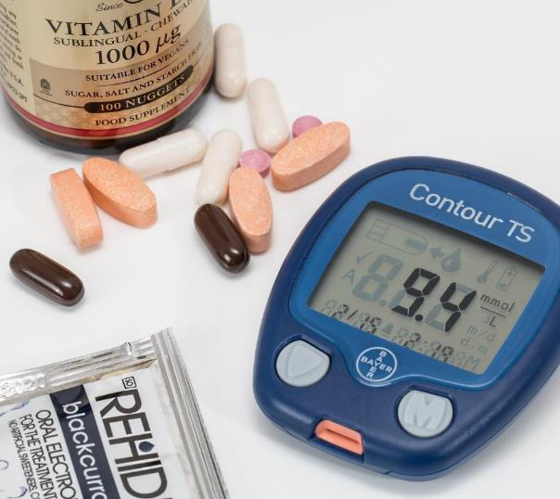
Text Here
This slide is 100% editable. Adapt it to your needs and capture your audience's attention.
Distribution of Glucose Monitoring Responses
Text Here
This slide is 100% editable. Adapt it to your needs and capture your audience's attention.
Notes:
We can use this side to explain the glucose testing piece

Slide 10
Diabetes-Related Admissions
Number of admissions with a diabetes diagnosis (primary, secondary, or tertiary).
Visual: Pie chart or bar graph showing the proportion of diabetes-related admissions within total admissions.
Notes:
Identify all diabetes diagnoses based on if it’s the primary, secondary or tertiary [third] and align them that way in the pie chart (update code to have the same)

Slide 11
Diabetes-Related Readmissions
Number of readmissions that involve diabetes patients.
Analysis of readmission rates specifically for patients diagnosed with diabetes.
Visual: Bar chart comparing diabetes readmissions to overall readmissions.
Total Admissions: 25000
Total Admissions with a Diagnosis of Diabetes: 8788
Total Readmissions with a Diagnosis of Diabetes: 4089
Notes:
Double check the data is accurate or update

Slide 12
Key Medical Causes of Hospital Readmissions based on Age
 | Other | Circulatory | Diabetes | Respiratory | Digestive | Injury
40-50 | 16% | 2% | 10% | 9% | 2% | 8%
50-60 | 25% | 36% | 24% | 51% | 71% | 42%
60-70 | 16% | 10% | 14% | 2% | 2% | 5%
70-80 | 22% | 24% | 17% | 22% | 22% | 11%
80-90 | 10% | 12% | 12% | 11% | 9% | 10%
This graph/chart is linked to excel, and changes automatically based on data. Just left click on it and select “edit data”.
Notes:
Edit table to input data collected or pull data to correlate to this slide

Slide 13
Line Chart showing Days Admitted
Year: 2021
Readmissions
This graph/chart is linked to excel, and changes automatically based on data. Just left click on it and select “edit data”.
Notes:
Need to edit the table to include data from our coding data set

Slide 14
Analysis of Factors Affecting Readmissions in Diabetes Patients
Discussion of any analysis performed on factors affecting readmissions for diabetes patients (e.g., glucose level monitoring, medication changes).
Insights or patterns observed (if any statistical analysis was performed).
Notes:
Need to double check this data to make sure it’s correct and draw conclusions

Slide 15
Conclusion and Recommendations
Summary of key findings:
The impact of diabetes on readmission rates.
Any critical factors identified that influence readmissions.
Recommendations for healthcare providers based on the analysis.

Slide 16
Detailed Statistical Analysis: If you performed specific statistical tests or modeling, include slides detailing these methodologies and results.
Case Studies or Patient Profiles: If relevant, i

Slide 17

Thank You
Address
# street number, city, state
Contact Number
0123456789
Email Address
emailaddress123@gmail.com

