Slide 1
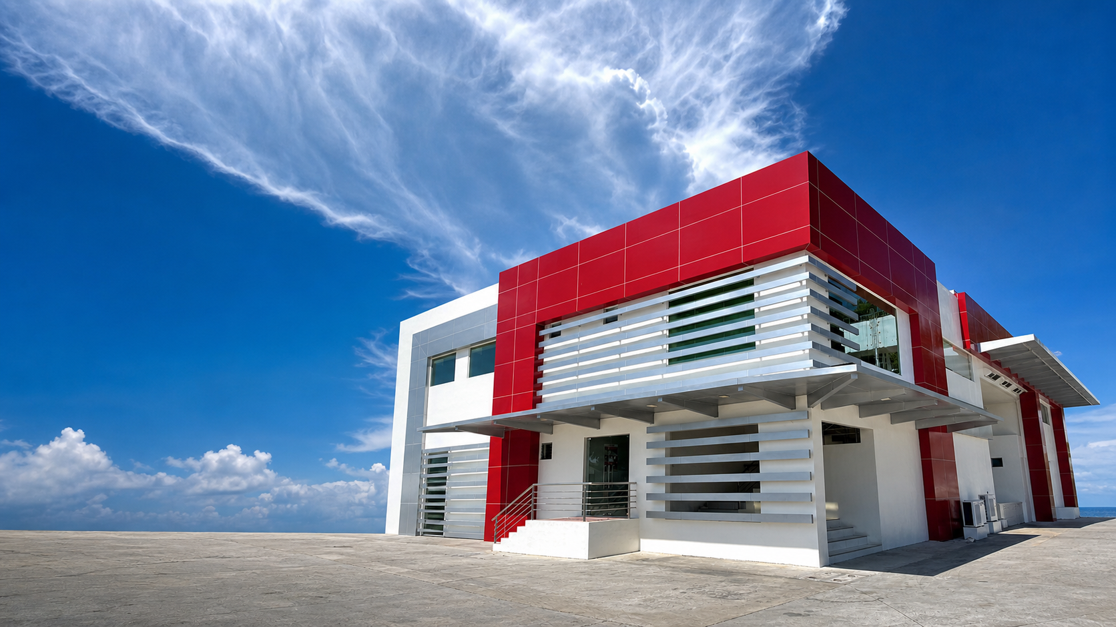

PEANUT KISSES
Document Tracking &
Management System
A complete guide to secure document creation, storage, access, approval, retrieval, disposal, and accountability.
SYSTEM OVERVIEW
PROCESS GUIDE
USER TUTORIAL
Presentation deck | 2026
SYSTEM PRESENTATION
01

Slide 2
EXECUTIVE OVERVIEW
One controlled workspace for every document
PK DMS connects records, files, physical locations, people, decisions, and evidence.
CONTROL
SECURITY
TRACEABILITY
Central register
Governed access
Traceable lifecycle
One authoritative catalog for both physical and digital documents. Search by title, number, owner, file, asset, area, or location.
Users see only what their role and document assignments allow. Administrators manage roles, permissions, and account status.
Requests, approvals, revisions, attachments, disposal, restoration, notifications, and authenticated actions are retained as an accountable trail.
Presentation message
The system does not only store files - it controls the complete life of a document.
OVERVIEW
02

Slide 3
WHY THE SYSTEM EXISTS
From scattered records to controlled information
The presentation can frame the project as a direct answer to common document-management risks.
BEFORE
WITH PK DMS
X
Files stored in unrelated folders
OK
One searchable document register
X
Paper records difficult to locate
OK
Mapped physical storage route
X
Unclear ownership and access
OK
Role plus assignment-based access
X
No consistent approval history
OK
Visible request and review workflow
X
Disposal decisions hard to prove
OK
Audited disposal and restoration
OVERVIEW
03

Slide 4
THE DOCUMENT JOURNEY
A simple process from receipt to final action
Every step has a clear owner, status, and history.
1
Receive
2
Register
3
Organize
4
Review
5
Retrieve
A document arrives as paper or a digital file.
Staff records its title, number, type, and owner.
Map a physical location or choose a digital folder.
The right people check, approve, and update it.
Authorized users search, open, or locate the record.
CLEAR AND CONTROLLED
The result
Staff spend less time searching, managers see the current status, and clients receive a consistent, accountable service.
HOW IT WORKS
04

Slide 5
ROLES AND RESPONSIBILITIES
Every user sees a workspace appropriate to the job
Actual access is controlled by both role permissions and document-specific assignments.
FULL GOVERNANCE
DAILY OPERATIONS
CONTROLLED VIEW
Administrator
Staff
Viewer / Auditor
- Configure storage catalogs
- Manage users and roles
- Create and manage documents
- Review requests and disposal
- Run backups and view audit logs
- Work with permitted documents
- Create requests
- Upload attachments or revisions when allowed
- Track personal request status
- Receive workflow notifications
- See assigned records only
- Review document details and evidence
- Follow mapped hardcopy routes
- No broad edit access unless explicitly permitted
ROLE PERMISSION
+
DOCUMENT ASSIGNMENT
=
VISIBLE & ALLOWED
ACCESS CONTROL
05

Slide 6
GETTING STARTED SECURELY
Sign in with your own account
Your role determines the pages and actions available after login.
PK DOCUMENT MANAGEMENT
SIGN IN
1
Open PK DMS
Dashboard
Documents
Requests
Notifications
Welcome back
Use the approved address provided by your organization.
Email address
2
Enter your account
Password
Type your assigned email and password.
Sign in securely
3
Check your role
Leave Remember me off on a shared computer. Always sign out when finished.
Confirm your name and role in the top-right account menu.
USER TUTORIAL
06

Slide 7
DASHBOARD TOUR
Start with the operational picture
The dashboard summarizes the workload and provides fast routes into the document lifecycle.
1
Total documents
2
Hardcopy
3
Softcopy
4
Pending work
Complete controlled register
Physical records and locations
Digital files and revisions
Requests awaiting action
DAILY CHECK
ORIENTATION
What to review first
How to navigate
1. Pending approvals
2. New notifications
3. Recent documents
4. Storage or request exceptions
Use the left sidebar for document types, folders, requests, administration, and system tools. The top title always confirms the current workspace.
USER TUTORIAL
07

Slide 8
TWO DOCUMENT TYPES
One register, two storage realities
The same controls apply, but retrieval information differs between physical and digital records.
PHYSICAL
DIGITAL
Hardcopy document
Softcopy document
Stored as an original physical item.
Key information:
- Area
- Specific storage
- Location
- Asset number
- Sequence
- Attached scan evidence
Stored as a controlled digital file.
Key information:
- Category folder
- Current file
- Revision number
- Revision reason
- Uploader and date
- Supporting attachments
Both types include title, number, creator, requester, status, assignment, dates, and audit activity.
DOCUMENT LIFECYCLE
08

Slide 9
HARDCOPY WORKFLOW
Register -> map -> assign -> retrieve
A hardcopy record must tell the next person exactly where the original can be found.
1
Register
2
Map storage
3
Attach evidence
4
Assign access
5
Retrieve
Create the title, number, requester, and record status.
Select Area -> Specific -> Location, plus Asset and Sequence.
Upload scans or supporting files without replacing the original.
Choose the users who are allowed to discover and view the record.
Follow the route and confirm asset/sequence before removing the copy.
Example storage route
ADMIN OFFICE > BACK OFFICE STORAGE > DU
HARDCOPY TUTORIAL
09

Slide 10
SOFTCOPY WORKFLOW
Upload once, revise with control
The current file stays clear while every revision remains traceable.
1
Choose folder
2
Create record
3
Assign users
4
Upload revision
Select the correct softcopy category or create the approved folder structure.
Enter document metadata and upload the first controlled file.
Grant visibility only to the staff who require the document.
Provide a new file and explain the reason for revision.
NOW
HISTORY
Current revision
Revision history
The document points to the latest approved working file for normal use.
Earlier versions retain file name, revision number, uploader, date, and reason.
Rule: never overwrite history manually. Use Upload Revision so the system records the change.
SOFTCOPY TUTORIAL
10

Slide 11
REQUEST AND APPROVAL PROCESS
Decisions move through a visible queue
The requester and reviewer each have a dedicated workspace.
1
2
3
4
5
User submits request
>
My Requests tracks status
>
Reviewer opens Approval Review
>
Approve or reject with context
>
Document status updates
KEEP WORK MOVING
Notification loop
Badges and the notification center surface new requests, decisions, assignments, and document updates. Opening an item marks it read and navigates to the relevant workspace.
WORKFLOW
11

Slide 12
DOCUMENT ASSIGNMENT
Give access deliberately - not broadly
Assignment metadata is visible but read-only to ordinary users.
ASSIGNS
USES
RESTRICTED
Administrator
Assigned user
Unassigned user
Selects one or more users, confirms the document, and saves the assignment. The system records who assigned access and when.
Can discover and open the document only when the role also permits the requested action.
Does not receive the document in listings, search, dashboard data, detail views, or revision routes.
CONTROLLED ACCESS
applies wherever the user searches, opens, or reviews a document
ACCESS CONTROL
12

Slide 13
FIND AND INSPECT A DOCUMENT
Search first, then narrow with Advanced filters
Hardcopy and Softcopy workspaces automatically show the filters that belong to that document type.
PK DOCUMENT MANAGEMENT
VIEWER
1
Choose workspace
Dashboard
Documents
Requests
Notifications
Hardcopy Document Module
Open Hardcopy Documents or Softcopy Documents.
Search number, title, creator, asset, area...
Advanced 2
ADVANCED SEARCH
2
Type keywords
Status: Approved
Assignment: Assigned
Search by number, title, person, asset, area, or filename.
Area: Admin Office
Location: Back Office
3
Open Advanced
Select a result to review details, access assignment, storage route, files, and activity.
Use status, assignment, folder, or storage fields to narrow results.
USER TUTORIAL
13

Slide 14
SUPPORTING EVIDENCE AND REVISIONS
Attach context without losing history
Evidence explains the record; revisions control the main working file.
ATTACHMENTS
VERSION HISTORY
Supporting evidence
Controlled revisions
Use for scanned pages, photos, receipts, references, or supporting Office/PDF files.
Hardcopy records may have evidence even though the original remains physical.
Use for successive versions of the principal softcopy document.
Always provide a meaningful reason so reviewers understand what changed.
Evidence answers: what supports this record?
Revisions answer: which version is current, and why?
DOCUMENT CONTROL
14

Slide 15
DOCUMENT DISPOSAL
A controlled decision - not a silent delete
Disposal preserves accountability and supports restoration when policy permits.
1
Request
2
Review
3
Decision
4
Disposed
5
Restore
Authorized user submits a disposal request and reason.
Reviewer evaluates the request and record context.
Approve or reject; the decision is recorded.
Record appears in Document Disposal with remarks and date.
Authorized personnel can restore a disposed record when justified.
Deletion and disposal are different: disposal is a visible lifecycle state; deletion removes a record and requires separate authority.
RECORD LIFECYCLE
15

Slide 16
NOTIFICATIONS AND AUDIT LOGS
Awareness for users, evidence for administrators
Two related tools answer different questions.
ACTIONABLE
TRACEABLE
Notification center
Audit and Activity Logs
Answers: What needs my attention?
- New assignments
- Request decisions
- Workflow updates
- Unread counter and direct navigation
Answers: Who did what and when?
- Authenticated user and role
- Action and module
- Affected record context
- Time and client computer IP
Sensitive passwords, tokens, authorization headers, and file contents are excluded from audit metadata.
ACCOUNTABILITY
16

Slide 17
SYSTEM ADMINISTRATION
Configure the structure before users create records
Good catalogs and permissions make daily document entry consistent.
01
02
Storage & Classification
User Accounts
Areas, specifics, locations, assets, sequences, and softcopy folders.
Profiles, roles, active status, registration review, and account governance.
03
04
Roles & Permissions
System Settings
Module and action rights based on job responsibilities.
Branding, presentation, document behavior, and protected integration status.
Recommended order: define storage -> define roles -> create users -> assign documents -> begin operations.
ADMINISTRATION
17

Slide 18
BACKUP, RESTORE, AND RESET
Protect information before it is needed
Administrative recovery actions are guarded and separated from normal document work.
SAFE COPY
RECOVERY
HIGH IMPACT
Backup
Restore
Start over
Create a database snapshot and preserve uploaded document storage according to the configured process. Record the purpose and date.
Choose the correct backup, understand the impact, confirm authorization, and verify the system after recovery.
Use only for an approved full reset. A safety copy is made first. This action is not part of normal daily use.
Operational rule: test the backup file, the application health, and a representative document - not only the backup count.
RESILIENCE
18

Slide 19
A COMPLETE DAY-IN-THE-LIFE EXAMPLE
From incoming document to accountable retrieval
Use this slide as the guided demonstration during the presentation.
1
Admin prepares the storage catalogs and user roles.
2
Staff registers a trademark application as hardcopy.
3
Staff maps ADMIN OFFICE -> BACK OFFICE STORAGE -> DU.
4
Admin assigns access to the responsible auditor.
5
Auditor finds the record and reviews attached scans.
6
A later disposal request moves through approval and audit.
DEMO COMPLETE
PRACTICAL TUTORIAL
19

Slide 20
PRESENTATION CLOSE
Controlled documents. Clear responsibility. Defensible history.
End with the system value, then proceed to the live demonstration or questions.
SPEED
SECURITY
TRUST
Find it
Protect it
Prove it
Searchable digital records and precise physical storage routes reduce retrieval time.
Roles, permissions, assignments, blank credentials, and controlled sessions limit exposure.
Requests, approvals, revisions, disposal history, notifications, and audit logs provide accountability.
Questions & live demonstration
Suggested demo: login -> dashboard -> create/find document -> assign user -> open details -> audit activity.
CLOSING
20

