Slide 1
Stronger Lower Bounds for Tree Covers
via Cyclic Symmetry
Shengtang Huang
Center on Frontiers of Computing Studies,
Peking University

Slide 2
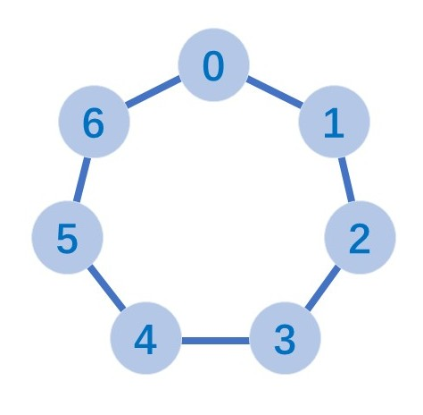
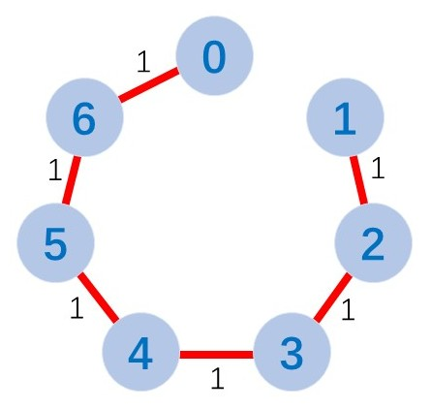
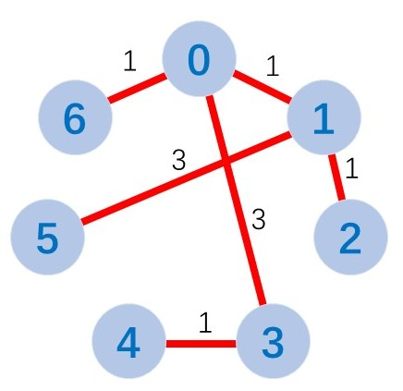

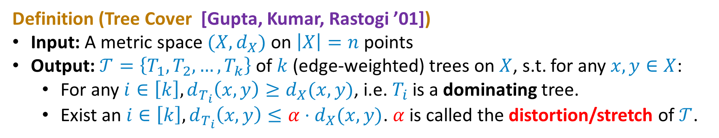


Tree Cover
Definition (Tree Cover [Gupta, Kumar, Rastogi ’01])
Input: A metric space $(X,d_{X})$ on $\left|X\right|=n$ points
Output: $𝒯=\left\{T_{1},T_{2},…,T_{k}\right\}$ of $k$ (edge-weighted) trees on $X$, s.t. for any $x,y∈X$:
For any $i∈\left[k\right],d_{T_{i}}\left(x,y\right)≥d_{X}(x,y)$, i.e. $T_{i}$ is a dominating tree.
Exist an $i∈\left[k\right], d_{T_{i}}\left(x,y\right)≤α⋅d_{X}(x,y)$. $α$ is called the distortion/stretch of $𝒯$.
$$α=1$$
$$T_{1}$$
$$T_{2}$$

Slide 3
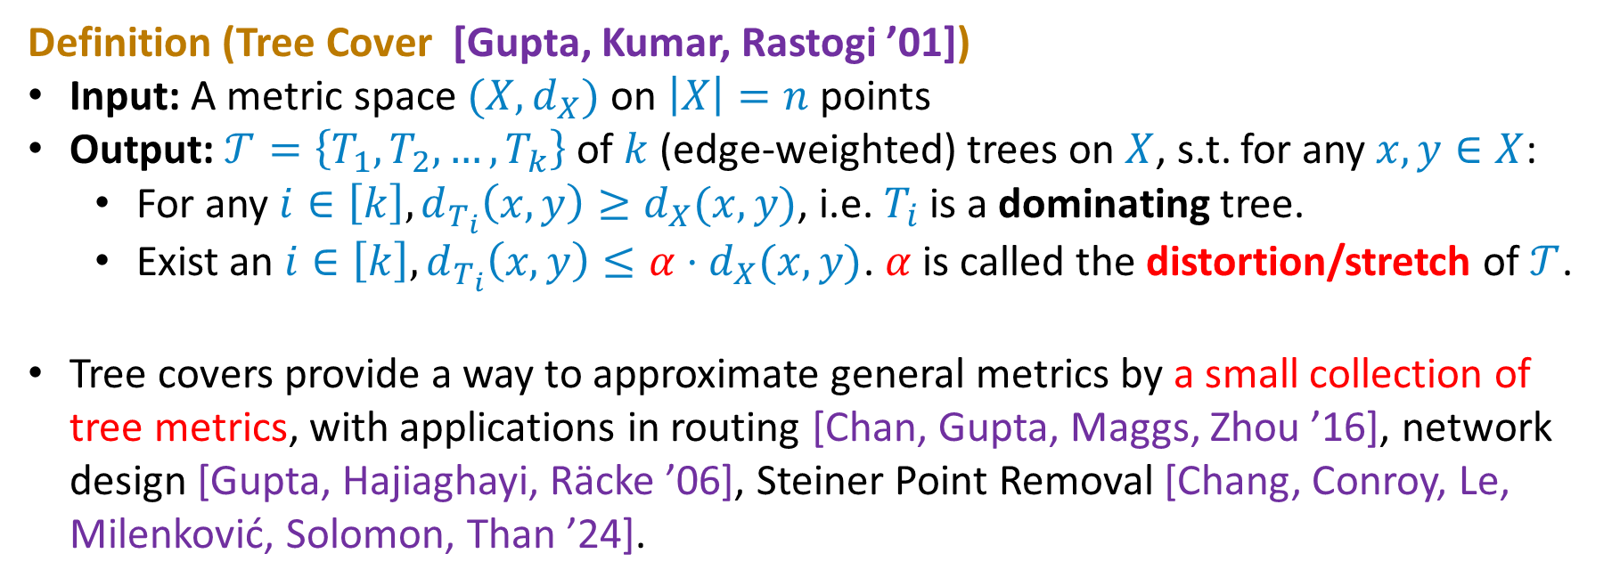
Tree Cover
Definition (Tree Cover [Gupta, Kumar, Rastogi ’01])
Input: A metric space $(X,d_{X})$ on $\left|X\right|=n$ points
Output: $𝒯=\left\{T_{1},T_{2},…,T_{k}\right\}$ of $k$ (edge-weighted) trees on $X$, s.t. for any $x,y∈X$:
For any $i∈\left[k\right],d_{T_{i}}\left(x,y\right)≥d_{X}(x,y)$, i.e. $T_{i}$ is a dominating tree.
Exist an $i∈\left[k\right], d_{T_{i}}\left(x,y\right)≤α⋅d_{X}(x,y)$. $α$ is called the distortion/stretch of $𝒯$.
Tree covers provide a way to approximate general metrics by a small collection of tree metrics, with applications in routing [Chan, Gupta, Maggs, Zhou ’16], network design [Gupta, Hajiaghayi, Räcke ’06], Steiner Point Removal [Chang, Conroy, Le, Milenković, Solomon, Than ’24].

Slide 4
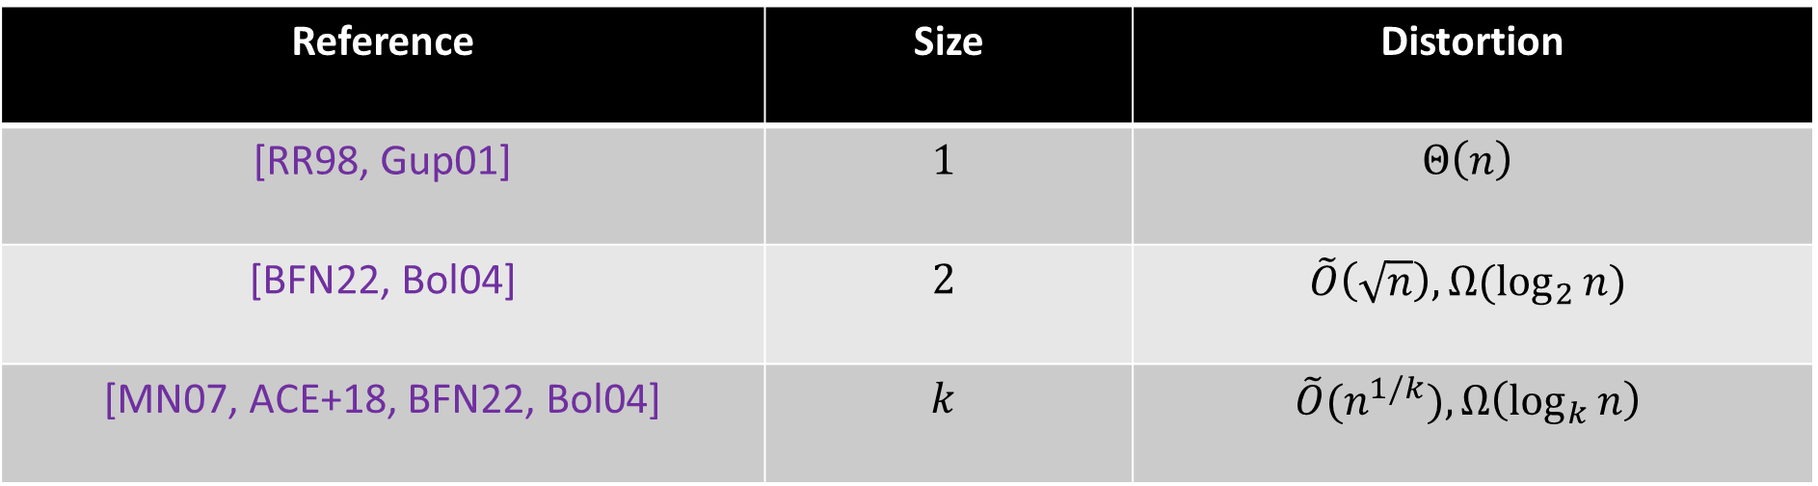
The Size–Distortion Tradeoff
Reference | Size | Distortion
[RR98, Gup01] | $$1$$ | $$Θ\left(n\right)$$
[BFN22, Bol04] | $$2$$ | $$\tilde{O}\left(\sqrt{n}\right), Ω(\log_{2}{n})$$
[MN07, ACE+18, BFN22, Bol04] | $$k$$ | $$\tilde{O}(n^{1/k}),Ω\left(\log_{k}{n}\right)$$
We mainly focus on results on general metric spaces.

Slide 5
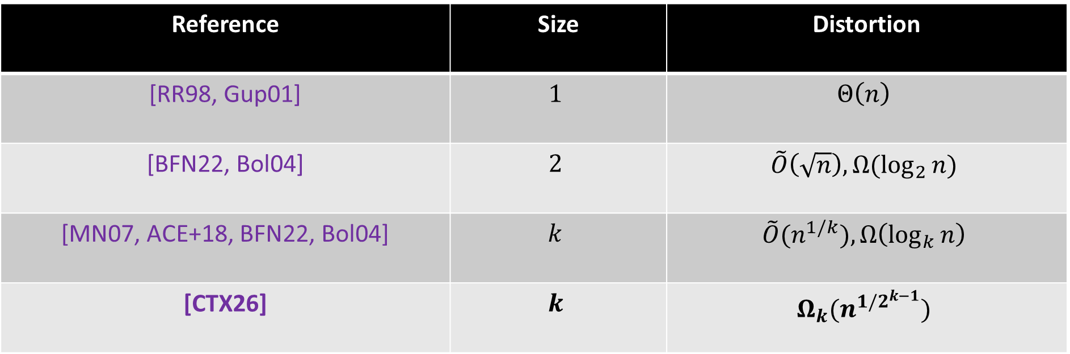
The Size–Distortion Tradeoff
Reference | Size | Distortion
[RR98, Gup01] | $$1$$ | $$Θ\left(n\right)$$
[BFN22, Bol04] | $$2$$ | $$\tilde{O}\left(\sqrt{n}\right), Ω(\log_{2}{n})$$
[MN07, ACE+18, BFN22, Bol04] | $$k$$ | $$\tilde{O}(n^{1/k}),Ω\left(\log_{k}{n}\right)$$
[CTX26] | $$k$$ | $$Ω_{k}(n^{1/2^{k−1}})$$
[Chen, Tan, Xu ’26] gave the first polynomial lower bound, by introducing a topological approach.

Slide 6
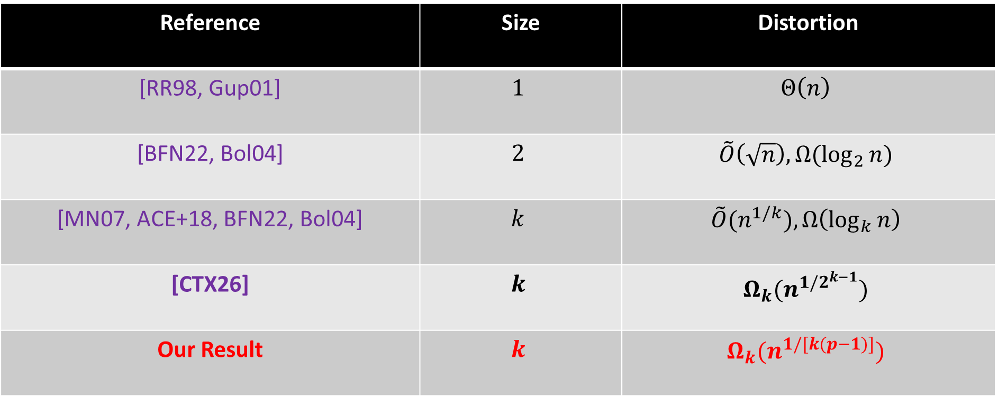
The Size–Distortion Tradeoff
Reference | Size | Distortion
[RR98, Gup01] | $$1$$ | $$Θ\left(n\right)$$
[BFN22, Bol04] | $$2$$ | $$\tilde{O}\left(\sqrt{n}\right), Ω(\log_{2}{n})$$
[MN07, ACE+18, BFN22, Bol04] | $$k$$ | $$\tilde{O}(n^{1/k}),Ω\left(\log_{k}{n}\right)$$
[CTX26] | $$k$$ | $$Ω_{k}(n^{1/2^{k−1}})$$
Our Result | $$k$$ | $$Ω_{k}(n^{1/[k(p−1)]})$$
We further develop the topological approach.
Here $p$ is the smallest prime s.t. $p>k$. Thus $p=O(k)$. Gap from $\exp{(k)}$ to $O(k)$.

Slide 7
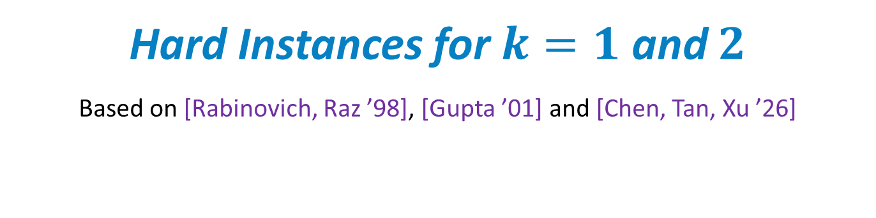
Hard Instances for $k=1$ and $2$
Based on [Rabinovich, Raz ’98], [Gupta ’01] and [Chen, Tan, Xu ’26]

Slide 8
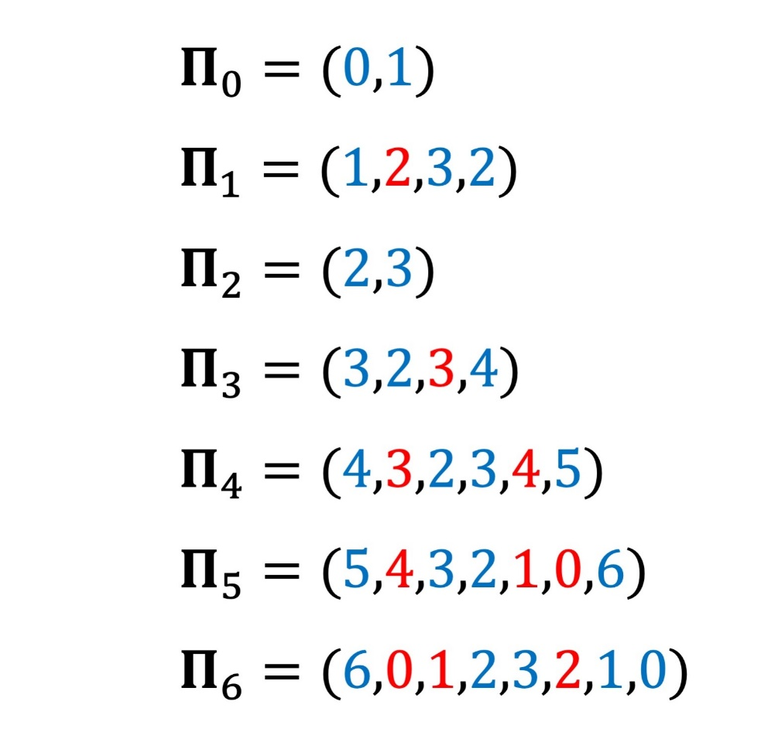
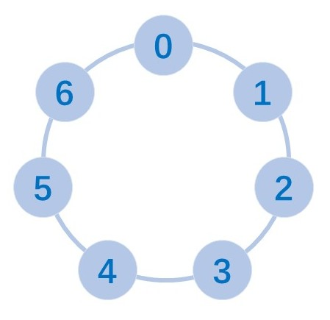
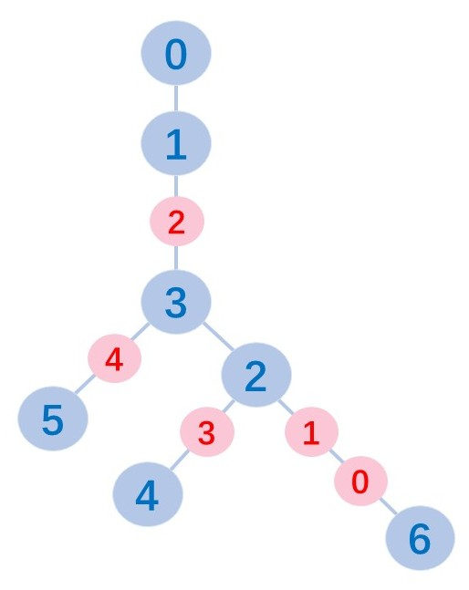
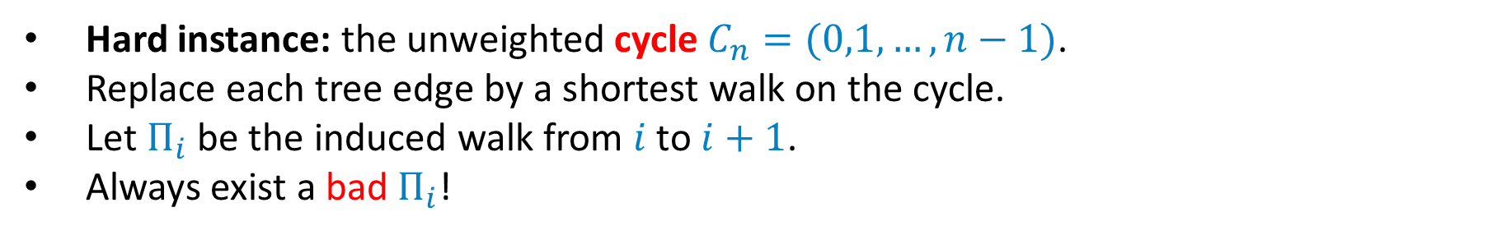

$k=1$: Cycle
Hard instance: the unweighted cycle $C_{n}=(0,1,…,n−1)$.
Replace each tree edge by a shortest walk on the cycle.
Let $Π_{i}$ be the induced walk from $i$ to $i+1$.
Always exist a bad $Π_{i}$!
(5,6): bad edge
always exists in a cycle

Slide 9
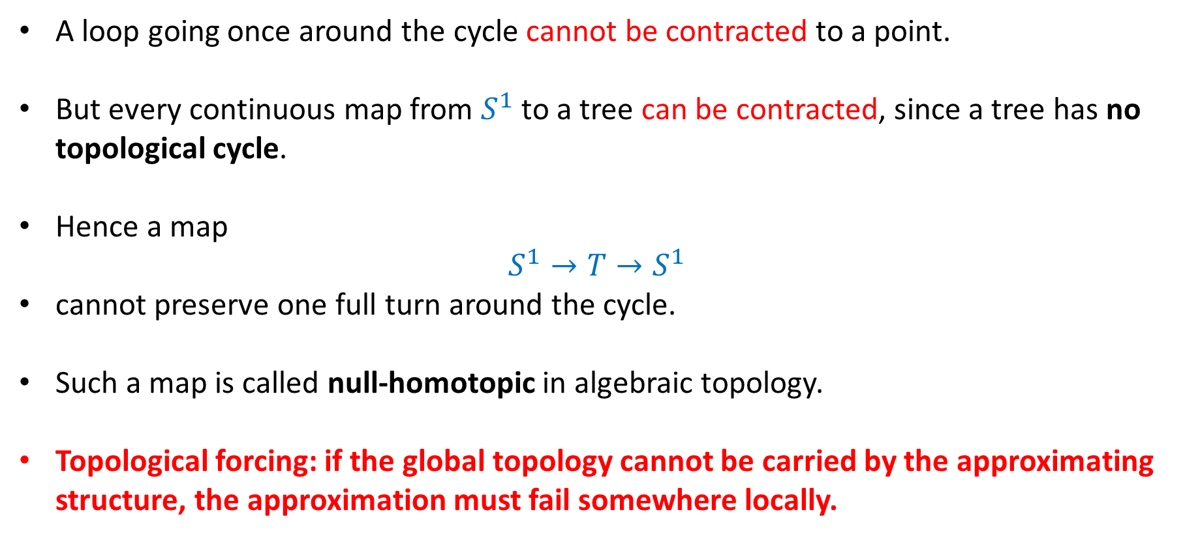
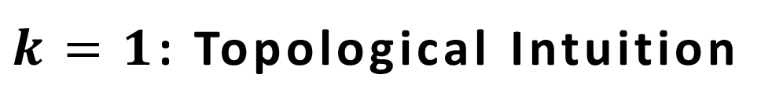
$k=1$: Topological Intuition
A loop going once around the cycle cannot be contracted to a point.
But every continuous map from $S^{1}$ to a tree can be contracted, since a tree has no topological cycle.
Hence a map
$$S^{1}→T→S^{1}$$
cannot preserve one full turn around the cycle.
Such a map is called null-homotopic in algebraic topology.
Topological forcing: if the global topology cannot be carried by the approximating structure, the approximation must fail somewhere locally.

Slide 10
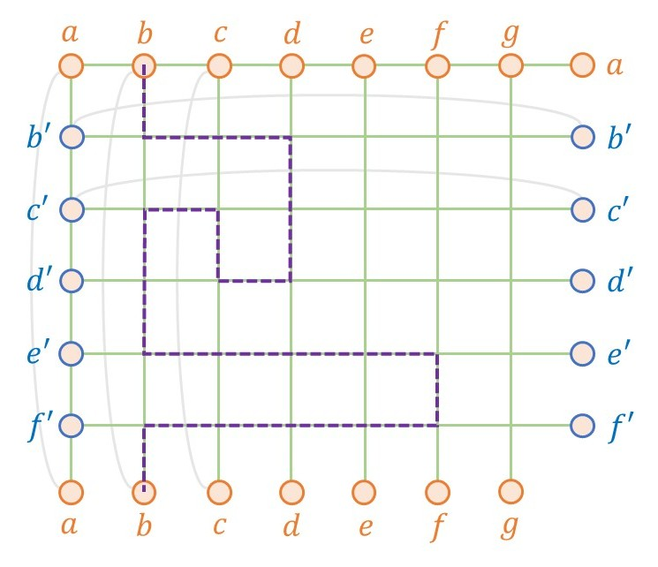
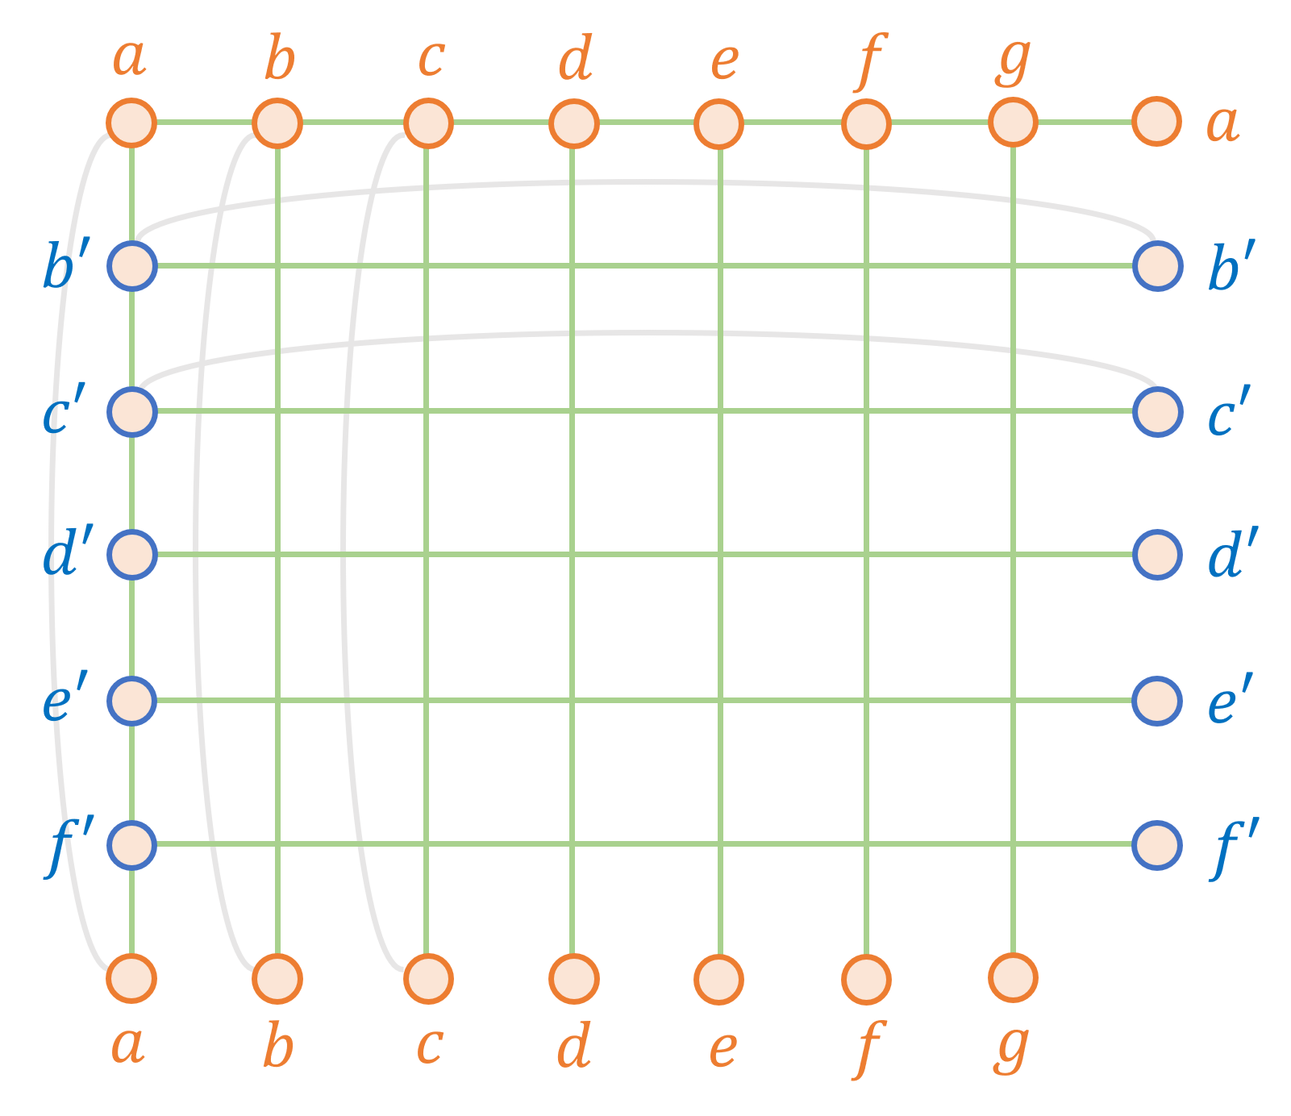
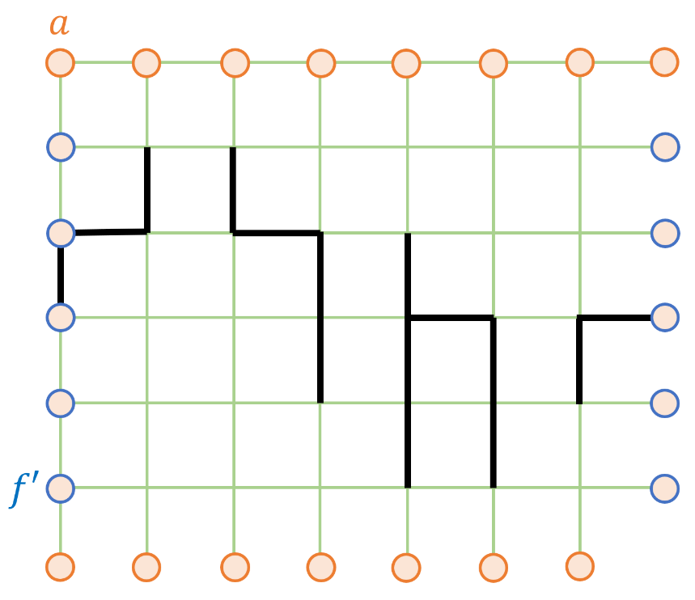
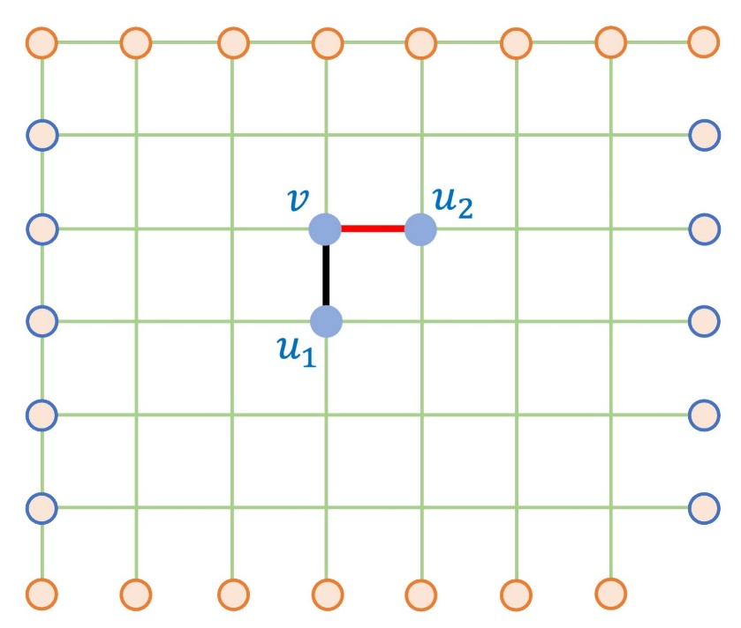
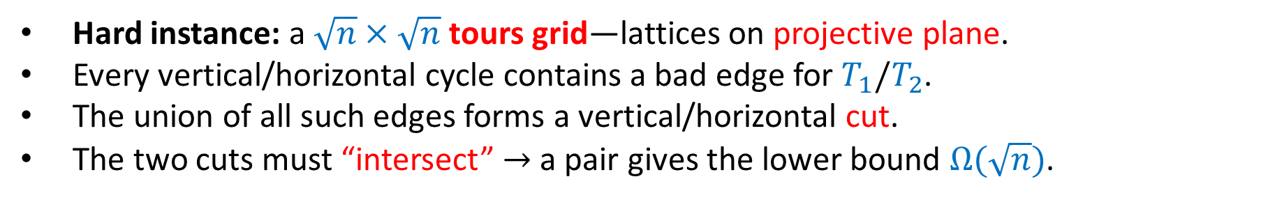

$k=2$: Tours Grid—Plant More Cycles
Hard instance: a $\sqrt{n}×\sqrt{n}$ tours grid—lattices on projective plane.
Every vertical/horizontal cycle contains a bad edge for $T_{1}/T_{2}$.
The union of all such edges forms a vertical/horizontal cut.
The two cuts must “intersect” $→$ a pair gives the lower bound $Ω(\sqrt{n})$.
Topology forces nontrivial walls in each dimension, the walls must intersect, and the intersection provides the desired pair.

Slide 11
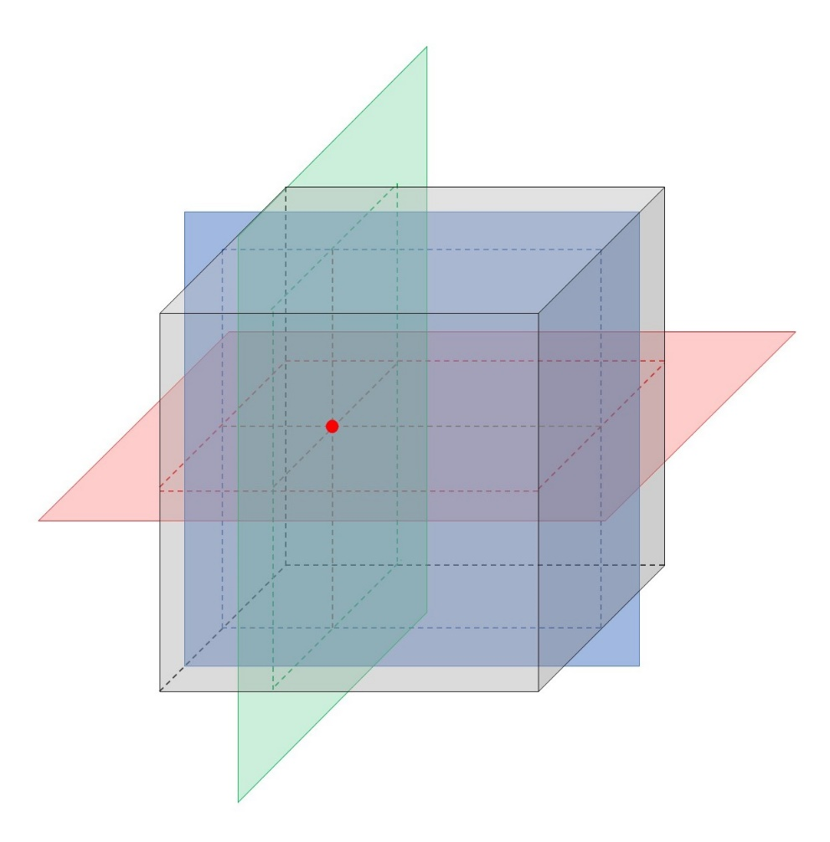
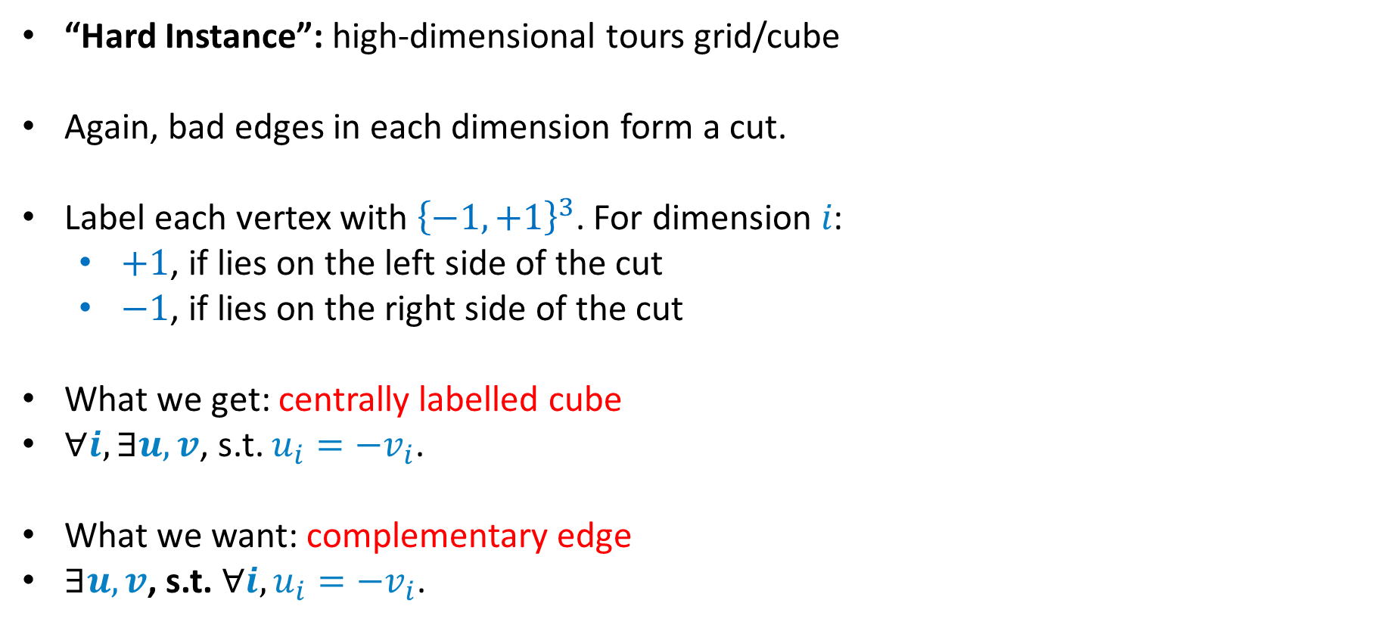

$k≥3$: Naive Intersection Fails
“Hard Instance”: high-dimensional tours grid/cube
Again, bad edges in each dimension form a cut.
Label each vertex with ${\left\{−1,+1\right\}}^{3}$. For dimension 𝑖:
$+1$, if lies on the left side of the cut
$−1$, if lies on the right side of the cut
What we get: centrally labelled cube
$∀i, ∃u,v$, s.t. $u_{i}=−v_{i}$.
What we want: complementary edge
$∃u,v$, s.t. $∀i, u_{i}=−v_{i}$.

Slide 12
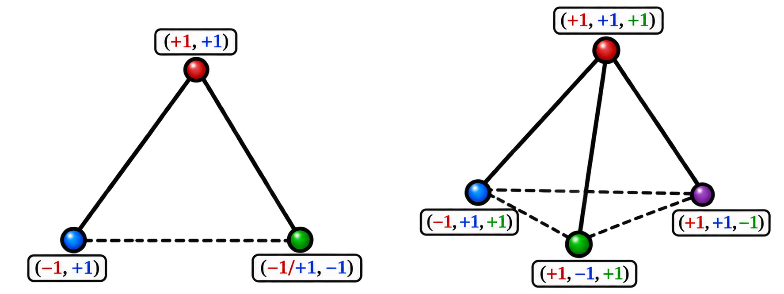

$k≥3$: Naive Intersection Fails
Centrally Labeled Cube ≠ Complementary Edges, for $k≥3$.
We still have an intersection of all dimensional cuts, but this intersection is not enough to provide the desired pair.
Need new topological forcing!

Slide 13

Topological Forcing for Larger $k$
Based on [Chen, Tan, Xu ’26]

Slide 14
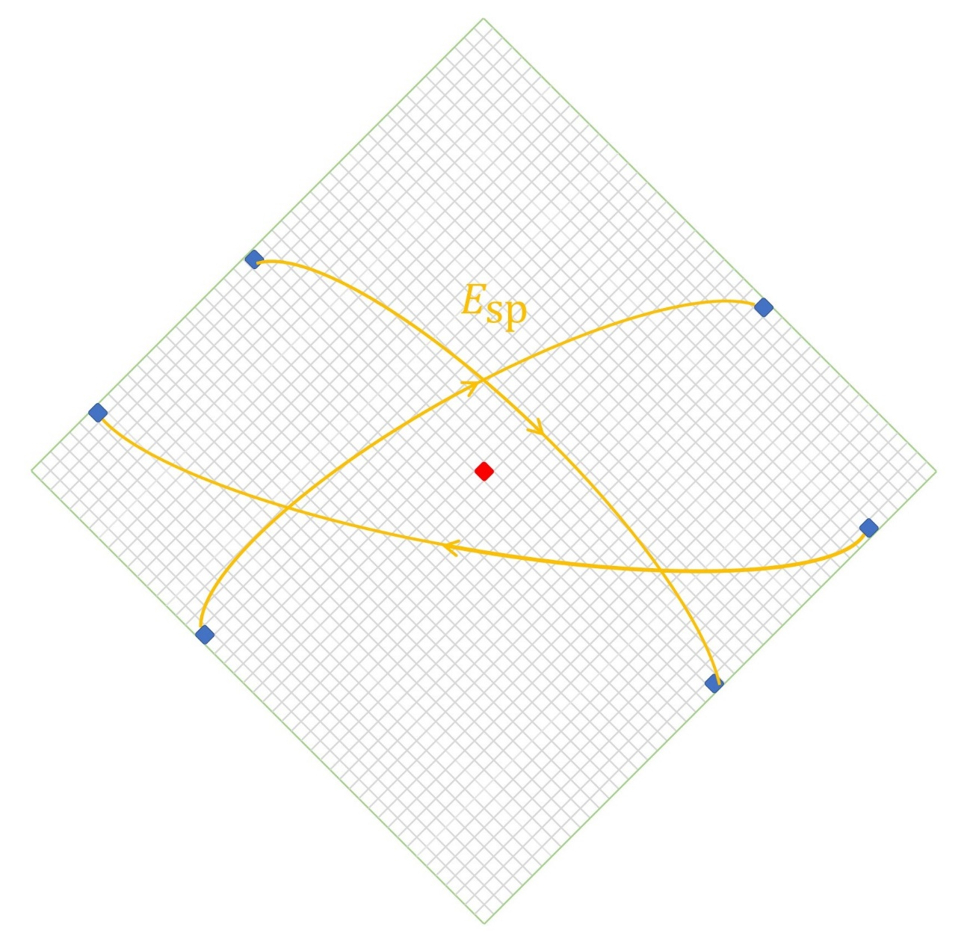
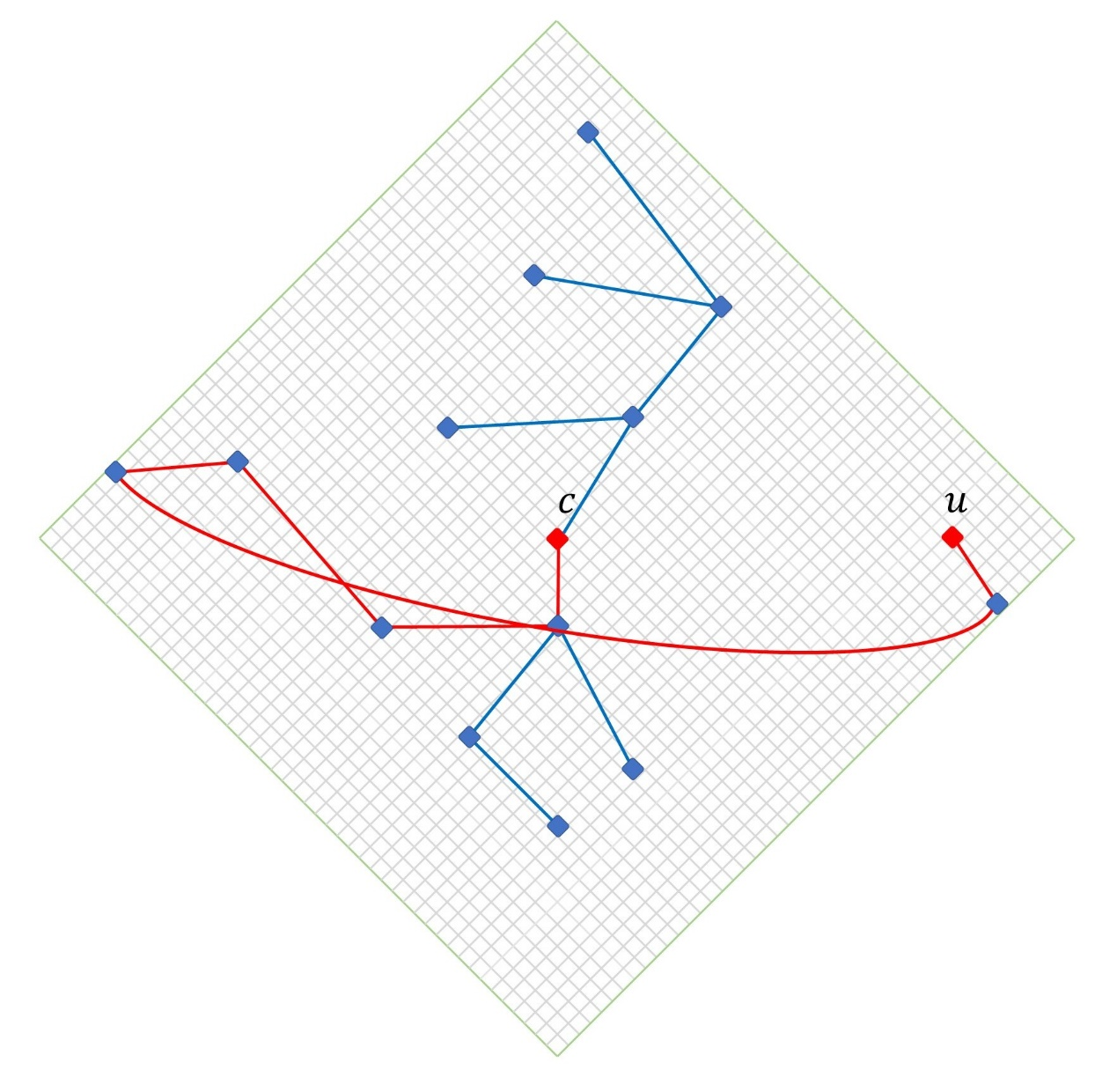
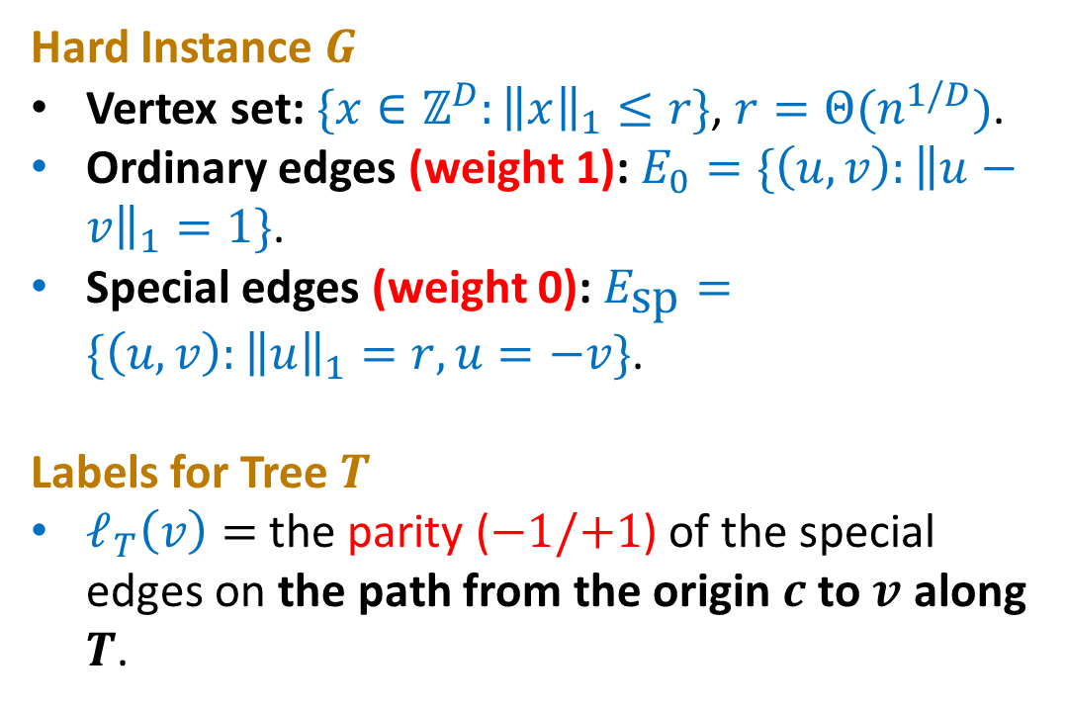

Hard Instances and Labels
Hard Instance $G$
Vertex set: $\{x∈ℤ^{D}:{\left\|x\right\|}_{1}≤r\}$, $r=Θ(n^{1/D})$.
Ordinary edges (weight 1): $E_{0}=\{\left(u,v\right):{\left\|u−v\right\|}_{1}=1\}$.
Special edges (weight 0): $E_{\text{sp}}=\{\left(u,v\right):{\left\|u\right\|}_{1}=r,u=−v\}$.
Labels for Tree $T$
$ℓ_{T}\left(v\right)=$ the parity ($−1/+1$) of the special edges on the path from the origin $c$ to $v$ along $T$.
$$ℓ_{T}\left(u\right)=+1$$

Slide 15


Nearby Vertices Have Different Labels
$$d_{G}\left(u,v\right)=O(1)$$
c
−1
v
−1
−1
no special edge → label −1
u
+1
−1
bad edge
+1
−1
+1
−1
+1
−1
+1
−1
+1
−1
cross one special edge → label +1
+1
+1
−1
special edge
$T$-path length $=Ω(r)$

Slide 16
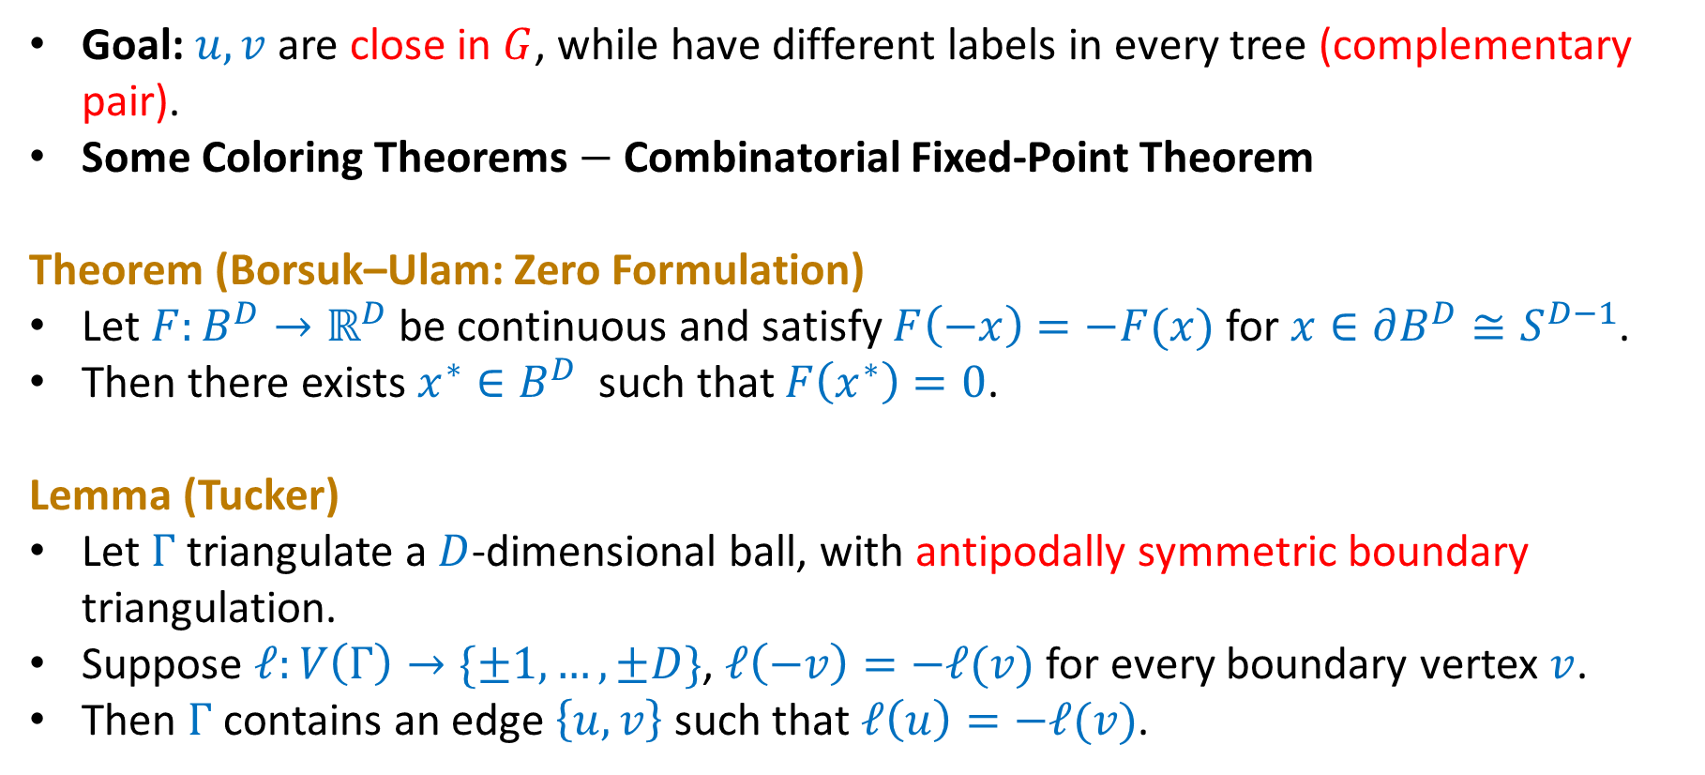
Borsuk–Ulam Theorem and Tucker’s Lemma
Goal: $u,v$ are close in $G$, while have different labels in every tree (complementary pair).
Some Coloring Theorems $−$ Combinatorial Fixed-Point Theorem
Theorem (Borsuk–Ulam: Zero Formulation)
Let $F:B^{D}→ℝ^{D}$ be continuous and satisfy $F\left(−x\right)=−F(x)$ for $x∈∂B^{D}≅S^{D−1}$.
Then there exists $x^{∗}∈B^{D}$ such that $F\left(x^{∗}\right)=0$.
Lemma (Tucker)
Let $Γ$ triangulate a $D$-dimensional ball, with antipodally symmetric boundary triangulation.
Suppose $ℓ:V\left(Γ\right)→\{±1,…,±D\}$, $ℓ\left(−v\right)=−ℓ(v)$ for every boundary vertex $v$.
Then $Γ$ contains an edge $\left\{u, v\right\}$ such that $ℓ\left(u\right)=−ℓ(v)$.

Slide 17
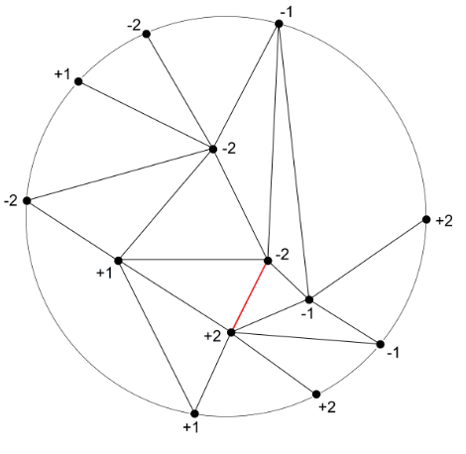
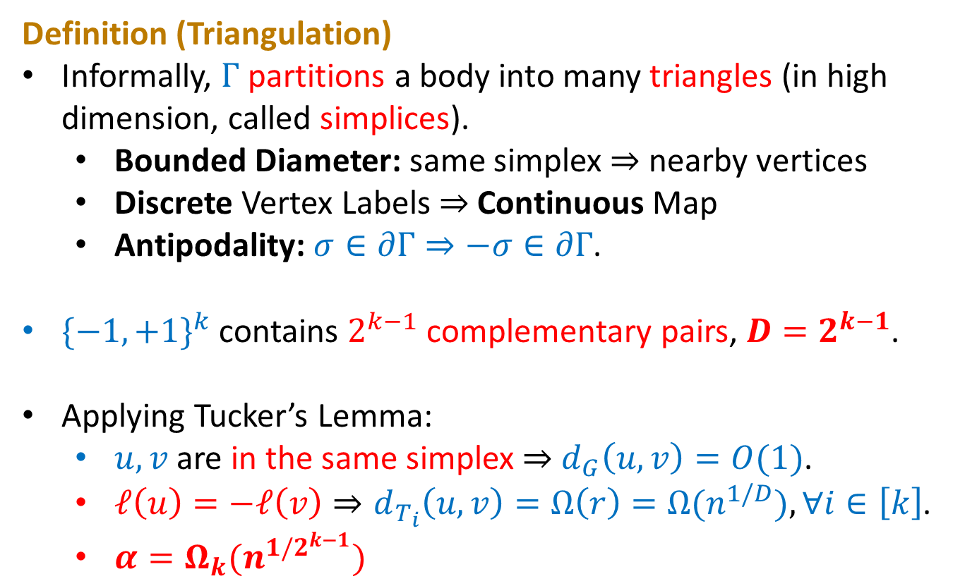
Dimension Becomes the Exponent
Definition (Triangulation)
Informally, $Γ$ partitions a body into many triangles (in high dimension, called simplices).
Bounded Diameter: same simplex$⇒$ nearby vertices
Discrete Vertex Labels $⇒$ Continuous Map
Antipodality: $σ∈∂Γ⇒−σ∈∂Γ$.
${\{−1,+1\}}^{k}$ contains $2^{k−1}$ complementary pairs, $D=2^{k−1}$.
Applying Tucker’s Lemma:
$u,v$ are in the same simplex $⇒$ $d_{G}\left(u,v\right)=O(1)$.
$ℓ\left(u\right)=−ℓ\left(v\right)⇒d_{T_{i}}\left(u,v\right)=Ω\left(r\right)=Ω(n^{1/D}),∀i∈\left[k\right]$.
$α=Ω_{k}(n^{{1/2}^{k−1}})$
An example of Tucker’s Lemma on Wikipedia

Slide 18
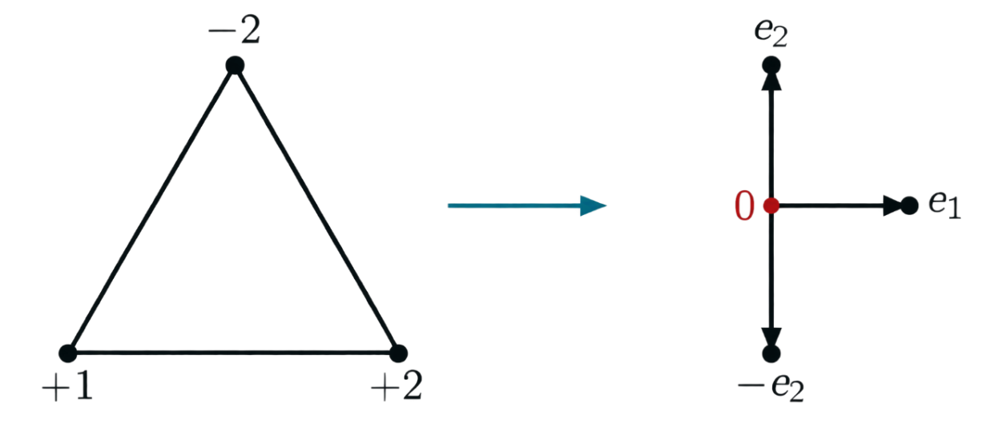
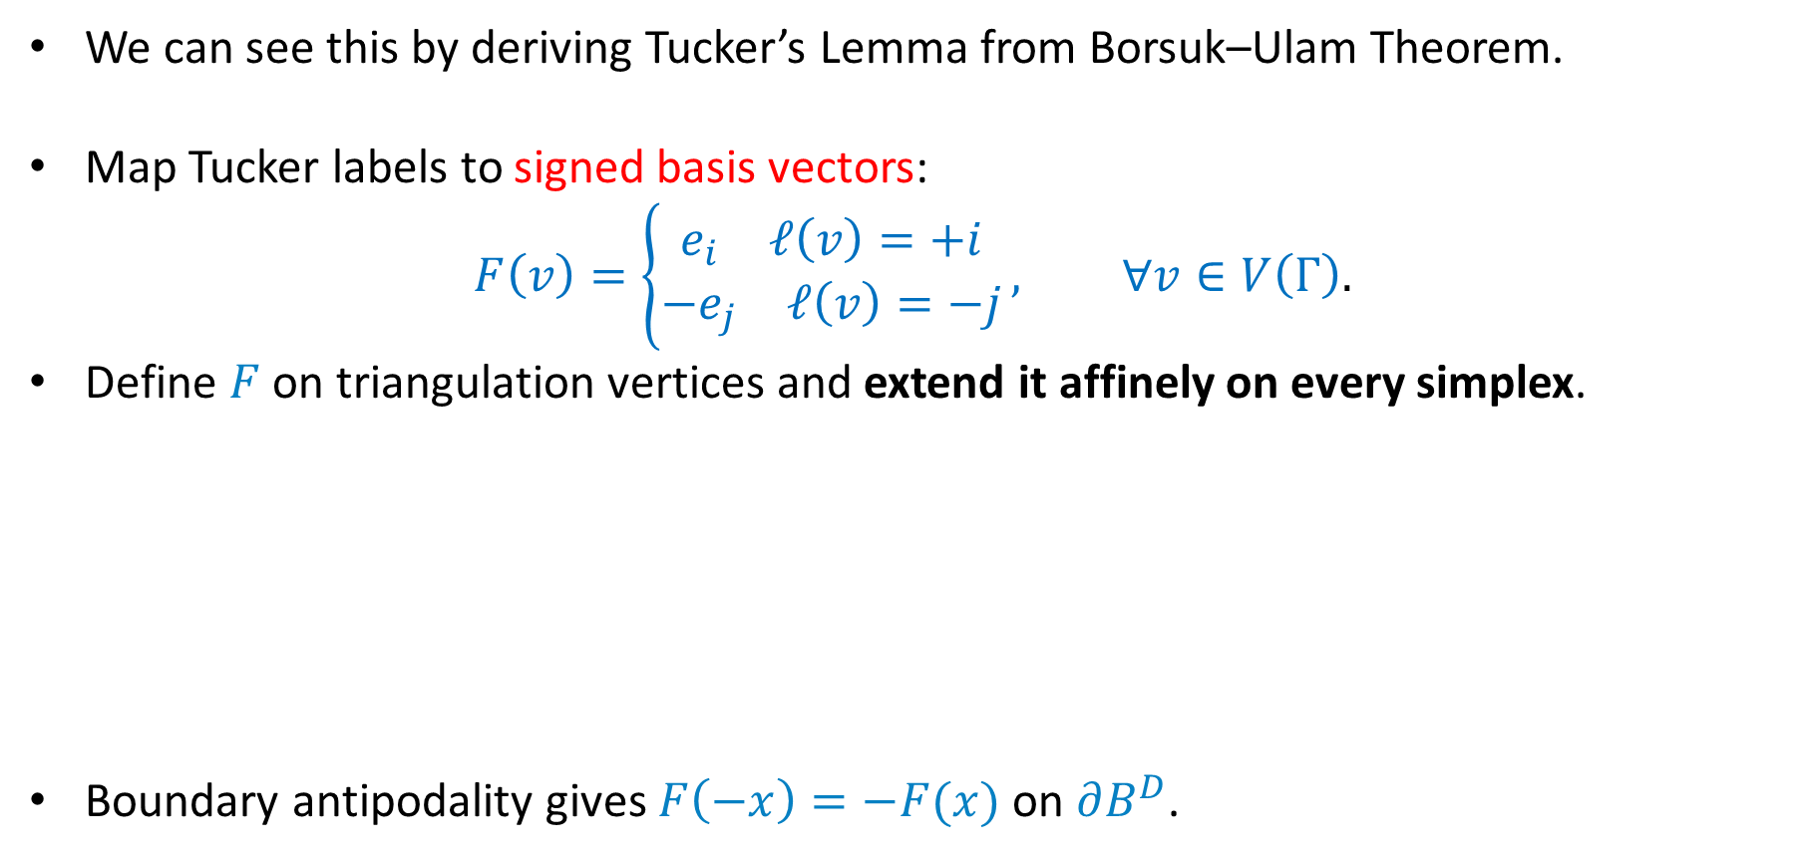

Why Is $2^{k−1}$ Unavoidable?
We can see this by deriving Tucker’s Lemma from Borsuk–Ulam Theorem.
Map Tucker labels to signed basis vectors:
$$F\left(v\right)=\left\{\begin{aligned}\begin{matrix}e_{i} & ℓ\left(v\right)=+i\end{matrix} \\ \begin{matrix}−e_{j} & ℓ\left(v\right)=−j\end{matrix}\end{aligned}\right., ∀v∈V\left(Γ\right).$$
Define $F$ on triangulation vertices and extend it affinely on every simplex.
Boundary antipodality gives $F\left(−x\right)=−F(x)$ on $∂B^{D}$.

Slide 19
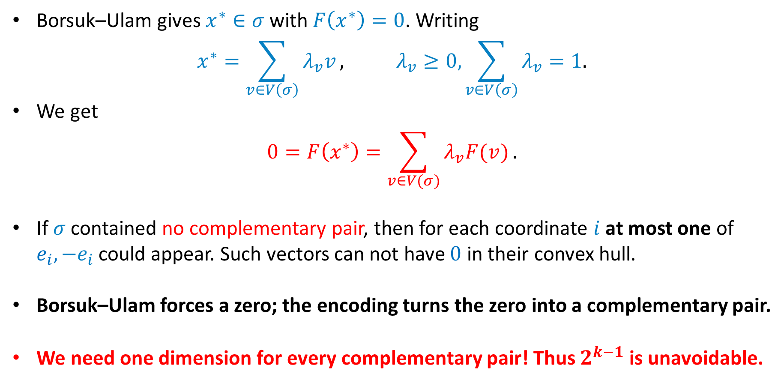
Why Is $2^{k−1}$ Unavoidable?
Borsuk–Ulam gives $x^{∗}∈σ$ with $F\left(x^{∗}\right)=0$. Writing
$$x^{∗}=\sum_{v∈V\left(σ\right)}{λ_{v}v}, λ_{v}≥0, \sum_{v∈V\left(σ\right)}{λ_{v}}=1.$$
We get
$$0=F\left(x^{∗}\right)=\sum_{v∈V(σ)}{λ_{v}F(v)}.$$
If $σ$ contained no complementary pair, then for each coordinate $i$ at most one of $e_{i}, −e_{i}$ could appear. Such vectors can not have $0$ in their convex hull.
Borsuk–Ulam forces a zero; the encoding turns the zero into a complementary pair.
We need one dimension for every complementary pair! Thus $2^{k−1}$ is unavoidable.
Can we do more cleverly? Apply the topological forcing while using fewer dimension.

Slide 20
From Antipodal Symmetry to Cyclic Symmetry
Our Approach [Huang ’26]

Slide 21


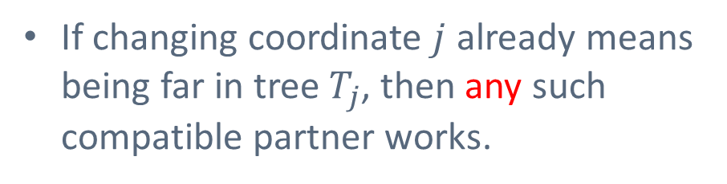

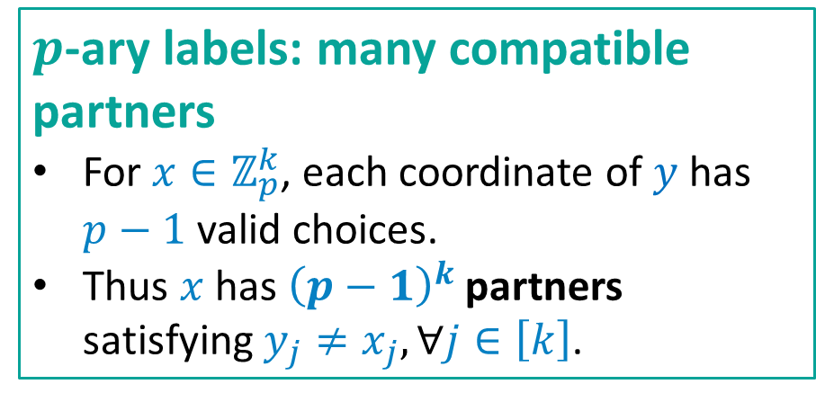
Binary Labels vs $p$-ary Labels
Binary labels: a prescribed partner
For $x∈{\{−1,+1\}}^{k}$, the only label differing from $x$ in every coordinate is $−x$.
Thus the good-pair relation is a perfect matching with $2^{k−1}$antipodal pair types.
$p$-ary labels: many compatible partners
For $x∈ℤ_{p}^{k}$, each coordinate of $y$ has $p−1$ valid choices.
Thus $x$ has ${\left(p−1\right)}^{k}$ partners satisfying $y_{j}≠x_{j}, ∀j∈\left[k\right]$.
Relaxation: any all-coordinate-different partner is enough, so lower-dimensional forcing may be possible.
If changing coordinate $j$ already means being far in tree $T_{j}$, then any such compatible partner works.
A direct Tucker encoding has to distinguish these $2^{k−1}$ pair types.

Slide 22
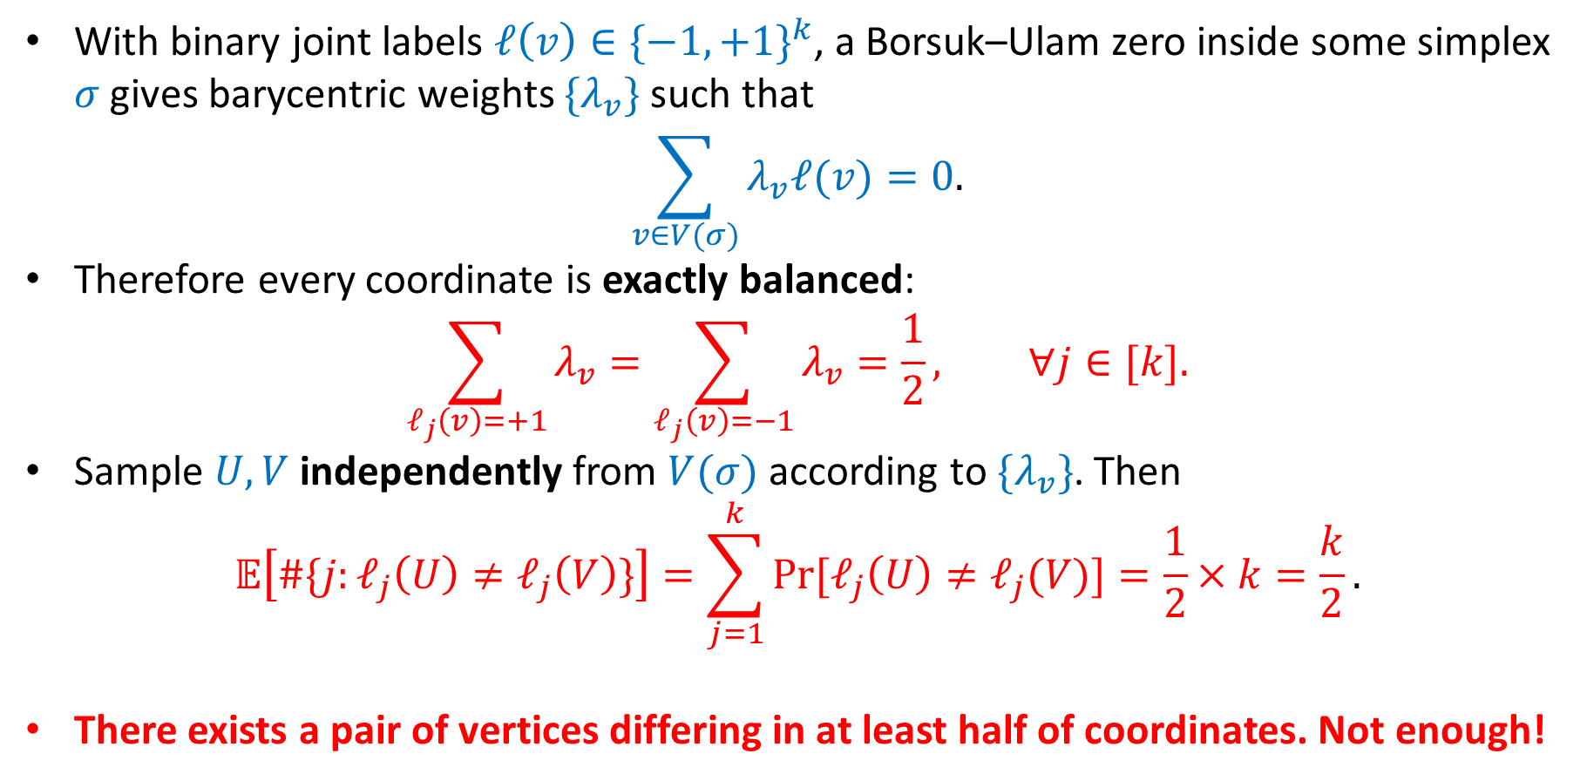
A Balanced View of Borsuk–Ulam
With binary joint labels $ℓ\left(v\right){∈\{−1,+1\}}^{k}$, a Borsuk–Ulam zero inside some simplex $σ$ gives barycentric weights $\{λ_{v}\}$ such that
$$\sum_{v∈V(σ)}{λ_{v}ℓ(v)}=0.$$
Therefore every coordinate is exactly balanced:
$$\sum_{ℓ_{j}\left(v\right)=+1}{λ_{v}}=\sum_{ℓ_{j}\left(v\right)=−1}{λ_{v}}=\frac{1}{2}, ∀j∈[k].$$
Sample $U,V$ independently from $V(σ)$ according to $\{λ_{v}\}$. Then
$$𝔼\left[\#\{j:ℓ_{j}\left(U\right)≠ℓ_{j}\left(V\right)\}\right]=\sum_{j=1}^{k}{\operatorname{Pr}{[ℓ_{j}\left(U\right)≠ℓ_{j}(V)]}}=\frac{1}{2}×k=\frac{k}{2}.$$
There exists a pair of vertices differing in at least half of coordinates. Not enough!

Slide 23
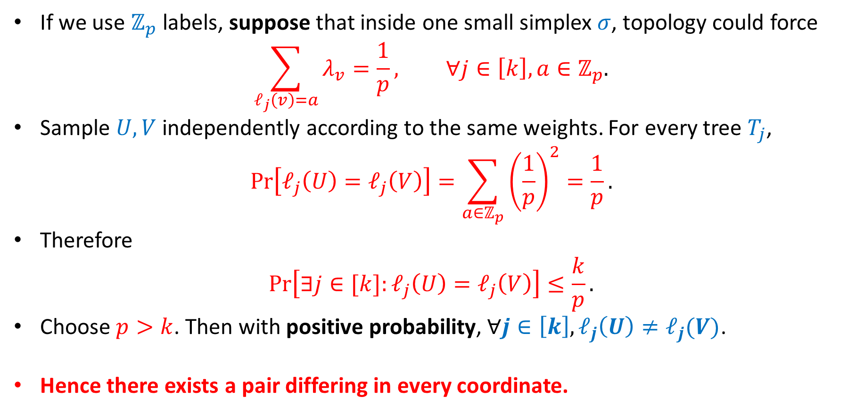
A Balanced View of Borsuk–Ulam
If we use $ℤ_{p}$ labels, suppose that inside one small simplex $σ$, topology could force
$$\sum_{ℓ_{j}\left(v\right)=a}{λ_{v}}=\frac{1}{p}, ∀j∈\left[k\right],a∈ℤ_{p}.$$
Sample $U,V$ independently according to the same weights. For every tree $T_{j}$,
$$\operatorname{Pr}\left[ℓ_{j}\left(U\right)=ℓ_{j}\left(V\right)\right]=\sum_{a∈ℤ_{p}}{{\left(\frac{1}{p}\right)}^{2}}=\frac{1}{p}.$$
Therefore
$$\operatorname{Pr}\left[∃j∈[k]:ℓ_{j}\left(U\right)=ℓ_{j}\left(V\right)\right]≤\frac{k}{p}.$$
Choose $p>k$. Then with positive probability, $∀j∈\left[k\right], ℓ_{j}\left(U\right)≠ℓ_{j}(V)$.
Hence there exists a pair differing in every coordinate.

Slide 24
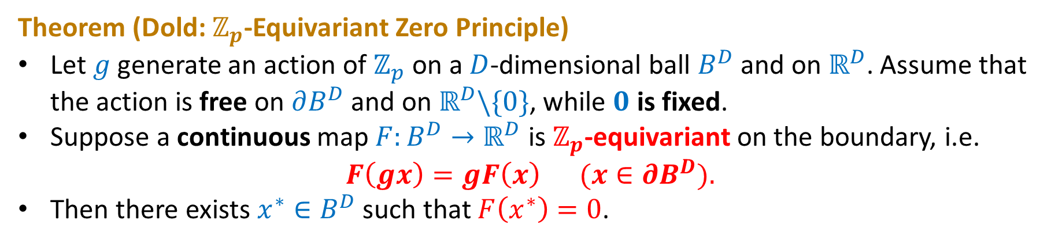

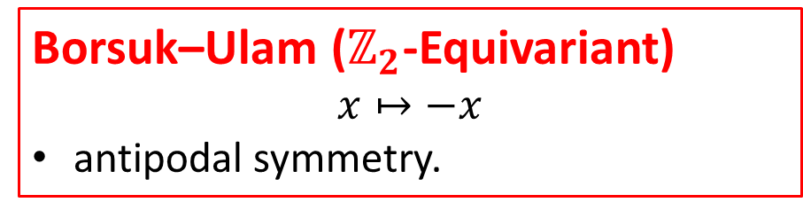
Dold’s Theorem: $ℤ_{p}$-Equivariant Borsuk–Ulam Theorem
Theorem (Dold: $ℤ_{p}$-Equivariant Zero Principle)
Let $g$ generate an action of $ℤ_{p}$ on a $D$-dimensional ball $B^{D}$ and on $ℝ^{D}$. Assume that the action is free on $∂B^{D}$ and on $ℝ^{D}\backslash \{0\}$, while $0$ is fixed.
Suppose a continuous map $F:B^{D}→ℝ^{D}$ is $ℤ_{p}$-equivariant on the boundary, i.e.
$$F\left(gx\right)=gF\left(x\right) (x∈∂B^{D}).$$
Then there exists $x^{∗}∈B^{D}$ such that $F\left(x^{∗}\right)=0$.
Borsuk–Ulam ($ℤ_{2}$-Equivariant)
$$x↦−x$$
antipodal symmetry.
Here
$$x↦gx, g^{p}=\text{id}$$
cyclic symmetry.

Slide 25
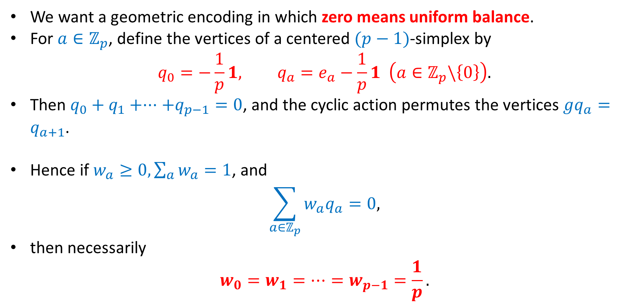
Encode One $ℤ_{p}$ Label by a Centered Simplex
We want a geometric encoding in which zero means uniform balance.
For $a∈ℤ_{p}$, define the vertices of a centered $(p−1)$-simplex by
$$q_{0}=−\frac{1}{p}1, q_{a}=e_{a}−\frac{1}{p}1 \left(a∈ℤ_{p}\backslash \left\{0\right\}\right).$$
Then $q_{0}+q_{1}+···+q_{p−1}=0$, and the cyclic action permutes the vertices $gq_{a}=q_{a+1}$.
Hence if $w_{a}≥0,\sum_{a}{w_{a}}=1$, and
$$\sum_{a∈ℤ_{p}}{w_{a}q_{a}}=0,$$
then necessarily
$$w_{0}=w_{1}=…=w_{p−1}=\frac{1}{p}.$$

Slide 26
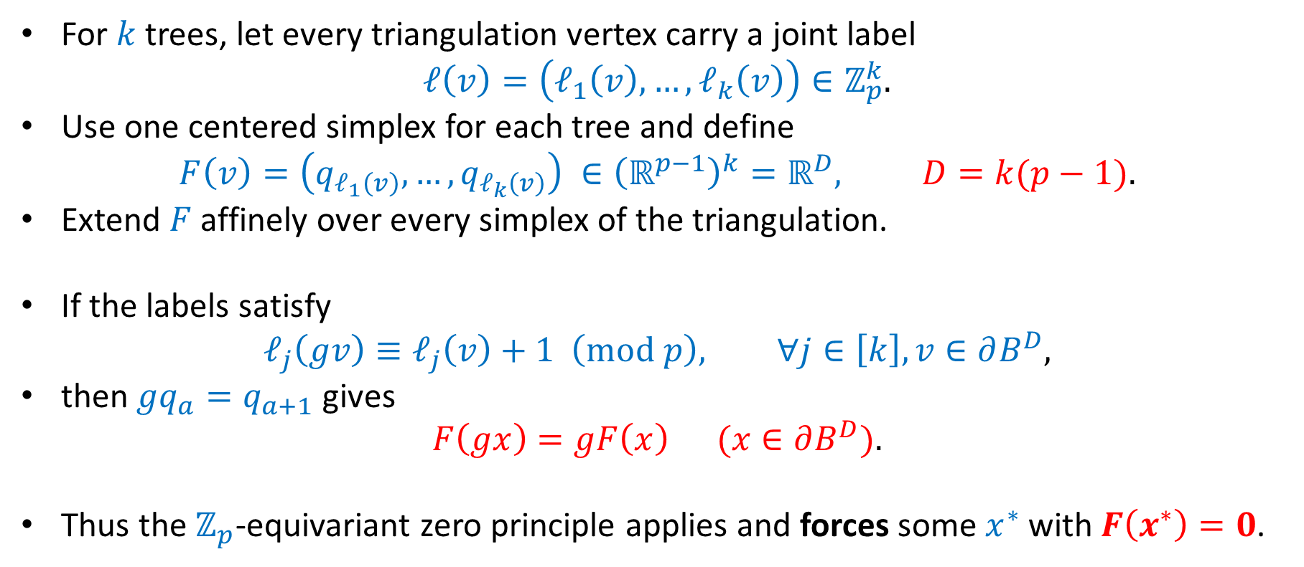
From $p$-ary Labels to an Equivariant Map
For $k$ trees, let every triangulation vertex carry a joint label
$$ℓ\left(v\right)=\left(ℓ_{1}\left(v\right),…,ℓ_{k}\left(v\right)\right)∈ℤ_{p}^{k}.$$
Use one centered simplex for each tree and define
$$F\left(v\right)=\left(q_{ℓ_{1}\left(v\right)},…,q_{ℓ_{k}\left(v\right)}\right) ∈{\left(ℝ^{p−1}\right)}^{k}=ℝ^{D}, D=k(p−1).$$
Extend $F$ affinely over every simplex of the triangulation.
If the labels satisfy
$$ℓ_{j}\left(gv\right)≡ℓ_{j}\left(v\right)+1 \left(\text{mod} p\right), ∀j∈\left[k\right],v∈∂B^{D},$$
then $gq_{a}=q_{a+1}$ gives
$$F\left(gx\right)=gF\left(x\right) (x∈∂B^{D}).$$
Thus the $ℤ_{p}$-equivariant zero principle applies and forces some $x^{∗}$ with $F\left(x^{∗}\right)=0$.

Slide 27
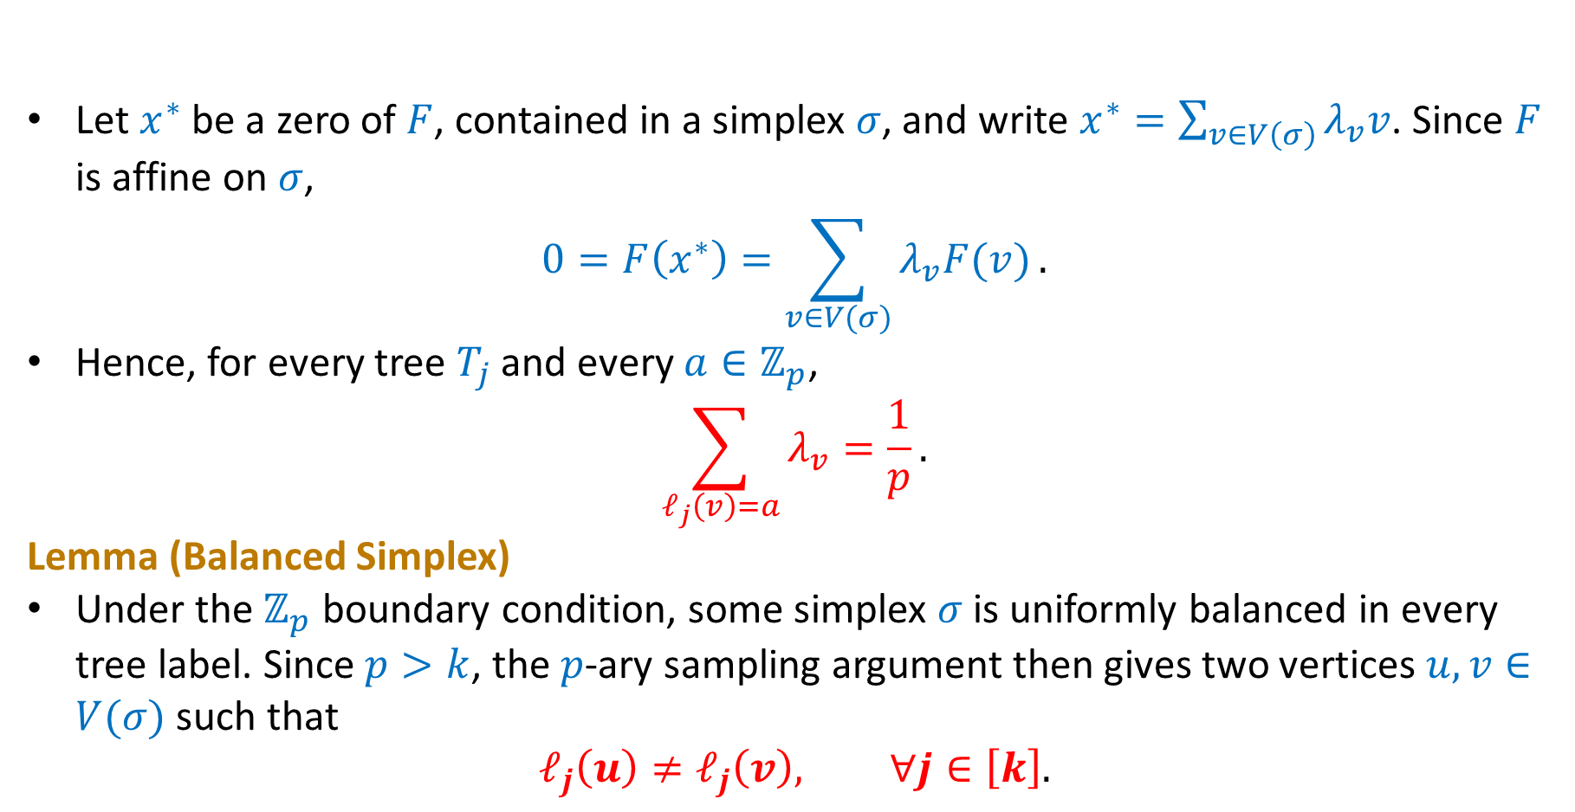
New Topological Forcing: Balanced Simplex
Let $x^{∗}$ be a zero of $F$, contained in a simplex $σ$, and write $x^{∗}=\sum_{v∈V\left(σ\right)}{λ_{v}v}$. Since $F$ is affine on $σ$,
$$0=F\left(x^{∗}\right)=\sum_{v∈V(σ)}{λ_{v}F(v)}.$$
Hence, for every tree $T_{j}$ and every $a∈ℤ_{p}$,
$$\sum_{ℓ_{j}\left(v\right)=a}{λ_{v}}=\frac{1}{p}.$$
Lemma (Balanced Simplex)
Under the $ℤ_{p}$ boundary condition, some simplex $σ$ is uniformly balanced in every tree label. Since $p>k$, the $p$-ary sampling argument then gives two vertices $u,v∈V(σ)$ such that
$$ℓ_{j}\left(u\right)≠ℓ_{j}\left(v\right), ∀j∈\left[k\right].$$

Slide 28
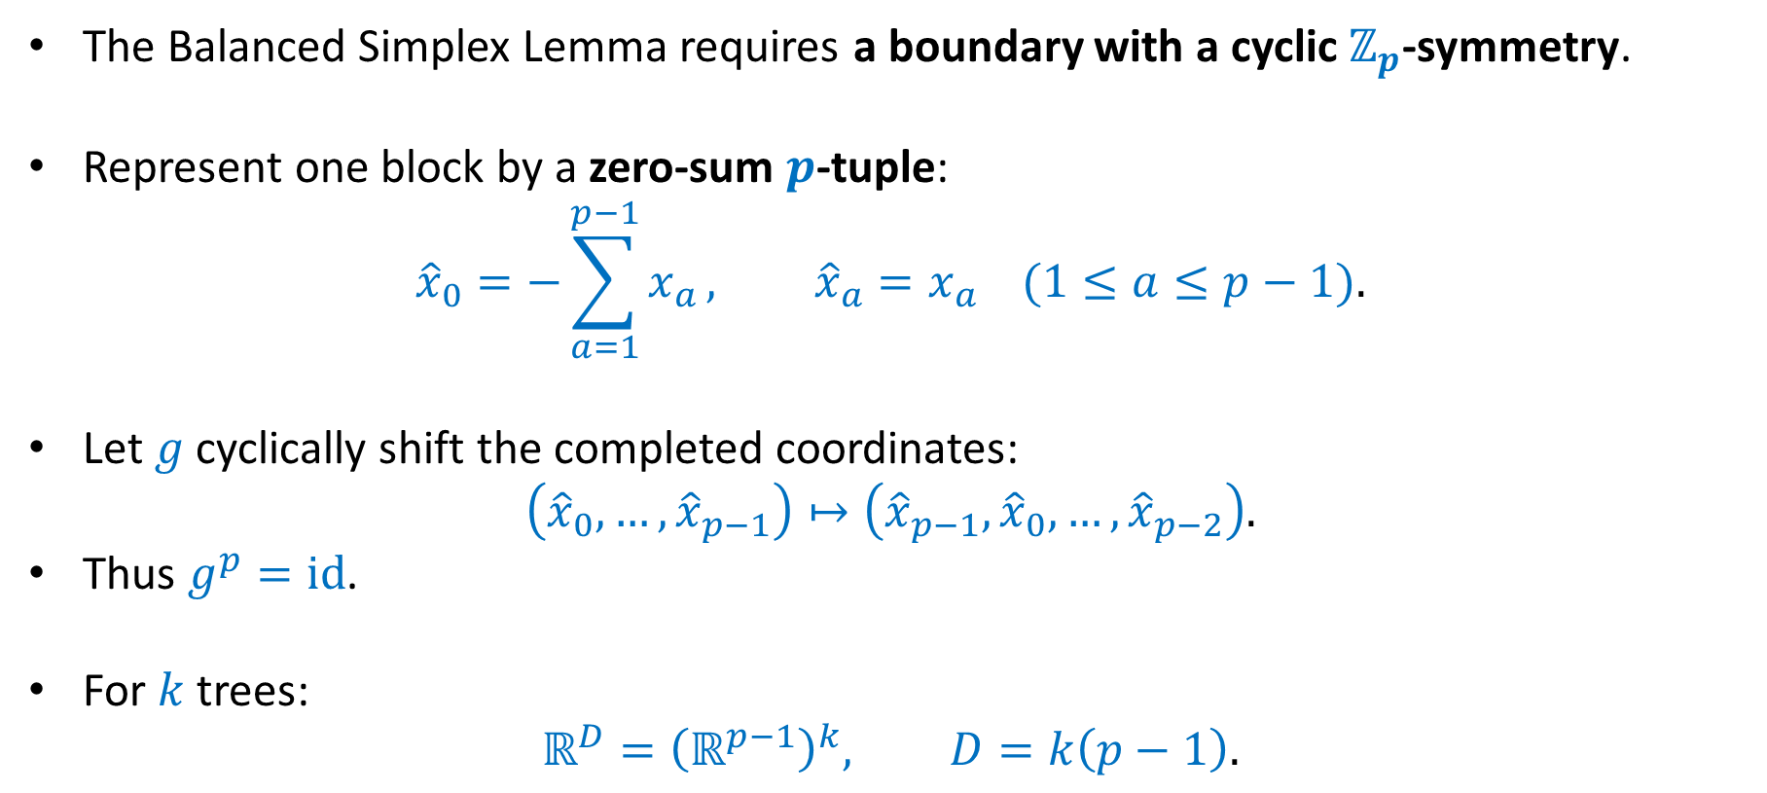
Building a Cyclic Geometry
The Balanced Simplex Lemma requires a boundary with a cyclic $ℤ_{p}$-symmetry.
Represent one block by a zero-sum $p$-tuple:
$${\hat{x}}_{0}=−\sum_{a=1}^{p−1}{x_{a}}, {\hat{x}}_{a}=x_{a} (1≤a≤p−1).$$
Let $g$ cyclically shift the completed coordinates:
$$\left({\hat{x}}_{0},…,{\hat{x}}_{p−1}\right)↦\left({\hat{x}}_{p−1},{\hat{x}}_{0},…,{\hat{x}}_{p−2}\right).$$
Thus $g^{p}=\text{id}$.
For $k$ trees:
$$ℝ^{D}={\left(ℝ^{p−1}\right)}^{k}, D=k\left(p−1\right).$$

Slide 29
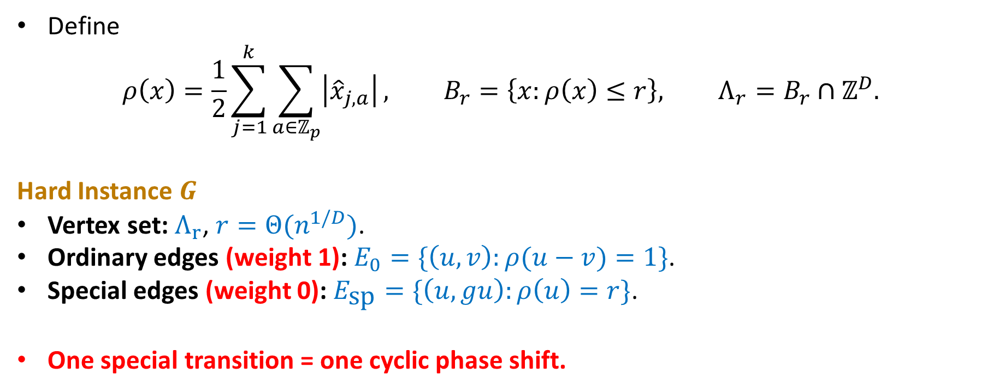
Hard Instance: Cyclic Boundary Quotient
Define
$$ρ\left(x\right)=\frac{1}{2}\sum_{j=1}^{k}{\sum_{a∈ℤ_{p}}{\left|{\hat{x}}_{j,a}\right|}}, B_{r}=\left\{x:ρ\left(x\right)≤r\right\}, Λ_{r}=B_{r}∩ℤ^{D}.$$
Hard Instance $G$
Vertex set: $Λ_{r}$, $r=Θ(n^{1/D})$.
Ordinary edges (weight 1): $E_{0}=\{\left(u,v\right):ρ(u−v)=1\}$.
Special edges (weight 0): $E_{\text{sp}}=\{\left(u,gu\right):ρ\left(u\right)=r\}$.
One special transition = one cyclic phase shift.

Slide 30
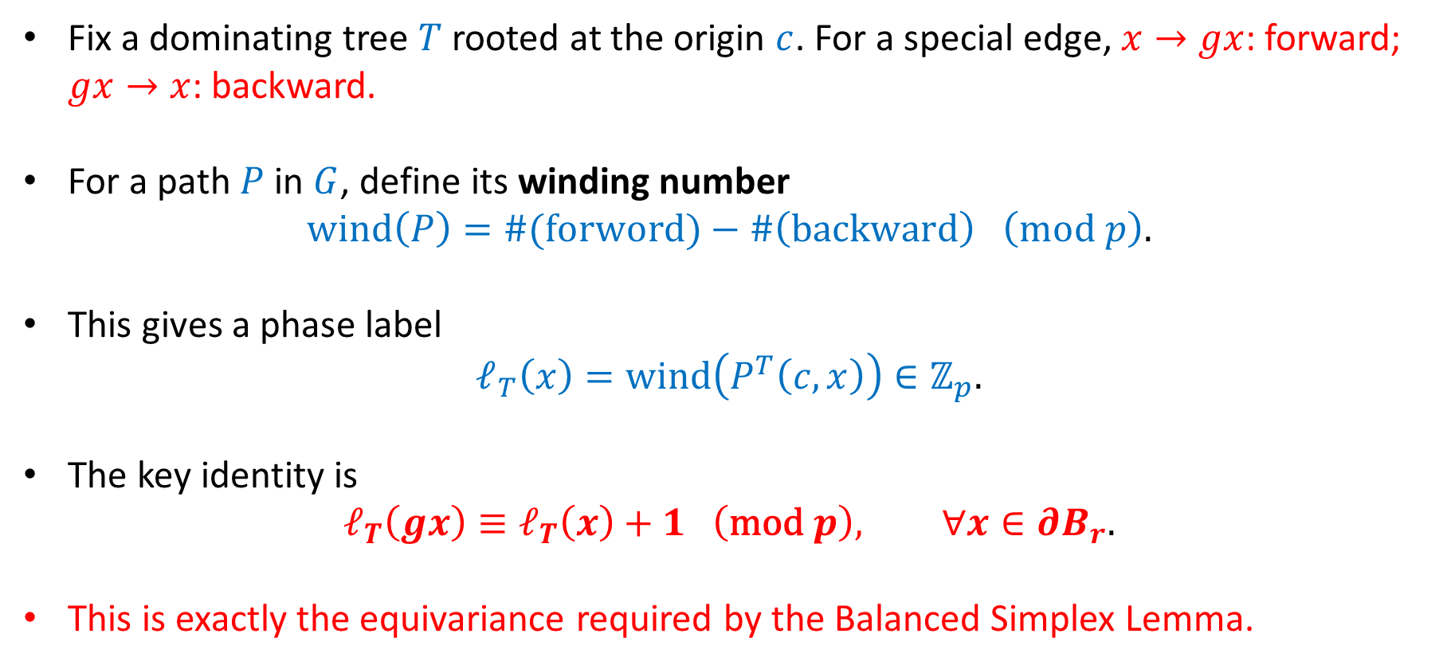
Each Tree Induces a Cyclic Winding Label
Fix a dominating tree $T$ rooted at the origin $c$. For a special edge, $x→gx$: forward; $gx→x$: backward.
For a path $P$ in $G$, define its winding number
$$\text{wind}\left(P\right)=\#(\text{forword})−\#\left(\text{backward}\right) \left(\text{mod} p\right).$$
This gives a phase label
$$ℓ_{T}\left(x\right)=\text{wind}\left(P^{T}\left(c,x\right)\right)∈ℤ_{p}.$$
The key identity is
$$ℓ_{T}\left(gx\right)≡ℓ_{T}\left(x\right)+1 \left(\text{mod} p\right), ∀x∈∂B_{r}.$$
This is exactly the equivariance required by the Balanced Simplex Lemma.

Slide 31
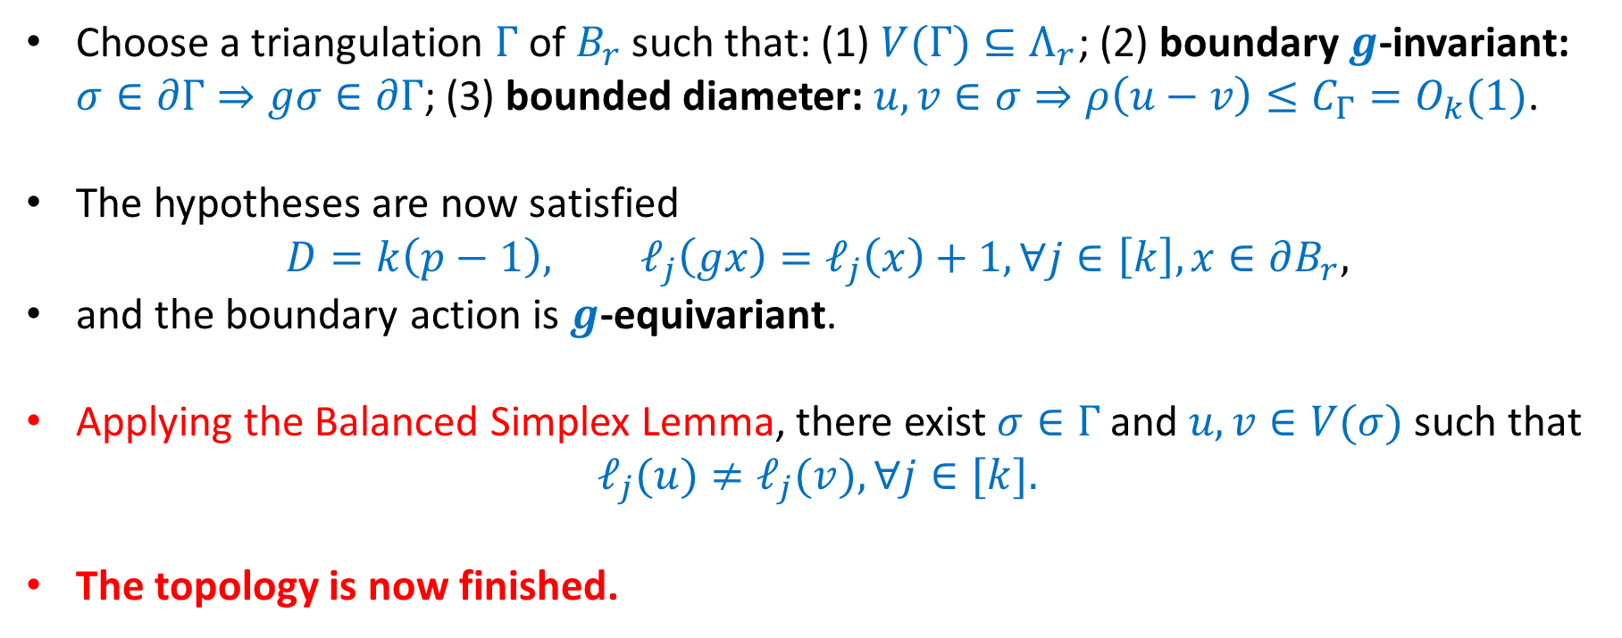
Apply the Balanced Simplex Lemma
Choose a triangulation $Γ$ of $B_{r}$ such that: (1) $V(Γ)⊆Λ_{r}$; (2) boundary $g$-invariant: $σ∈∂Γ⇒gσ∈∂Γ$; (3) bounded diameter: $u,v∈σ⇒ρ\left(u−v\right)≤C_{Γ}=O_{k}(1)$.
The hypotheses are now satisfied
$$D=k\left(p−1\right), ℓ_{j}\left(gx\right)=ℓ_{j}\left(x\right)+1,∀j∈\left[k\right],x∈∂B_{r},$$
and the boundary action is $g$-equivariant.
Applying the Balanced Simplex Lemma, there exist $σ∈Γ$ and $u,v∈V(σ)$ such that
$$ℓ_{j}(u)≠ℓ_{j}(v),∀j∈[k].$$
The topology is now finished.

Slide 32
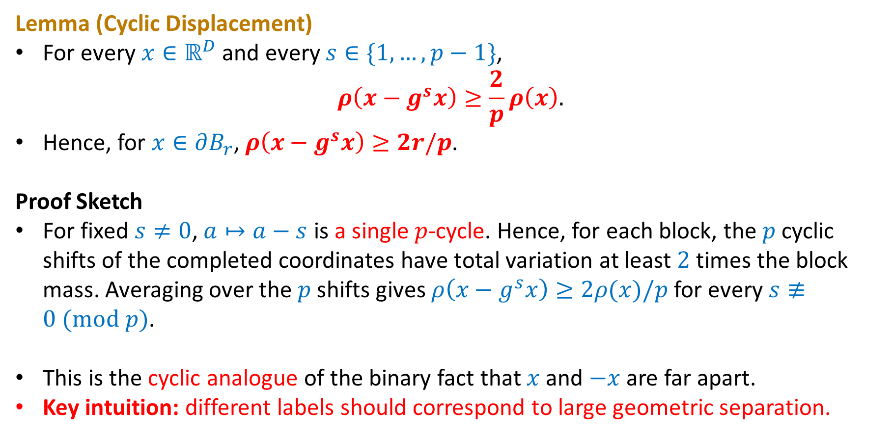
Orbit Points Are Far Apart
Lemma (Cyclic Displacement)
For every $x∈ℝ^{D}$ and every $s∈\{1,…,p−1\}$,
$$ρ\left(x−g^{s}x\right)≥\frac{2}{p}ρ\left(x\right).$$
Hence, for $x∈∂B_{r}$, $ρ\left(x−g^{s}x\right)≥2r/p$.
Proof Sketch
For fixed $s≠0$, $a↦a−s$ is a single $p$-cycle. Hence, for each block, the $p$ cyclic shifts of the completed coordinates have total variation at least $2$ times the block mass. Averaging over the $p$ shifts gives $ρ\left(x−g^{s}x\right)≥2ρ(x)/p$ for every $s≢0 (\text{mod} p)$.
This is the cyclic analogue of the binary fact that $x$ and $−x$ are far apart.
Key intuition: different labels should correspond to large geometric separation.

Slide 33



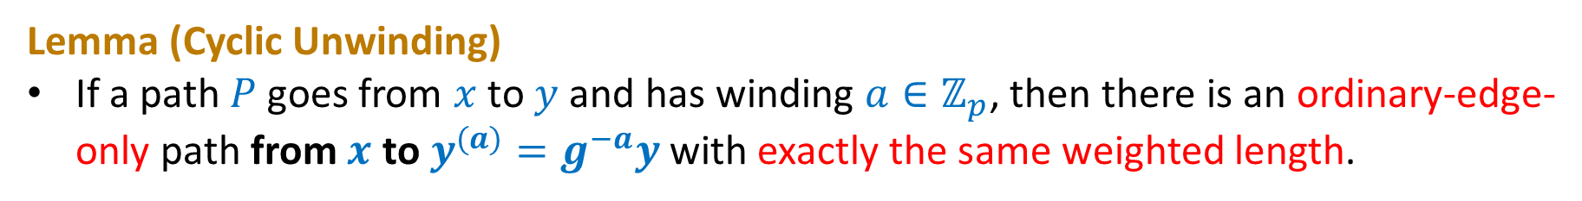





Cyclic Unwinding
Lemma (Cyclic Unwinding)
If a path $P$ goes from $x$ to $y$ and has winding $a∈ℤ_{p}$, then there is an ordinary-edge-only path from $x$ to $y^{(a)}=g^{−a}y$ with exactly the same weighted length.
$$x$$
$e_{1}$: 1st special edge
$$y$$
original lifted path
$e_{2}$: 2nd special edge
g⁻¹
$$\text{g}\text{−1}$$
$$y^{(1)}=g^{−1}y$$
⋮
$$y^{(2)}=g^{−2}y$$
$$y^{(a)}=g^{−a}y$$

Slide 34
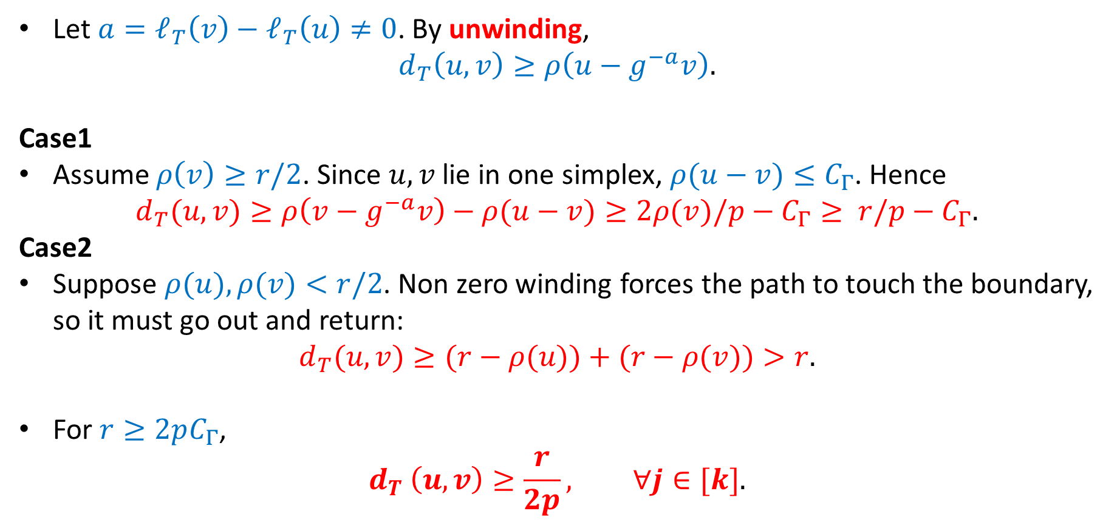

Different Phase $⇒$ Large Tree Distance
Let $a=ℓ_{T}\left(v\right)−ℓ_{T}\left(u\right)≠0$. By unwinding,
$$d_{T}\left(u,v\right)≥ρ\left(u−g^{−a}v\right).$$
Case1
Assume $ρ\left(v\right)≥r/2$. Since $u,v$ lie in one simplex, $ρ(u−v)≤C_{Γ}$. Hence
$$d_{T}(u,v)≥ρ\left(v−g^{−a}v\right)−ρ(u−v)≥2ρ(v)/p−C_{Γ}≥ r/p−C_{Γ}.$$
Case2
Suppose $ρ(u),ρ(v)<r/2$. Non zero winding forces the path to touch the boundary, so it must go out and return:
$$d_{T}(u,v)≥(r−ρ(u))+(r−ρ(v))>r.$$
For $r≥2pC_{Γ}$,
$$d_{T} \left(u,v\right)≥\frac{r}{2p}, ∀j∈[k].$$

Slide 35

Putting Everything Together
The Balanced Simplex Lemma gives $u,v$ in the same simplex with different labels in every tree.
Triangulation has bounded diameter, giving $d_{G}\left(u,v\right)≤C_{Γ}$.
For every $j∈[k]$, $d_{T_{j}}\left(u,v\right)≥r/(2p)$.
$$α≥\frac{r}{2pC_{Γ}}=Ω_{k}(r)$$
$$D=k(p−1), |V(G)|=Θ_{k}\left(r^{D}\right)$$
$$\text{Choose} r=Ω_{k}(n^{1/D}) \text{gives} α=Ω_{k}(n^{1/\left[k\left(p−1\right)\right]})$$

Slide 36

Summary
 | Chen–Tan–Xu | Ours
Per-Tree Label | $$ℤ_{2}$$ | $$ℤ_{p}$$
Desired Partner | Unique Antipode | Many Compatible Partners
Topological Output | Complementary Pair | Balanced Simplex
Extraction | Direct | Sampling + Union Bound
Dimension | $$2^{k−1}$$ | $$k\left(p−1\right)=O\left(k^{2}\right)$$
The key change is not the alphabet itself, but relaxing from finding a prescribed partner to exploiting $p$-ary compatibility through balance.

Slide 37

Open Problems
For general metric spaces: upper bound $=\tilde{O}(n^{1/k})$, lower bound $=Ω_{k}(n^{1/O(k^{2})})$.
For $k≥3$, obtaining tight (or nearly tight) bounds remains open.
Many questions remain open for special metric families, such as
Euclidean and doubling metrics [Chan ’98], [Bikeev, Kupavskii, Turevskii ’26], [Le, Milenković, Solomon, Zhang ’26] and [Chen, Tan, Xu ’26];
planar and minor-free graph metrics [Le, Pham, Than, Tran ’26].
How much can additional geometric or graph structure improve the size–distortion tradeoff?
We expect the stretch reduces to $O(1)$ at some point as the number of trees increasing.

Slide 38
Thank you for listening!
Thanks Hangyu Xu for introducing me to this problem, explaining their work [Chen, Tan, Xu ’26], and generously sharing his slides as material for preparing this talk.
Pictures in Page 2, 8, 10, 11 and 14 are taken from Hangyu’s slides.

