Slide 1
Verification and Validation

Slide 2
Verification and Validation
Assuring that a software system meets a user's needs

Slide 3
Objectives
To introduce software verification and validation and to discuss the distinction between them
To describe the program inspection process and its role in V & V
To explain static analysis as a verification technique
To describe the Cleanroom software development process

Slide 4
Topics covered
Verification and validation planning
Software inspections
Automated static analysis
Cleanroom software development

Slide 5
Verification vs validation
Verification:
"Are we building the product right"
The software should conform to its specification
Validation:
"Are we building the right product"
The software should do what the user really requires

Slide 6
The V & V process
Is a whole life-cycle process - V & V must be
applied at each stage in the software process.
Has two principal objectives
  The discovery of defects in a system
  The assessment of whether or not the system is usable in
  an operational situation.

Slide 7
Static and dynamic verification
Software inspections Concerned with analysis of
the static system representation to discover problems (static verification)
  May be supplement by tool-based document and code analysis
Software testing Concerned with exercising and
observing product behaviour (dynamic verification)
  The system is executed with test data and its operational behaviour is observed

Slide 8
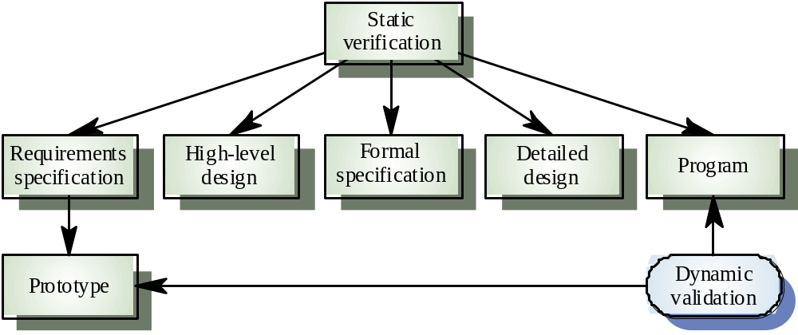
Static and dynamic V&V

Slide 9
Program testing
Can reveal the presence of errors NOT their
absence
A successful test is a test which discovers one
or more errors
The only validation technique for non-functional
requirements
Should be used in conjunction with static
verification to provide full V&V coverage

Slide 10
Types of testing
Defect testing
  Tests designed to discover system defects.
  A successful defect test is one which reveals the presence
  of defects in a system.
  Covered in Chapter 20
Statistical testing
  tests designed to reflect the frequence of user inputs. Used
  for reliability estimation.
  Covered in Chapter 21

Slide 11
V& V goals
Verification and validation should establish confidence that the software is fit for purpose
This does NOT mean completely free of defects
Rather, it must be good enough for its intended use and the type of use will determine the degree of confidence that is needed

Slide 12
V & V confidence
Depends on system’s purpose, user expectations and marketing environment
  Software function
    The level of confidence depends on how critical the software is to an organisation
  User expectations
    Users may have low expectations of certain kinds of software
  Marketing environment
    Getting a product to market early may be more important than finding defects in the program

Slide 13
Testing and debugging
Defect testing and debugging are distinct
processes
Verification and validation is concerned with establishing the existence of defects in a program
Debugging is concerned with locating and
repairing these errors
Debugging involves formulating a hypothesis
about program behaviour then testing these
hypotheses to find the system error

Slide 14
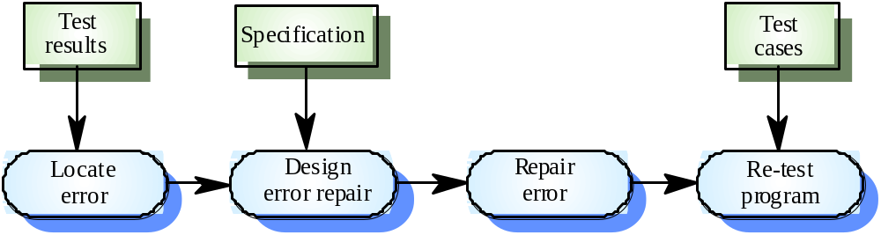
The debugging process

Slide 15
V & V planning
Careful planning is required to get the most out of testing and inspection processes
Planning should start early in the development process
The plan should identify the balance between static verification and testing
Test planning is about defining standards for the testing process rather than describing product tests

Slide 16
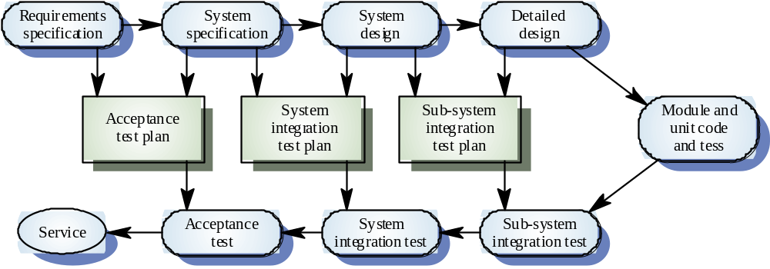
The V-model of development

Slide 17
The structure of a software test plan
The testing process
Requirements traceability
Tested items
Testing schedule
Test recording procedures
Hardware and software requirements
Constraints

Slide 18
Software inspections
Involve people examining the source representation with the aim of discovering anomalies and defects
Do not require execution of a system so may be used before implementation
May be applied to any representation of the system (requirements, design, test data, etc.)
Very effective technique for discovering errors

Slide 19
Inspection success
Many diffreent defects may be discovered in a single inspection. In testing, one defect ,may mask another so several executions are required
The reuse domain and programming knowledge so reviewers are likely to have seen the types of error that commonly arise

Slide 20
Inspections and testing
Inspections and testing are complementary and not opposing verification techniques
Both should be used during the V & V process
Inspections can check conformance with a specification but not conformance with the customer’s real requirements
Inspections cannot check non-functional characteristics such as performance, usability, etc.

Slide 21
Program inspections
Formalised approach to document reviews
Intended explicitly for defect DETECTION (not
correction)
Defects may be logical errors, anomalies in the code that might indicate an erroneous condition (e.g. an uninitialised variable) or non-compliance with standards

Slide 22
Inspection pre-conditions
A precise specification must be available
Team members must be familiar with the
organisation standards
Syntactically correct code must be available
An error checklist should be prepared
Management must accept that inspection will
increase costs early in the software process
Management must not use inspections for staff
appraisal

Slide 23
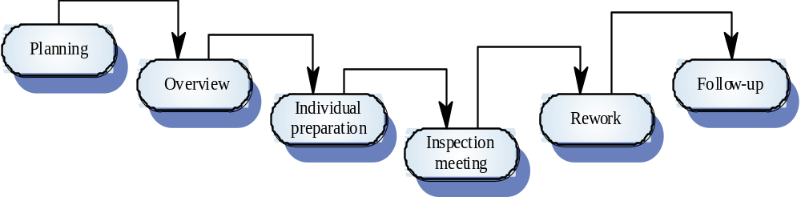
The inspection process

Slide 24
Inspection procedure
System overview presented to inspection team
Code and associated documents are
distributed to inspection team in advance
Inspection takes place and discovered errors
are noted
Modifications are made to repair discovered
errors
Re-inspection may or may not be required

Slide 25
Inspection teams
Made up of at least 4 members
Author of the code being inspected
Inspector who finds errors, omissions and inconsistencies
Reader who reads the code to the team
Moderator who chairs the meeting and notes
discovered errors
Other roles are Scribe and Chief moderator

Slide 26
Inspection checklists
Checklist of common errors should be used to
drive the inspection
Error checklist is programming language
dependent
The 'weaker' the type checking, the larger the
checklist
Examples: Initialisation, Constant naming, loop
termination, array bounds, etc.

Slide 27
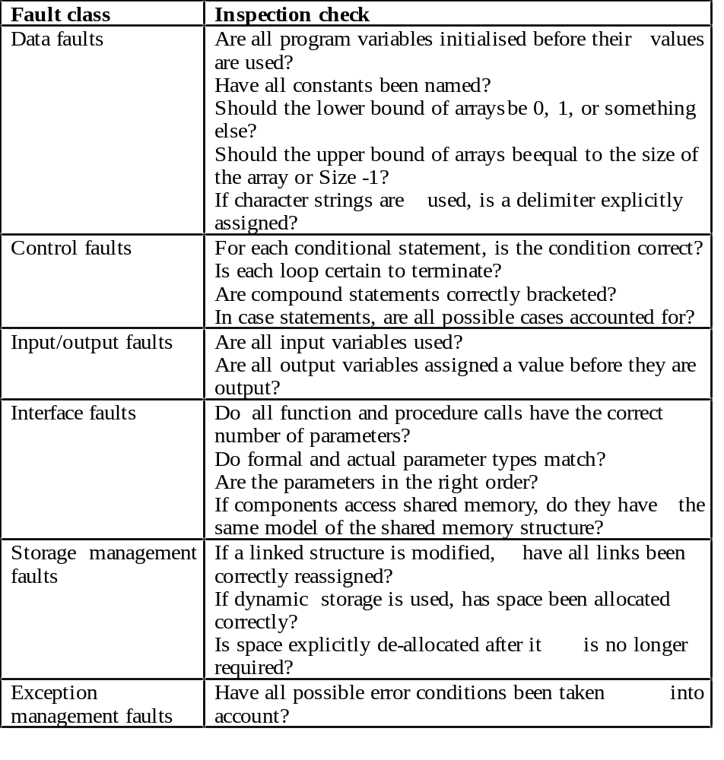
Inspection checks

Slide 28
Inspection rate
500 statements/hour during overview
125 source statement/hour during individual
preparation
90-125 statements/hour can be inspected
Inspection is therefore an expensive process
Inspecting 500 lines costs about 40 man/hours
effort = £2800

Slide 29
Automated static analysis
Static analysers are software tools for source text processing
They parse the program text and try to discover potentially erroneous conditions and bring these to the attention of the V & V team
Very effective as an aid to inspections. A
supplement to but not a replacement for
inspections

Slide 30
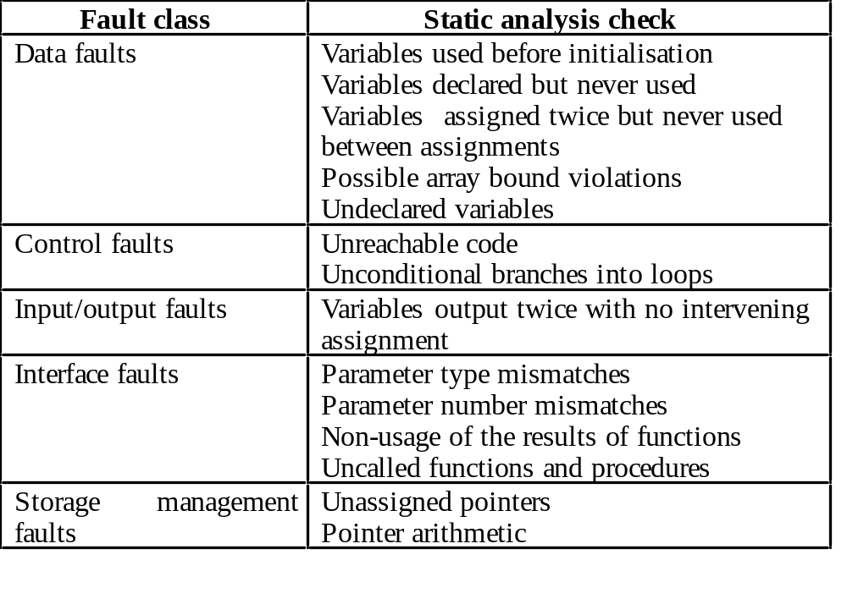
Static analysis checks

Slide 31
Stages of static analysis
Control flow analysis. Checks for loops with
multiple exit or entry points, finds unreachable
code, etc.
Data use analysis. Detects uninitialised
variables, variables written twice without an
intervening assignment, variables which are
declared but never used, etc.
Interface analysis. Checks the consistency of
routine and procedure declarations and their
use

Slide 32
Stages of static analysis
Information flow analysis. Identifies the
dependencies of output variables. Does not
detect anomalies itself but highlights
information for code inspection or review
Path analysis. Identifies paths through the program and sets out the statements executed in that path. Again, potentially useful in the review process
Both these stages generate vast amounts of information. Must be used with care.

Slide 33
LINT static analysis
138% more lint_ex.c
#include <stdio.h>
printarray (Anarray)
int Anarray;
{
printf(“%d”,Anarray);
}
main ()
{
int Anarray[5]; int i; char c;
printarray (Anarray, i, c);
printarray (Anarray) ;
}
139% cc lint_ex.c
140% lint lint_ex.c
lint_ex.c(10): warning: c may be used before set
lint_ex.c(10): warning: i may be used before set
printarray: variable # of args. lint_ex.c(4) :: lint_ex.c(10)
printarray, arg. 1 used inconsistently lint_ex.c(4) :: lint_ex.c(10)
printarray, arg. 1 used inconsistently lint_ex.c(4) :: lint_ex.c(11)
printf returns value which is always ignored

Slide 34
Use of static analysis
Particularly valuable when a language such as C is used which has weak typing and hence many errors are undetected by the compiler
Less cost-effective for languages like Java that have strong type checking and can therefore detect many errors during compilation

Slide 35
Cleanroom software development
The name is derived from the 'Cleanroom'
process in semiconductor fabrication. The
philosophy is defect avoidance rather than
defect removal
Software development process based on:
  Incremental development
  Formal specification.
  Static verification using correctness arguments
  Statistical testing to determine program reliability.

Slide 36
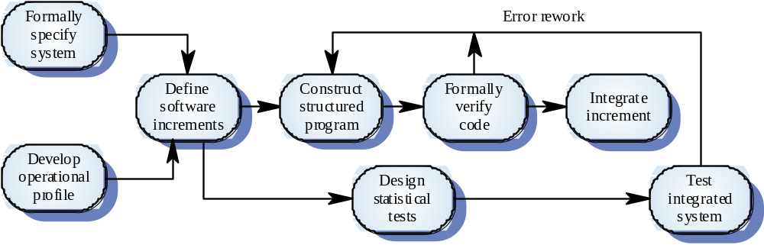
The Cleanroom process

Slide 37
Cleanroom process characteristics
Formal specification using a state transition model
Incremental development
Structured programming - limited control and abstraction constructs are used
Static verification using rigorous inspections
Statistical testing of the system (covered in Ch. 21).

Slide 38
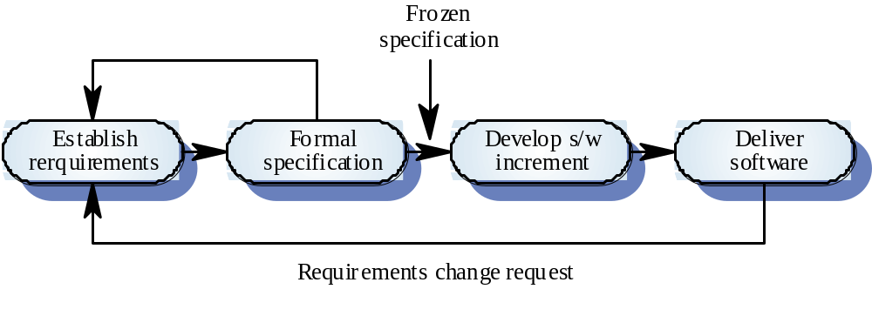
Incremental development

Slide 39
Formal specification and inspections
The state based model is a system specification and the inspection process checks the program against this model
Programming approach is defined so that the correspondence between the model and the system is clear
Mathematical arguments (not proofs) are used to increase confidence in the inspection process

Slide 40
Cleanroom process teams
Specification team. Responsible for developing
and maintaining the system specification
Development team. Responsible for
developing and verifying the software. The
software is NOT executed or even compiled
during this process
Certification team. Responsible for developing
a set of statistical tests to exercise the software
after development. Reliability growth models
used to determine when reliability is acceptable

Slide 41
Cleanroom process evaluation
Results in IBM have been very impressive with
few discovered faults in delivered systems
Independent assessment shows that the
process is no more expensive than other
approaches
Fewer errors than in a 'traditional' development
process
Not clear how this approach can be transferred
to an environment with less skilled or less
highly motivated engineers

Slide 42
Key points
Verification and validation are not the same thing. Verification shows conformance with specification; validation shows that the program meets the customer’s needs
Test plans should be drawn up to guide the testing process.
Static verification techniques involve examination and analysis of the program for error detection

Slide 43
Key points
Program inspections are very effective in discovering errors
Program code in inspections is checked by a small team to locate software faults
Static analysis tools can discover program anomalies which may be an indication of faults in the code
The Cleanroom development process depends on incremental development, static verification and statistical testing

