Slide 1

Sentiment Analysis on Game-stop gaming Products Presented by Pearlin Ronald Pereira (815060)

Slide 2

Agenda
Introduction
Insights & Recommendation
Conclusion
References

Slide 3

Introduction
The presentation delves into a comprehensive Sentiment Analysis of GameStop product evaluations, unveiling valuable insights into the emotions and sentiments expressed by consumers. This exploration aims to provide a nuanced understanding of consumer experiences and preferences pertaining to GameStop products.

Slide 4

Insights & Recommendations

Slide 5
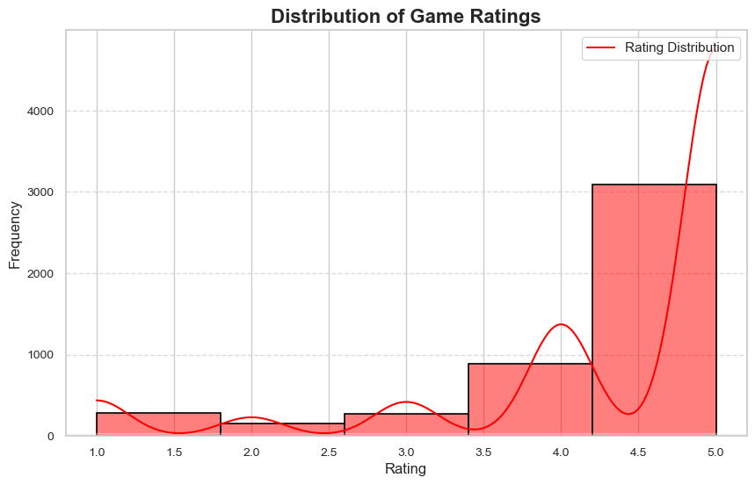
Distribution of Game-stop Product Ratings
Insights: The bar chart shows how often people gave different scores when rating the product.
Recommendations: Look carefully at what customers say for all the different scores. This way, you can find where things can get better and make the product more satisfying overall.

Slide 6
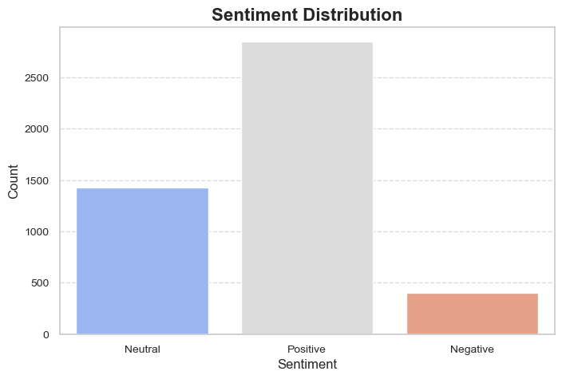
Analyzing Game-stop Product Reviews
Insights: The sentiment distribution chart gives a quick overview of how consumers feel about the product based on their review titles. It sorts these feelings into Positive, Negative, or Neutral categories using their overall sentiment scores.
Recommendations: Regularly check and address issues mentioned in negative sentiments to enhance overall product satisfaction.

Slide 7
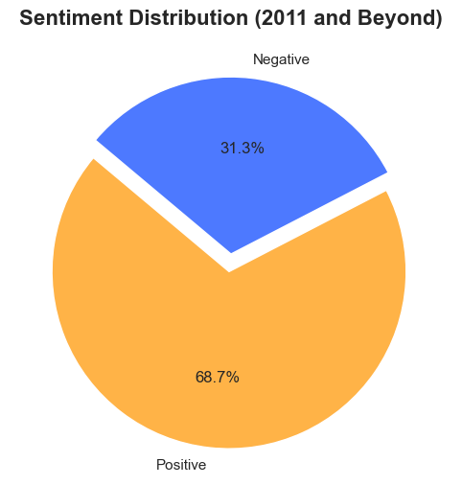
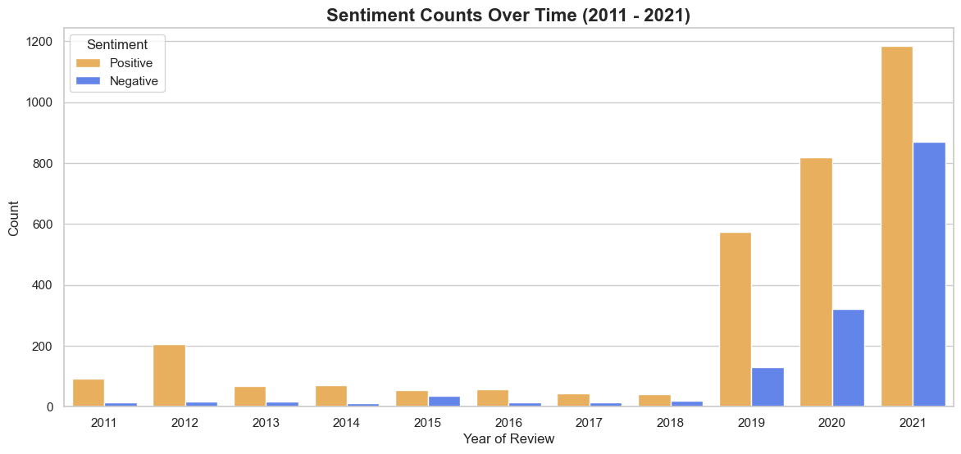
Analyzing the Game-stop Product Reviews (2011 - 2021)
Insights: The sentiment distribution chart and bar chart illustrate how consumer sentiments in GameStop product reviews have evolved since 2011, classifying them as Positive or Negative.
Recommendations: Utilize the collected data to examine sentiment trends over time, identify patterns, and strategize actions to consistently address recurring issues, ensuring continuous enhancement of customer satisfaction.

Slide 8
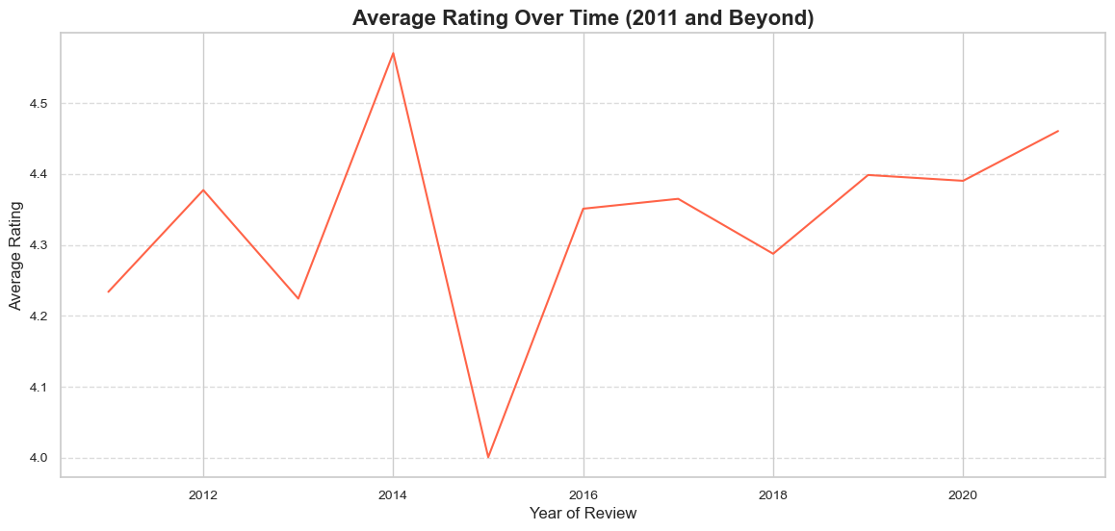
Average rating over time (2011 and Beyond)

Slide 9
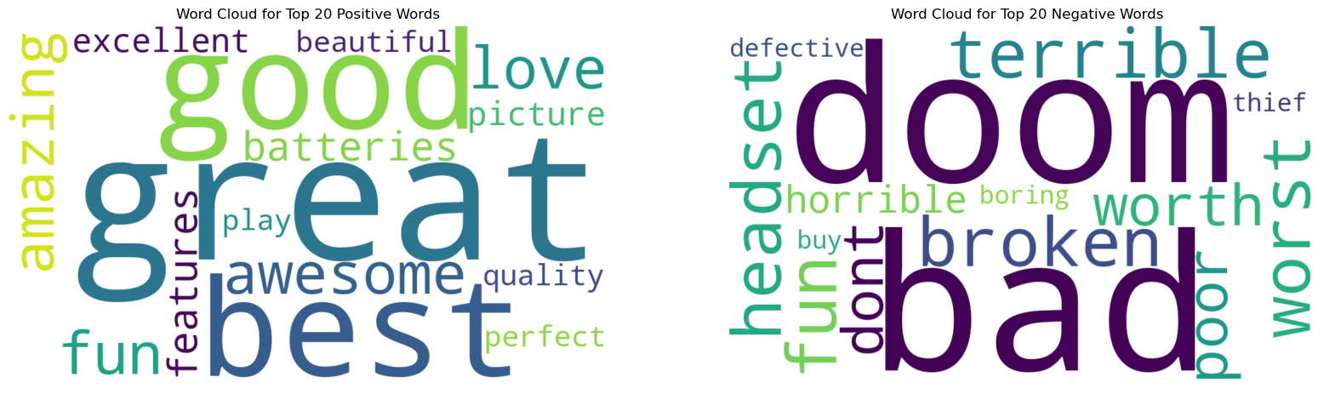
Word Cloud of Positive and Negative Words

Slide 10
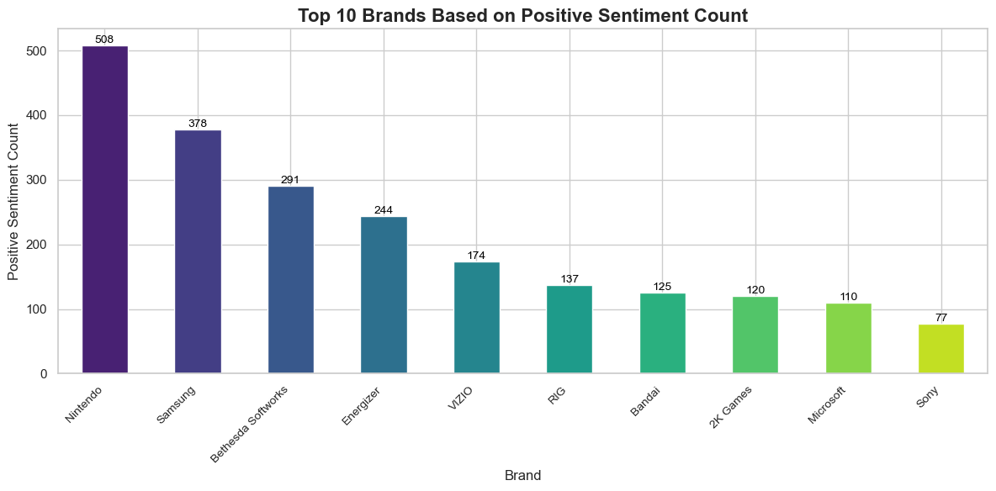
Game-stop's Top 10 Brands with Positive Reviews
Insights: The bar chart showcases the top ten companies consistently receiving positive sentiments in GameStop product ratings, providing valuable insights into user preferences.
Recommendations: Leverage this data to identify successful companies and gain a deeper understanding of the factors contributing to favorable sentiment. Tailor marketing and product strategies to align with these positive attitudes, thereby enhancing overall consumer satisfaction.

Slide 11
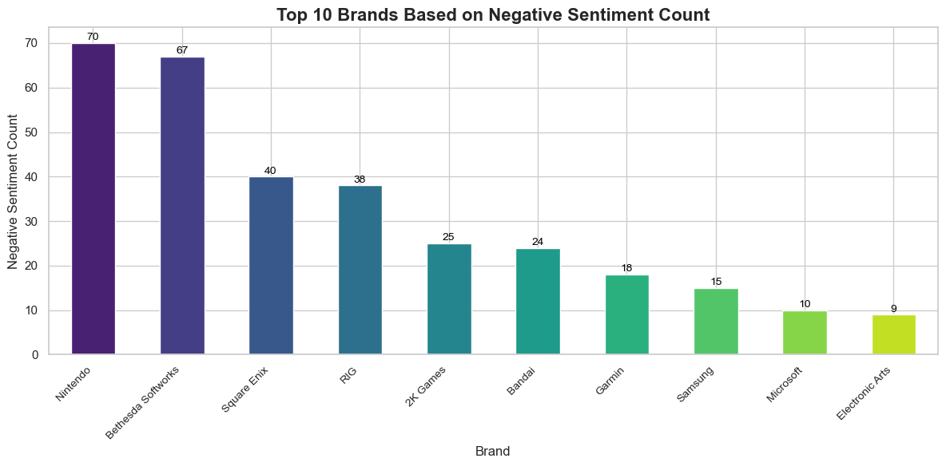
Game-stop's Top 10 Brands Facing Negative Reviews
Insights: The visual representation highlights the brands that have consistently received a significant number of negative sentiments in GameStop's product reviews.
Recommendations: Thoroughly examine the issues raised in reviews for these brands, aiming to address and enhance the identified concerns. This strategic approach is intended to boost overall customer satisfaction.

Slide 12
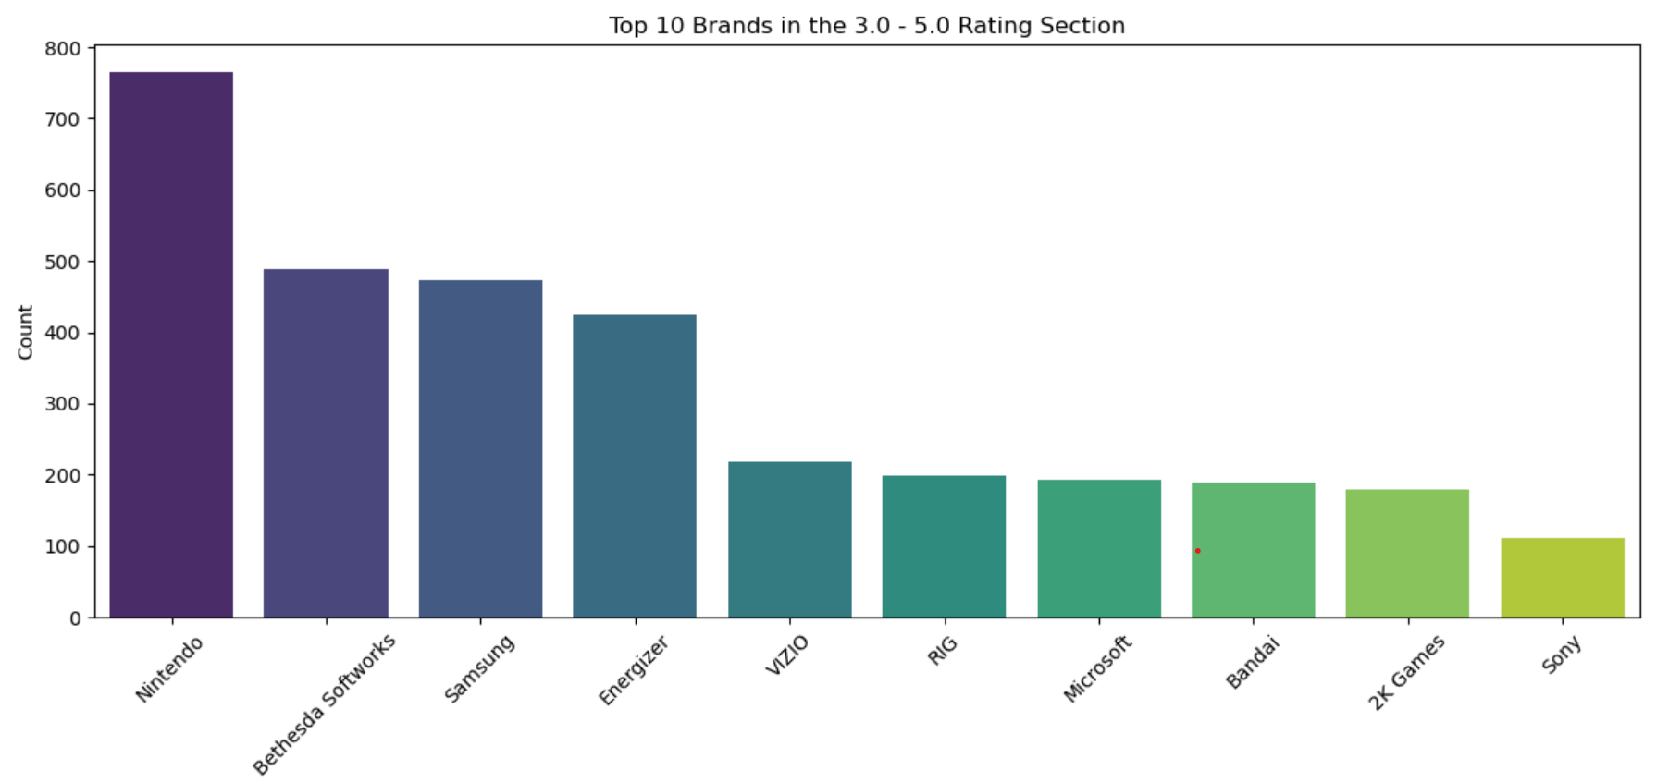
Elite Performers: Top 10 Brands with Exceptional Ratings (3-5)
Insights: This visualization spotlights companies that have garnered notable ratings falling within the 3.0 to 5.0 range, providing valuable insights into customer preferences and satisfaction within the positive rating spectrum.
Recommendations: Delve into the commonalities among these top-rated companies to identify key characteristics contributing to outstanding customer experiences.

Slide 13
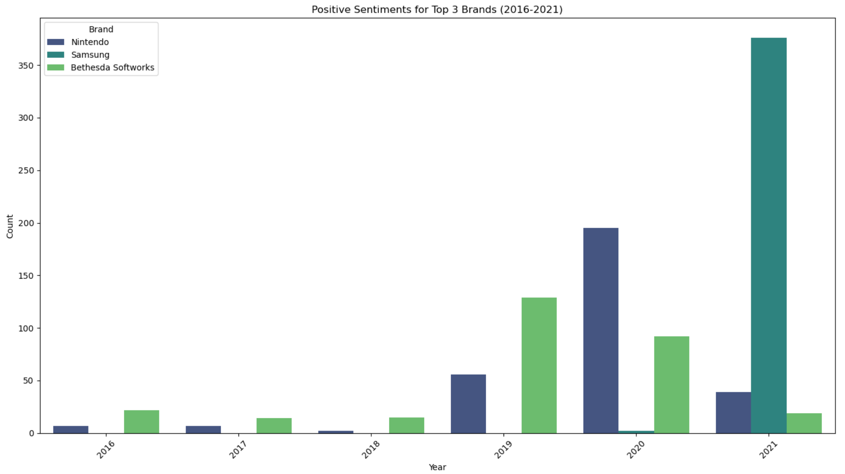
Positive Sentiments for Top 3 Brands (2016-2021)
Insights: Samsung commenced with zero reviews in 2016 and concluded with the highest number of positive reviews in 2021.
Recommendations: Scrutinize Samsung's journey, evolving from no reviews in 2016 to becoming the most-reviewed brand. Simultaneously, investigate Nintendo's significant decline in reviews in 2021, exploring potential factors contributing to this shift. Leverage these insights to formulate brand-specific engagement strategies, capitalizing on Samsung's success and addressing any issues influencing Nintendo's decline.

Slide 14
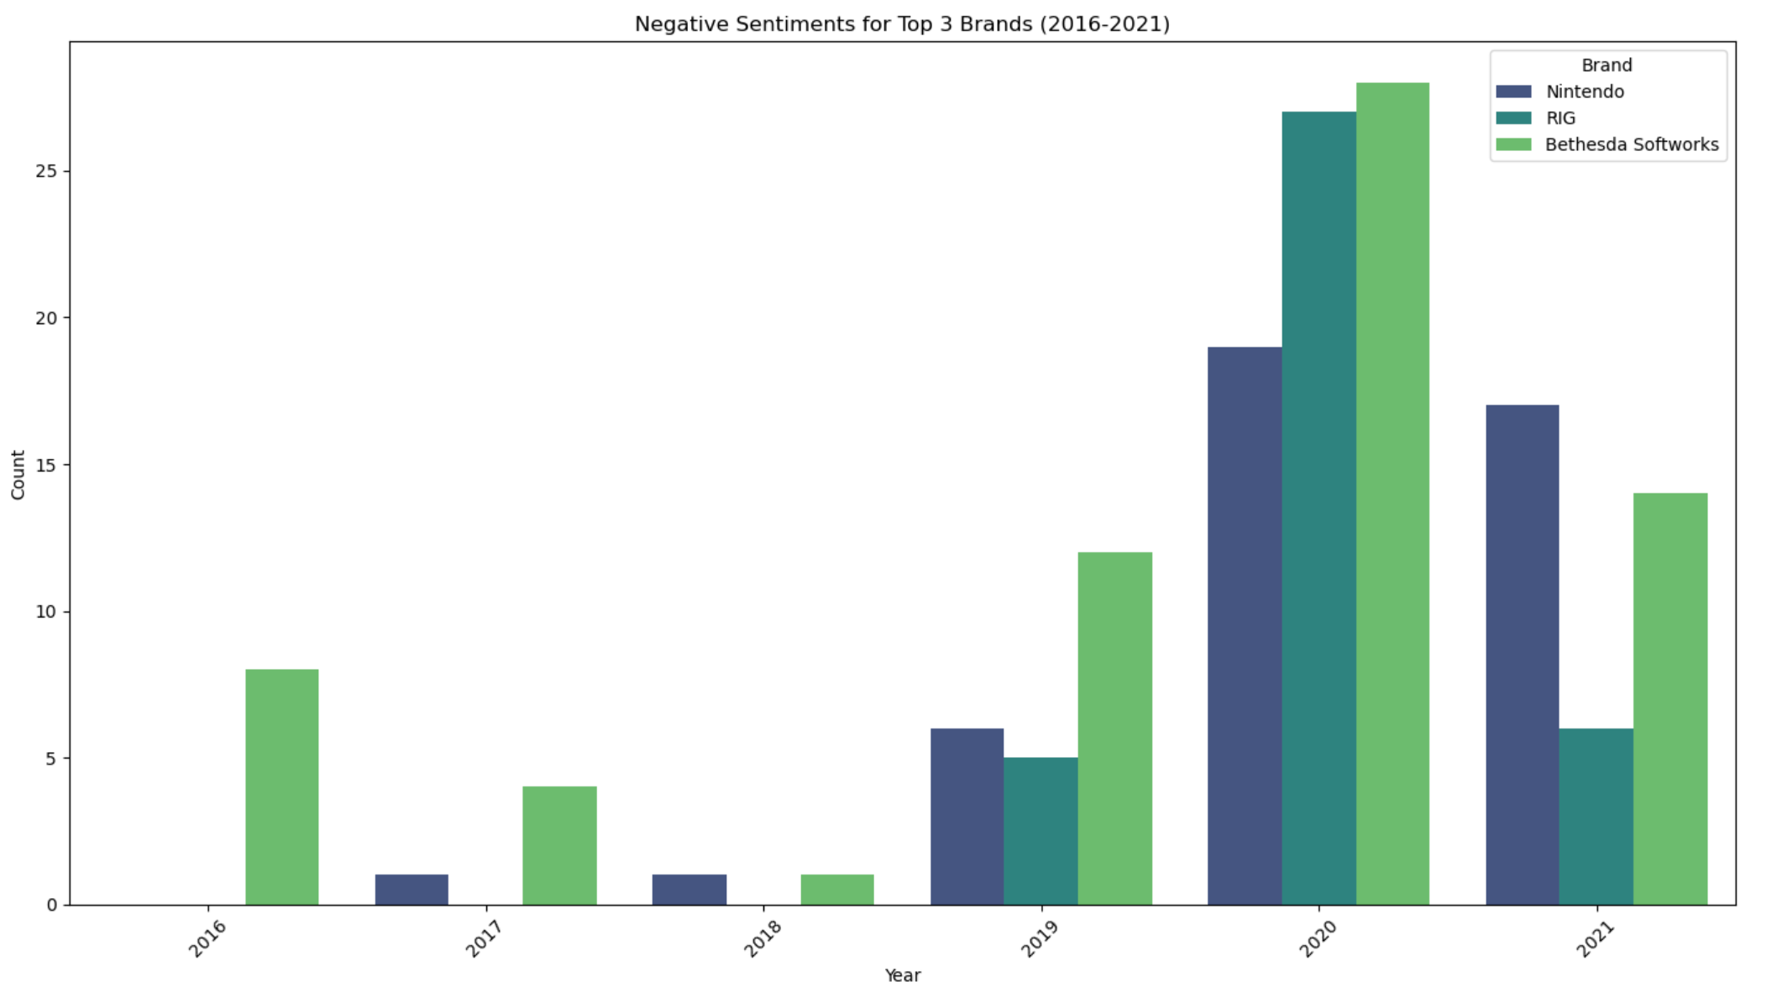
Negative Sentiments Analysis for Top 3 Brands (2016-2021)
Insights: The graph illustrates fluctuations in unfavorable sentiment for the top three brands over time, highlighting potential areas of concern.
Recommendations: Investigate the spikes in negative sentiment, particularly in 2020 and 2021, and address any recurring issues impacting consumer satisfaction. Proactively implement strategies to enhance the brand image, ensuring a positive trajectory in customer sentiment over the coming years.

Slide 15

Conclusion
The comprehensive sentiment analysis of GameStop product evaluations uncovered dynamic trends and patterns over time. Noteworthy findings include the exponential surge in Samsung reviews, a significant uptick in Nintendo sentiment until 2021, and insights into top companies based on positive and negative sentiment. This study provides valuable information for businesses to adapt their strategies, enhance consumer satisfaction, and adeptly navigate evolving consumer emotions.

Slide 16

References
https://crawlfeeds.com/datasets/gamestop-product-reviews-dataset
https://github.com/SwapnilWagh06/Sentiment-Analysis-for-Steam-Reviews

Slide 17

Thank you

