Slide 1
Django
By Komal Singh

Slide 2
Django is a free and open source web application framework which offers fast and effective dynamic website development.
What is framework?
A web framework is a code library that makes web development faster and easier by providing common patterns for building reliable, scalable and maintainable web applications.

Slide 3
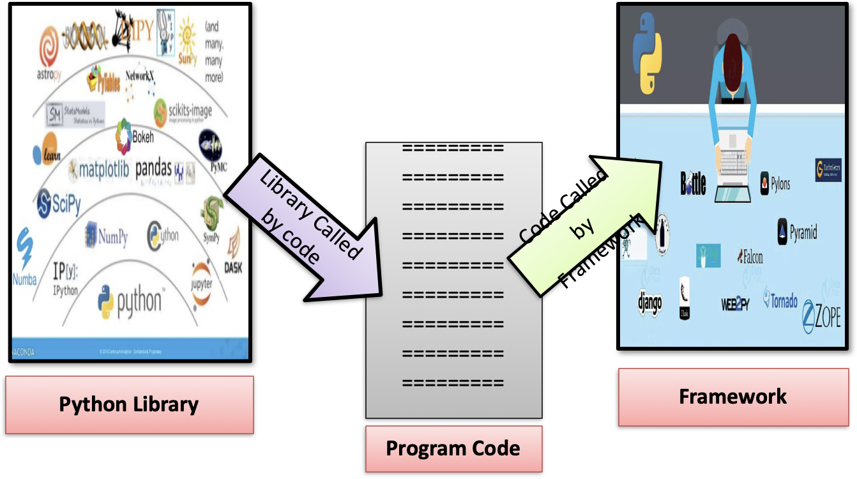
To understand it more clear lets understand the difference between library and framework

Slide 4
Introduction
Django is a free and open-source web framework.
It is written in Python.
It follows the Model-View-Template (MVT) architectural pattern.
It is maintained by the Django Software Foundation (DSF).
It is used by several top websites like Youtube, Google, Dropbox,Yahoo Maps, Mozilla, Instagram,Washington Times, Nasa and many more.
Django was created in 2003 as an internal project at Lawrence Journal-World Newspaper for their web development.
The Original authors of Django Framework are: Adrian Holovaty, Simon Willison
After Testing this framework with heavy traffics, Developers released for the public as open source framework on July 21st 2005.
The Django was named in the memory of Guitarist Django Reinhardt.

Slide 5
Top Features of Django
1)Fast:
Django was designed to help developers take applications from concept to completion
as quickly as possible.
2) Fully loaded:
Django includes dozens of extras we can use to handle common Web development tasks. Django takes care of user authentication, content administration, site maps, RSS feeds, and many more tasks.

Slide 6
3) Security:
Django takes security seriously and helps developers avoid many common security mistakes, such as SQL injection, cross-site scripting, cross-site request forgery and clickjacking.
Its user authentication system provides a secure way to manage user accounts and passwords.
4) Scalability:
Some of the busiest sites on the planet use Django’s ability to quickly and flexibly scale to meet the heaviest traffic demands.
5) Versatile:
Companies, organizations and governments have used Django to build all sorts of
things — from content management systems to social networks to scientific
computing platforms.

Slide 7
MVT
The Model-View-Template (MVT) is slightly different from MVC.
In fact the main difference between the two patterns is that Django itself takes care of the Controller part (Software Code that controls the interactions between the Model and View), leaving us with the template. The template is a HTML file mixed with Django Template Language (DTL).
The MVT (Model View Template) is a software design pattern.
It is a collection of three important components Model View and Template.
The Model helps to handle database.
It is a data access layer which handles the data.

Slide 8
The Template is a presentation layer which handles User Interface part completely.
The View is used to execute the business logic and interact with a model to carry data and renders a template.
Although Django follows MVC pattern but maintains its own conventions. So, control is handled by the framework itself.
There is no separate controller and complete application is based on Model View and Template. That's why it is called MVT application.

Slide 9
Here, a user requests for a resource to the Django, Django works as a controller and check to the available resource in URL.
If URL maps, a view is called that interact with model and template, it renders a template.
Django responds back to the user and sends a template as a response.

Slide 10
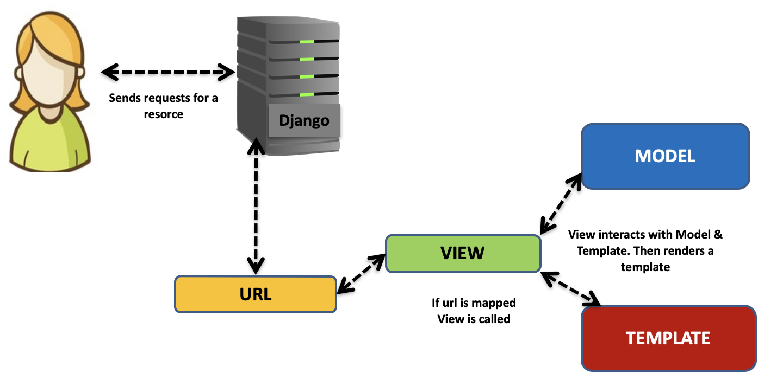
At last Django responds back to the user and sends a template as a response.

Slide 11
The MVT is a software design pattern which includes three important components Model, View and Template.
The Model helps to handle database. It is a data access layer which handles the data.
The Template is a presentation layer which handles User Interface part completely.
The View is used to execute the business logic and interact with a model to carry data and renders a template.
Although Django follows MVC pattern but maintains it’s own conventions. Here control is handled by the framework itself.

Slide 12
What is django ORM?
Django ORM stands for Django Object-Relational Mapping.
It's a powerful tool provided by the Django web framework for interacting with databases using Python objects.
Here's how it works:
Object-Relational Mapping:
Django ORM allows developers to work with database tables as Python objects.
Each table in the database is represented by a Python class, and each row in the table is represented by an instance of that class.

Slide 13
Abstraction: Django ORM abstracts away the need to write SQL queries directly.
Instead, developers can perform database operations using Python syntax, which is more intuitive and less error-prone for many developers.
Querysets: Django ORM provides QuerySets, which are a collection of database queries that can be used to retrieve data from the database.
QuerySets can be filtered, sliced, and manipulated in various ways to retrieve the required data.

Slide 14
Model Definitions: Django ORM relies heavily on model definitions. Models are Python classes that represent database tables.
They define the structure of the data, including fields and their types.
Automatic Query Generation: Django ORM automatically generates SQL queries based on the Python code written by the developer.
This means that developers don't have to worry about writing complex SQL queries manually; Django takes care of it.
Overall, Django ORM simplifies database interactions in Django projects, making it easier for developers to build web applications without needing extensive knowledge of SQL. It abstracts away the complexities of database management and allows developers to focus on writing Python code.

Slide 15
Migrations
Migrations are Django’s way of propagating changes you make to your models (adding a field, deleting a model, etc.) into your database schema.
They’re designed to be mostly automatic, but you’ll need to know when to make migrations, when to run them, and the common problems you might run into.

Slide 16
The Commands
There are several commands which you will use to interact with migrations and Django’s handling of database schema:
migrate, which is responsible for applying and unapplying migrations.
makemigrations, which is responsible for creating new migrations based on the changes you have made to your models.
sqlmigrate, which displays the SQL statements for a migration.
showmigrations, which lists a project’s migrations and their status.

Slide 17
You should think of migrations as a version control system for your database schema.
makemigrations is responsible for packaging up your model changes into individual migration files - analogous to commits - and migrate is responsible for applying those to your database.
Migrations will run the same way on the same dataset and produce consistent results, meaning that what you see in development and staging is, under the same circumstances, exactly what will happen in production.
Django will make migrations for any change to your models or fields - even options that don’t affect the database - as the only way it can reconstruct a field correctly is to have all the changes in the history, and you might need those options in some data migrations later on (for example, if you’ve set custom validators).

Slide 18
Backend Support
Migrations are supported on all backends that Django ships with, as well as any third-party backends if they have programmed in support for schema alteration (done via the SchemaEditor class).
However, some databases are more capable than others when it comes to schema migrations; some of the caveats are covered below.
PostgreSQL¶
PostgreSQL is the most capable of all the databases here in terms of schema support.

Slide 19
Database Engines
Django comes with a SQLite database which is great for testing and debugging at the beginning of a project.
However, it is not very suitable for production.
Django also support these database engines:
PostgreSQL
MariaDB
MySQL
Oracle
We will take a closer look at the PostgreSQL database engine.

