Slide 1
PostgreSQL
By Komal Singh

Slide 2
Why do we need PostgreSQL?
PostgreSQL is a open-source relational database based on an object-oriented approach that works on the rules stated by ANSI. It is the only database that implements the basic functionality of object-oriented.
In PostgreSQL, advanced concepts like table inheritance and function overloading are available.
PostgreSQL has rich active community support and is well-maintained by the leading tech giants.
The best part is that Postgresql completely implements the concept of data concurrency.
Install a package called psycopg2.

Slide 3
There are many relational database management systems (RDBMSs) to choose from if the relational model best represents your data.
PostgreSQL is one of the most popular and well-regarded open-source relational databases in the world.
One of the primary reasons for choosing to use PostgreSQL is its large list of features.
PostgreSQL possesses an incredible number of features related to performance, security, programming extensions, and configuration among others.

Slide 4
One of the most fundamental ways that PostgreSQL is different from most other relational databases comes from its core design.
Relational Database Management Systems (RDBMSs): RDBMSs are software specifically designed to handle relational databases, where data is stored in table-like structures with predefined columns and data types.
Data can be queried, modified, and retrieved using techniques based on relational algebra, usually through structured query language (SQL).

Slide 5
Object oriented features
PostgreSQL, on the other hand, is technically an Object-Relational Database Management System (ORDBMS).
This means that it has the same relational capabilities as an RDBMS, but additionally has some object-oriented features.
Practically speaking, this means that PostgreSQL allows you to:
Define your own complex data types
Overload functions to work with different argument data types
Define inheritance relationships between tables.

Slide 6
PostgreSQL – System Architecture
PostgreSQL has a Client-server model of architecture. In the simplest term a PostgreSQL service has 2 processes:
Server-side process: This is the “Postgres” application that manages connections, operations, and static & dynamic assets.
Client-side process(Front-end applications): These are the applications that users use to interact with the database.
It generally has a simple UI and is used to communicate between the user and the database generally through APIs.

Slide 7
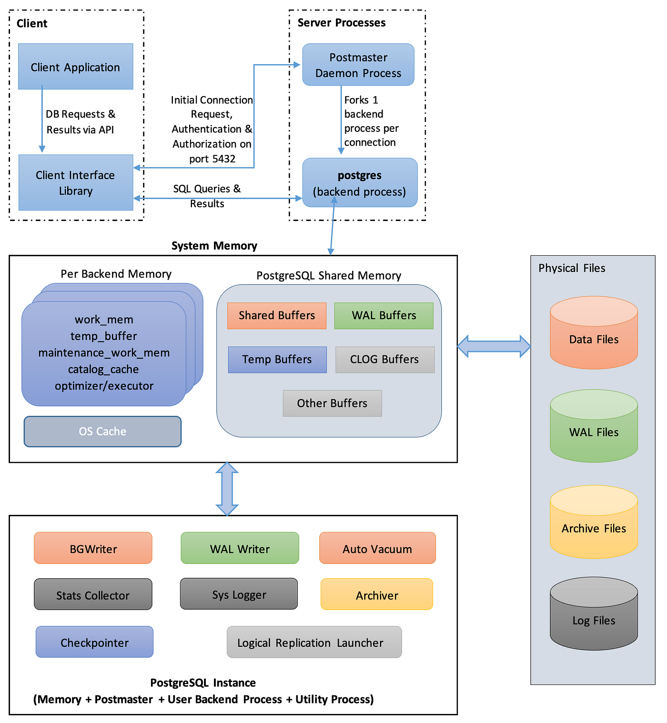
System Architecture

Slide 8
Client-side Process :
When the user runs queries on PostgreSQL, the Client Application can connect to the PostgreSQL server (Postmaster Daemon Process) and submit queries through one of many Database Client Application program interface supported by PostgreSQL like JDBC, Perl DBD, ODBC, etc. that helps to provide client-side libraries.
In the Client Process, the Communication between Client Application and Client Application library occurs with the help of Library API as shown in the figure below:

Slide 9
1. Postmaster Daemon Process :
The system architecture of PostgreSQL is based on Process-Per-Transaction Model(Client/Server Model).
A running PostgreSQL site is managed by Postmaster which is a central coordinating process. It is also known as Server Process.
The postmaster daemon process is responsible for :
Initializing the server
Shutting Down the server
Handling Connection requests from new clients.
Perform Recovery.
Run Background Processes.

Slide 10
Shared Memory
Shared memory is the memory that is simultaneously accessed by multiple programs in order to provide fast and efficient results with less redundancy.
Shared Disk Buffer: The purpose of the shared disk buffer is to minimize the disk Input/Output.Disk Input/Output takes more time which causes redundancy and an inefficient system.
Frequently used blocks must be in the buffer for as long as possible to minimize contention when many users access it at the same time.
The advantages of using a shared buffer are:
Reduce time.
Can Access a very large amount of Data Easily.
Minimize heating when multiple users is accessing at the same time.

Slide 11
WAL(Write Ahead Log) Buffer
The WAL buffer is a buffer that temporarily stores changes to the database.
The contents stored in the WAL buffer are written to the WAL file at a predetermined point in time.
From a backup and recovery point of view, WAL buffers and WAL files are very important.
CLOG Buffers
Log files contains a log of transaction metadata.
This log tells PostgreSQL which transactions completed and which did not.
The clog is small and never has any reason to become bloated, so you should never have any reason to touch it.

Slide 12
2. Back-end process:
The Postmaster is responsible for handling initial client connections.After Performing an initialization process such as authentication of the user.
The postmaster process then creates a new “backend” process for every connection it accepts. The connection is then handed over to the new backend process. i.e process per transaction model
The Backend Server is responsible for Executing queries submitted by the client by performing necessary specific operations.
Each backend server will handle only a single query at a time.
At a time multiple clients are connected to the system hence multiple backend servers are executing queries concurrently.
The back-end server access data from the main-memory buffer pool which is placed in shared memory.

Slide 13
3. Background processes
Mandatory processes: We cannot Enable/Disable these processes.
BGWriter
WAL Writer
Checkpointer
Optional Processes:
Stats-collector
Autovacuum launcher
Archiver
Syslogger
WAL Writer

Slide 14
Physical Files
Provide physical Storage to Data in Disk Storage.
The data in these files are stored permanently and used for their respective operation.
The following listed are the physical files in the PostgreSQL database.
Data Files
Wal Files
Log Files
Archive Logs

Slide 15
Data Files
The PostgreSQL Data Files are used to store the actual data.
It stores the actual data and no such instruction or any kind of code information.
When the user requests the data, PostgreSQL looks for the data in the shared buffer if it is not there then it loads data from the data files in the shared buffer and then processes further.
Wal Files
The PostgreSQL WAL files are used to store all changes from the WAL Buffer before the commit happens.
WAL files are primarily used to maintain durability and consistency during a write operation on database storage.

Slide 16
Log Files
The PostgreSQL Log files store all logs related to the server, stderr, csvlog, Syslog, error message, warning message, informative message, and so on.
It helps the database administrator to debug any issue in detail.
Archive Logs
The PostgreSQL Archive Log files are used to store the WAL segment on the disk.
The Archive logs are used in case there is an unexpected crash that happens due to which the data is lost, in that scenario the Archive logs are used to repair/recover the database.

