Slide 1

S1_GROUP 2: CLIMATE
Probabilistic Forecasting of Extreme Weather Events
Group Members
Abhi Jain
Dhruti Kobawala
Prarthana Gajera
Shlok Shah
Pearl Patel
AU2440173
AU2440005
AU2440202
AU2440178
AU2440085

Slide 2

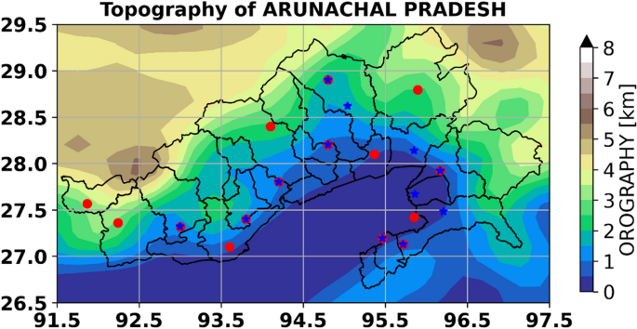
Background & Motivation
Background:
Traditional deterministic forecasts give only one possible outcome and do not capture uncertainty which is a major limitation during extreme rainfall or storms.
Motivation:
Extreme rainfall directly impacts defense logistics, border operations, and infrastructure planning. We selected Arunachal Pradesh because its complex terrain and frequent extreme rainfall events make it a high-risk region where probabilistic forecasting is most needed.
Why It Happens:
Extreme weather is unpredictable due to:
• Chaotic atmospheric conditions
• Model simplifications
• Measurement noise and limited data
Our Focus:
Apply probabilistic forecasting to the Arunachal Pradesh rainfall dataset, a region known for extreme events
Goal:
Move from “what will happen” to “how likely is it to happen?”

Slide 3
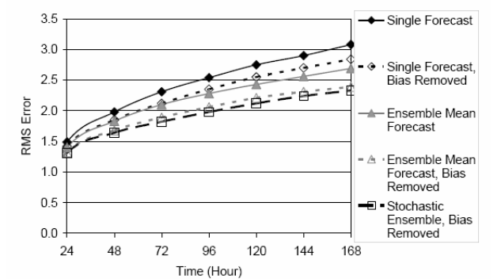
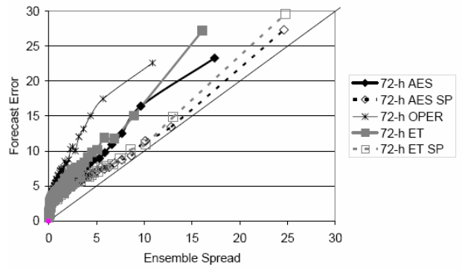
Base Paper Overview
Purpose of the Paper:
To Study how to improve forecasting of high-impact weather using ensemble-based probabilistic methods.
Approach Used:
• Based on the NOGAPS global atmospheric model
• Added stochastic perturbations to represent model uncertainty
• Compared ensemble methods: BV, ET, and AES
Key Findings:
• Stochastic perturbations improved ensemble spread
• ET and AES performed better than the operational BV method
• A 96-hour ensemble-mean (with bias correction) matched a 48-hour deterministic forecast
Why It Matters for Us:
The paper shows that ensemble and Bayesian methods give more reliable predictions, directly supporting our approach for extreme rainfall uncertainty in Arunachal Pradesh.

Slide 4

Problem Formulation
Problem Statement:
Deterministic weather forecasts do not capture uncertainty, and do not do so well for extreme events (e.g. heavy rainfall and storms). This limits the effective planning of defense operations and resilience of the infrastructure. This project applies some of the probabilistic techniques to quantify the uncertainty of the extreme weather events from ensemble forecasting and Bayesian inference. The goal is to estimate event likelihoods and provide risk-informed decision supporting.
Core Focus:
Quantifying uncertainty in extreme weather predictions
Estimating the probability of rare events for better decision support
Need for Uncertainty Modeling:
Real-world systems exhibit inherent randomness
Effective decisions depend on understanding risk and variability, not just outcomes

Slide 5
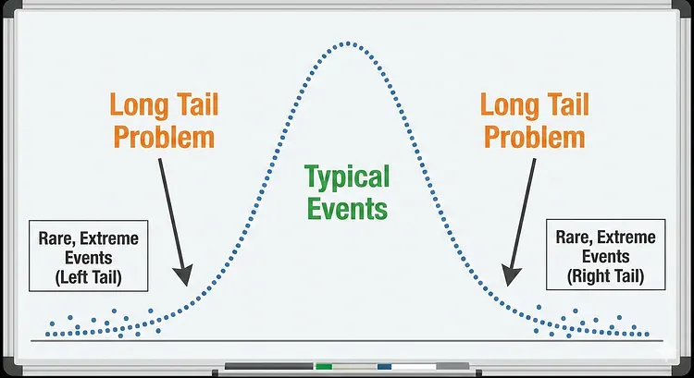
Problem Formulation
Limitation of Deterministic Methods
Provide single-point outputs, ignoring variability
Do not represent uncertainty or confidence levels
Struggle to capture rare, high-impact events
Role of Probabilistic Techniques:
Enable estimation of event likelihood instead of fixed values
Capture a range of possible outcomes
Improve reliability in extreme scenarios
Nature of the Challenge:
Extreme weather events lie in the tail of the distribution, where data is sparse and highly unpredictable
Small deviations in prediction can result in significant real-world impact

Slide 6

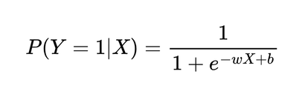



Mathematical Model
Event Definition
An extreme event is defined using a threshold :
X >
Transforms the problem into identifying tail-region behavior
Probabilistic Representation
Model the likelihood of an extreme event as:
Converts prediction into a probability estimation problem
Logistic Regression Model
Maps input features to a probability between 0 and 1
Captures transition from normal to extreme conditions

Slide 7
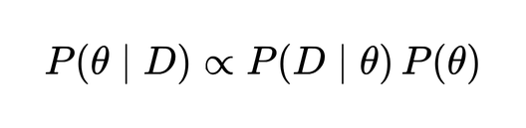


Mathematical Model
Bayesian Inference Update
Updates model parameters using observed data
Incorporates prior knowledge with new evidence
Ensemble Representation
Generate multiple predictions:
Estimate distribution characteristics:
Mean (expected outcome)
Variance (uncertainty)
Model Variables
X: Input Variables
: Threshold for extreme events
Y: Event Indicator (0 or 1)
: Model parameters
: Parameter set for Bayesian update

Slide 8
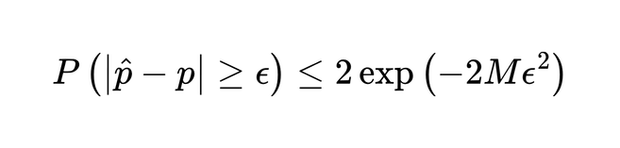
Bounds Used in the Problem
Hoeffding Inequality:
What it means?
How is it used in our project?
Why is it necessary?
Bounds the probability of deviation between:
Estimated Probability
True Probability
Works for independent bounded random variables
Ensures concentration of estimate around true value
Applied to ensemble simulation outputs
Each simulation treated as a random sample
Used to bound error in extreme event probability estimation
Simulation results are random - need reliability
Provides confidence in estimated probabilities
Prevents over-reliance on a single simulation outcome
Converts randomness - controlled uncertainty

Slide 9
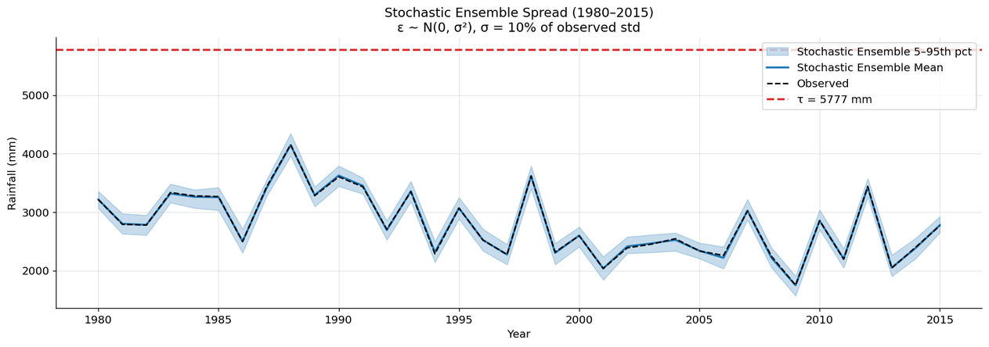

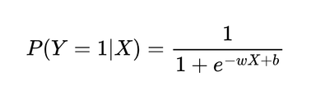
Deterministic Approach
Idea:
One prediction based on fixed input data.
No modeling of randomness or uncertainty.
In Our Model (M3):
Threshold:
Extreme Event: Y=1 if R>τ
Logistic Regression:
Traits:
Same output every time
Equal weights (no change)
Quick and easy to repeat
Restrictions:
No representation of uncertainty
Sensitive to mistakes in input
Not good for extreme events

Slide 10
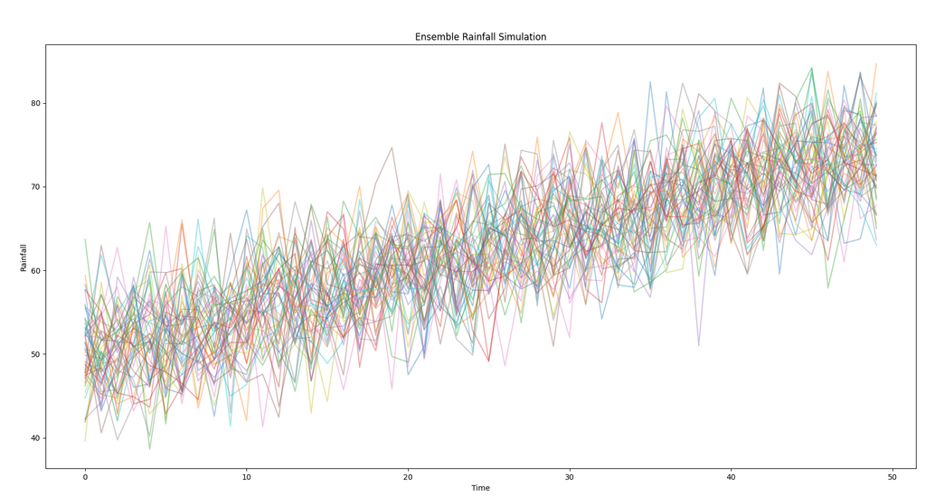
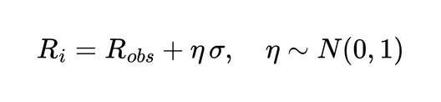
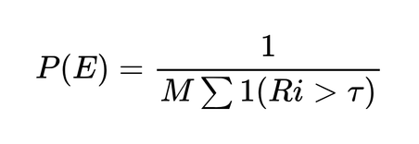
Randomized Approach
Idea:
Several predictions to model uncertainty
Each = possible rain scenario
In Our Model (M4):-
Ensemble:
M = 50 people
Estimating Probability:-
Important Features:-
It captures:
Uncertainty at first
Uncertainty in the model
Uses:
Ensemble spread (standard deviation)
Intervals of confidence
From the Results:-
Better RMSE and Brier scores
Better relationship between skill and spread

Slide 11
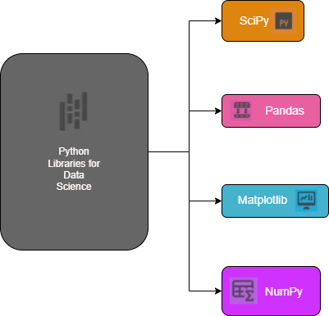
Coding & Simulation
Tools and Libraries
Code Snippet
import numpy as np
import pandas as pd
import matplotlib.pyplot as plt
import matplotlib.gridspec as gridspec
from scipy import stats
from scipy.stats import norm, gamma, lognorm, genextreme
NumPy for numerical simulation
Pandas for data preprocessing
SciPy for statistical modeling
Matplotlib for visualization

Slide 12
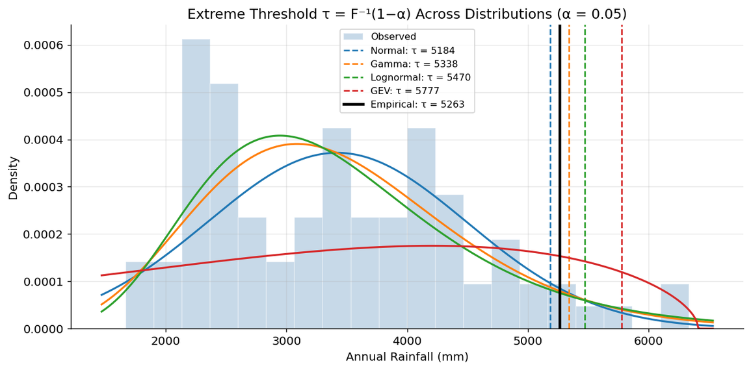


Coding & Simulation
Implemention: Defining Extreme Events
Code Snippet
ALPHA = 0.05
tau_empirical = np.quantile(ANNUAL, 1 - ALPHA)
thresholds = {"Empirical": tau_empirical}
for name, dist in fitted.items():
thresholds[name] = dist.ppf(1 - ALPHA)
Threshold Definition Approach:
Extreme events defined using upper quantile
represents top 5% extreme values
Threshold computed using:
Empirical data quantile
Fitted probability distributions

Slide 13

Coding & Simulation
Implemention: Randomized Simulation using Ensemble Modeling
Code Snippet
M = 50
np.random.seed(42)
sigma_perturbation = 0.10 * ANNUAL.std() # perturbation scale ~107 mm
ensemble = np.zeros((n, M))
for i in range(M):
eta = np.random.normal(0, 1, n) # η ~ N(0,1) per year
ensemble[:, i] = ANNUAL + sigma_perturbation * eta
# Ensemble summary
ens_all_mean = ensemble.mean()
ens_all_std = ensemble.std()
Simulation Setup:
Generated M = 50 simulations for each data point
Added Gaussian noise:
Perturbation scaled using data variability
Reproducibility ensured using fixed random seed
Randomized Modeling Approach:
Instead of a single value, generate multiple possible outcomes
Captures uncertainty in real-world data
Models variability in extreme event behavior
We simulate multiple possible realizations using stochastic perturbations to capture uncertainty in extreme event prediction.

Slide 14
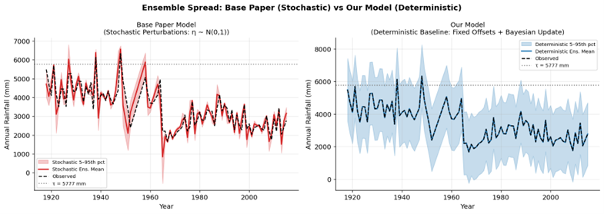
Results
Deterministic Approach | Randomized Approach
Fixed output for given input | Multiple possible outcomes
Poor at handling uncertainty | Models uncertainty effectively
Fixed ensemble spread | Dynamic, realistic spread
High accuracy (misleading) | Better probability estimates

Slide 15
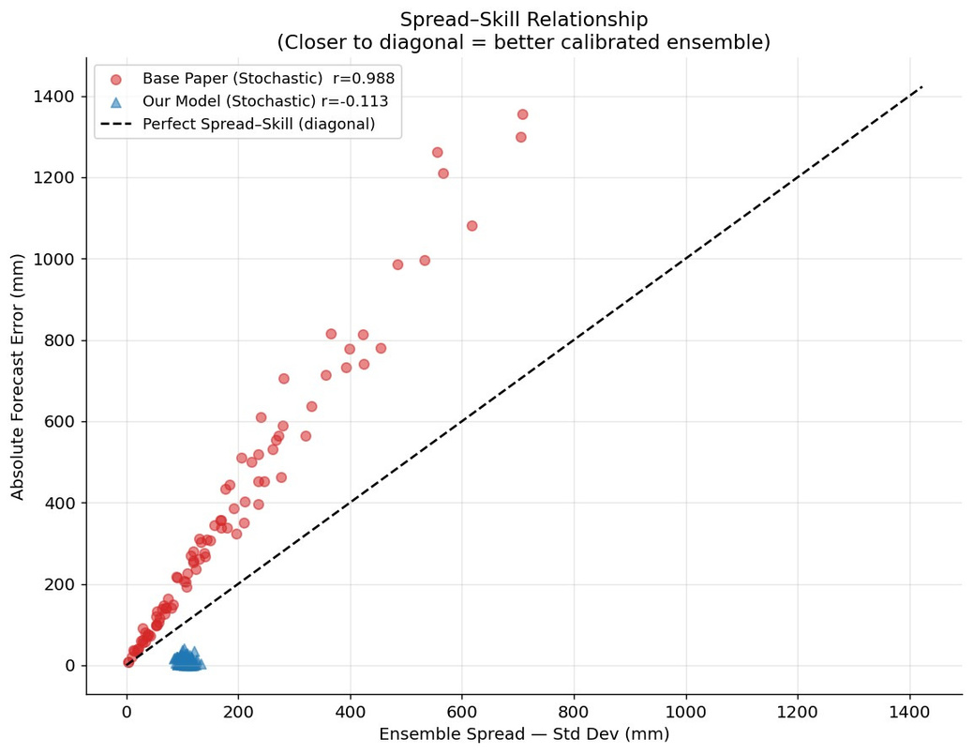
Results
Observation from Graph
Base model (red): Points near diagonal → well-calibrated
Our model (blue): Scattered & flat → poor calibration
Key Issues
Fixed Ensemble Spread
Same spread for all cases (not realistic)
No Spread–Error Relationship
Uncertainty does not increase with error
Lack of Randomness
Deterministic perturbations → rigid behavior
Overfitting Effect
Very low errors, poor generalization

Slide 16
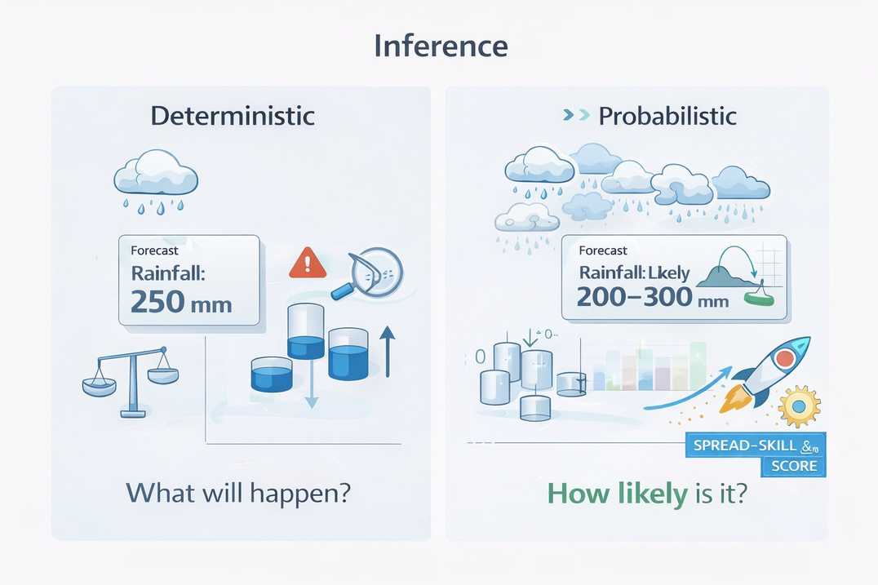
Inference
From Domain (Weather) Perspective
Extreme events are rare (~2.2%) but high-impact
Deterministic models fail to capture uncertainty in weather systems
Evidence of non-stationarity (extremes clustered before 1950)
Probabilistic modeling enables risk-aware decision making
From Computer Science Perspective
Accuracy is misleading in imbalanced datasets
Deterministic models → stable but poor uncertainty modeling
Randomized models → better calibration & real-world representation
Metrics like Brier Score & spread-skill are more meaningful

Slide 17
References
Multiuser detection for S-UMTS and GMR-1 mobile systems. (2006, August 1). IEEE Conference Publication | IEEE Xplore. https://ieeexplore.ieee.org/document/4100561
https://medium.com/%40arpitashekhar9/long-tail-problems-of-eta-prediction-systems-529ba4481a66
https://news.stanford.edu/stories/2021/12/warming-makes-weather-less-predictable?utm_source=chatgpt.com
https://www.upgrad.com/blog/python-cheat-sheet/

Slide 18
THANK YOU!

