Slide 1
SDB Invoicing Solution — Claim Integrity Agent
Pearls Consulting

Slide 2
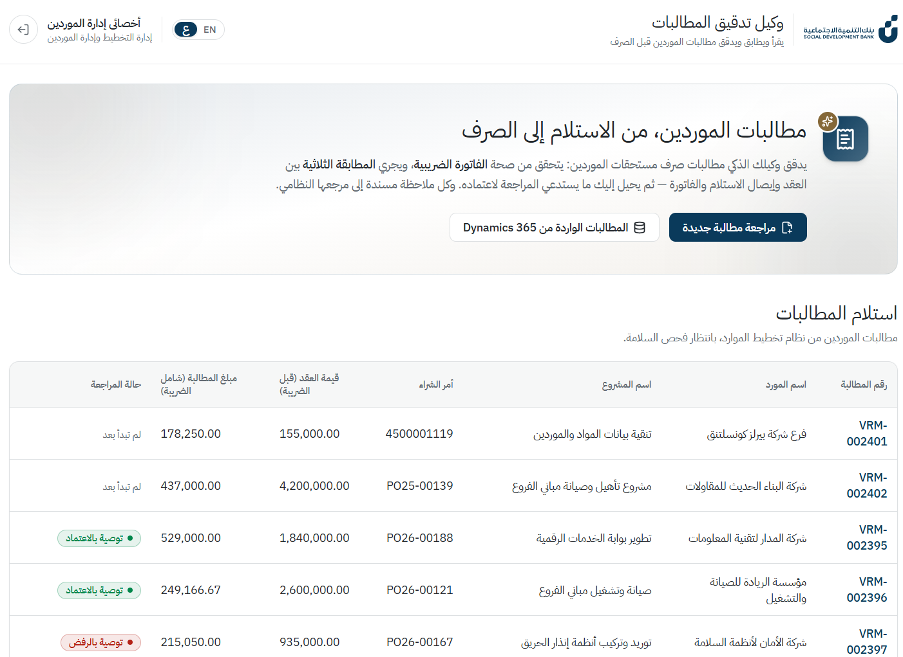
Claims intake queue — استلام المطالبات
Vendor claims pulled from Dynamics 365, each showing where it is in the review and the agent's recommendation.
• Fully bilingual — Arabic RTL / English with one toggle
• Dynamics 365 integration — claims, PO and contract values come from the ERP
Notes:
Screenshot: 1_home.png

Slide 3
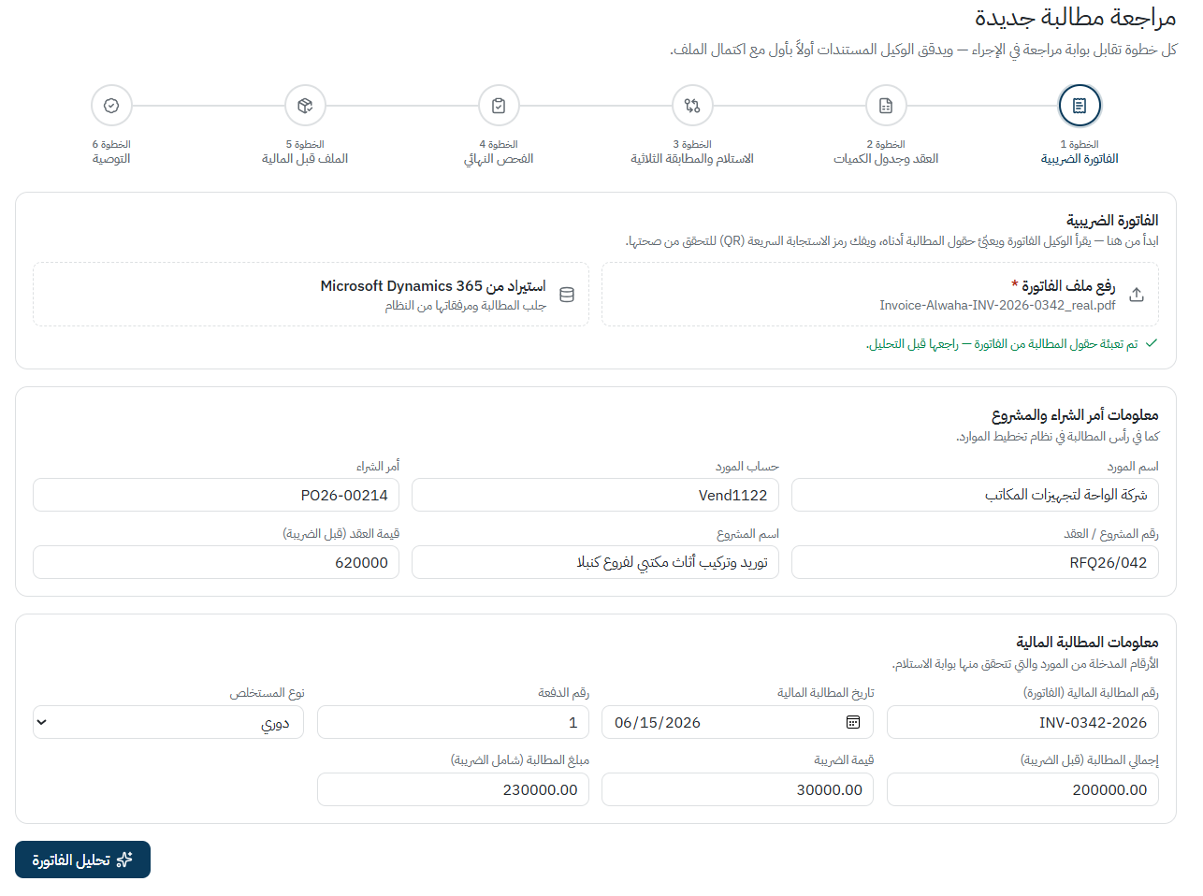
Step 1 — Tax invoice intake
The reviewer uploads the vendor's tax invoice. The agent reads it and pre-fills the claim — invoice number, date, amounts and VAT — so nothing is re-typed.
• Guided 6-step review, one step per gate of SDB's procedure (SP-01-04-05-02)
• The same claim can be imported directly from Dynamics 365 instead
Notes:
Screenshot: 2_invoice.png

Slide 4
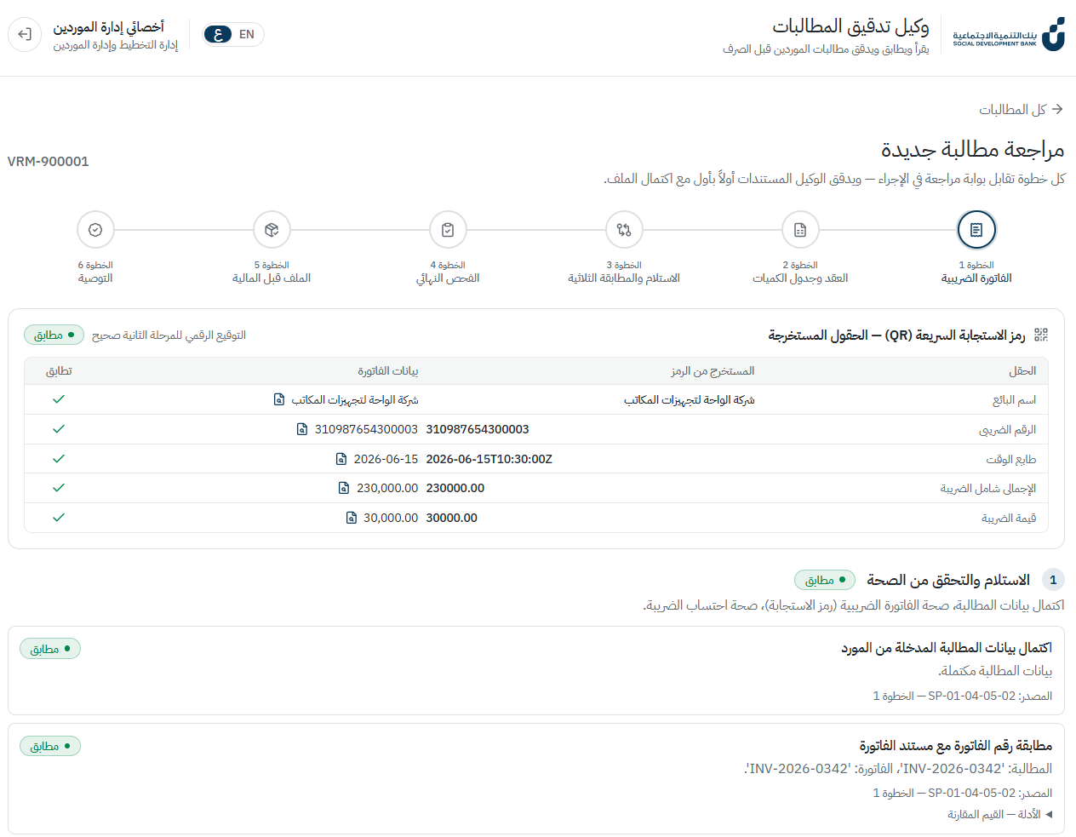
Step 1 — ZATCA QR verification
The agent decodes the QR code printed on the tax invoice and compares every field it carries — seller, VAT number, timestamp, totals — against the invoice face. Here all five match and the Phase-2 digital signature verifies.
• Each check cites its source in SDB's procedure or the regulation
• Evidence is one click away: every compared value links to its location in the PDF
Notes:
Screenshot: 3_invoice_qr.png

Slide 5
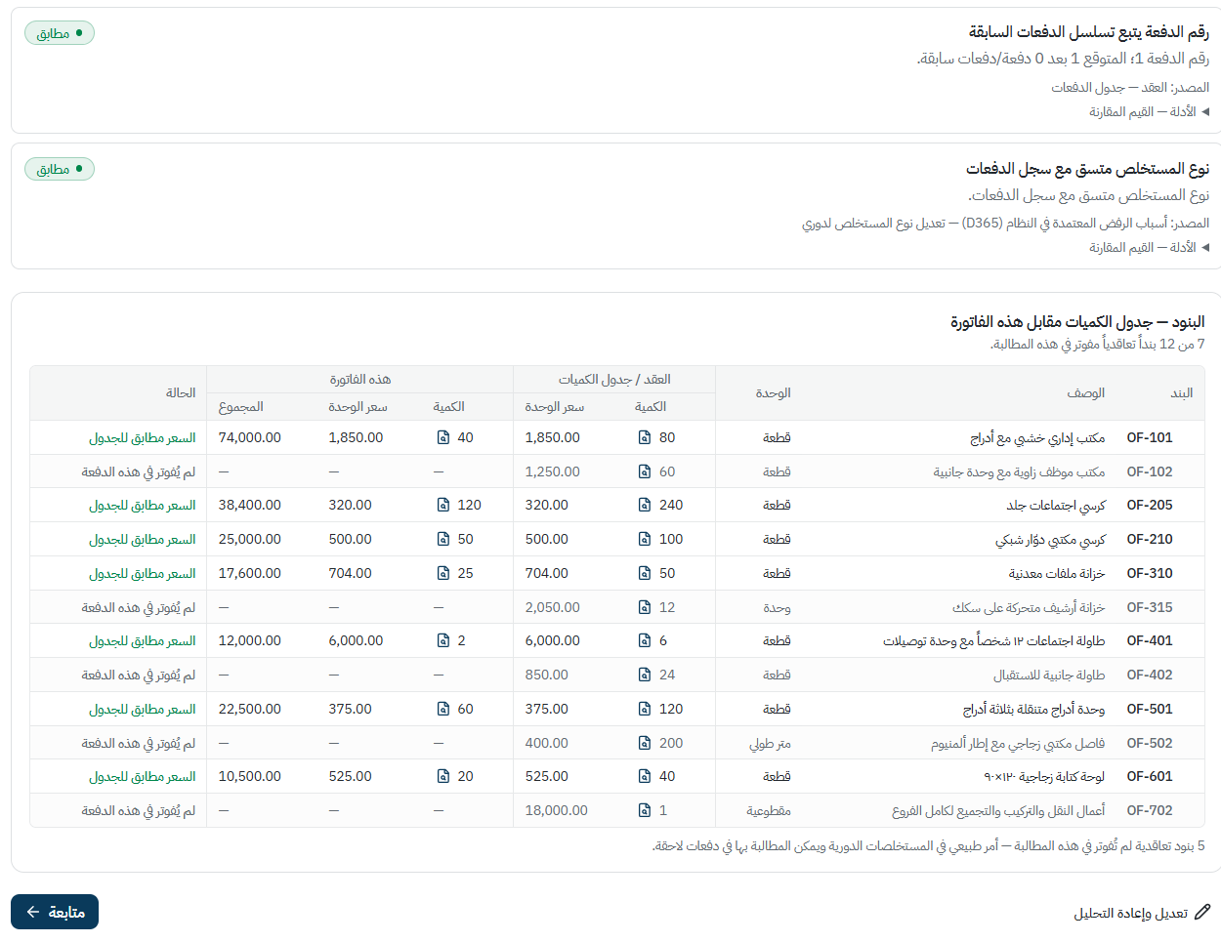
Step 2 — Invoice lines vs the contract's Bill of Quantities
The agent extracts every line from the invoice and matches it to the contracted BoQ — item code, unit, quantity and unit price. 7 of 12 contracted items are billed, every price matches the schedule, and the 5 unbilled items are flagged as normal for a periodic claim.
• Also checks the payment sequence and the claim type against the payment history (a known D365 rejection reason at SDB)
Notes:
Screenshot: 4_boq.png

Slide 6
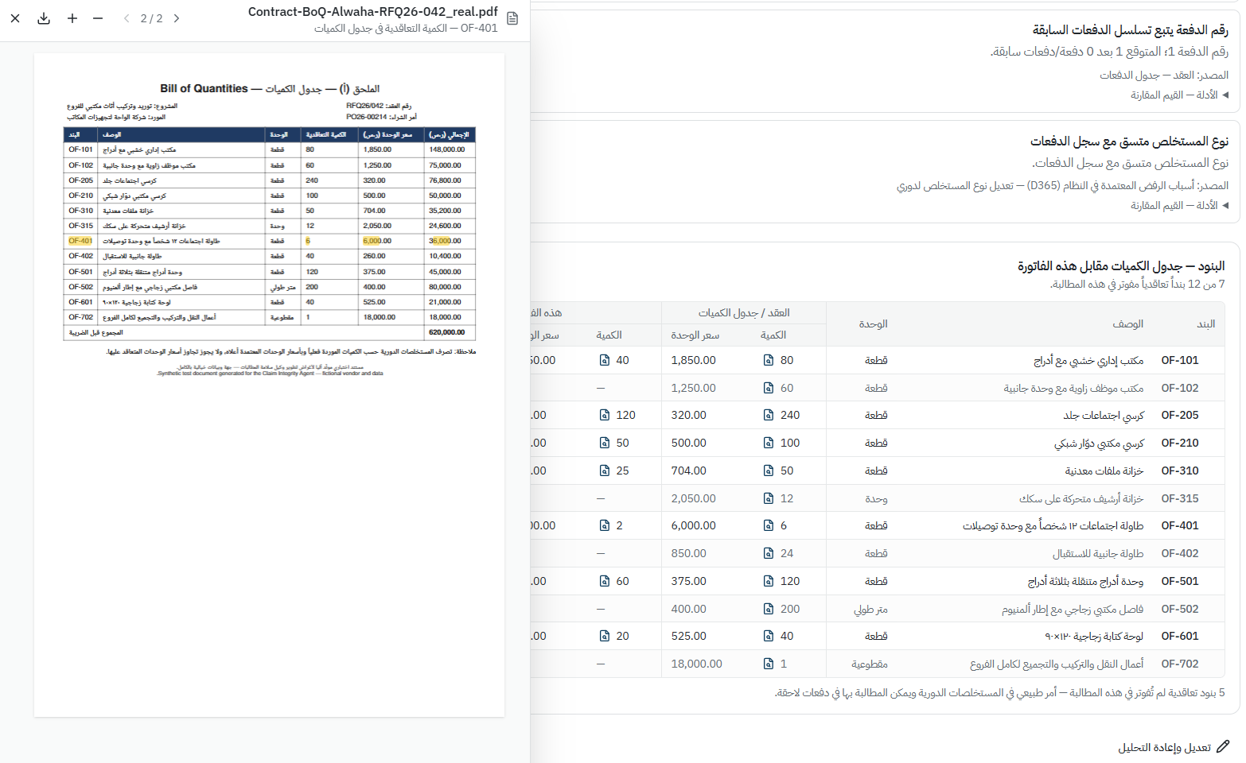
Evidence behind every extraction
Every extracted value links back to its exact location in the source document — one click opens the invoice with the figure highlighted. Reviewers verify; they don't take the agent's word for it.
Notes:
Screenshot: 5_boq_evidence.png

Slide 7
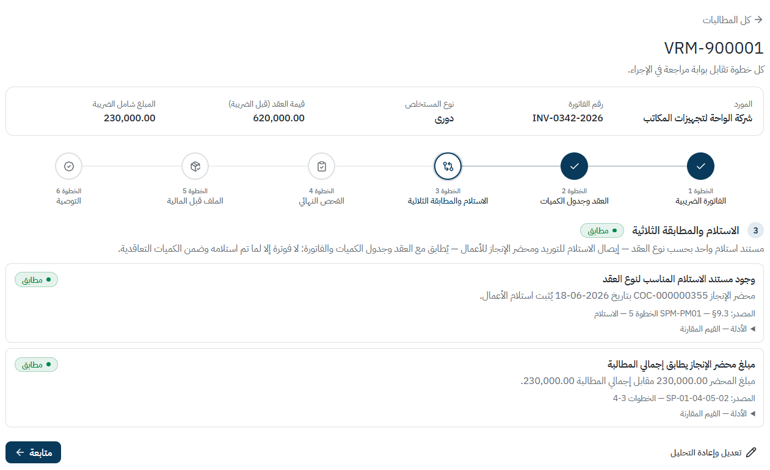
Step 3 — Acceptance & three-way match
The agent confirms the right acceptance document exists for the contract type — here the completion certificate COC-000000355 — and that its certified amount equals the claim total. Where an ERP product receipt exists, quantities are reconciled line by line across contract, receipt and invoice.
Notes:
Screenshot: 6_threeway.png

Slide 8
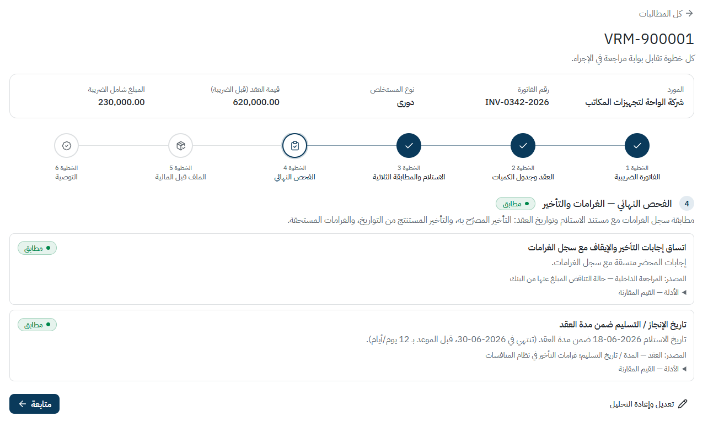
Step 4 — Final check: completion certificate, dates and penalties
The completion certificate is cross-checked against the vendor's penalty register and the contract dates: delivery 165 days before the contract end, and the certificate's 'no delay / no stoppage' declarations agree with the penalty record.
• Catches the case SDB reported — a certificate declaring no delay for a vendor who was penalised for one
Notes:
Screenshot: 7_penalties.png

Slide 9
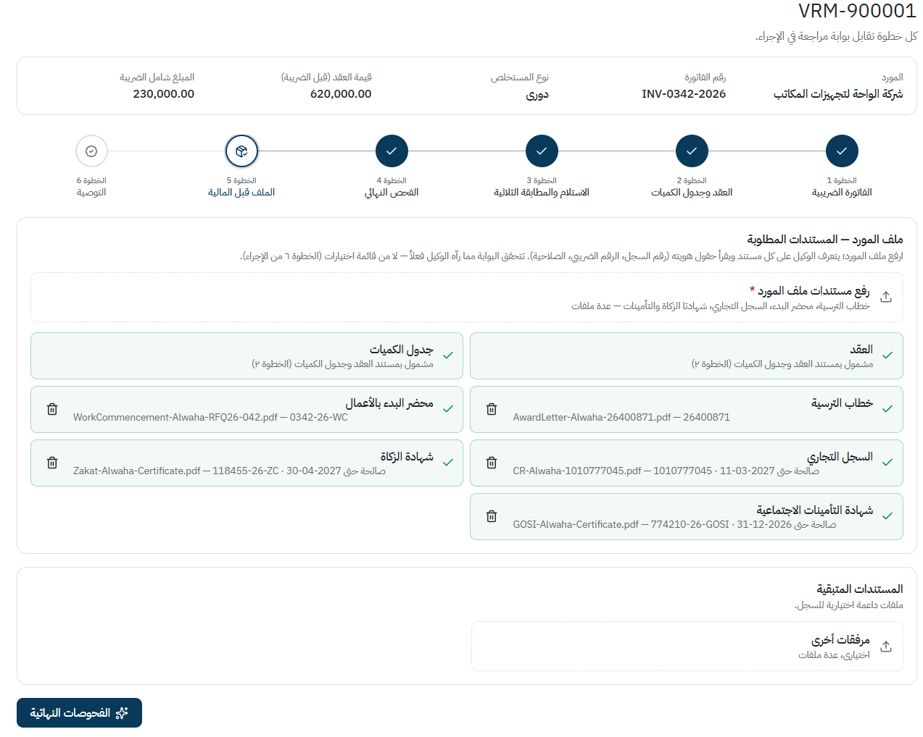
Step 5 — Vendor file: legal & compliance documents
The agent identifies each document in the vendor file — award letter, work commencement, commercial registration, GOSI and Zakat certificates — reads its reference number and validity date, and confirms the pack required by procedure step 6 is complete.
• Completeness is based on what the agent actually read, not on a checkbox list
• Expired or missing certificates are flagged before the claim reaches finance
Notes:
Screenshot: 8_prefinance.png

Slide 10
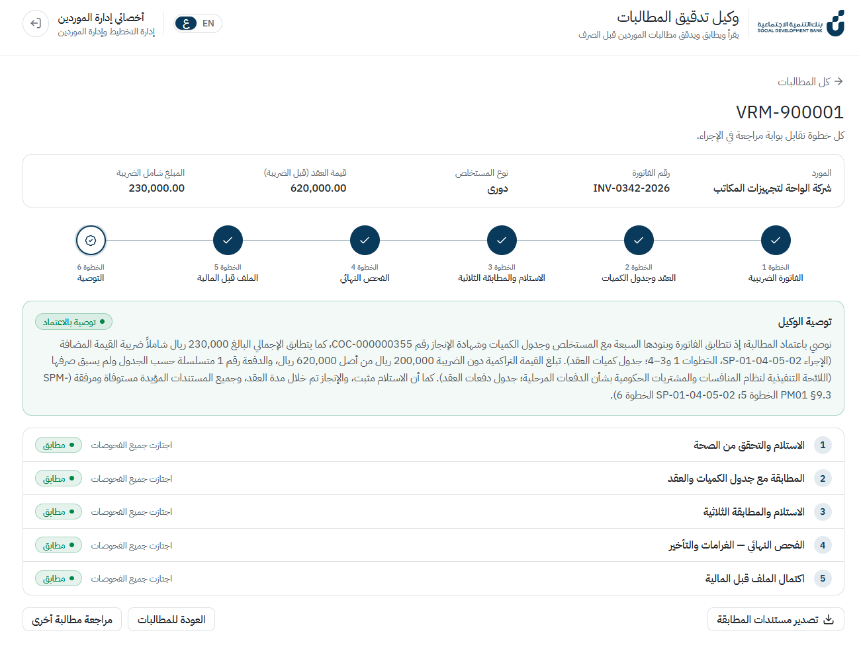
Step 6 — Recommendation and hand-off
The agent issues its recommendation with a written rationale citing the procedure steps and regulations behind it, and a one-line verdict per gate. The reviewer keeps the decision.
• Export bundles every document that took part in the matching — tax invoice, contract/BoQ, completion certificate — named by claim number, ready for finance and audit
Notes:
Screenshot: 9_summary_and_export.png

