Slide 1
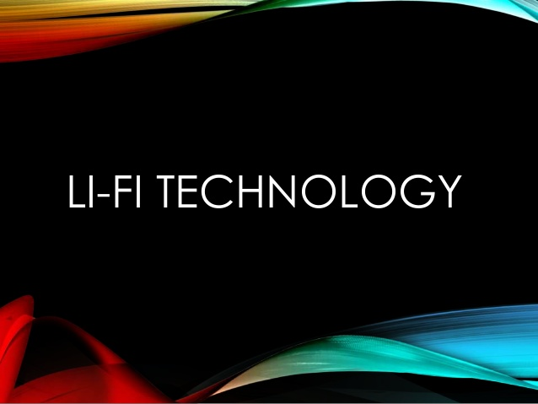
Hamdard Institute of Engineering Sciences & Technology
Presented By
Rasim Izhar Ali BECS/S13/0109
Murad Ali Jamali BECS/S13/0106

Slide 2
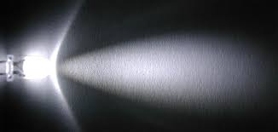
Table of Contents
What is Li-fi?
Introduction
History
Present Scenario
Issues of Using Radio Spectrum
Who can resolve this issue?
Principle of Li-Fi
Why Li-Fi use VLC?
Li-Fi Vs Wi-Fi
Applications Of Li-Fi.
Merits And Demerits
Conclusion

Slide 3

What is Li-fi(LIGHT FIDELITY)?
Light based Wi-Fi
Light is used instead of radio waves to transmit information.
Transceiver fitted LED lamps acts like Wi-Fi modems.
LED lamps can light a room as well as transmit-receive information.
Sending data through a LED light bulb that varies in intensity faster than human eye can follow.

Slide 4
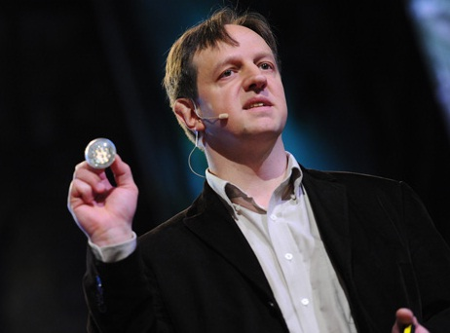
History
Prof. Harald Haas, from university of Edinburgh in the UK is the founder of Lifi.
On 20th July 2011 he used a table lamp with an LED bulb to transmit a video of blooming flowers that was then projected onto a screen behind him. During the event he periodically blocked the light from lamp to prove that the lamp was indeed the source of incoming data.
Professor Harald Haas

Slide 5
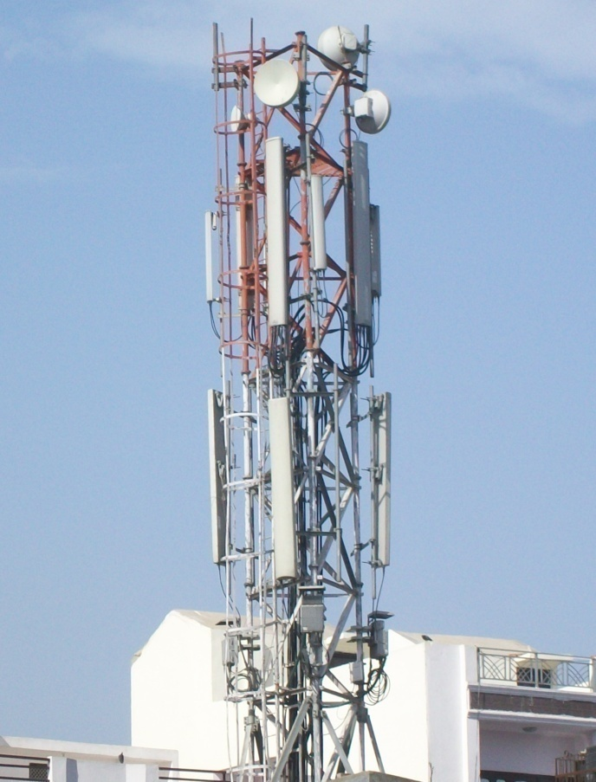
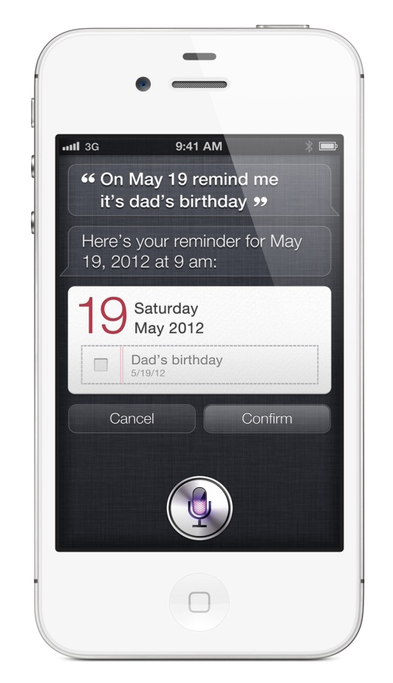
Present Scenario
1.4 Million Base Stations
5 Billion Mobile Stations

Slide 6
Present Scenario
Radio Spectrum is congested but the demand for wireless data double each other.
Data in the form of tera bytes travel every week or month.
Every one want to use wireless data but the capacity is drying up resulting in different issues.
So, what can carry this excess demand in future

Slide 7
Interesting, right?
This is just a sneak preview of the full presentation. We hope you like it! To see the rest of it, just click here to view it in full on PowerShow.com. Then, if you’d like, you can also log in to PowerShow.com to download the entire presentation for free.

