Slide 1
BEN130 Built Environment Economics Week 5 – Market Equilibrium & The Free Market System

Slide 2
Module Content
Introduction to economic concepts, scarcity, choice and opportunity cost.
Macro and micro economic theory and how it influences development projects.
Real estate market forces, demand and supply, price elasticity, market equilibrium, free market system.
Government intervention, control and regulation and how it impacts on market prices and costs.

Slide 3
1. Market equilibrium

Slide 4
Markets and equilibrium
So far we have considered the separate concepts of demand and supply.
This first part of the lecture will examine the price mechanism (also known as market mechanism), how this brings about equilibrium and the effects of changes in supply and demand on the market price and quantity.
This will enable us to examine how the free market solves the basic economic problems and draw a comparison with a planned economy.

Slide 5
Markets and equilibrium
A market occurs when buyers and sellers interact to exchange goods and services (whether physical or online).
Equilibrium (Gillespie p. 125) occurs in a market when the quantity supplied equals the quantity demanded (Demand = Supply) and there is no incentive for this position to change.

Slide 6
Equilibrium in a Free Market
In a free market equilibrium is reached by changes in the price.
Decisions of producers and consumers are made independently of each other; the price mechanism acts to bring these decisions together and to equate the quantity supplied and demanded.
As demand or supply conditions change the price will adjust to bring about a new equilibrium price and quantity.
So, how does this work?

Slide 7
Price mechanism in the Free Market
In the free market the price mechanism is acting as:
A signal and incentive; as the price rises this acts as a signal to other producers (on the supply side of an industry) that this is an industry they might want to enter to earn high or higher profits (e.g. residential housing market during a peak period), and
A rationing device; as the price increases it reduces the quantity demanded until it equals the quantity supplied.
i.e. Due to Price Mechanism & Law of Market Forces:
When there is a shortage of goods, the price rises.
When there is a surplus of goods, the price falls.

Slide 8
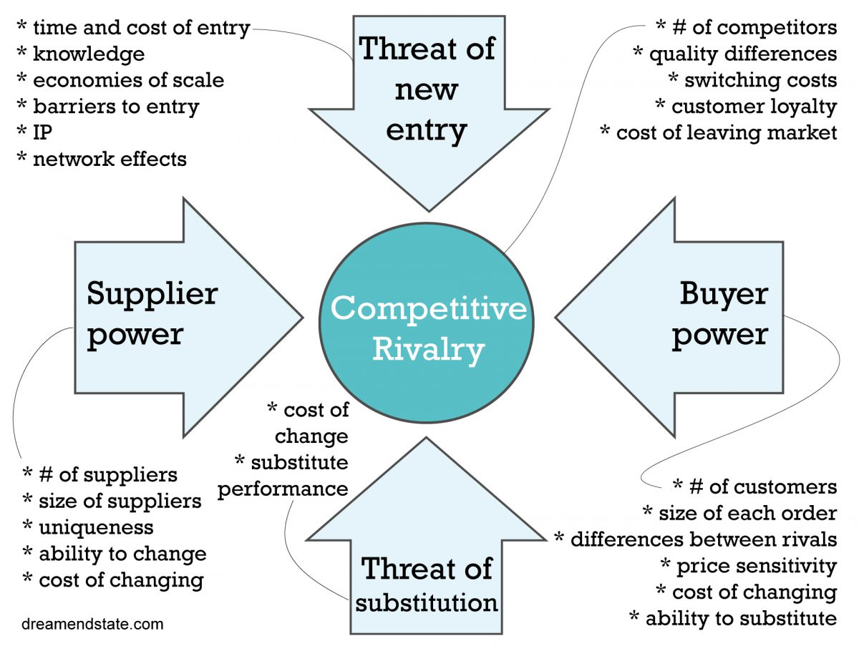
Porter’s Five Forces

Slide 9
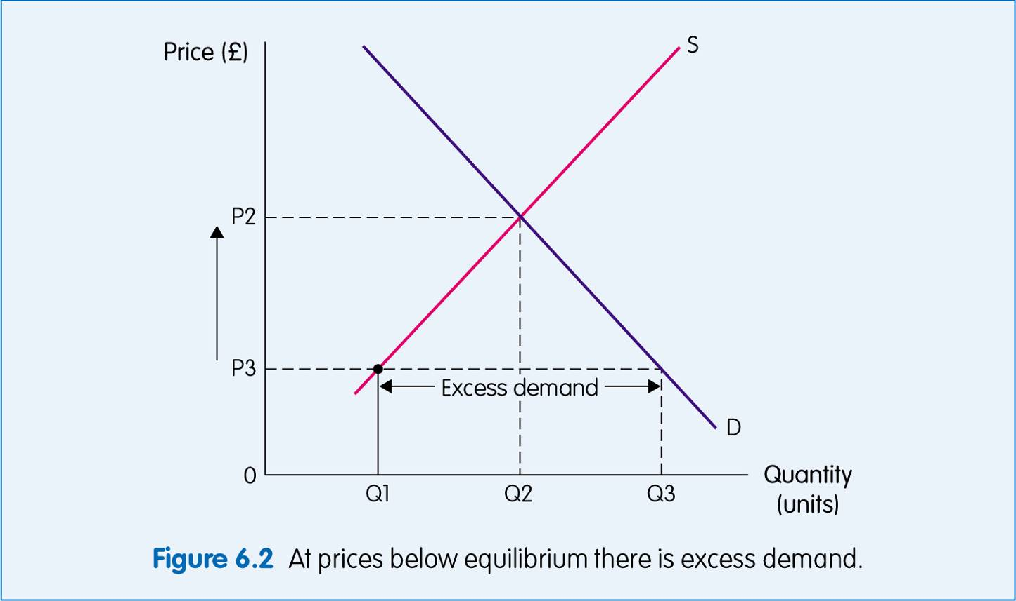
Shortage
Shortage occurs when the quantity demanded exceeds the quantity supplied:

Slide 10
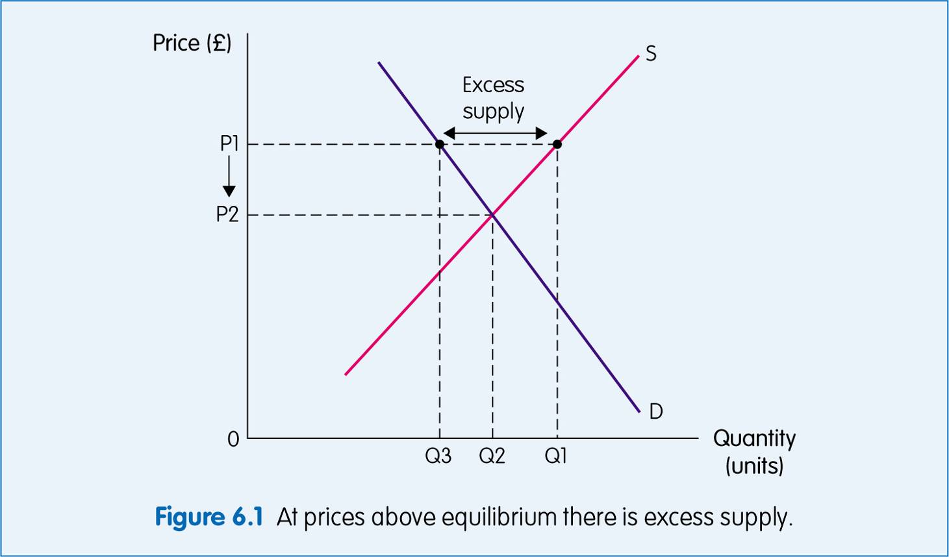
Surplus
Surplus occurs when the quantity supplied exceeds the quantity demanded:

Slide 11
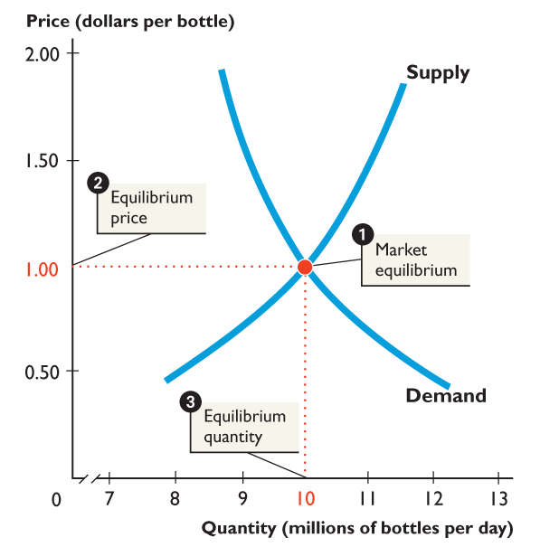
Example of Equilibrium
Consider the following simple example:
The demand and supply for bottled water is as follows:

Slide 12

Example of Equilibrium
Market equilibrium occurs at the intersection of the demand curve and the supply curve (where D=S) at Point 1
We can identify the equilibrium price & quantity demanded at this point:
The equilibrium price is $1 a bottle
The equilibrium quantity is 10 million bottles (per day)
Notes:
The equilibrium price is $1 a bottle

Slide 13
Effect of Increase in Demand
Imagine now that a new study shows that drinking tap water is unsafe. How do you think this might affect the Equilibrium price & quantity?
- There will be a change in demand for bottled water (a shift in the demand curve)
- How do we show this on the Demand & Supply graph?
Demand will increase at each and every price, thus the curve will shift to the right, resulting in an increase in the price and the quantity supplied.

Slide 14
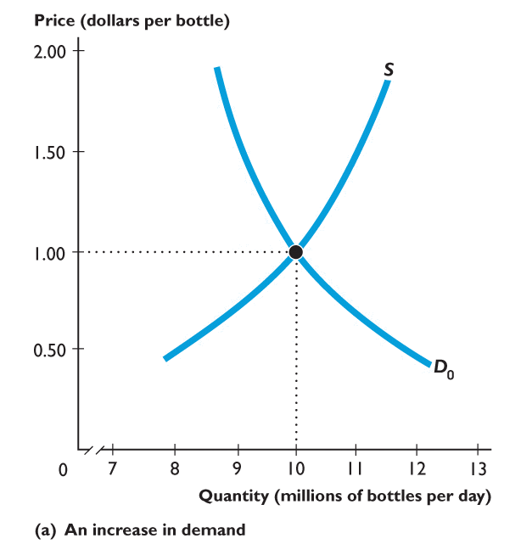
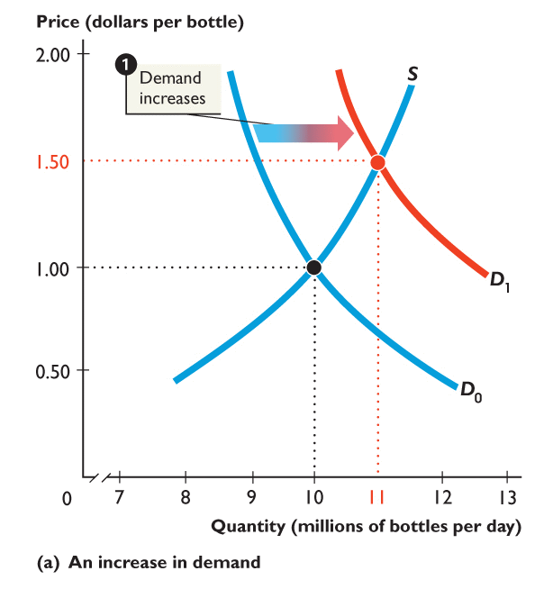
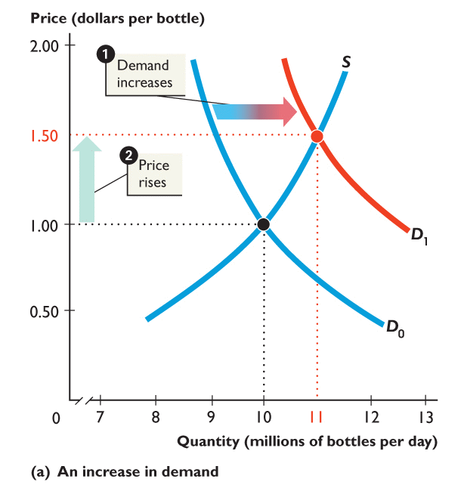
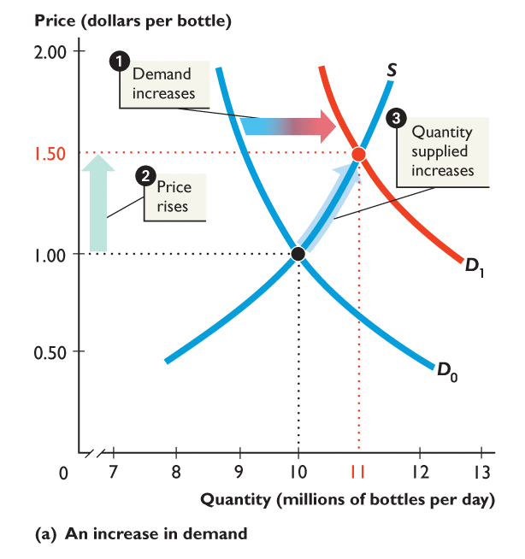
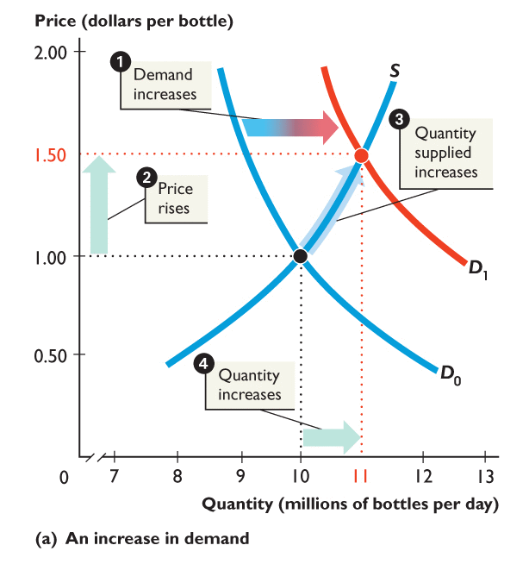
Increase in Demand
1. An increase in demand shifts the demand curve rightward (from D0 to D1).
2. At $1.00 a bottle, there is a shortage, so the price rises to $1.50.
3. The quantity supplied increases along the supply curve.
4. Equilibrium quantity now increases to 11m bottles per day.
Notes:
Tell students that they will do much better on the exam if they DRAW the demand-supply graph to answer a question.
Show them how much easier it is to see the effects of a change in demand or a change in supply or both on the equilibrium price and equilibrium quantity if they draw the graph.

Slide 15
Fall in Demand
Now imagine that a new zero calorie sports drink is invented.
- How will this affect the demand for bottled water?
- The sports drink is a substitute for water so you would expect a fall in demand; demand curve shifts to the left.

Slide 16
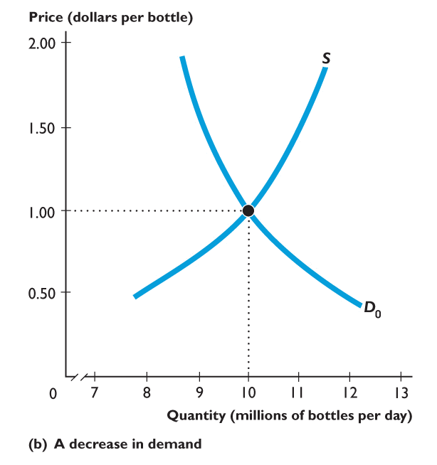
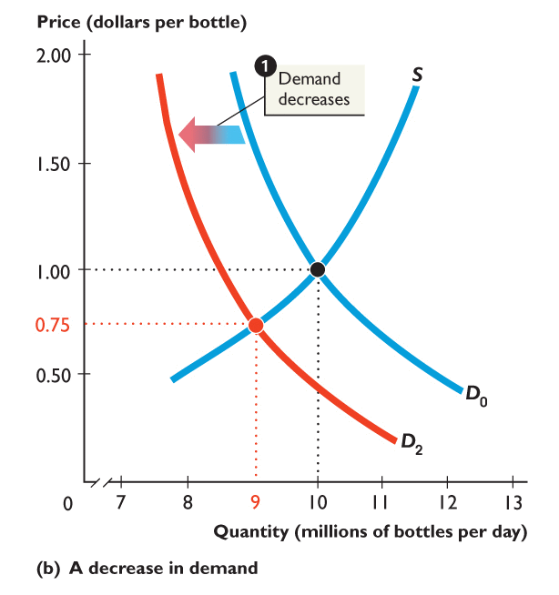
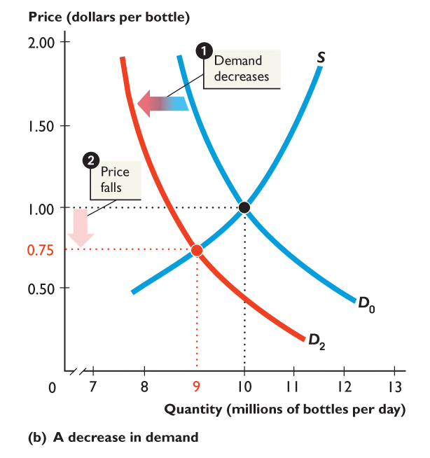
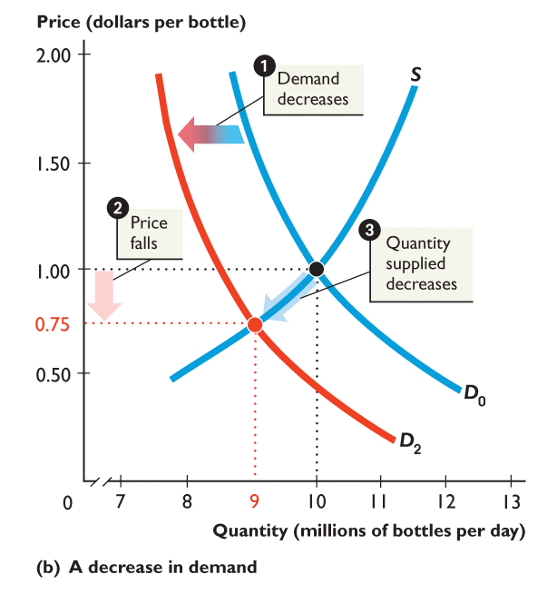
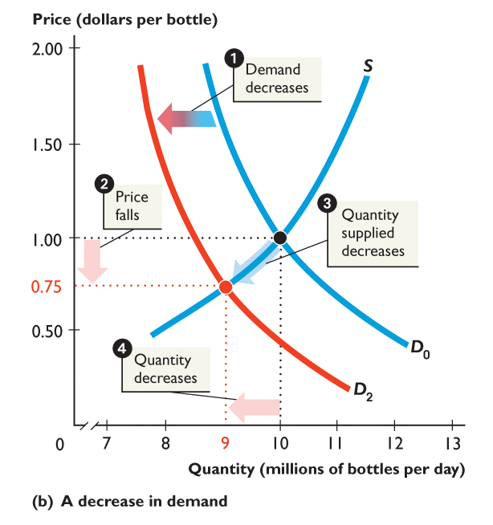
Fall in Demand
1. A decrease in demand shifts the demand curve leftward (D0 to D2).
2. At $1.00 a bottle, there is a surplus, so the price falls to $0.75.
3. Quantity supplied decreases along the supply curve.
4. Equilibrium quantity decreases to 9m bottles per day.
Notes:
Now emphasize the distinction between a change in supply and a change in the quantity supplied.

Slide 17
A Change in Supply
Now consider the effect of a change in supply.
Imagine that a number of European producers of bottled water buy springs and open plants in the US.
This will increase the supply of bottled water in the US, thus the curve shifts to the right.

Slide 18
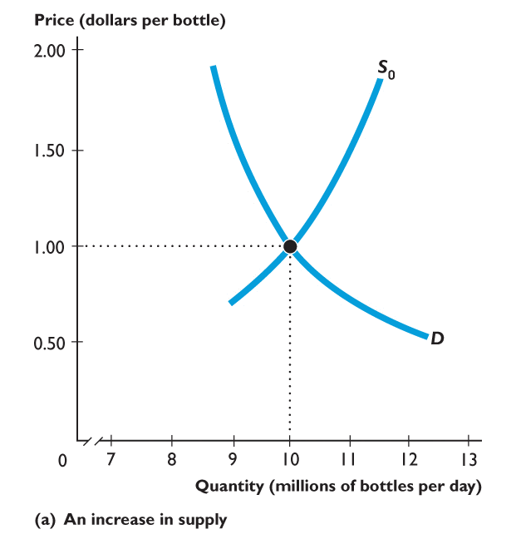
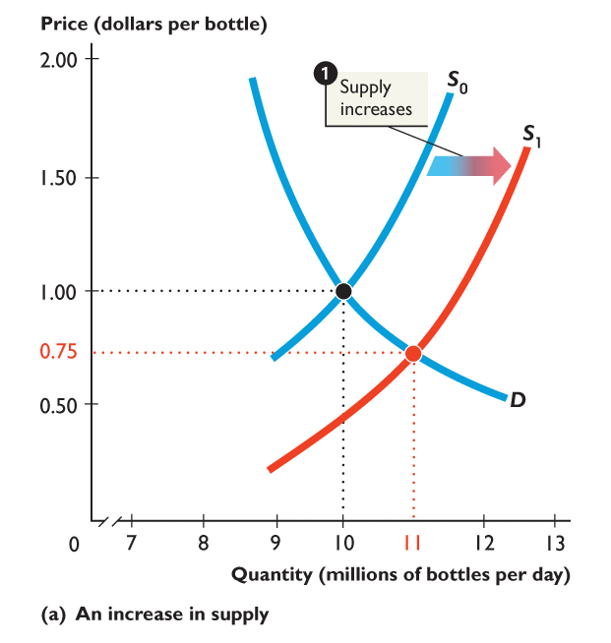
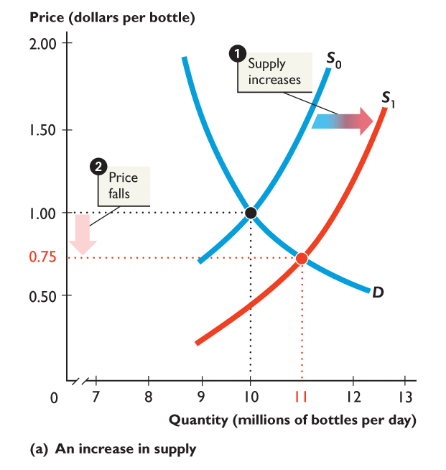
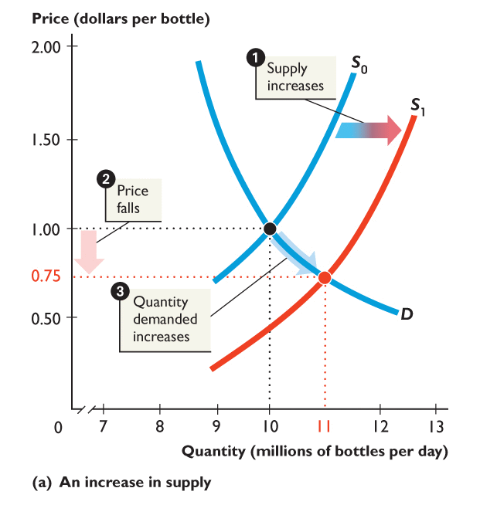
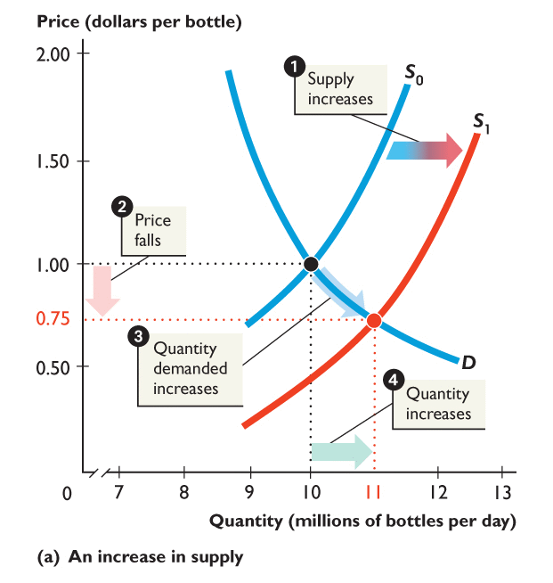
Increase in Supply
1. An increase in supply shifts the supply curve rightward (S0 to S1).
2. At $1 a bottle, there is a surplus, so the price falls to $0.75.
3. Quantity demanded increases along the demand curve.
4. Equilibrium quantity increases to 11m.

Slide 19
Growing Supply in the ‘Real World’
‘Expectations of future oil supply key to explaining drop in price’ (June 2015)
Between June 2014 and January 2019, the price of crude oil fell by nearly 60%, one of the three largest falls since the 1970s. Even after the recovery in recent months, oil prices remain around 50% lower.
There are three potential explanations for the fall in prices:
Rapid increase in the actual supply of oil due to the resumption of Libyan production and the ongoing US shale-oil production boom,
Higher future supply of oil due to the decision by OPEC in November not to cut production despite plummeting prices. Many market participants saw this as a signal that the OPEC was willing to tolerate lower prices, perhaps in an effort to undercut high-cost oil production like shale-oil.
Slowing prospects for global growth, suggesting a weaker outlook for oil demand.
http://bankunderground.co.uk/2015/06/26/oil-is-not-as-it-seems-expectations-of-future-oil-supply-key-to-explaining-drop-in-price/

Slide 20
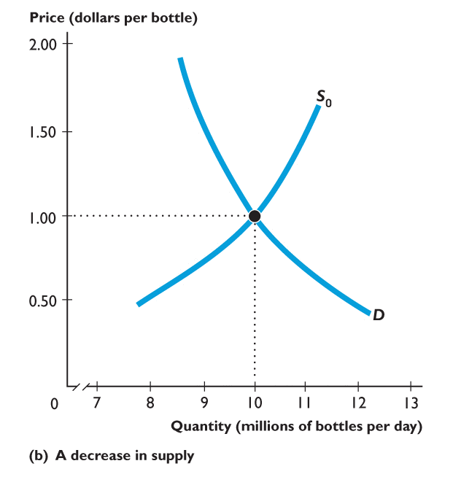
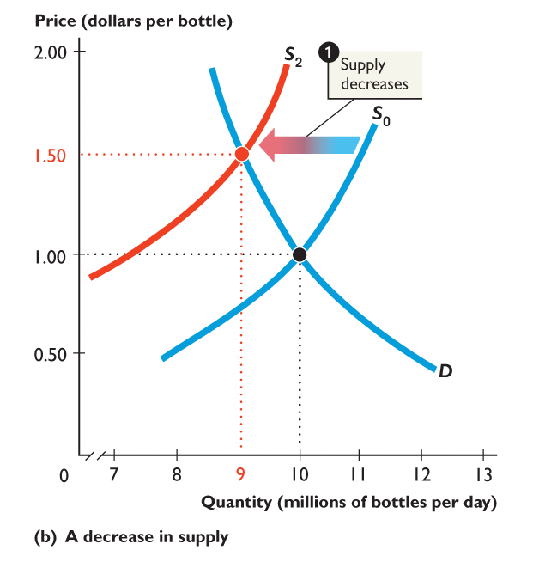
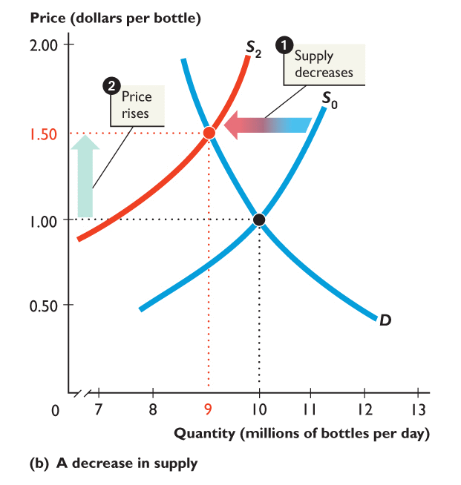
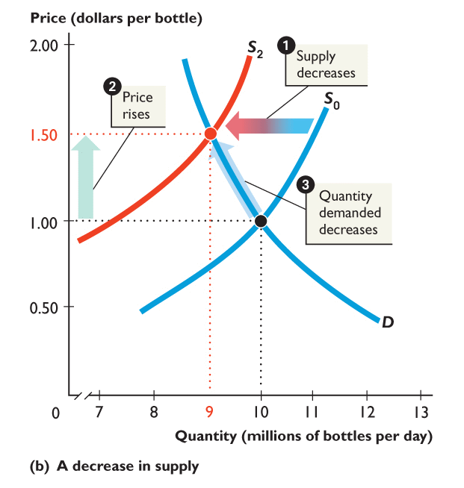
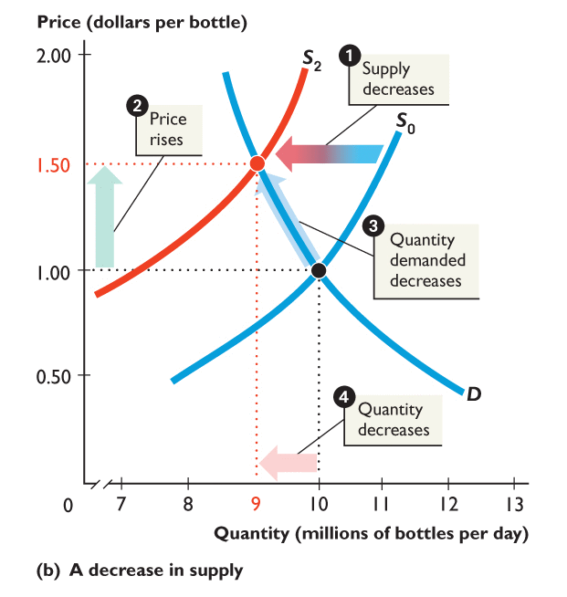
Decrease in Supply
Finally, consider the case where there is a drought and supply curve shifts to the left:
1. A decrease in supply shifts the supply curve leftward (S0 to S2).
2. At $1.00 a bottle, there is a shortage, so the price rises to $1.50.
3. Quantity demanded decreases along the demand curve.
4. Equilibrium quantity decreases to 9m

Slide 21
Summary
Assuming a downward sloping demand curve and upward sloping supply curve:
An outward shift in demand increases the equilibrium price and quantity
An inward shift in demand decreases the equilibrium price and quantity
An outward shift in supply decreases the equilibrium price and increases the equilibrium quantity
An inward shift in supply increases the equilibrium price and decreases the equilibrium quantity

Slide 22
Effect of indirect taxes & subsidies
Indirect Taxes, e.g. VAT, increase the prices paid by buyers and lower the prices received by sellers (Gillespie pp. 137-8).
So, taxes decrease the quantity produced and lead to underproduction.
Subsidies, on the other hand, lower the prices paid by buyers and increase the prices received by sellers (Gillespie pp. 139-40).
So, subsidies increase the quantity produced and lead to overproduction.

Slide 23
Effect of indirect tax
An indirect tax must be paid by the supplier
The imposition of an indirect tax increases the equilibrium price and reduces the quantity
If demand is more price inelastic than supply the incidence of an indirect tax falls mainly on consumers
If supply is more price inelastic than demand the incidence of an indirect tax falls mainly on producers
Two examples of indirect tax? Per Unit & % of Unit.

Slide 24
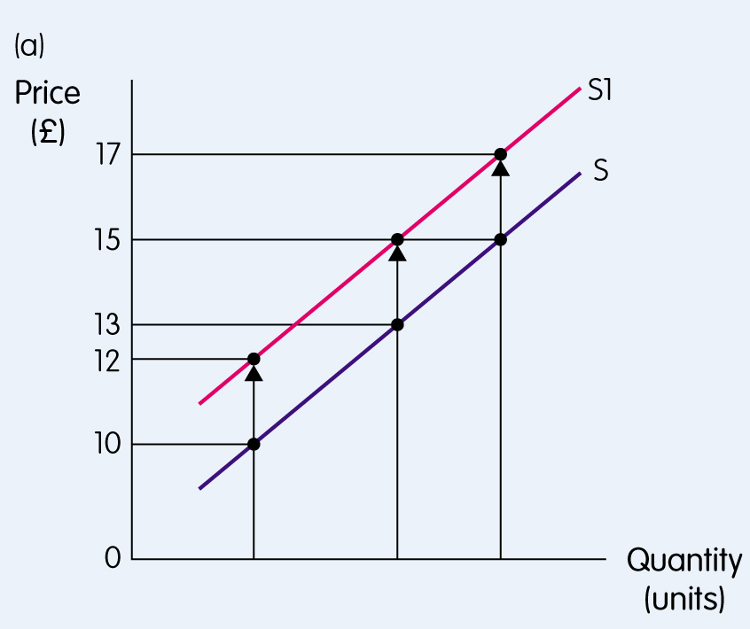
The effect of a per unit indirect tax being imposed

Slide 25
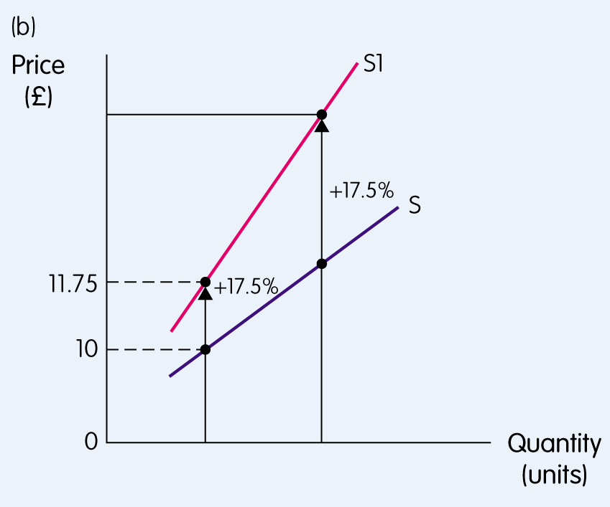
The effect of a percentage indirect tax being imposed

Slide 26
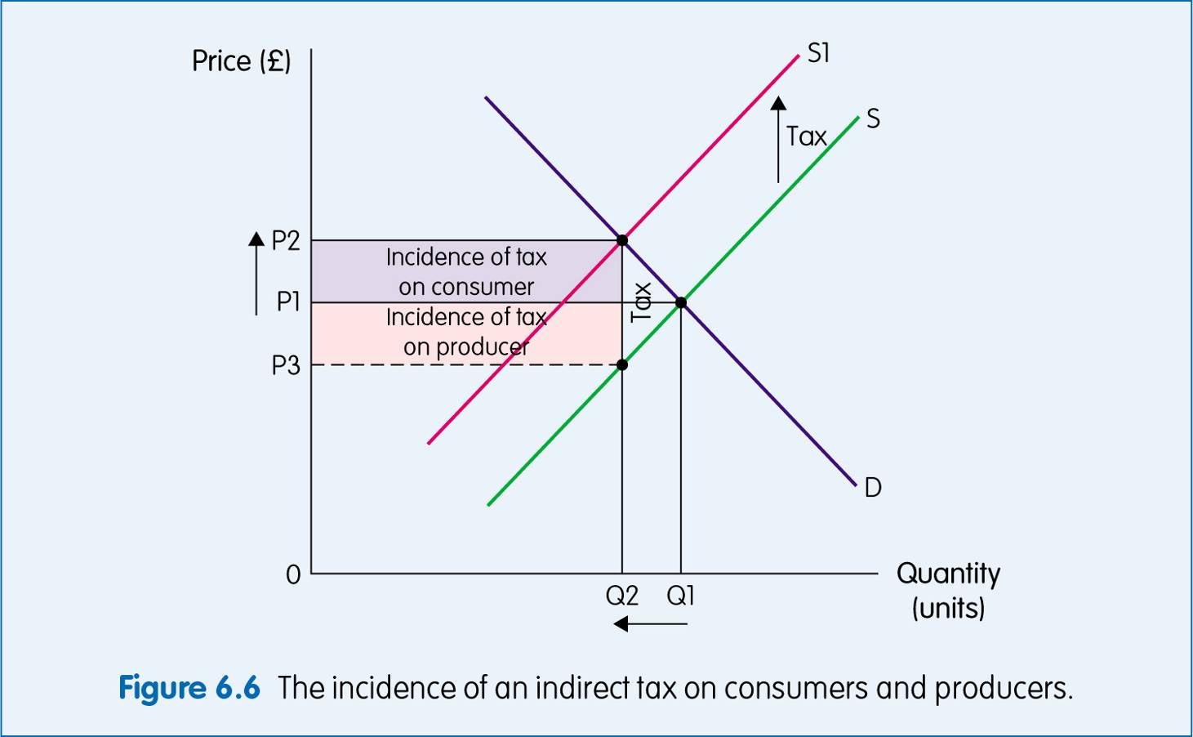
The incidence of indirect tax on producers and consumers

Slide 27
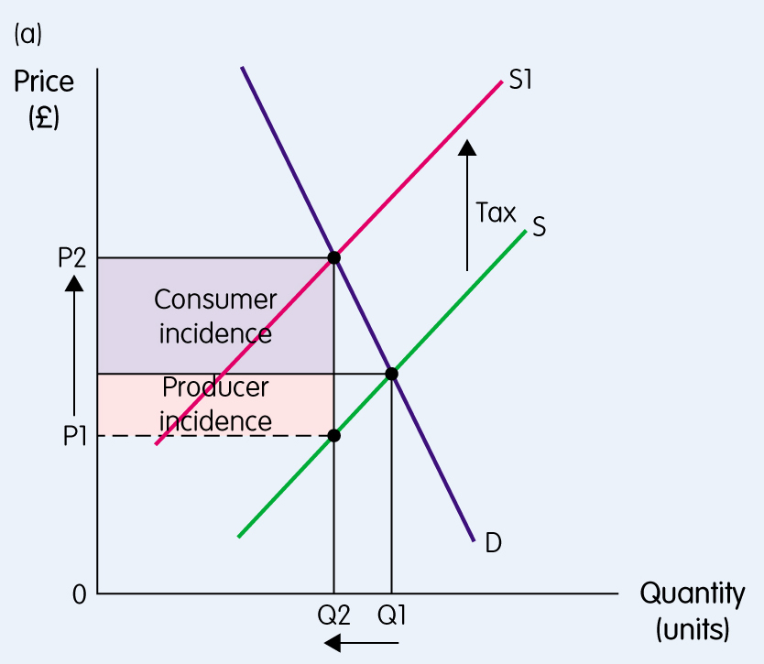
The incidence of an indirect tax
The incidence of an indirect tax on consumers is greater when demand is more price inelastic than supply

Slide 28
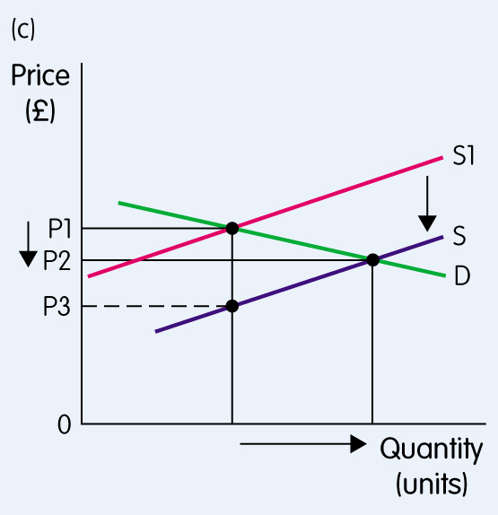
The effect of a subsidy
The subsidy is equal to P1- P3. The price for consumers in this case falls from P1-P2. P2-P3 is the amount of the subsidy per unit retained by the firm.

Slide 29
2. The Free Market System

Slide 30
Advantages of the free market system
In a free market, decisions about what to produce are determined by supply and demand (Gillespie p. 149).
In theory, i.e. based on “strong assumptions”, the free market maximises social welfare (social marginal benefit = social marginal cost) i.e. maximises community surplus (Gillespie pp. 150-3)

Slide 31
Advantages of the free market system
Consumer surplus measures the difference between what a consumer is willing to pay for a product and what he or she actually pays
Producer surplus measures the difference between the price producers are willing to sell at and the price they actually receive
Community surplus = consumer surplus + producer surplus

Slide 32
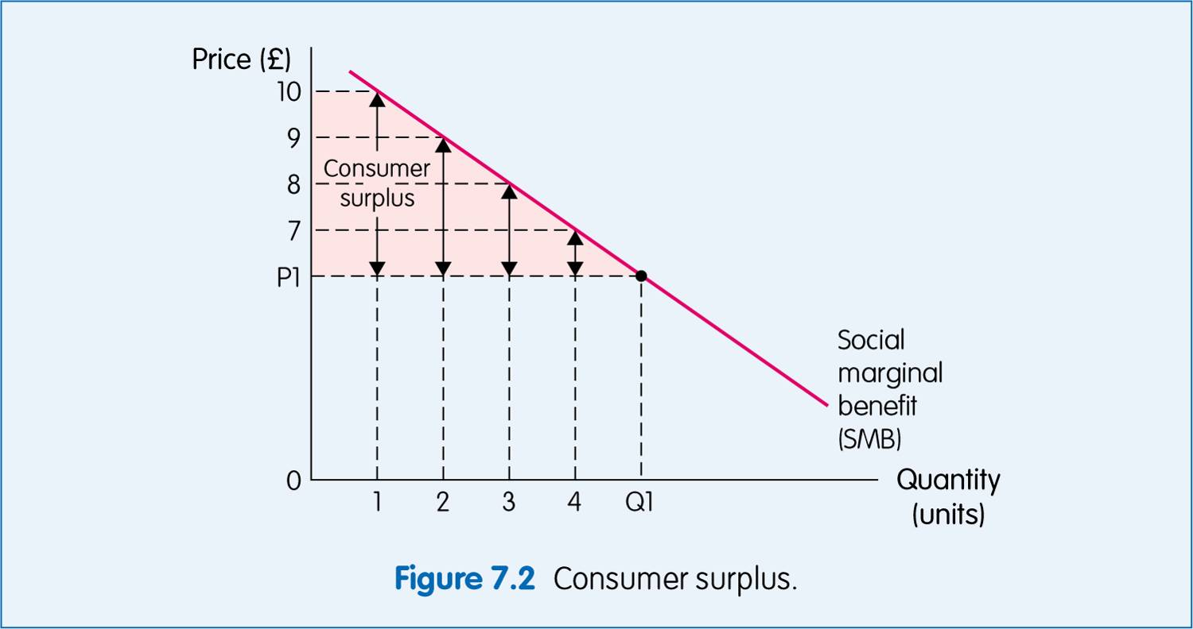
Consumer surplus

Slide 33
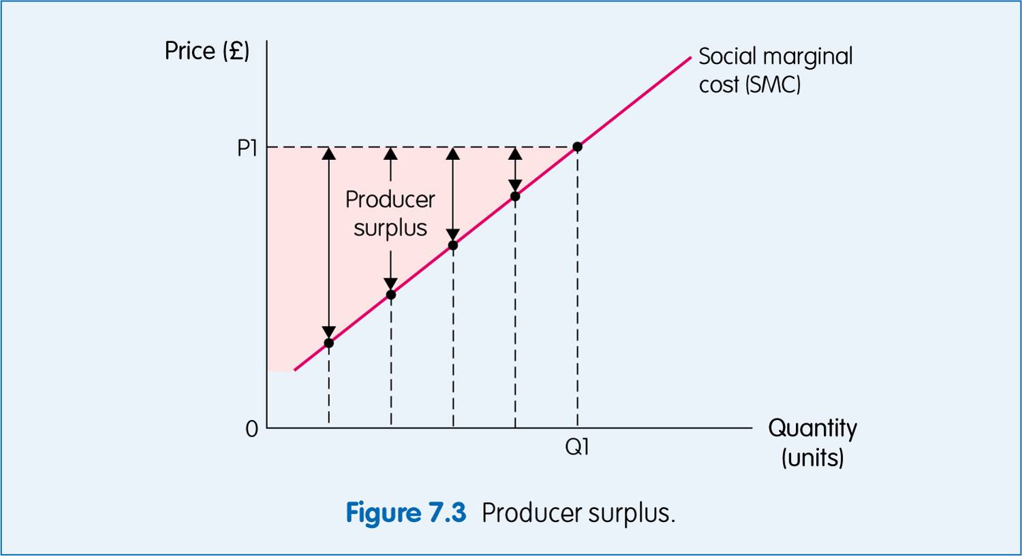
Producer surplus

Slide 34
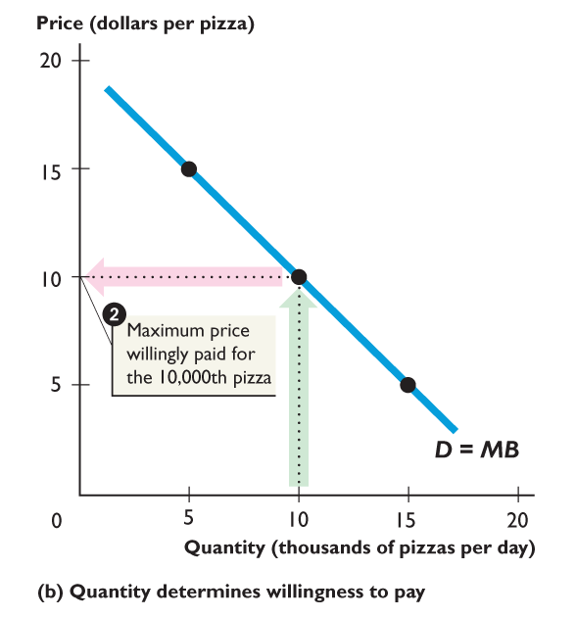
Examples
These concepts are best explained with reference to an example. Consider the following demand curve for pizza:

Slide 35
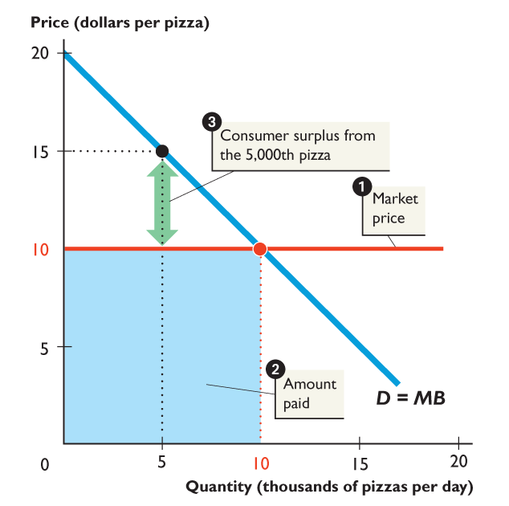
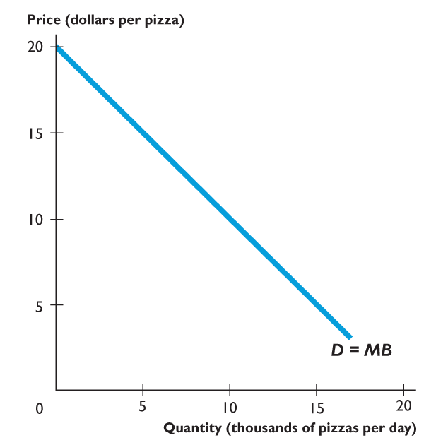
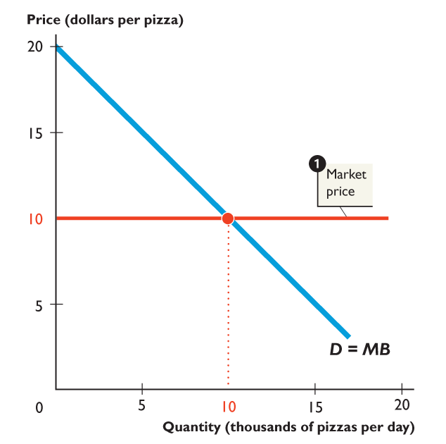
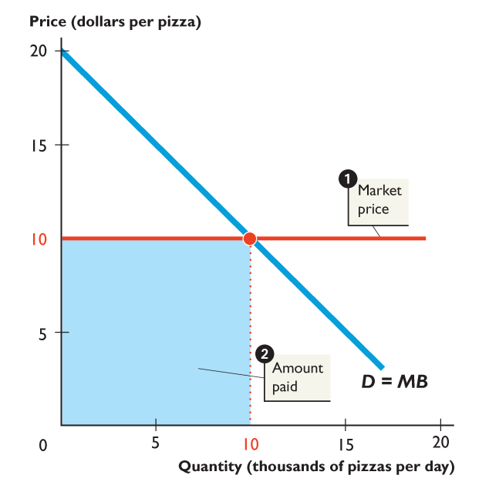
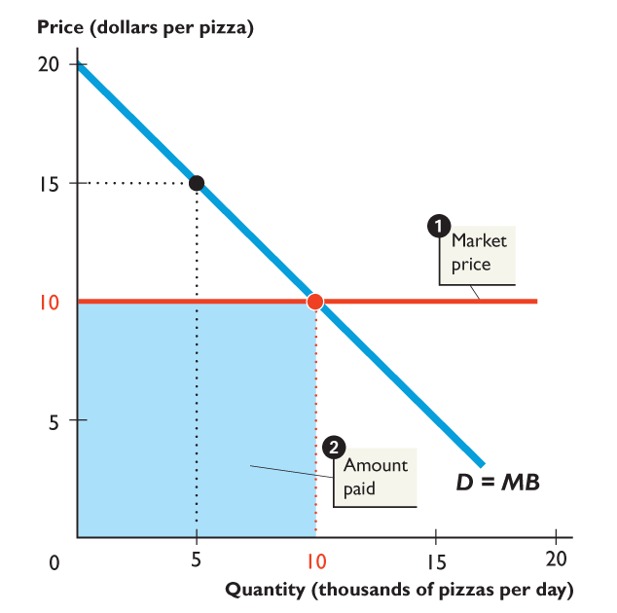
Consumer Surplus
1. The market price of a pizza is $10.
2. At this price people buy 10,000 pizzas
3. But people are willing to pay $15 for the 5,000th pizza, so consumer surplus from that pizza is $5.
4. People are also willing to pay $17.5 for the 2,500th pizza, etc. etc.. We need to add the whole area to which this applies…
Notes:
The consumer surplus, producer surplus, and deadweight loss are all generally triangular in shape. Indeed, if you draw only linear demand and supply curves and do not make either curve vertical or horizontal, these surpluses and any deadweight loss are triangles. So, it is a good idea to remind your students of the formula for calculating the area of a triangle. Make sure to do several examples of the calculation for both consumer and producer surplus. Remind them that this area represents a dollar value. This reminder is especially useful when you quantify the deadweight losses created by monopolies, quotas, subsidies, etc. Many students just see the loss to society as a loss of jobs or less output, but you can create more intuition by putting the loss in dollar terms.

Slide 36
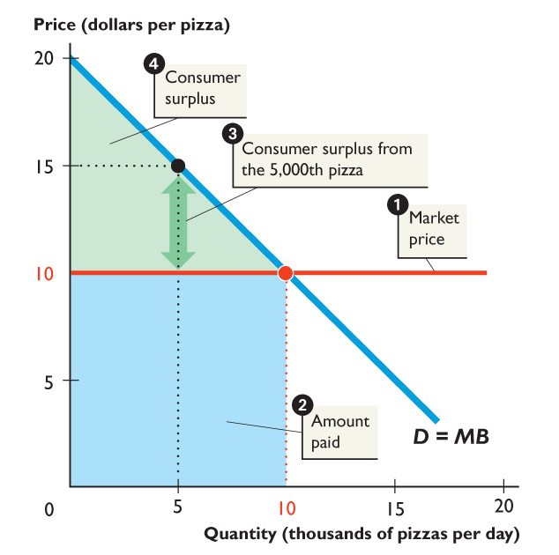
Total Consumer Surplus
Total consumer surplus from the 10,000 pizzas that people buy is the area of the green triangle.
(This relates to all the pizzas that people would have been willing and able to buy at prices above $10 per pizza, yet did not have to. Hence the term consumer surplus)
Notes:
The consumer surplus, producer surplus, and deadweight loss are all generally triangular in shape. Indeed, if you draw only linear demand and supply curves and do not make either curve vertical or horizontal, these surpluses and any deadweight loss are triangles. So, it is a good idea to remind your students of the formula for calculating the area of a triangle. Make sure to do several examples of the calculation for both consumer and producer surplus. Remind them that this area represents a dollar value. This reminder is especially useful when you quantify the deadweight losses created by monopolies, quotas, subsidies, etc. Many students just see the loss to society as a loss of jobs or less output, but you can create more intuition by putting the loss in dollar terms.

Slide 37
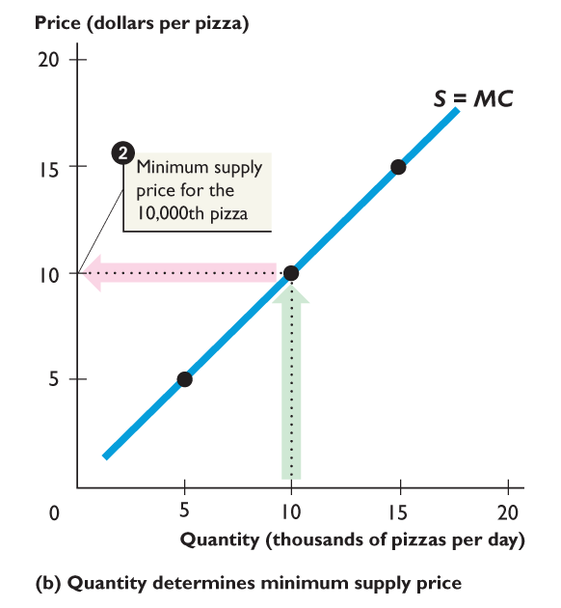
Producer Surplus
To demonstrate producer surplus now consider the following supply curve for pizza:

Slide 38
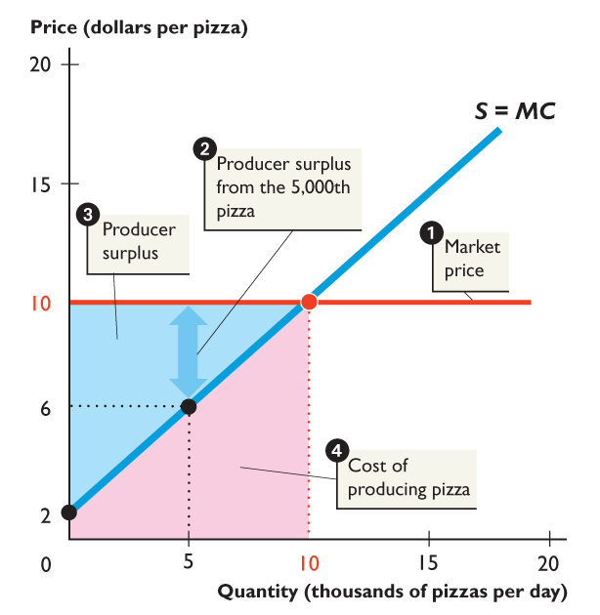
Producer Surplus
The producer surplus is shown by the blue shaded area; this is the difference between the price producers are willing to sell at (a shown by supply curve) and the price they actually receive (market price)

Slide 39
Maximising Social Welfare
It is sometimes said that social welfare is maximised in a free market (though this is based on strong assumptions):
At equilibrium, the quantity supplied = the quantity demanded
This means that the extra benefit to society of the last unit produced and sold = the extra cost to society of that unit:
Social marginal benefit = Social marginal cost
Therefore, the welfare of society will not change if an extra unit is produced – this means welfare must be maximised.

Slide 40
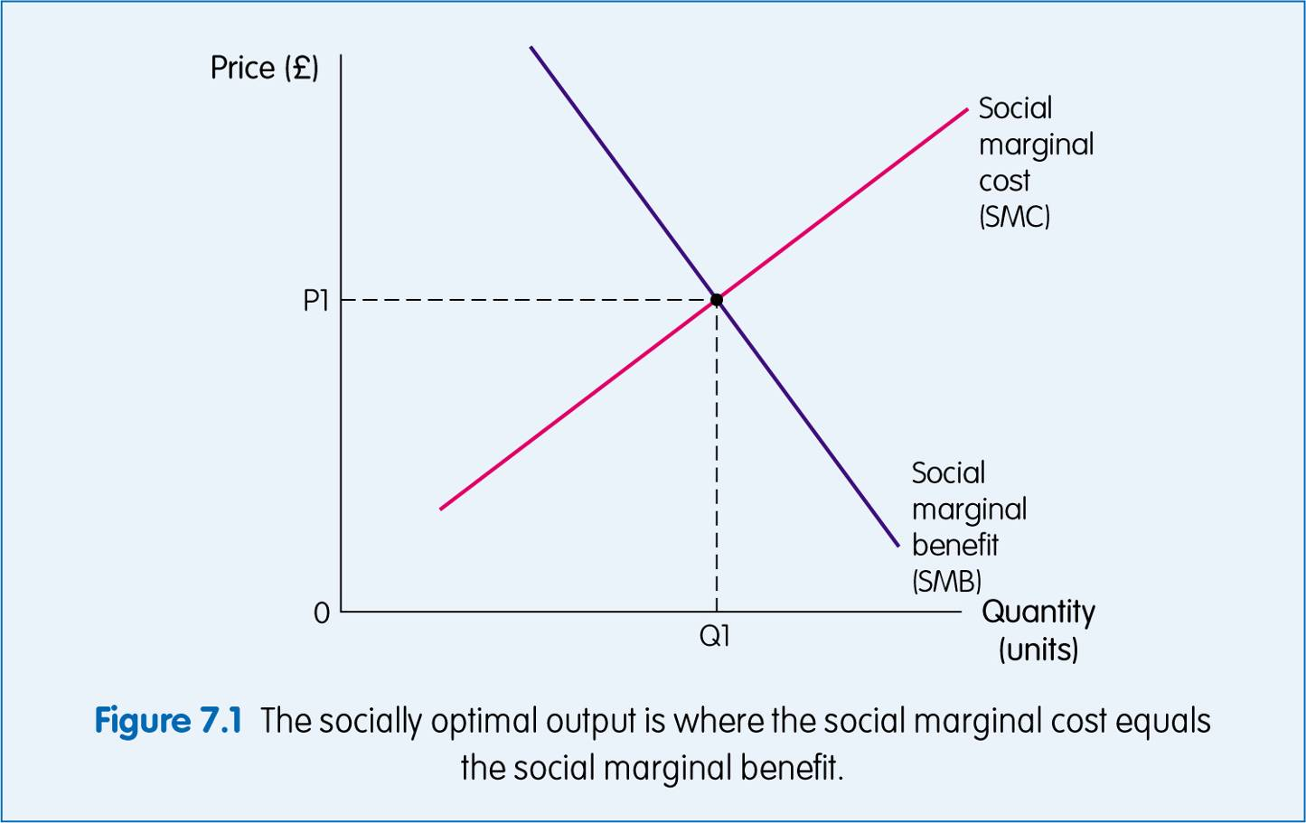
The free market may maximise social welfare
On all units up to the point Q1 the extra social benefit is greater than the extra social cost of providing it:
SMB > SMC
Therefore society as a whole will gain from these units being produced and consumed.
On all units beyond Q1, SMB < SMC therefore society would lose out if these units were produced.
Hence equilibrium occurs at SMC = SMB and the welfare to society is maximised.

Slide 41
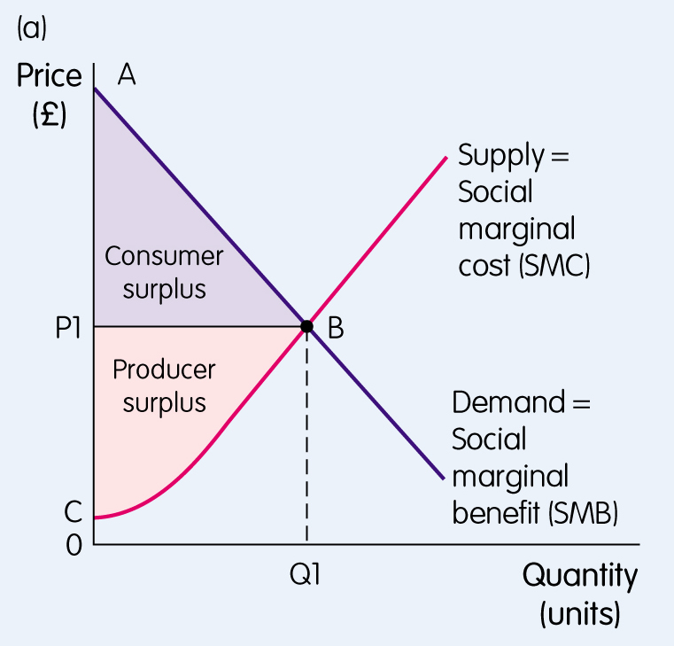
The free market may maximise social welfare

Slide 42
Disadvantages of the market system
(Gillespie pp. 154-70)
Monopoly power: a firm dominates a market
Externalities: divergence between private and social costs and benefits
Merit goods: society believes is more beneficial than individuals do.
Public goods: non-diminishable and non-excludable - once produced available to everyone
Income inequality

Slide 43
Monopoly power
So far we have assumed that market forces are allowed to operate, and that these will enable equilibrium at Q1 and P1 (Point E).
However, in some markets, some firms might become dominant and exert ‘monopoly power’.
A monopolist is a price setter.
It might decide to restrict output and push up the price (shown on next slide – movement from Point E (Q1/P1) to Point B (Q2/P2).
This has the effect of eroding consumer surplus, with an associated increase in producer surplus.
Thus although the community surplus (the aggregate of consumer and producer surplus) is unchanged it is now weighted in favour of the producer.

Slide 44
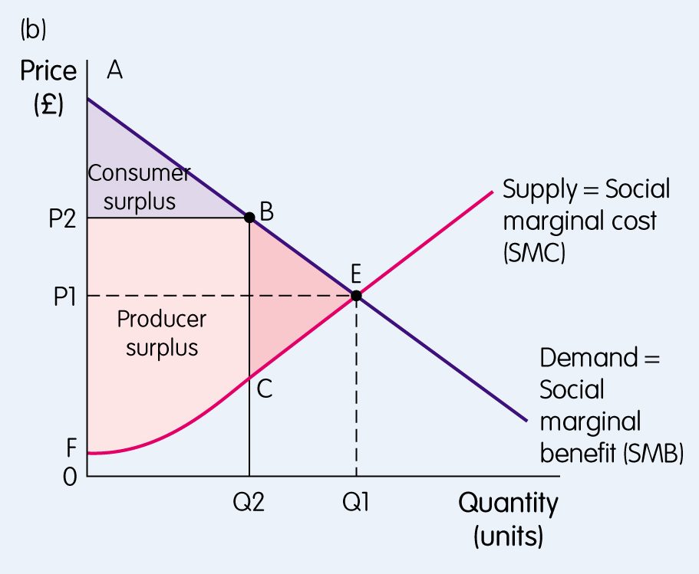
Monopoly power

Slide 45
Externalities
In a free market, individuals pursue their own self-interests.
This means that their choices might not be those that are optimal for society as a whole.
e.g. If you are considering whether or not to have the flu vaccine, you will consider your own self interests and not the potential benefits to others if you were vaccinated.
However, in preventing the spread of infection, the social benefits of the vaccine exceed the private benefits.
This is known as a positive consumption externality; the product is under-consumed relative to what is socially optimal:

Slide 46
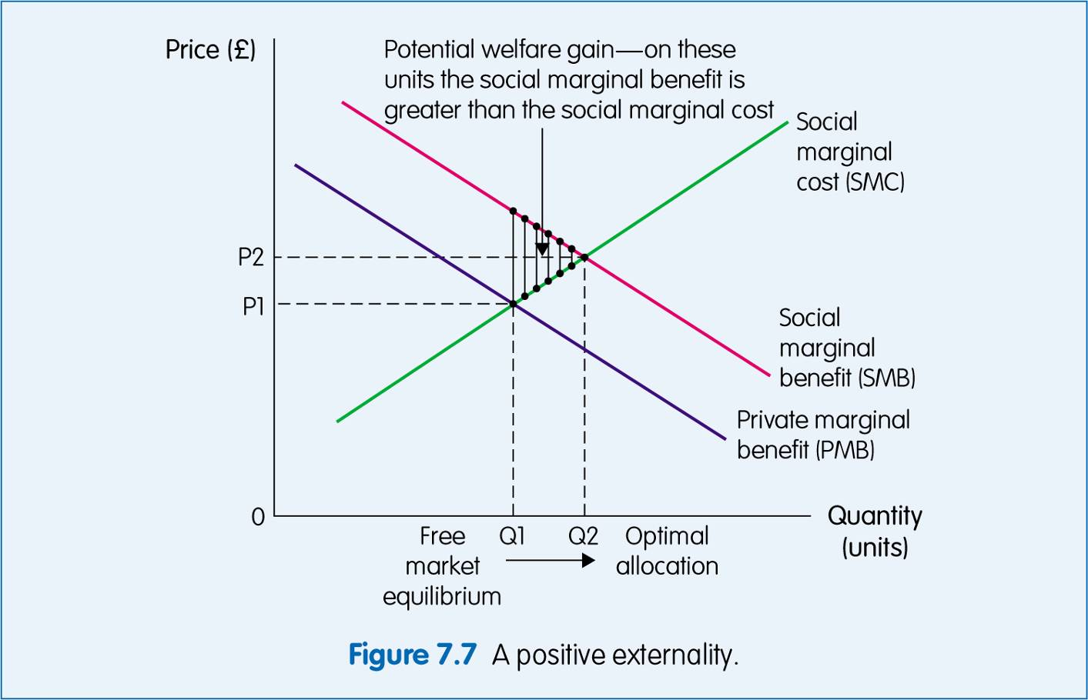
Positive externality

Slide 47
Negative Externality
It can also be the case that the social benefits of consumption are less than the private benefits.
For example, if a factory produces carbon emissions that are harmful to the environment. This might be the cheapest/ easiest and hence favourable means of emission for the factory but the impact on society (the cost) as a whole exceeds the benefits to the factory.
Thus there is said to be a negative externality of consumption, meaning too much of the product is produced/consumed relative to what is optimal for society:

Slide 48
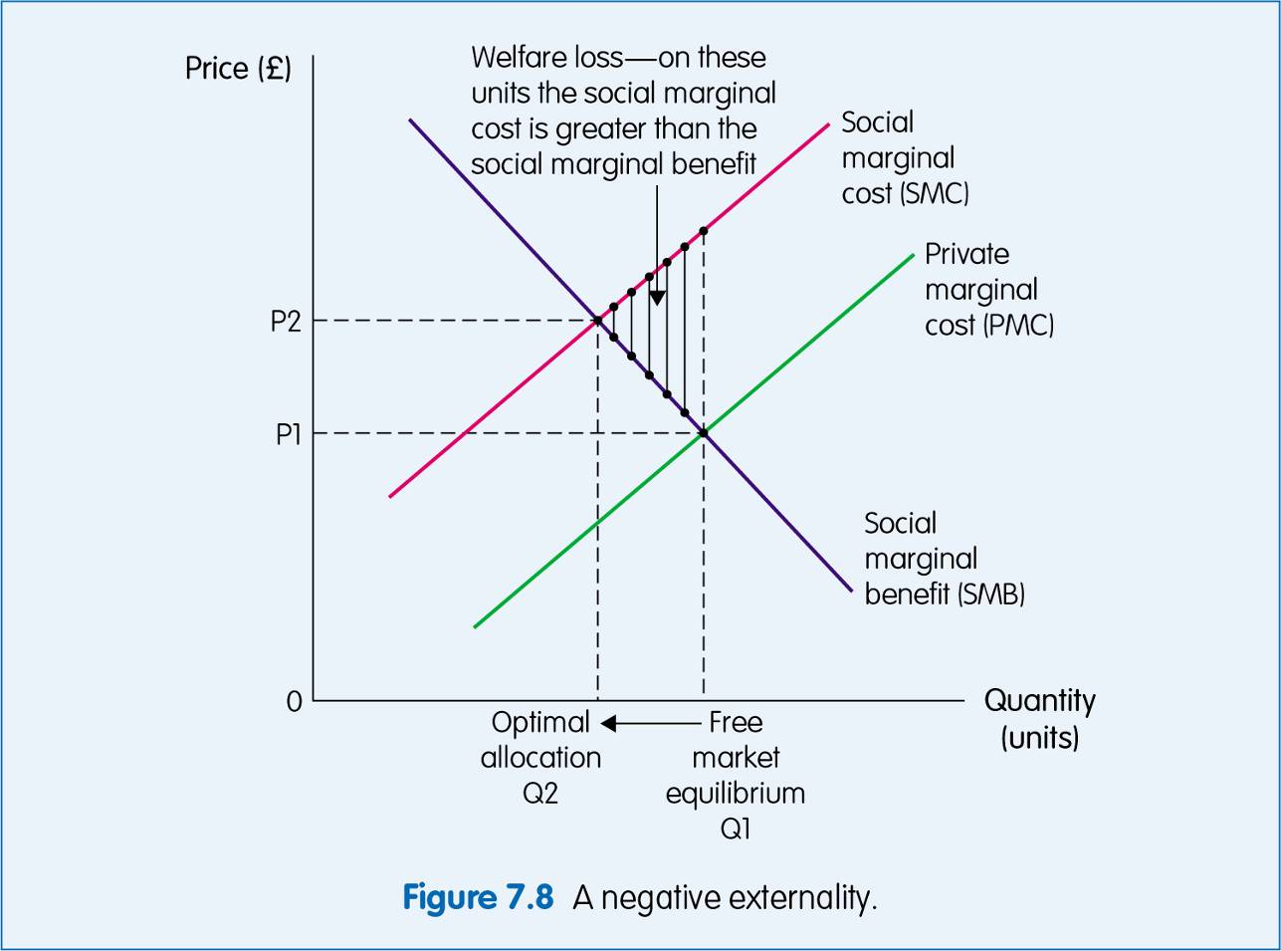
Negative externality

Slide 49
Merit Goods
A merit good is one which society believes is more beneficial than private individuals do.
We discussed this in Week 1 lecture when I explained that, left to their own devices, individuals would have a tendency to under-consume in areas such as education/health.
This is similar to a positive externality, but merit goods occur specifically because the government has superior knowledge of the effects of these products.
Examples include the government sponsoring education, health, museums, art galleries, etc. because they are deemed good for society.
Demerit goods are products that we consume without appreciating the harm they create, for example, cigarettes, some drugs.

Slide 50
Public Goods
A public-good is defined as one that is non-diminishable and non-excludable. This means that, once it is provided, regardless of how many people consume it, it will be available to everyone. Examples include traffic lights/police patrols/open wifi networks, public conveniences, parks, etc.
The problem with public goods is that no one would be willing to pay for them since they would be provided anyway. This is known as the free-rider problem; people will wait for someone else to pay for the product, knowing that they will be able to ‘free-ride’ and benefit without paying.

Slide 51
Income Inequality
Final disadvantage of free market system is that it may lead to income inequality.
Some people will earn high incomes if they have products/skills which are in demand and others will earn very little e.g. QS versus others!! Others vs QSs!!
This may well be economically efficient but is it fair?
Society might wish the Government to do something about income distribution.
This is why we see Governments providing specific welfare/benefits, to redress income inequalities that are arguably unjust.

Slide 52
BEN130 Built Environment Economics Week 5 – Market Equilibrium & The Free Market System

