Slide 1

Pager Rotation Duties in the DevOps Model
Industry Best Practices & Cultural Integration
By: Paul Fralix CSD380 02/22/2026

Slide 2

Why Pager Rotation Duties Matter
• Modern systems require continuous 24/7 reliability.
• Pager rotations ensure rapid incident response.
• DevOps emphasizes shared responsibility and fast feedback loops.
• Effective on‑call practices reduce downtime and improve customer experience.

Slide 3
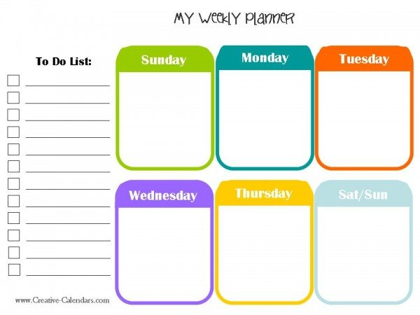
Defining On‑Call Rotations
• A structured schedule assigning engineers responsibility for responding to alerts.
• Ensures continuous coverage and minimizes service disruption.
• Includes escalation paths, alerting rules, and defined responsibilities.
• Supported by automation tools to reduce manual overhead.
This Photo by Unknown Author is licensed under CC BY-SA

Slide 4

DevOps and Operational Ownership
• Engineers who build services also support them in production.
• Strengthens accountability and improves code quality.
• Real‑time feedback informs better design and deployment practices.
• Encourages cross‑functional collaboration and operational excellence.
“You build it, you run it” — a core DevOps principle emphasizing accountability.

Slide 5
Industry‑Recognized On‑Call Best Practices
Use automated scheduling and escalation policies.
Keep rotations fair, predictable, and transparent.
Provide runbooks for common incidents to reduce response time.
Ensure global coverage when needed through distributed teams.
Review and refine schedules regularly.

Slide 6



Supporting Engineer Well‑Being
Challenges:
• Alert fatigue
• Sleep disruption
• Stress from unpredictable workloads
Risks:
• Reduced performance
• Increased turnover
• Lower system reliability
Solutions:
• Tune alerts to reduce noise
• Ensure recovery time
• Promote blameless postmortems
• Encourage team‑wide support
This Photo by Unknown Author is licensed under CC BY-NC

Slide 7


Sample Weekly Rotation Structure
Primary On‑Call: Handles all incoming alerts.
Secondary On‑Call: Backup if primary is unavailable.
Escalation Chain: Team lead → SRE → Incident Commander.
Coverage: Weekly rotation with a handoff meeting.

Slide 8
Standard Incident Response Lifecycle
Alert
Diagnose
Mitigate
Document
Postmortem
SLO‑based alerting reduces noise and focuses on customer impact.

Slide 9
Cultural Alignment with DevOps Principles
Reinforces shared responsibility across development and operations.
Creates faster feedback loops that improve deployment safety.
Encourages continuous improvement through post‑incident learning.
Builds resilience and operational maturity across teams.

Slide 10
References:
AlertOps. (2023). On‑call rotation best practices: How to build effective schedules and reduce burnout. https://alertops.com/on-call-rotation-best-practices/
Atlassian. (2023). A manager’s guide to improving on‑call. https://www.atlassian.com/incident-management/on-call
Google SRE. (2017). Site reliability engineering: On‑call and incident response. https://sre.google/sre-book/handling-overload/
Kim, G., Humble, J., Debois, P., Willis, J., & Forsgren, N. (2021). The DevOps handbook: How to create world-class agility, reliability, and security in technology organizations (2nd ed.). IT Revolution.
PagerDuty. (2023). On‑call basics: Rotations, schedules, and escalation policies. https://www.pagerduty.com/resources/learn/on-call-basics/

