Slide 1





$$Start$$
$$\overset{⃑}{P}\left(t=1\right), \overset{⃑}{Q}(t=1)$$
Initial loading
$$\frac{∂\overset{⃑}{V}}{∂\overset{⃑}{P}},\frac{∂\overset{⃑}{V}}{∂\overset{⃑}{Q}}$$
Feed into sensitivity
Update loading
$$Δ\overset{⃑}{V}$$
Generate voltage shift
$$\overset{⃑}{P}\left(t=t+1\right)$$
$$\overset{⃑}{Q}(t=t+1)$$
Update curve with shift
Power Flow
Simulate reduced circuit

Slide 2
















$$Q_{a}$$
$$V_{a}$$
$$V_{c}$$
VAr output
$$Q_{b}$$
$$Q_{c}$$
Node voltage
$$V_{b}$$
$$V_{d}$$
$$Q_{d}$$
$$Q_{a}$$
$$V_{a}±VDA$$
$$V_{c}±VDA$$
VAr output
$$Q_{b}$$
$$Q_{c}$$
Node voltage
$$V_{b}±VDA$$
$$V_{d}±VDA$$
$$Q_{d}$$

Slide 3
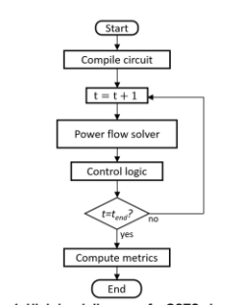


$$Start$$
$$\overset{⃑}{S}\left(t=1\right)$$
Initial loading from full circuit
$$\frac{∂\overset{⃑}{V}}{∂\overset{⃑}{S}}$$
Feed into sensitivity matrix
Update loading from full circuit
$$Δ\overset{⃑}{V}$$
Generate voltage shift vector
$$\overset{⃑}{S}\left(t=t+1\right)$$
Update control curves with shift vector
Reduced Circuit
Run reduced circuit powerflow

Slide 4







QSTS Logic
$$Start$$
t=0
Compile Reduced circuit
t=t+1
Inverter update logic
Get full
circuit loading
$$\overset{⃑}{S_{o}}\left(t\right)$$
$$\frac{∂\overset{⃑}{V}}{∂\overset{⃑}{S_{o}}}$$
Feed into sensitivity matrix
Get reduced
circuit loading
$$\overset{⃑}{S_{r}}\left(t\right)$$
$$VDA$$
Generate VDA vector
Circuit Power flow
Update control curves with VDA
Circuit control logic
$$t=t_{end}?$$
$$End$$

Slide 6
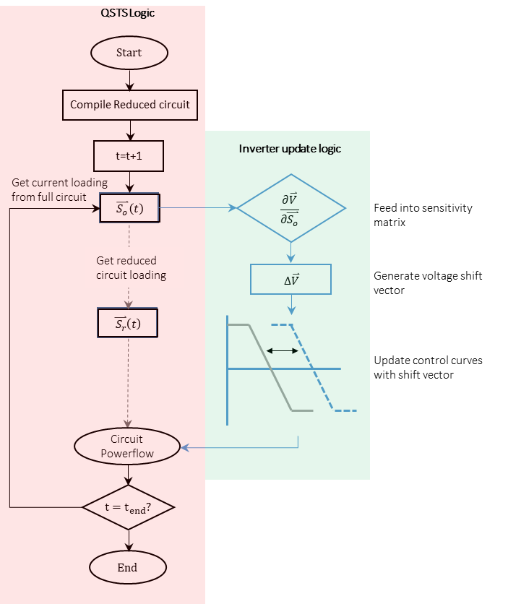

Slide 7
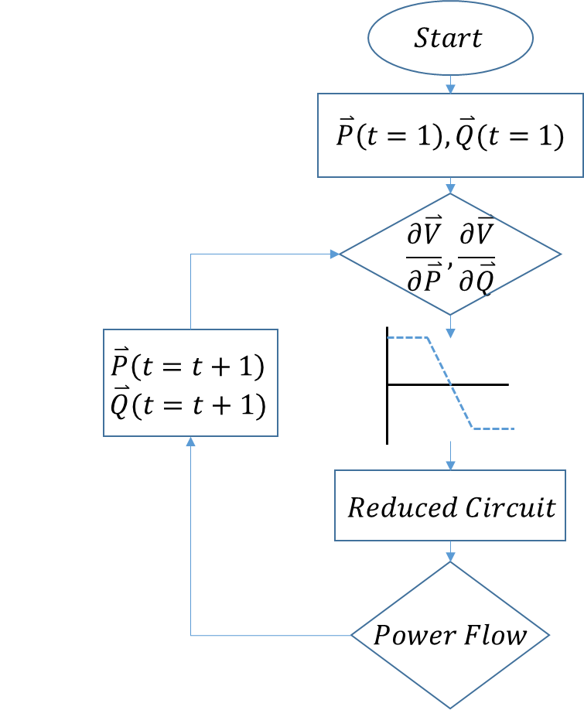
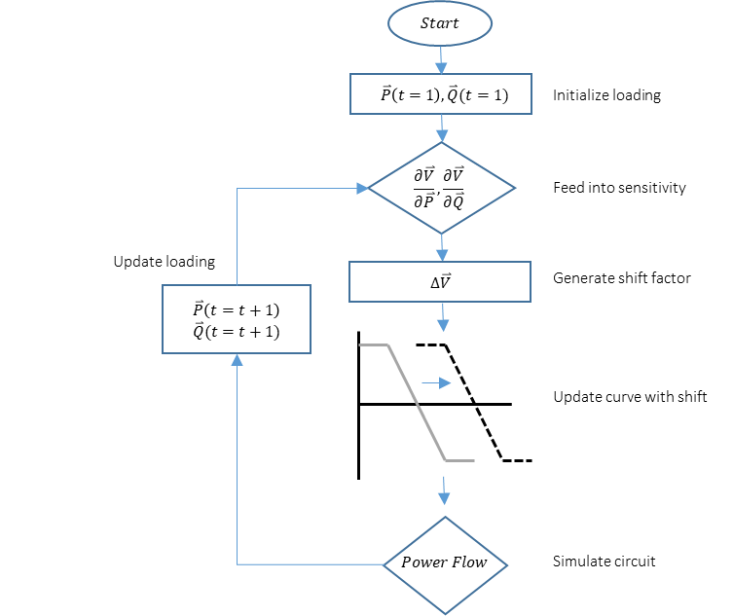

Slide 8


650
646
645
632
633
634
611
684
675
692
$${PV}_{671}$$
$${PV}_{675}$$
NCB
CB
NCB
CB
652
680

Slide 9

650
646
645
632
633
634
611
684
671
692
675
NCB
CB
$${PV}_{692}$$
652
680

Slide 10


650
646
645
632
633
634
611
684
671
675
NCB
CB
$${PV}_{671}$$
$${PV}_{675}$$
652
680

Slide 11
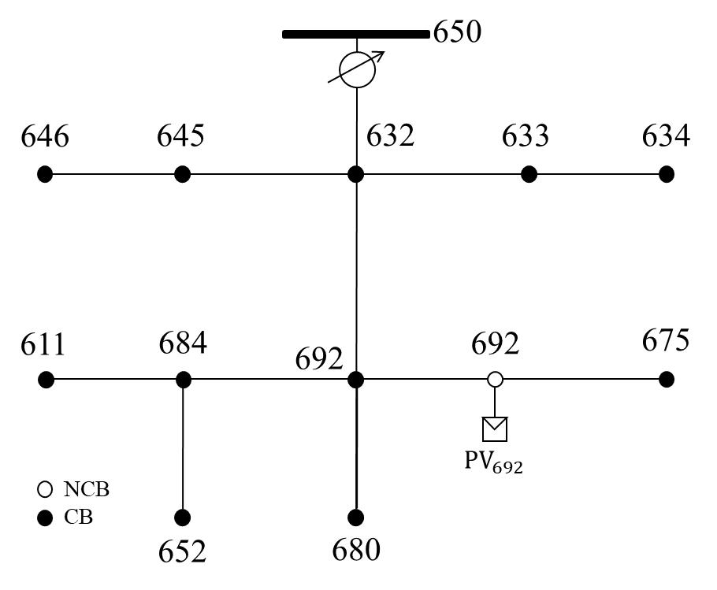

Slide 12
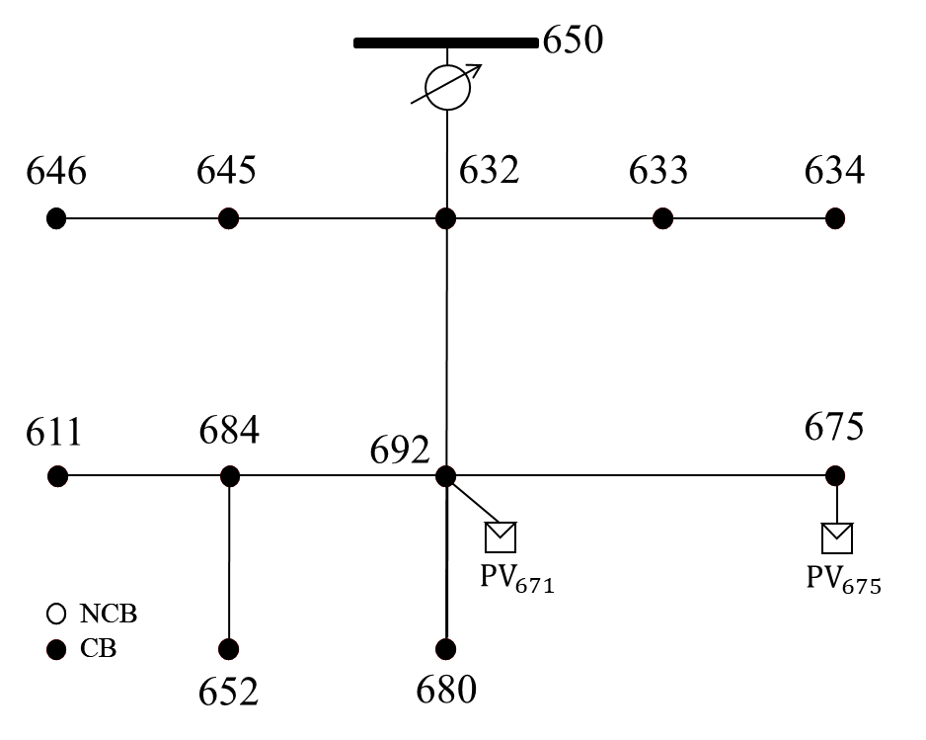

Slide 13
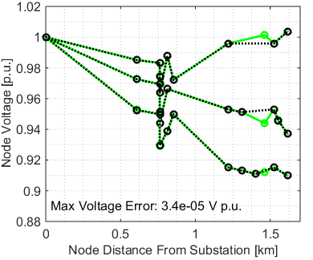
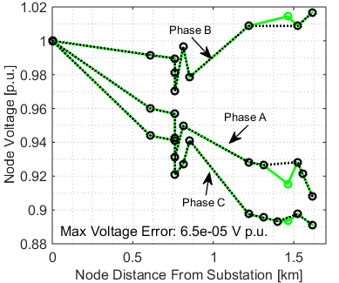

Slide 14


$$\left[\begin{matrix}a_{2}^{ℓ_{1},m_{1}} & ⋯ & a_{2}^{ℓ_{1},M} \\ ⋮ & ⋮ & ⋮ \\ \begin{matrix}a_{2}^{L,m_{1}} \\ a_{2}^{g_{1},m_{1}} \\ \begin{matrix}⋮ \\ a_{2}^{G,m_{1}}\end{matrix}\end{matrix} & \begin{matrix}⋯ \\ ⋯ \\ \begin{matrix}⋮ \\ ⋯\end{matrix}\end{matrix} & \begin{matrix}a_{2}^{L,M} \\ a_{2}^{g_{1},M} \\ \begin{matrix}⋮ \\ a_{2}^{G,M}\end{matrix}\end{matrix}\end{matrix} \right]$$
$$\left[\begin{matrix}a_{1}^{ℓ_{1},m_{1}} & ⋯ & a_{1}^{ℓ_{1},M} \\ ⋮ & ⋮ & ⋮ \\ \begin{matrix}a_{1}^{L,m_{1}} \\ a_{1}^{g_{1},m_{1}} \\ \begin{matrix}⋮ \\ a_{1}^{G,m_{1}}\end{matrix}\end{matrix} & \begin{matrix}⋯ \\ ⋯ \\ \begin{matrix}⋮ \\ ⋯\end{matrix}\end{matrix} & \begin{matrix}a_{1}^{L,M} \\ a_{1}^{g_{1},M} \\ \begin{matrix}⋮ \\ a_{1}^{G,M}\end{matrix}\end{matrix}\end{matrix} \right]$$

