Slide 1

2021
跳槽看“薪”情
IT行业现状分析展望
From 语晴

Slide 2
个人介绍
print the presentation and make it into a film a wider field
投身金融行业
此处添加详细文本描述，建议与标题相关并符合整体语言风格，语言描述尽量简洁生动。尽量将每页幻灯片的字数控制在 200字以内。
蚂蚁金服转入渡一
此处添加详细文本描述，建议与标题相关并符合整体语言风格，语言描述尽量简洁生动。尽量将每页幻灯片的字数控制在 200字以内。
普本科班毕业
此处添加详细文本描述，建议与标题相关并符合整体语言风格，语言描述尽量简洁生动。尽量将每页幻灯片的字数控制在 200字以内。
搜狐迈入百度
此处添加详细文本描述，建议与标题相关并符合整体语言风格，语言描述尽量简洁生动。尽量将每页幻灯片的字数控制在 200字以内。

Slide 3
01
IT行业分析展望
print the presentation and make it into a film a wider field
目 录
02
不难倒你不死心之面试题一
print the presentation and make it into a film a wider field
CONTENT
03
不难倒你不死心之面试题二
print the presentation and make it into a film a wider field
04
简历二三事儿
print the presentation and make it into a film a wider field

Slide 4
PART 01
IT行业分析展望
The user can demonstrate on a projector or computer, or print the presentation and make it into a film to be used in a wider field The user can demonstrate

Slide 5
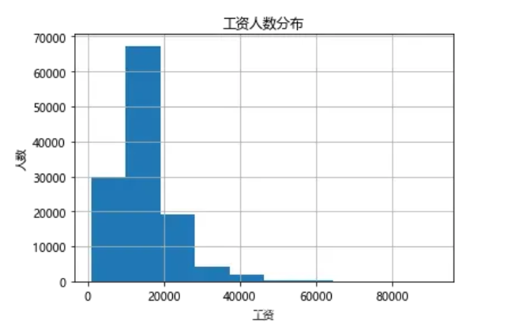
互联网“薪”情
01
04
02
03

Slide 6
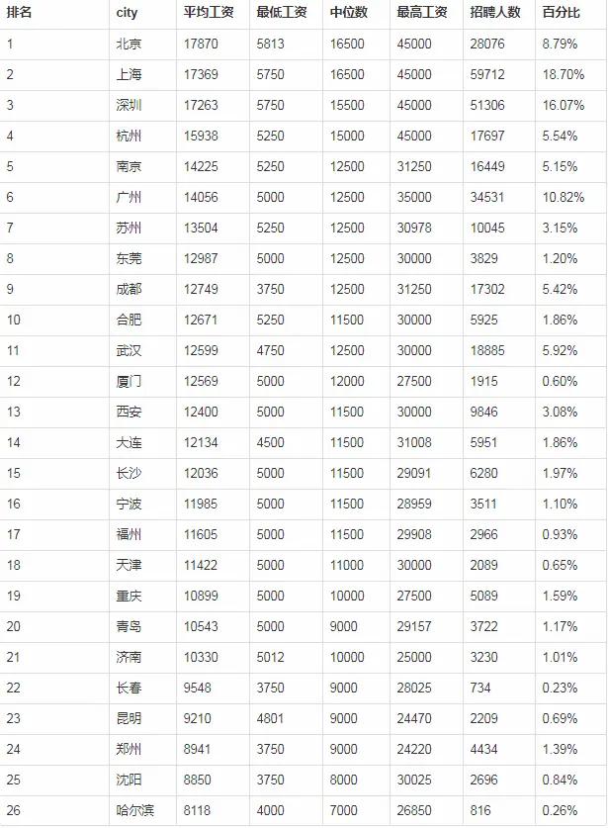
互联网人才需求
01
02
03
04

Slide 7


IT行业分类
print the presentation and make it into a film a wider field
游戏研发
Please replace text, click add relevant headline, modify the text content, also can copy your content to this directly. Please replace text, click add relevant headline, modify the text content, also can copy your content to this directly. Please replace text, click add relevant headline, modify the text content, also can copy your content to this directly.
金融研发
企业项目研发等
Please replace text, click add relevant headline, modify the text content, also can copy your content to this directly. Please replace text, click add relevant headline, modify the text content, also can copy your content to this directly. Please replace text, click add relevant headline, modify the text content, also can copy your content to this directly.
Please replace text, click add relevant headline, modify the text content, also can copy your content to this directly. Please replace text, click add relevant headline, modify the text content, also can copy your content to this directly. Please replace text, click add relevant headline, modify the text content, also can copy your content to this directly.
多种
从业方向
电商研发
通信研发
Please replace text, click add relevant headline, modify the text content, also can copy your content to this directly. Please replace text, click add relevant headline, modify the text content, also can copy your content to this directly. Please replace text, click add relevant headline, modify the text content, also can copy your content to this directly.
Please replace text, click add relevant headline, modify the text content, also can copy your content to this directly. Please replace text, click add relevant headline, modify the text content, also can copy your content to this directly. Please replace text, click add relevant headline, modify the text content, also can copy your content to this directly.

Slide 8
技术领域分类
print the presentation and make it into a film a wider field
后端开发
包括分布式、微服务等
运维研发
大数据开发
Please replace text, click add relevant headline, modify the text content, also can copy your content to this directly. Please replace text, click add relevant headline, modify the text content, also can copy your content to this directly. Please replace text, click add relevant headline, modify the text content, also can copy your content to this directly.
Please replace text, click add relevant headline, modify the text content, also can copy your content to this directly. Please replace text, click add relevant headline, modify the text content, also can copy your content to this directly. Please replace text, click add relevant headline, modify the text content, also can copy your content to this directly.
测试开发
云计算开发
Please replace text, click add relevant headline, modify the text content, also can copy your content to this directly. Please replace text, click add relevant headline, modify the text content, also can copy your content to this directly. Please replace text, click add relevant headline, modify the text content, also can copy your content to this directly.
Please replace text, click add relevant headline, modify the text content, also can copy your content to this directly. Please replace text, click add relevant headline, modify the text content, also can copy your content to this directly. Please replace text, click add relevant headline, modify the text content, also can copy your content to this directly.

Slide 9
前阿里同事的经历
print the presentation and make it into a film a wider field
大专毕业进入外包
升为p6测试工程师
升为p7产品专家
Please replace text, click add relevant headline, modify the text content, also can copy your content to this directly. Please replace text, click add relevant
Please replace text, click add relevant headline, modify the text content, also can copy your content to this directly. Please replace text, click add relevant
Please replace text, click add relevant headline, modify the text content, also can copy your content to this directly. Please replace text, click add relevant
最低级别转入阿里
转型产品
汇报PPT
Please replace text, click add relevant headline, modify the text content, also can copy your content to this directly. Please replace text, click add relevant
Please replace text, click add relevant headline, modify the text content, also can copy your content to this directly. Please replace text, click add relevant
Please replace text, click add relevant headline, modify the text content, also can copy your content to this directly. Please replace text, click add relevant

Slide 10
HR跨行程序员的案例
print the presentation and make it into a film a wider field
升职为项目经理
转型为HR
Please replace text, click add relevant headline, modify the text content, also can copy your content to this directly. Please replace text, click add relevant
Please replace text, click add relevant headline, modify the text content, also can copy your content to this directly. Please replace text, click add relevant headline, modify the text content, also can copy your content to this directly. Please replace text, click add relevant headline, modify the text content, also can copy your content to this directly.
第四阶段
第二阶段
第一阶段
第三阶段
报了某培训机构转型程序员
Please replace text, click add relevant headline, modify the text content, also can copy your content to this directly. Please replace text, click add relevant modify the text content, also can copy your content to this directly. Please modify the text content, also can copy your content to this directly. Please
海洋大学建筑类专业毕业
Please replace text, click add relevant headline, modify the text content, also can copy your content to this directly. Please replace text, click add relevant

Slide 11
行业要求
print the presentation and make it into a film a wider field
算法、微服务、分布式等
Please replace text, click add relevant headline, modify the text content, also can copy your content to this directly. Please replace text, click add relevant
web开发和框架搭建
项目测试、部署和运维
Please replace text, click add relevant headline, modify the text content, also can copy your content to this directly. Please replace text, click add relevant
Please replace text, click add relevant headline, modify the text content, also can copy your content to this directly. Please replace text, click add relevant
数据库和连接池的使用
基础语法和面向对象
Please replace text, click add relevant headline, modify the text content, also can copy your content to this directly. Please replace text, click add relevant
Please replace text, click add relevant headline, modify the text content, also can copy your content to this directly. Please replace text, click add relevant

Slide 12
课程大纲
print the presentation and make it into a film a wider field
SSM和SpringBoot、Redis
Please replace text, click add relevant headline, modify the text content, also can copy your content to this directly. Please replace text, click add relevant
Mysql和JavaEE
项目实战和算法特训
02
06
Please replace text, click add relevant headline, modify the text content, also can copy your content to this directly. Please replace text, click add relevant
Please replace text, click add relevant headline, modify the text content, also can copy your content to this directly. Please replace text, click add relevant
03
01
05
公开课
04
Linux、Nginx、网络等
Please replace text, click add relevant headline, modify the text content, also can copy your content to this directly. Please replace text, click add relevant
Dubbo和SpringCloud
Please replace text, click add relevant headline, modify the text content, also can copy your content to this directly. Please replace text, click add relevant
Please replace text, click add relevant headline, modify the text content, also can copy your content to this directly. Please replace text, click add relevant

Slide 13
PART 02
不难倒你不死心之面试题一
The user can demonstrate on a projector or computer, or print the presentation and make it into a film to be used in a wider field The user can demonstrate

Slide 14
题目一
print the presentation and make it into a film a wider field
01
用JAVA程序写出当你在超市购物花费1.1元时，你给收银员2元钱，收银员找你0.9元的过程；
02
double total = 2.0;
double used = 1.1;
double result = total - used;
System.out.println("result : " + result);
03
04

Slide 15
题目二
print the presentation and make it into a film a wider field
01
以下代码的输出结果为
02
int j = 0;
for (int i = 0; i < 10; i++) {
System.out.println(i);
j = j++;
}
System.out.println(j);
03
04

Slide 16
题目三
print the presentation and make it into a film a wider field
01
以下代码的输出结果为
02
int a = 1,b = 2,c = 3;
if(a > b && c++ > b){
}
System.out.println(c);
int aa = 1,bb = 2,cc = 3;
if(aa > bb & cc++ > bb){
}
System.out.println(cc);
03
04

Slide 17
题目四
print the presentation and make it into a film a wider field
01
以下代码的输出结果为
02
String str1 = 'a' + 3 + "Hello";
String str2 = "Hello" + 'a' + 3;
System.out.println(str1);
System.out.println(str2);
03
04

Slide 18
题目五
print the presentation and make it into a film a wider field
01
代码填空题，写出缺失的代码
02
public static void main(String[] args){
int a=10;
int b=10;
method(a,b);
// 需要在method方法被调用之后，
// 仅打印出a=100,b=200,请写出method方法的代码
System.out.println(“a=”+a);
System.out.println(“b=”+b);
}
03
04

Slide 19
PART 03
不难倒你不死心之面试题二
The user can demonstrate on a projector or computer, or print the presentation and make it into a film to be used in a wider field The user can demonstrate

Slide 20
题目一
print the presentation and make it into a film a wider field
01
在空格处填上适当的数，让下面的程序能输出“Hello World!”。
02
public static void main(String[] args) {
int num = _____________;
if (num < 0 && num == Math.abs(num)) {
System.out.println("Hello World!");
}
}
03
04

Slide 21
题目二
print the presentation and make it into a film a wider field
01
在下面代码if后的括号中填空，要求程序输出“ab”
02
public static void main(String[] args) {
if () {
System.out.println("a");
} else {
System.out.println("b");
}
}
03
04

Slide 22
PART 04
简历二三事儿
The user can demonstrate on a projector or computer, or print the presentation and make it into a film to be used in a wider field The user can demonstrate

Slide 23
感谢聆听
The user can demonstrate on a projector or computer, or print the presentation and make it into a film to be used in a wider field The user can demonstrate
From 语晴

