Slide 1
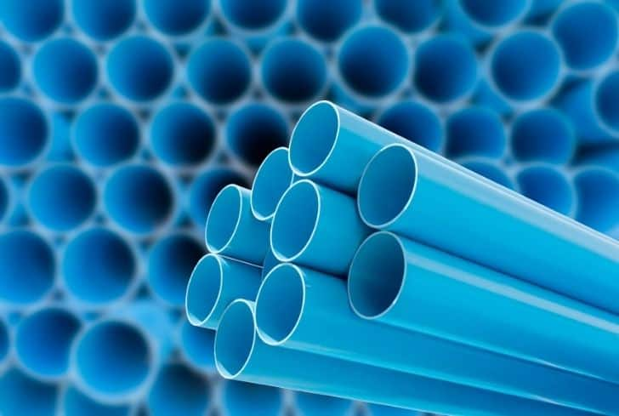
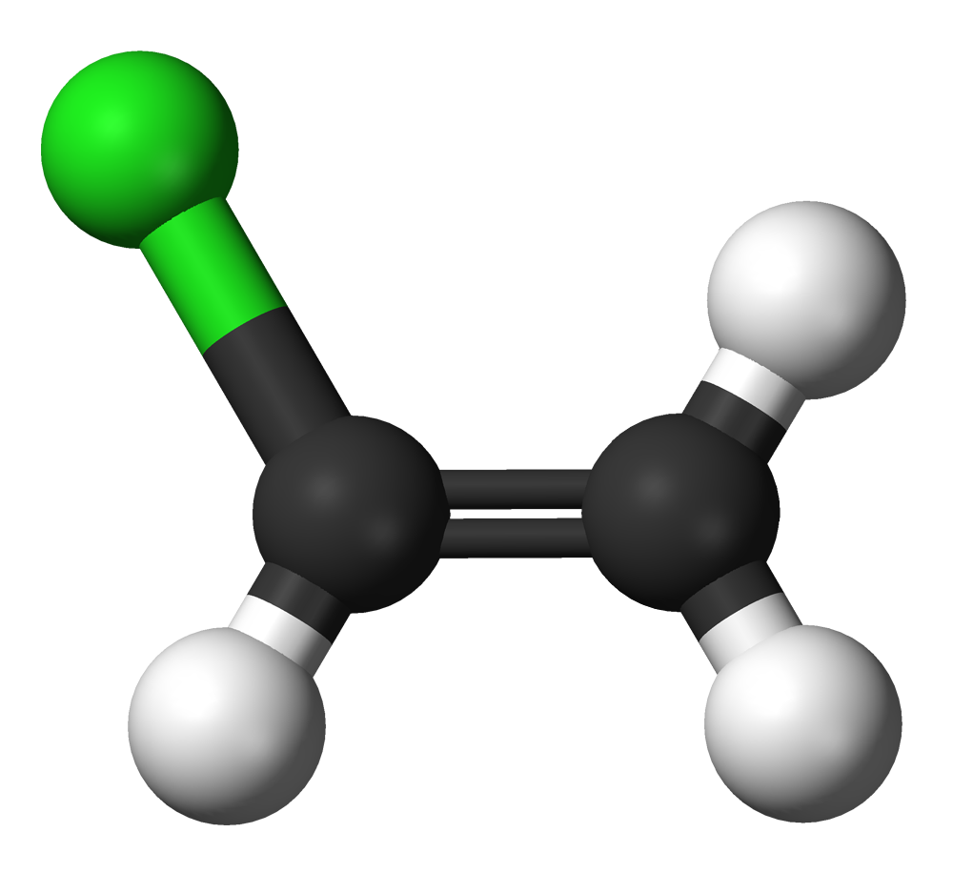

Poly Vinyl Chloride
(PVC)
Tomaz Chevres

Slide 2
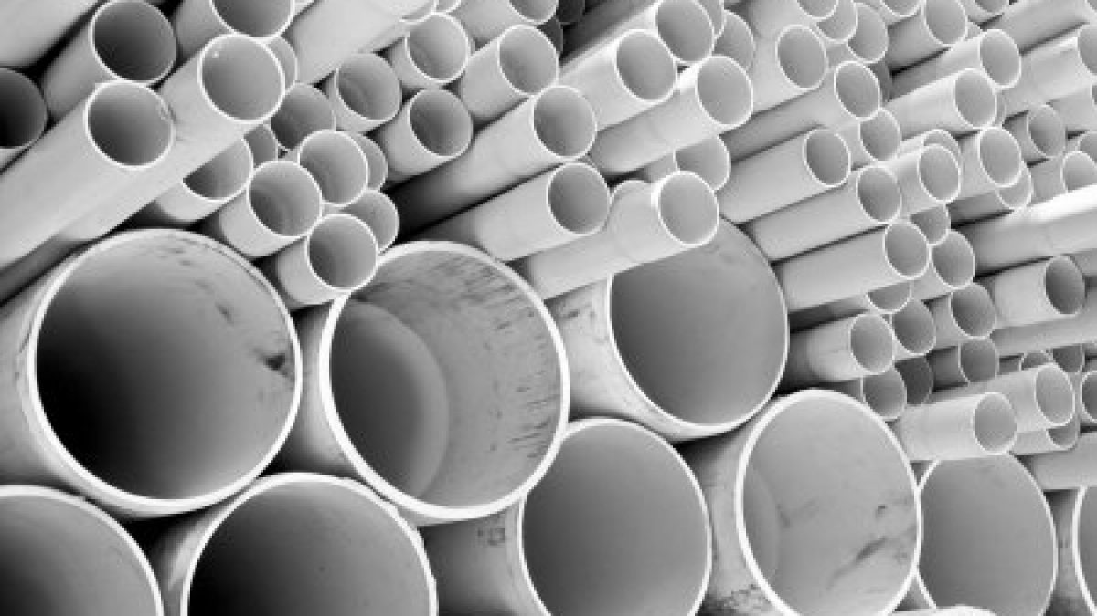
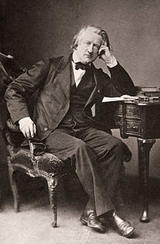
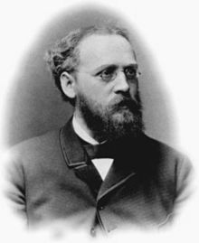
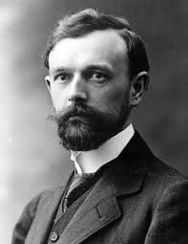
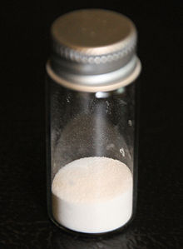
History
Henri Victor Regnault, 1838
Eugene Baumann, 1872
Fritz Klatte, 1913

Slide 3
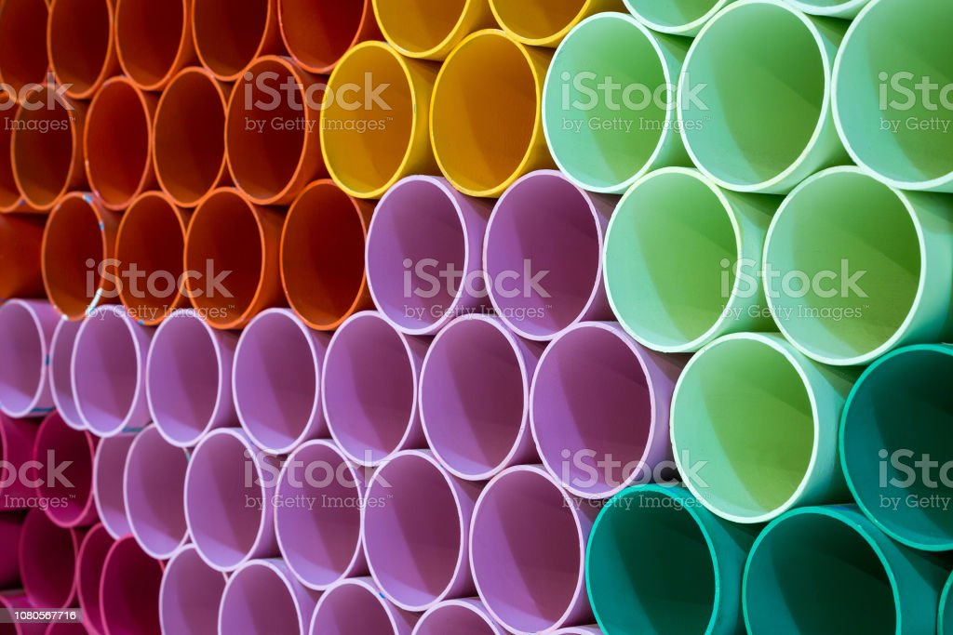
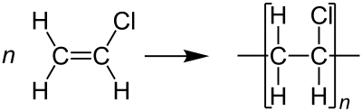
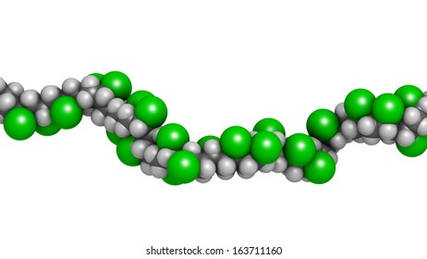
Structure+Polymerization

Slide 4
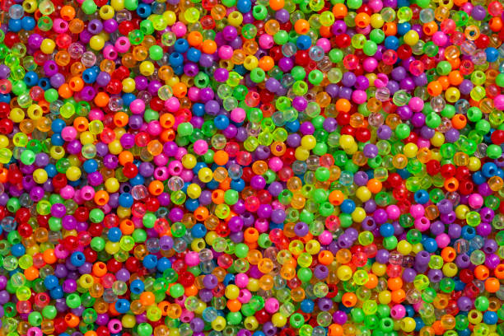




Building & Construction
USES
Household Products
Medicine
Packaging

Slide 5




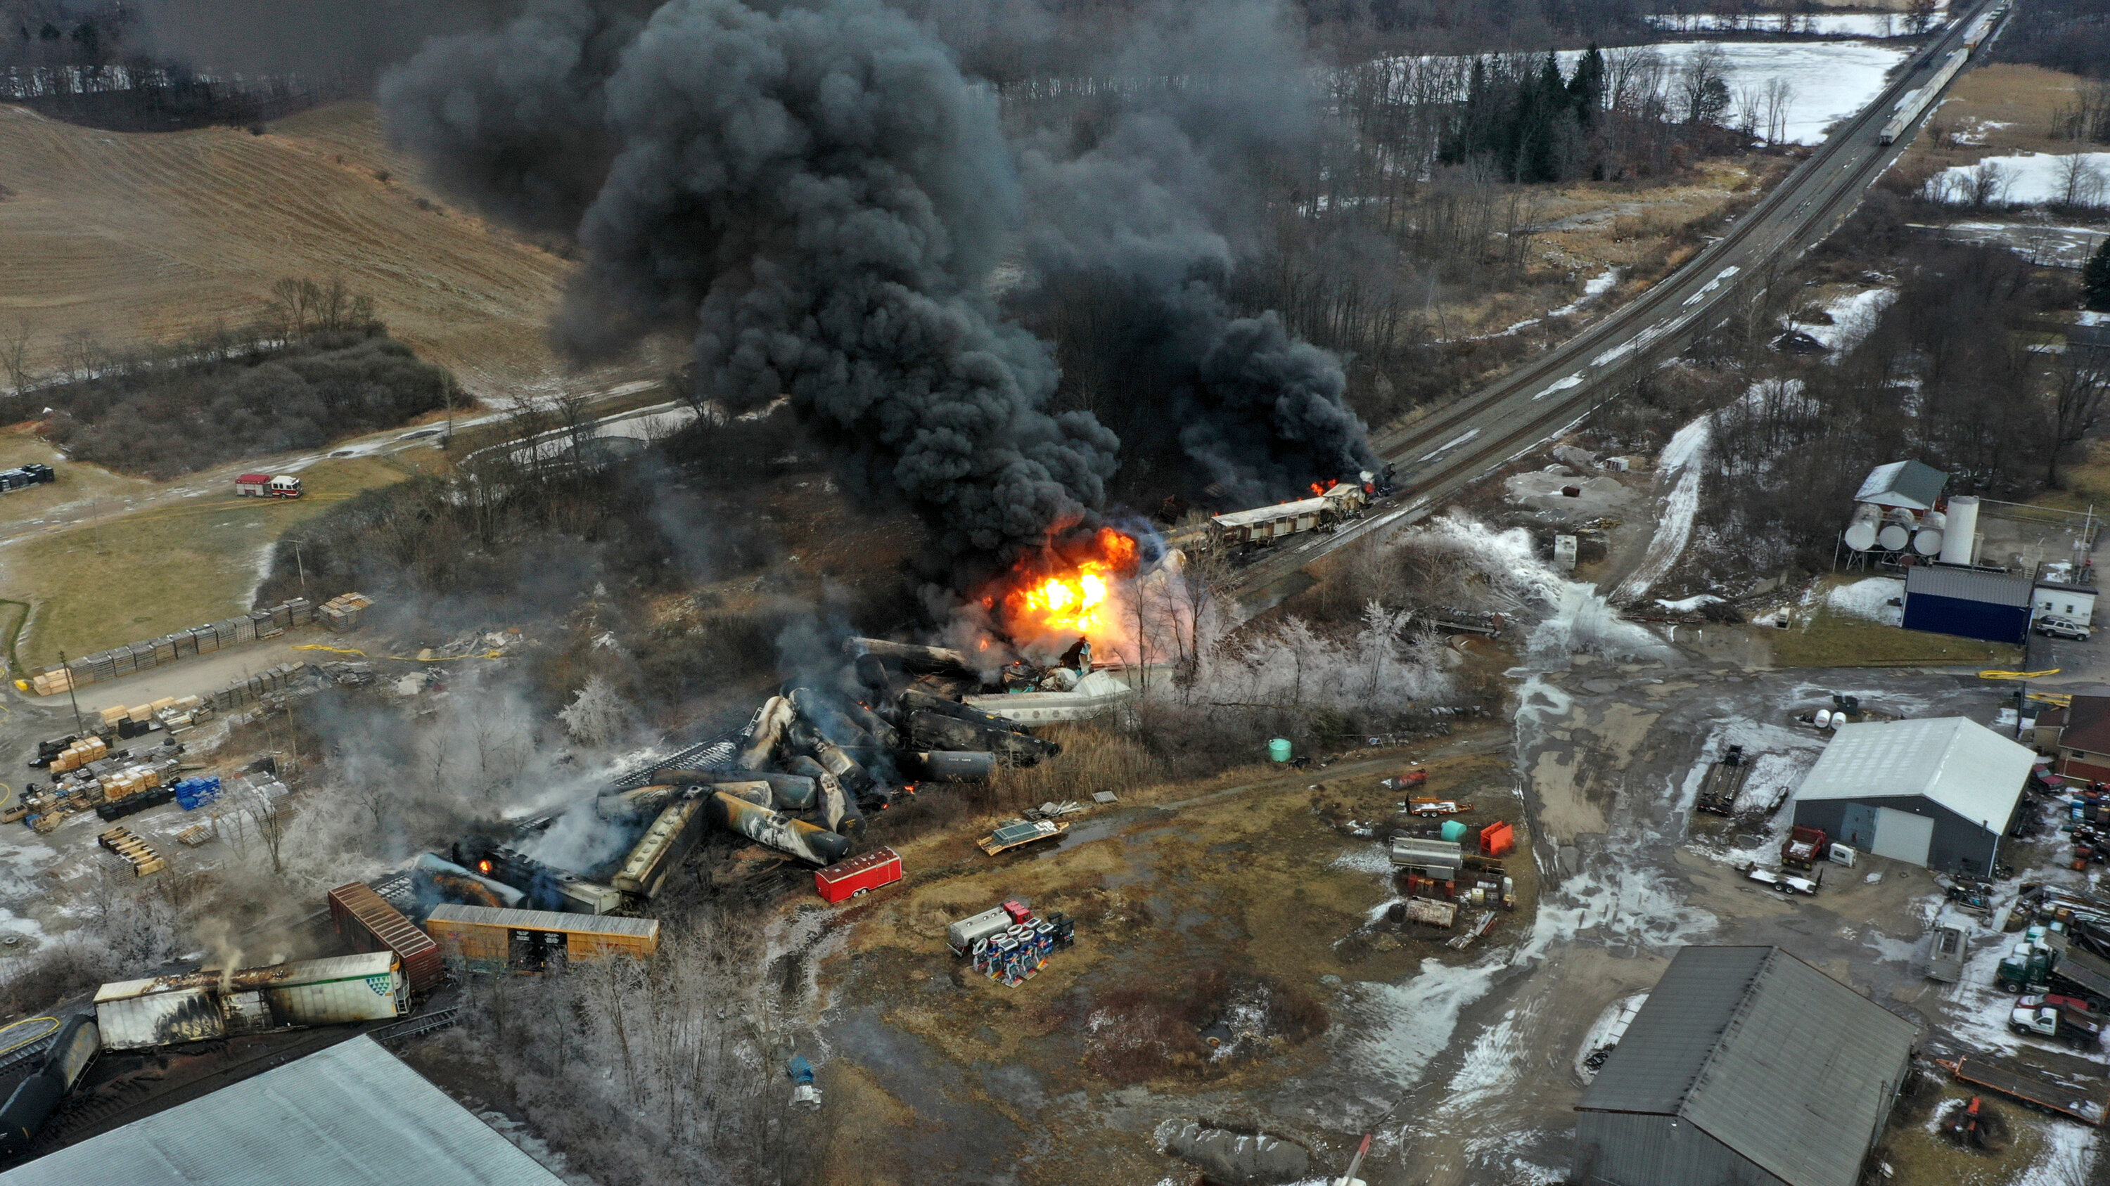
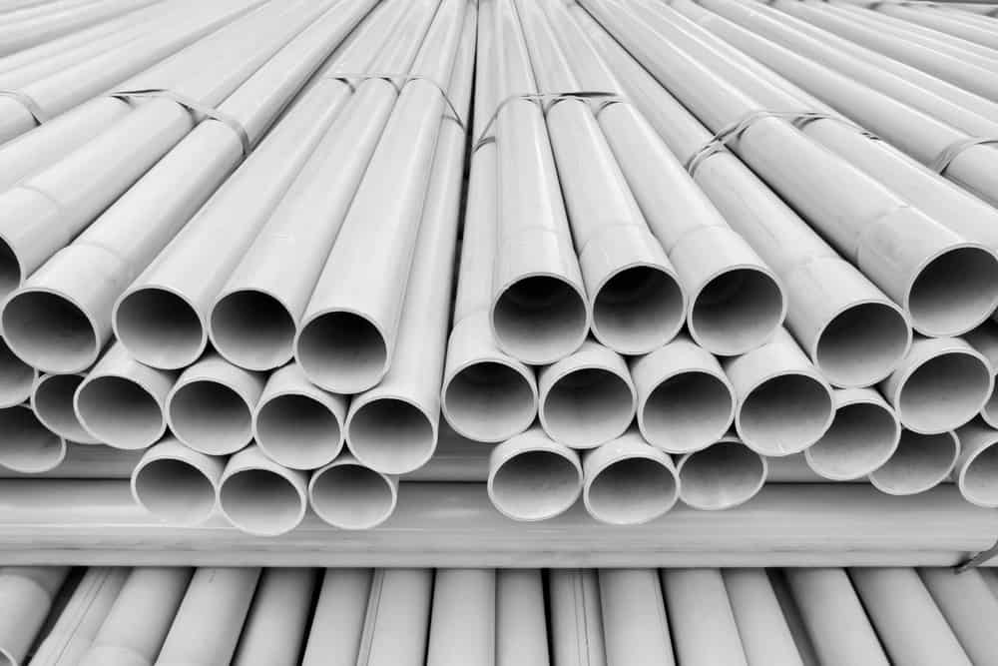
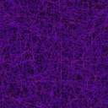
Health & Safety
Vinyl Chloride
Polyvinyl Chloride
4
1
3
2
1
0
Group 1 Carcinogen
*may contain toxic additives
↑
bad
↑
less bad

