Slide 1
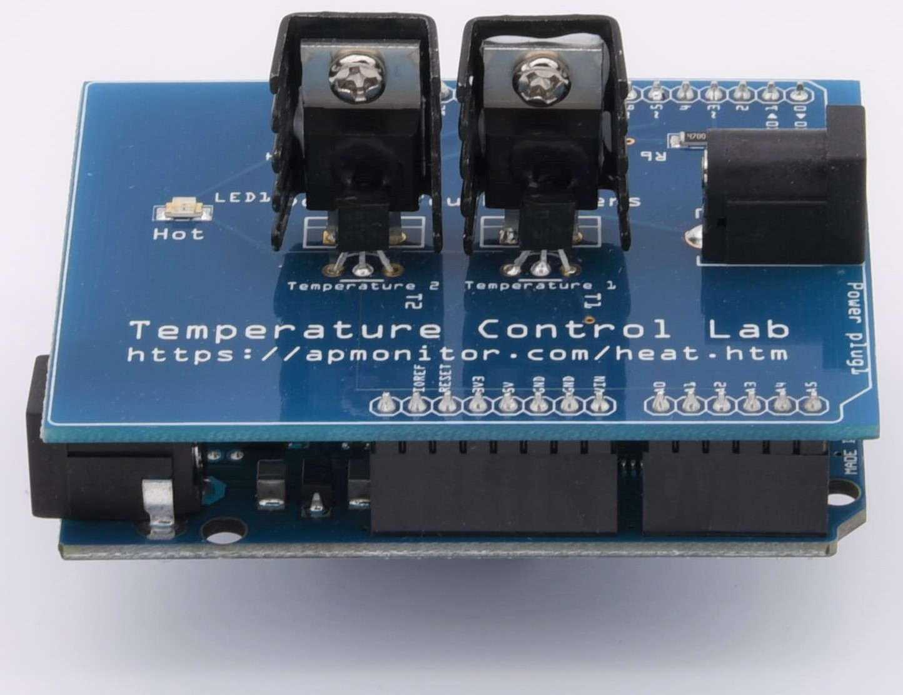
SC42035 - Integration Project
Group 39:
Pim de Bruin – 4545702
Marco Delgado Gosálvez – 4268083 <speaker>

Slide 2
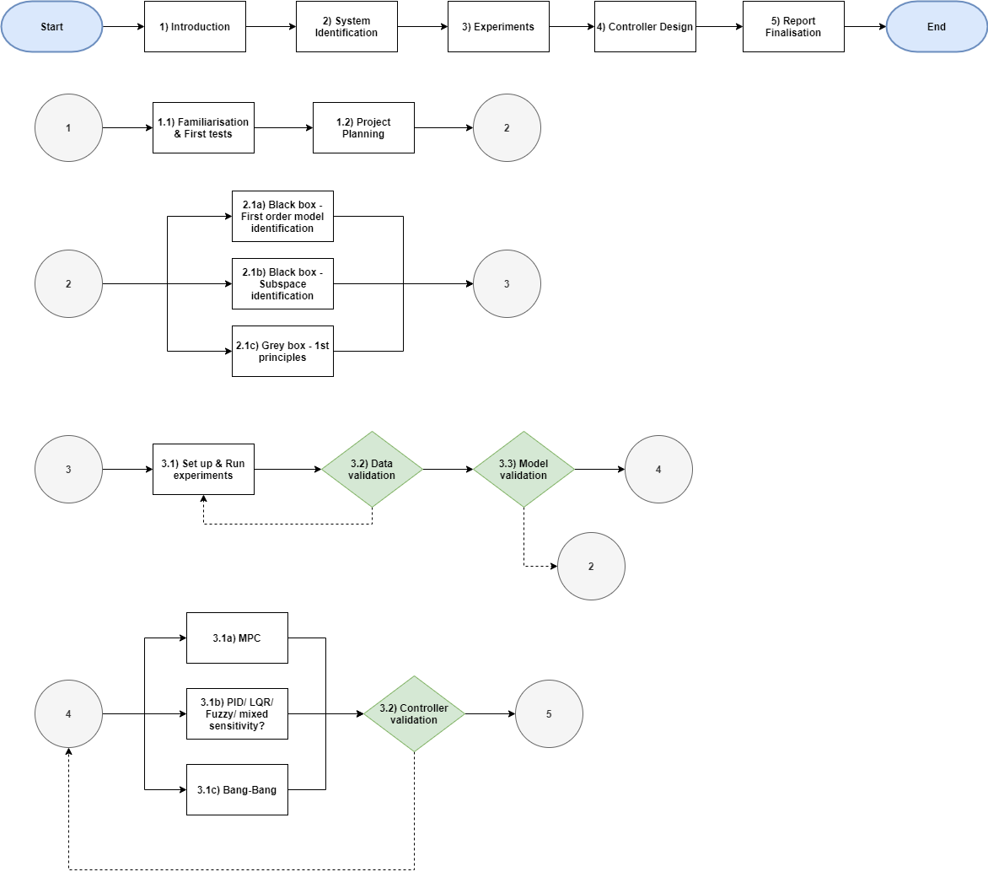

Slide 3
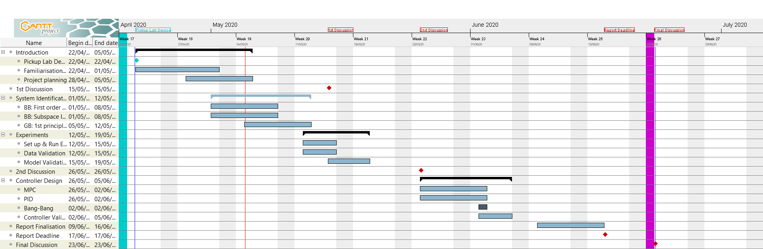
Gantt chart for Integration Project
1st simple test data
2 done + 1 almost = 3 SI methods
Next: set up proper experiment
Controllers: PID, MPC (?)

