Slide 1
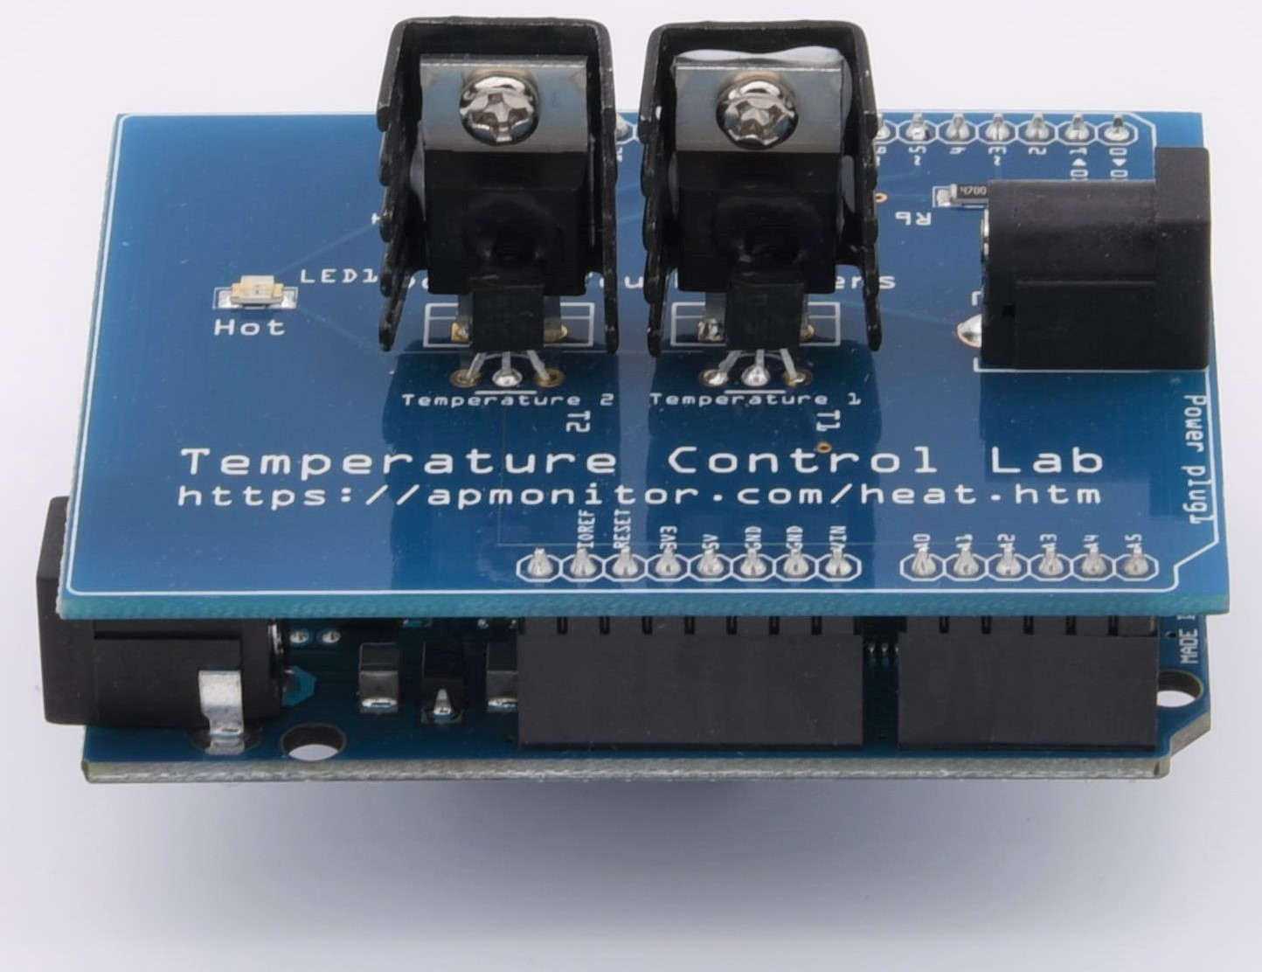
SC42035 - Integration Project 1st Discussion – 15th May 2020
Group 39:
Pim de Bruin – 4545702
Marco Delgado Gosálvez – 4268083 <speaker>

Slide 2
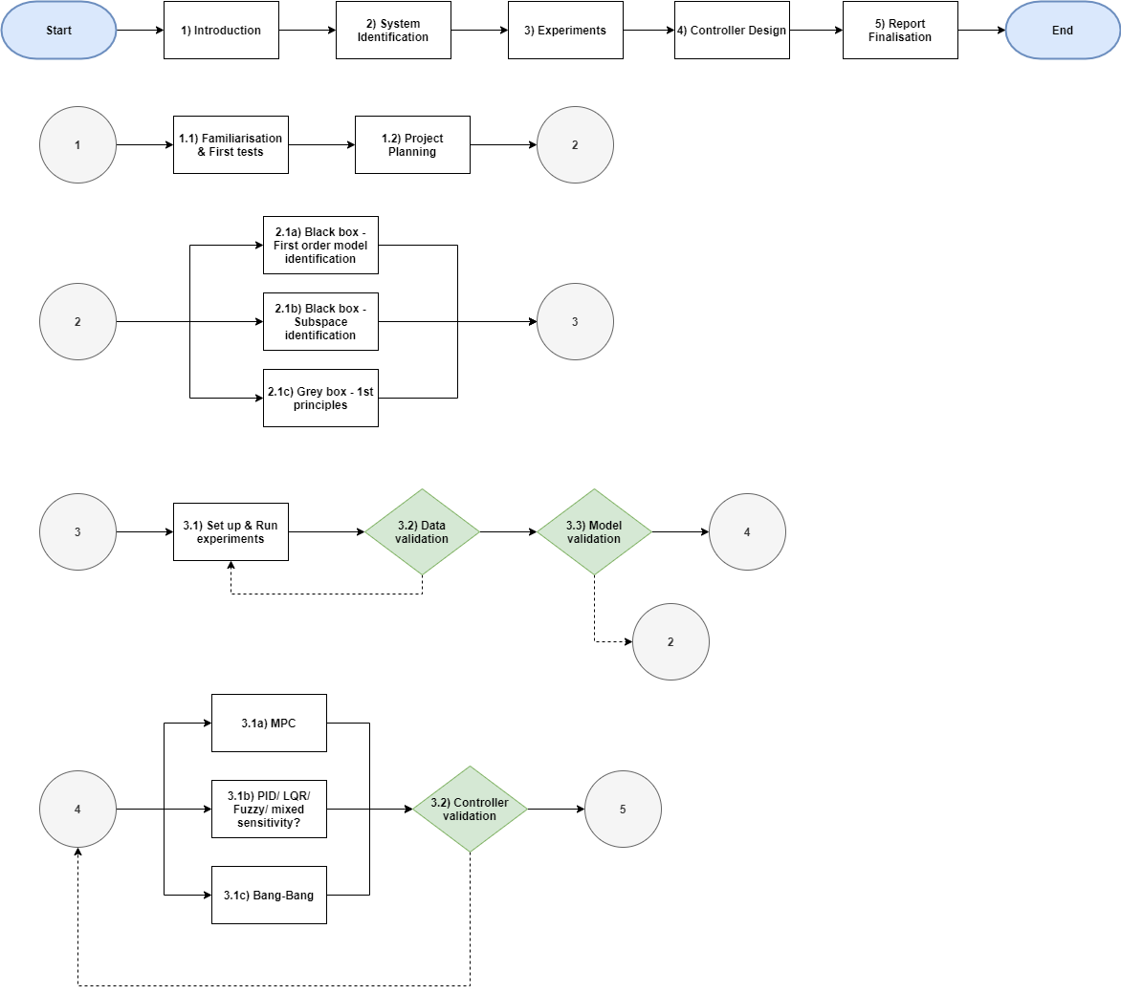

Slide 3
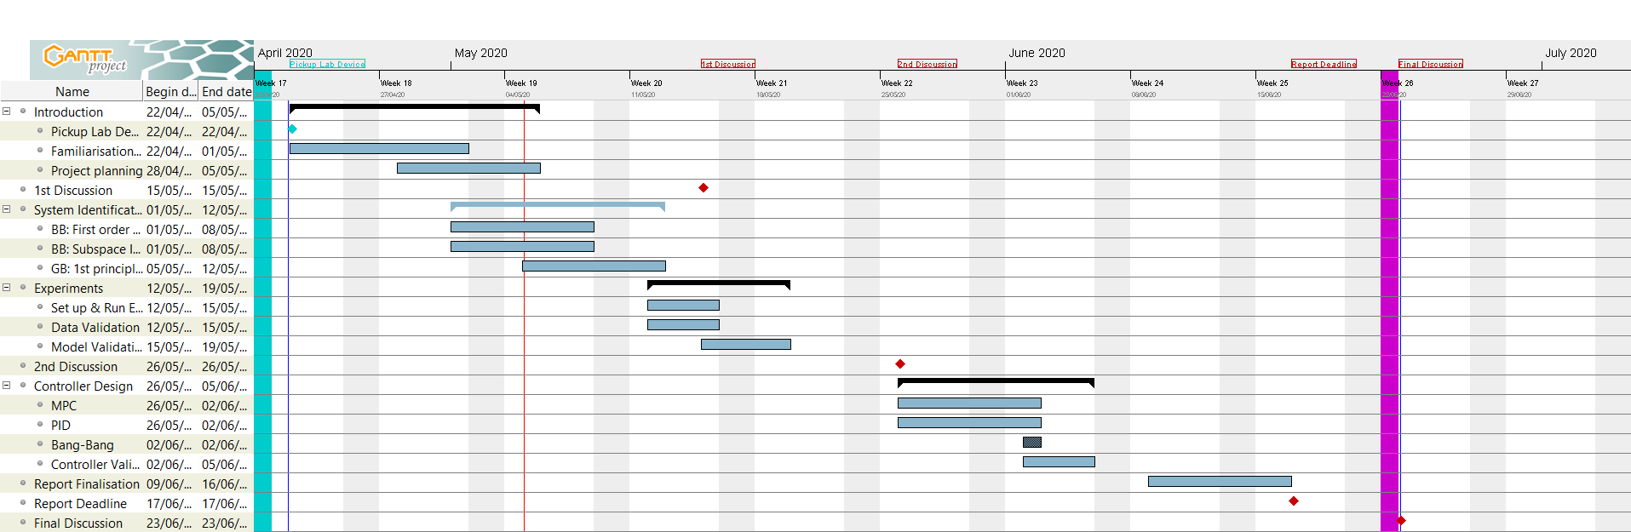
Gantt chart for Integration Project

