Slide 1
Machine Learning & Data Analysis
Ali Haider
Giacomo Pedemonte

Slide 2
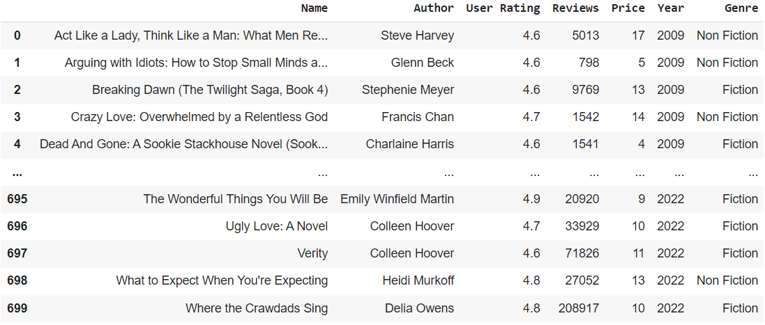
Dataset: Amazon Top 50 Bestselling Books 2009 – 2022
In this dataset there are 7 features that represent the most important characteristics for bestsellers.
The Dataset contains
700 Books
441 Unique Titles
305 Authors
The dataset doesn’t contain empty values and there is no cleaning to make on the dataset.

Slide 3
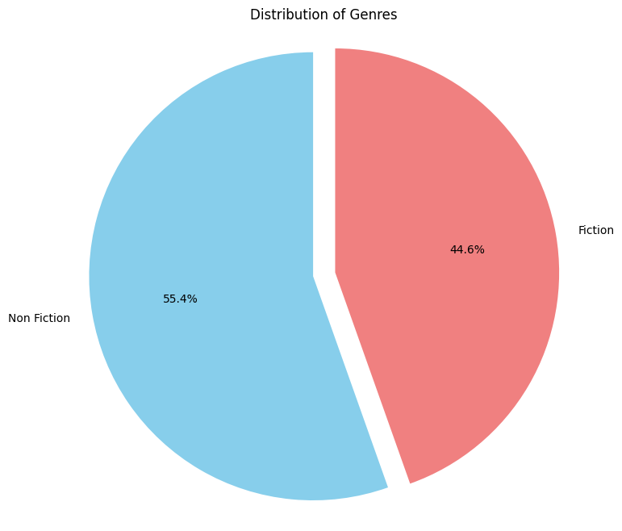
Dataset: Amazon Top 50 Bestselling Books 2009 – 2022
Genres: Fiction & Non Fiction
It seems that a shift towards Non-Fiction may be beneficial for writers

Slide 4
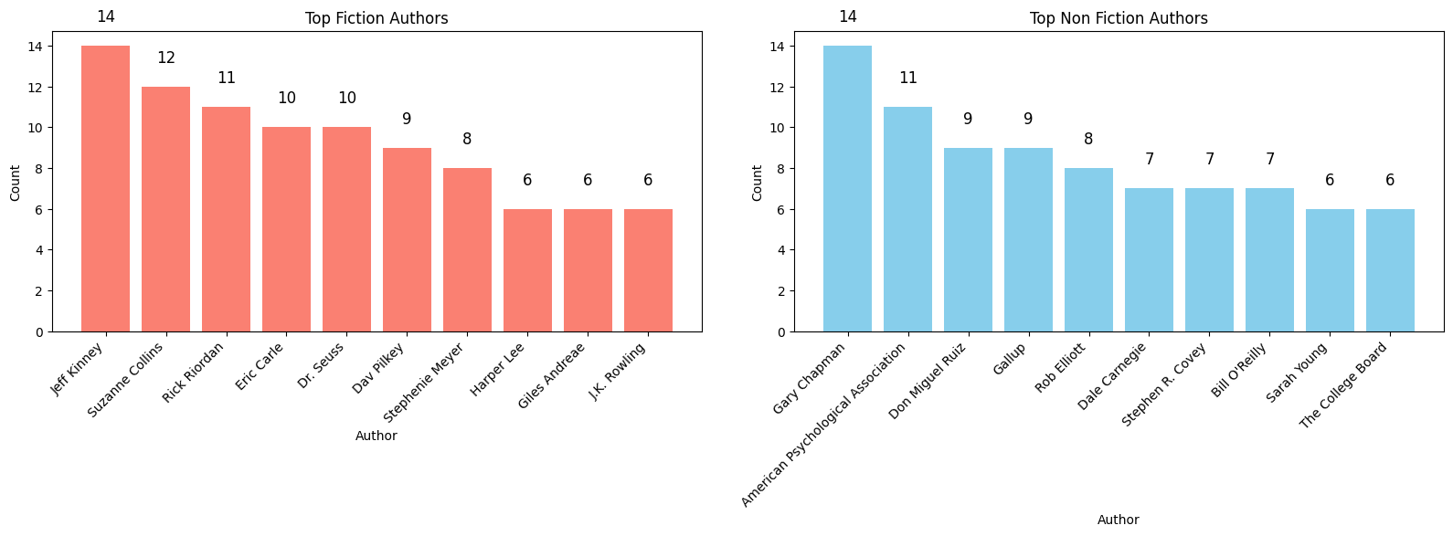
Data Analysis - Authors
Jeff Kinney and Gary Chapman are respectively the most present artist in the two Genres

Slide 5
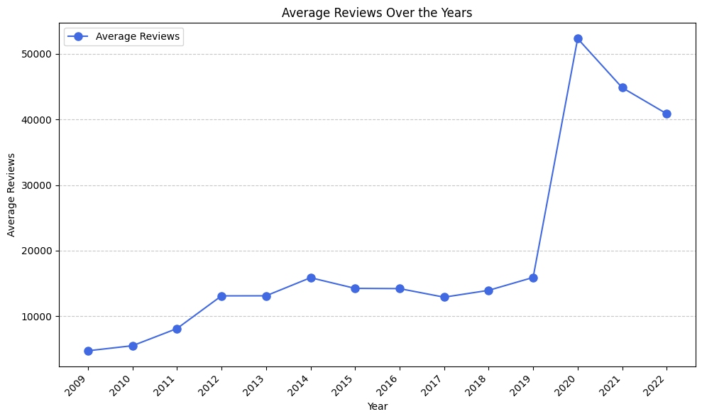
Data Analysis - Reviews
Noticeable Increase in User Reviews for Bestsellers Over the Years
2020 Shows a Significant Spike in User Reviews
Possibly Linked to the COVID-19 Pandemic Encouraging Reading Habits

Slide 6
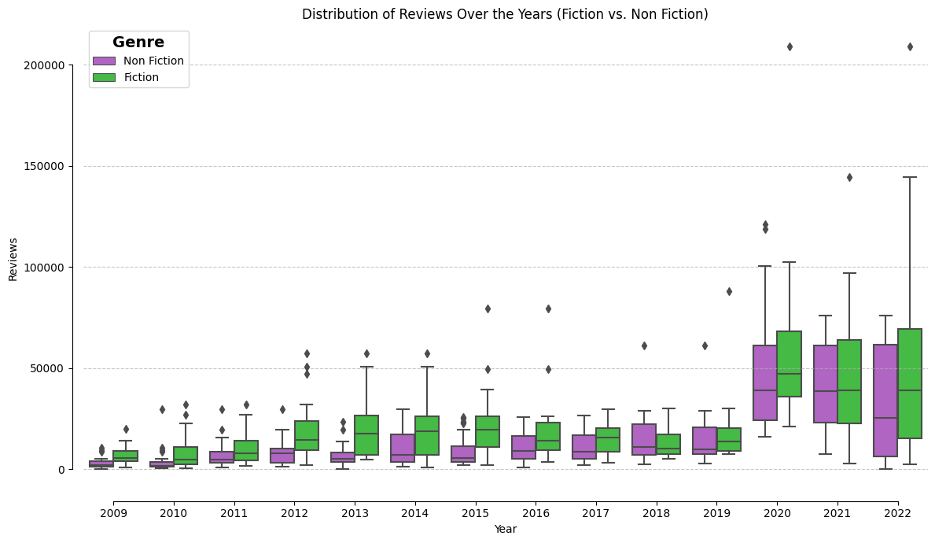
Data Analysis - Reviews by Genre over the Years

Slide 7
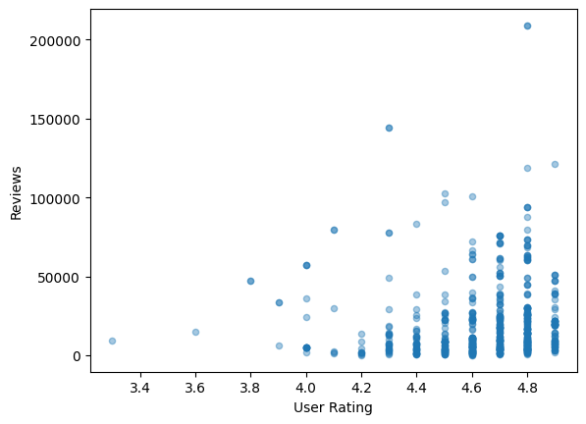
Data Analysis - User Rating and Reviews Analysis
Books with relatively low Ratings have fewer Reviews
No Observable Correlation Between User Rating and the Number of Reviews
A high User Rating doesn't Necessarily Mean more Reviews, and vice versa.
So let's combine normalized reviews and ratings to calculate book popularity.

Slide 8
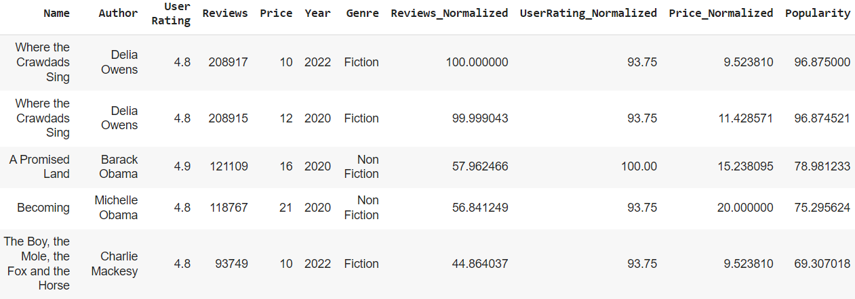
Data Analysis - Popularity
We combined normalized reviews and ratings to calculate book popularity.
This approach provides a more comprehensive view of book appreciation

Slide 9
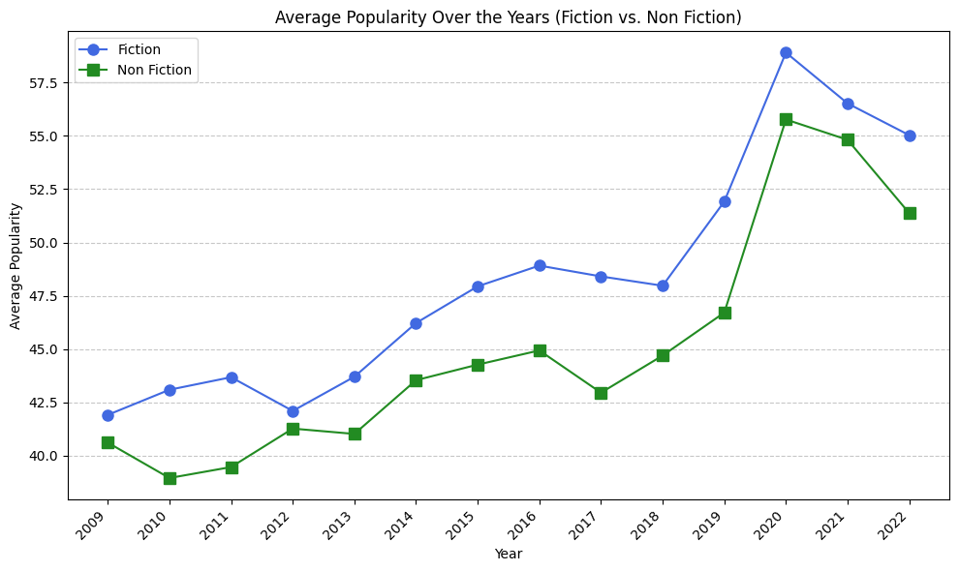
Data Analysis - Popularity by Genre Over the Years

Slide 10
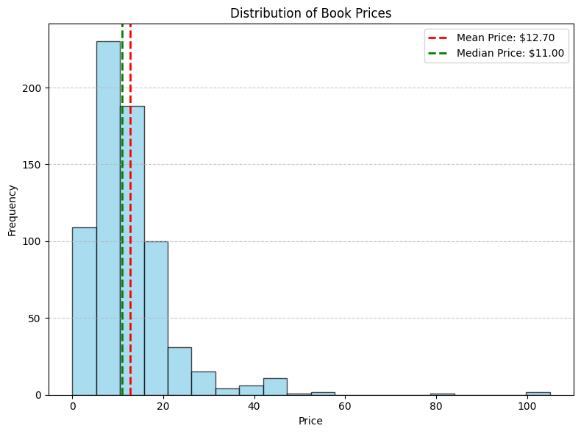
Data Analysis - Price Over the Years
Most Bestsellers priced below $20
We can say that affordable books attract new and Non-Traditional readers

Slide 11
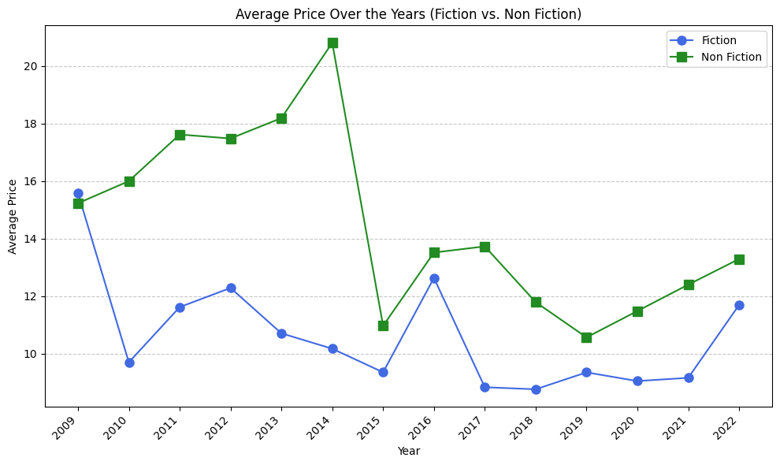
Data Analysis - Price by Genre Over the Years
Non-Fiction books have consistently commanded higher prices on average.
This is because Non-Fiction authors aim to maximize their profits, often targeting readers willing to invest in knowledge.
In contrast, Fiction authors may price their books more affordably as they work to build a dedicated reader base for future works.

Slide 12
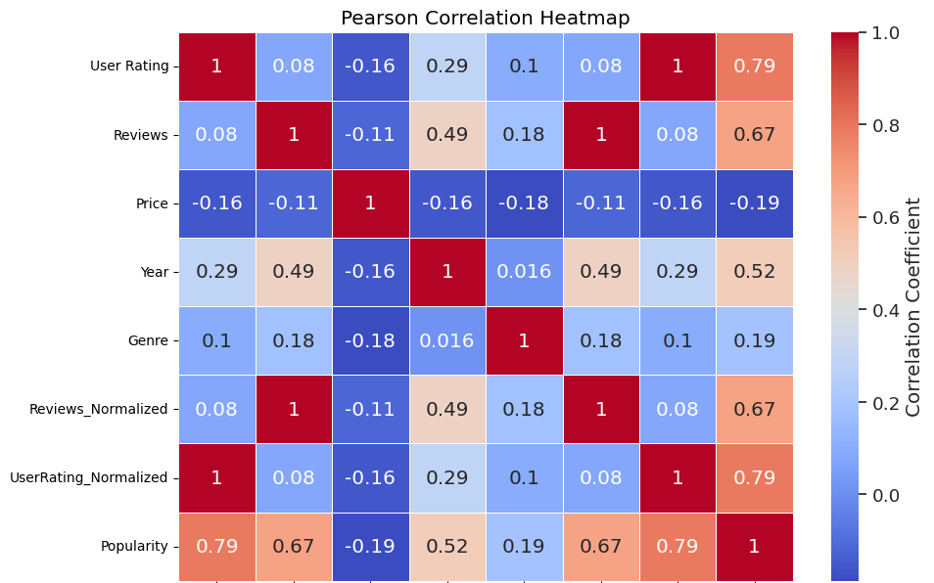
Data Analysis - Correlation of the Features
There are no features that are correlated with each other.
The only features that seems to be correlated are the Year and the Popularity as we have discovered also in previous analysis: in the last years the popularity of books increases.

Slide 13
Machine Learning
Given the absence of strong feature correlations, we adjusted our analysis approach.
We proactively explored correlations in other areas of the dataset.
This adaptability allowed us to uncover valuable insights:
Genre Prediction using the books name
Books Recommendation System using text features
Price Prediction using all the books features

Slide 14
Machine Learning - Genre Prediction
To make the prediction of the Genre easier we assign a numerical representation to the Genre feature:
Non Fiction = 0, Fiction = 1
X = Name
y = Genre
Counting words in texts, excluding stop words (such as 'a,' 'an,' 'the,' ...)
Transforming the texts into a Document Term Matrix (DTM): this will enable us to analyze the frequency of key words in the texts
Data Split for Training and Validation
Training a Logistic Regression model on our Training set
Evaluating the Model on Validation Data

Slide 15
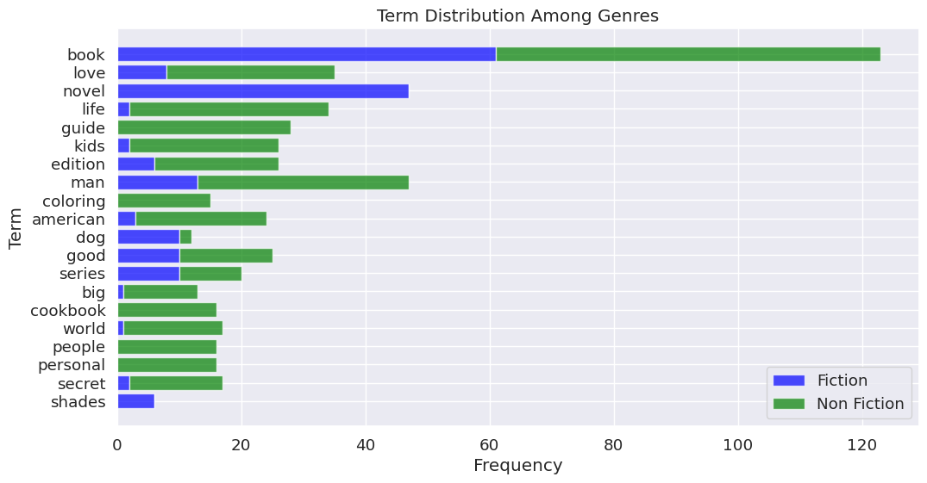
Machine Learning - Genre Prediction
Terms Distribution

Slide 16
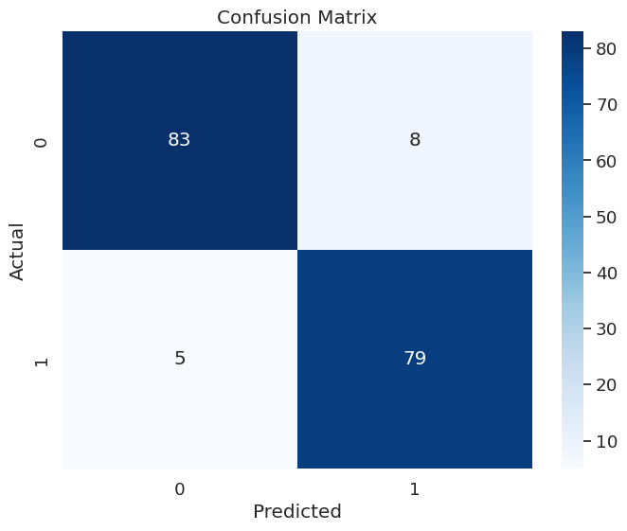
Machine Learning - Genre Prediction
Evaluation
To evaluate our Model we’ve used the Confusion Matrix. Since it is a binary classification problem this matrix have dimension 2*2.
The top left square represents the right prediction of the Non Fiction books by checking the y_test with the y_pred (TN).
The bottom right square represents the right prediction for Fiction books (TP).

Slide 17
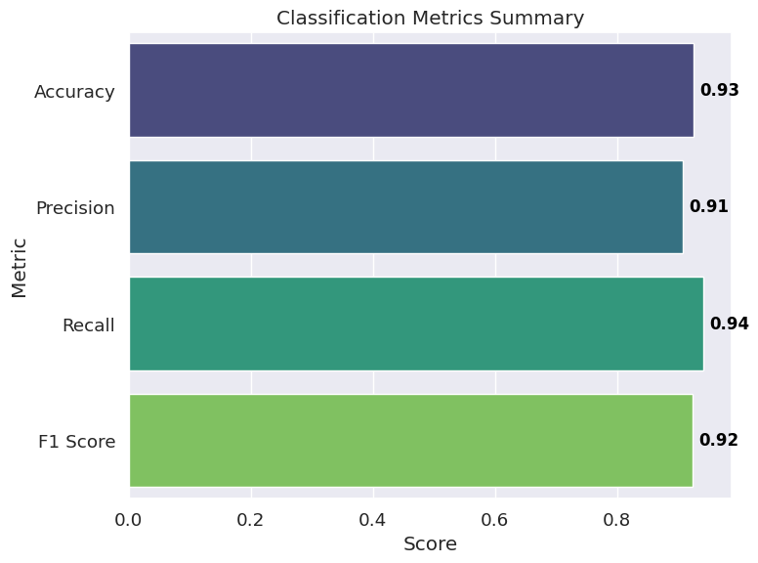
Machine Learning - Genre Prediction
Evaluation
Analyzing those metrics we can assume that our model predict with high precision and accuracy the genre of the book with only the name as input.
This is confirmed also by the F1 score which is the harmonic mean of the Precision and Recall metrics.
The Recall metrics indicates us the number of TP(Fiction books) over the total actual number of the Fiction Books.

Slide 18
Machine Learning - Book Recommendation
We want to recommend books similar to the book’s title that the user insert as input.
First of all we agglomerate the three features that we will use for the Content-Based Filtering:
Name
Author
Genre
This combination will be transformed in a TF-IDF(Term Frequency-Inverse Document Frequency) vector for text features, which helps in quantifying the importance of words in the text.
Then calculates the cosine similarities between books based on their text features using the linear kernel method, which can be useful for tasks like recommendation systems or text-based similarity analysis.
Let’s see how it works!

Slide 19


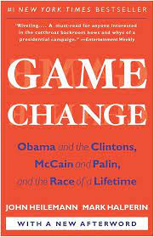
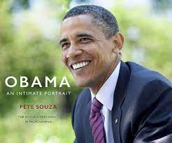
Machine Learning - Book Recommendation
Input:
A promised Land
Output:
Becoming, Michelle Obama Obama: An Intimate Portrait
Game Change: Obama and the Clintons, McCain and Palin, and the Race of a Lifetime

Slide 20
Machine Learning - Book Recommendation
To understand if the above Content-Based Filtering Model was the best to obtain this book recommendation, we try with different Model called Hybrid-Approach that makes us consider also the quantitative features.
We are now combining the TF-IDF Matrix with the normalized values of the quantitative data inside the dataset like:
User Rating
Reviews
Popularity.
As it has emerged from the previous analysis the low correlation between the feature will makes us obtain a less precise result corresponding on the Content-Based Filtering.

Slide 21


Machine Learning - Book Recommendation
Input:
A promised Land
Output:
Where The Crawdads Sing
Becoming, Michelle Obama
The Boy, the Mole, the Fox and the Horse
Worst Results!

Slide 22
Machine Learning - Price Prediction
Until now, we doesn’t used well the numerical features to obtain prediction because we have seen in the analysis that there aren’t feature correlated to each other.
Now we want to understand if it is possible to predict the price using all the features of the books.
So we consider to make the prediction of the book’s price:
Name
Author
User Ratings
Reviews
Year
Popularity
We start using a Ridge Regression then applied Kernels with Kernel-Ridge Regression and make a Cross-Validation to tune the hyperparameters to find the best alpha and gamma that makes the regression fit better the data and obtain more precision of the model.

Slide 23
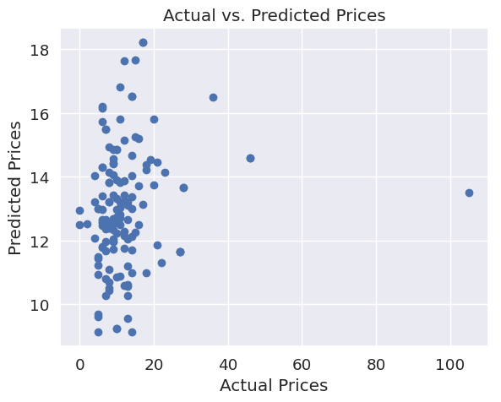
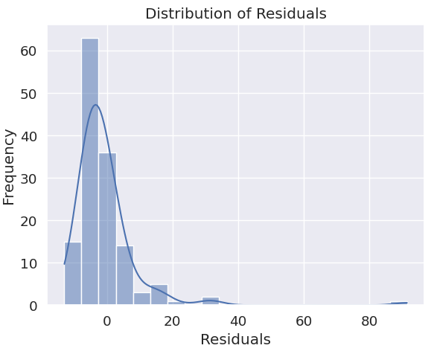
Machine Learning - Price Prediction
Ridge
Evaluation | Value
Mean Squared Error (MSE) | 109.76
Root Mean Squared Error (RMSE) | 10.48
Mean Absolute Error (MAE) | 5.84
R-squared (R2) | 0.02
Since the Errors are very high we cannot consider this model good to predict the price.
The value of alpha used was alpha = 0.001 We can try with Kernels to obtain a better result.
Notes:
Ridge Regression:
Purpose: Ridge regression is a type of linear regression that is useful when you have a dataset with potentially correlated features, and you want to prevent overfitting.
Benefit: It adds a regularization term (L2 penalty) to the linear regression cost function, which helps to limit the magnitude of the coefficients. This prevents the model from fitting the noise in the data and reduces the risk of overfitting.
Use Case: You might start with Ridge regression as a baseline model to handle linear relationships between features and target variables in your dataset.

Slide 24
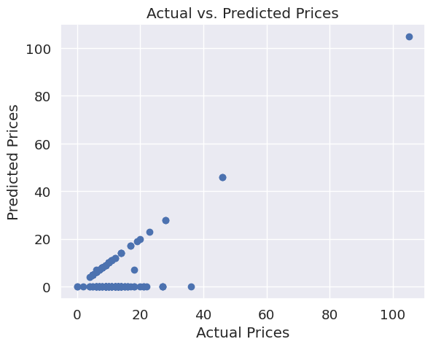
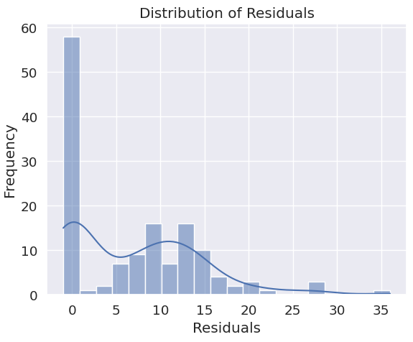
Machine Learning - Price Prediction
KernelRidge
Evaluation | Value
Mean Squared Error (MSE) | 102.65
Root Mean Squared Error (RMSE) | 10.13
Mean Absolute Error (MAE) | 7.00
R-squared (R2) | 0.08
Those value are obtained with hyperparameters, alpha = 0.001 and gamma = 1000.
Since the result is better than before but maybe can we obtain a better result with making Cross-Validation using GridSearch.
Notes:
Kernel Ridge Regression:
Purpose: Kernel Ridge regression extends Ridge regression by using the kernel trick to capture non-linear relationships in the data.
Benefit: It allows you to model complex, non-linear relationships between features and target variables. By selecting an appropriate kernel function (e.g., radial basis function - RBF), you can capture intricate patterns in the data.
Use Case: Consider Kernel Ridge regression if you suspect that linear models are not sufficient for your data, and you want to capture more complex interactions.

Slide 25
Machine Learning - Price Prediction
Cross-Validation
Cross-Validation makes us find the best combination of the hyperparameters: alpha and gamma:
Tuning alpha:
A smaller alpha allows the model to fit the training data more closely, but it may lead to overfitting.
A larger alpha imposes stronger regularization, which can help prevent overfitting.
The optimal value for alpha depends on the dataset and should be tuned to find the best trade-off between bias and variance.
Tuning gamma:
A smaller gamma value makes us obtain something linear.
A larger gamma value makes it more peaked.
Tuning gamma can be important for achieving the right balance between model complexity and generalization.

Slide 26
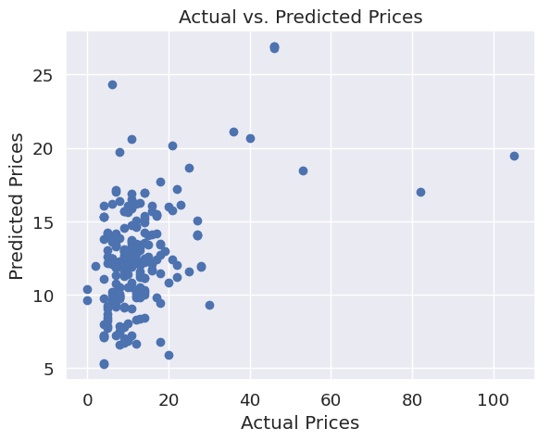
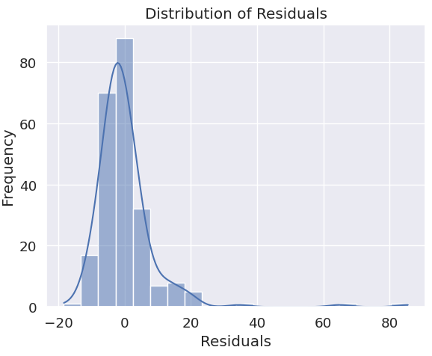
Machine Learning - Price Prediction
Cross-Validation
Evaluation | Value
Mean Squared Error (MSE) | 94.35
Root Mean Squared Error (RMSE) | 9.71
Mean Absolute Error (MAE) | 5.50
R-squared (R2) | 0.20
With the Cross-Validation we obtain as best hyperparameters:
Alpha = 1.0
Gamma = 0.0001
We obtain an improvement in respect of the simple usage of the Ridge Regression(the RMSE now is under 10) but we can’t take this prediction seriously because the Errors remains too high.
Notes:
Cross-Validation Purpose: Cross-validation is a technique used to assess a model's performance and generalization to unseen data. It helps in hyperparameter tuning and model selection.
Benefit: Cross-validation provides a more robust estimate of a model's performance by evaluating it on multiple subsets of the data. It helps you choose the best model (with the most suitable hyperparameters) based on how well it generalizes to new data.
Use Case: Cross-validation is typically used after you have selected a modeling approach (e.g., Ridge or Kernel Ridge) to fine-tune hyperparameters and obtain a more reliable estimate of model performance.

Slide 27
Conclusion
To make a quick resume of what we have discover performing the Data Analysis and Machine Learning:
Discovered the features inside the datasets analyzing the best genres and finding out the correlation of the features.
Machine Learning models to obtain several different prediction:
Prediction of the genre
Book Recommendation System
Prediction of the price
The models that makes us obtain a more accurate results were the models that takes consideration of the text features. The poor correlation between the other features makes us obtain not trustable results for the Prediction of the price

Slide 28
THE END
Thanks for the Attention!

