Slide 1
Design & Implementation of Timing and synchronization for an automotive amplifier BITS ZG629T: Dissertation
By
Mohan Karthik p
id: 2011HZ12013

Slide 2
Agenda
Problem Statement
Introduction to the problem space
Proposed solution (Designs)
Testing and Results
Conclusions
Q & A

Slide 3
Problem Statement
Design and Implement a precise time synchronization protocol as a foundation for an automotive audio amplifier.
Design a software architecture for implementation of time synchronization on Analog Devices® ADSP-BF518 Blackfin processor.
Utilize the open source ptpd implementation as the base source code.
Modify the open source implementation to utilize Blackfin’s hardware time stamping features for precise accuracy.
Demonstrate the precise time synchronization features of the ADSP-BF518 with respect to another node (PC) executing the open source implementation to prove compatibility.

Slide 4
Introduction to the problem space
Overview of traditional media streaming
Why point to point connections don’t work anymore.
Requirements for A/V streaming
Synchronized media streams.
Worst case delays in the order of 2ms.
Assurance of network resources.
Problems with traditional IT networks
No inherent notion of time.
Delays and jitter.
Network congestion

Slide 5
Introduction to the problem space
The Audio and Video Bridging Standard (IEEE Std 802.1BA)
Precise synchronization (IEEE Std 802.1 AS),
Best Master Clock algorithm
Precise clock synchronization
Clock syntonization
Traffic shaping for media streams (IEEE Std 802.1 Qav),
Admission controls (or stream reservation) (IEEE Std 802.1 Qat), and
Identification of non-participating devices (IEEE Std 802.1 BA).

Slide 6
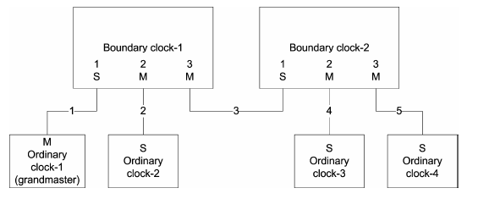
Introduction to the problem space
Precise Time Synchronization (IEEE Std 1588)
Single Grand Master clock on the system.
Grand master clock is chosen dynamically by a distributed protocol.
Ordinary clocks participate and attempt to synchronize to the grand master precisely.
Boundary clocks transport the time sensitive data reliably.

Slide 7
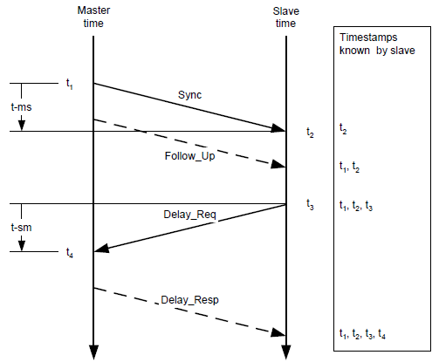
Introduction to the problem space
Precise Time Synchronization (IEEE Std 1588)
Message sequence followed by the IEEE Std 1588 in order to establish time synchronization across master and slave.

Slide 8
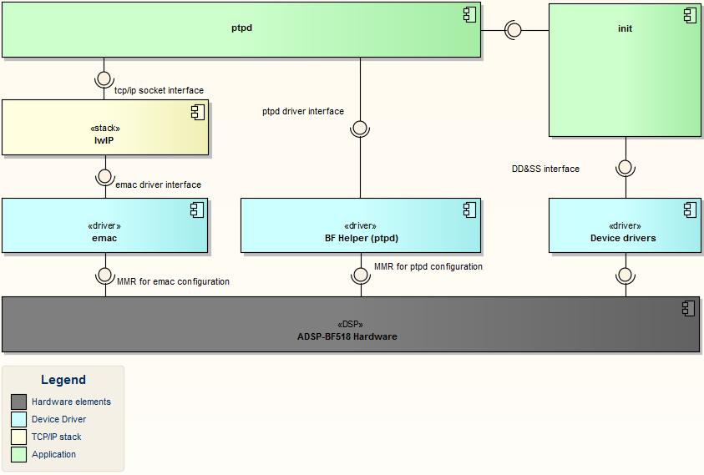
Proposed Solution
Architectural Design
(Protocol Implementation)
(System initialization)
(TCP/IP stack)
(EMAC driver)
(PTPD driver)
(DD&SS)

Slide 9
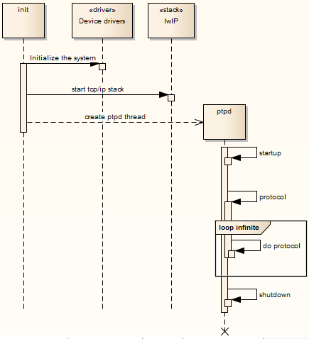
Proposed Solution
System initialization

Slide 10
Proposed Solution
Ptpd component
Ptpd: Active thread
Protocol: protocol implementation
Sys: init, shutdown & utility
Bmc: Best master clock algorithm
Servo: clock syntonization functionalities
Net: net services, sending receiving messages
Msg: message packing, unpacking
Timer: timer functionalities

Slide 11
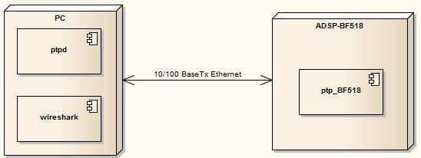
Testing and Results
Test Setup
Test Sequence
Power on the PC
Connect the PC to the ADSP_BF518 via a direct 10/100BaseTx Ethernet cable
Configure the PC to static IP (169.254.0.1)
Start the wireshark application on the PC and set it to capture mode.
Start the UART terminal emulator on the PC to capture the BF518 logs
Start the ptpd application on the PC.
Configure BF518 to static IP (169.254.0.2)
Start the BF518 application.
Capture the logs from PC, BF518 and wireshark.

Slide 12
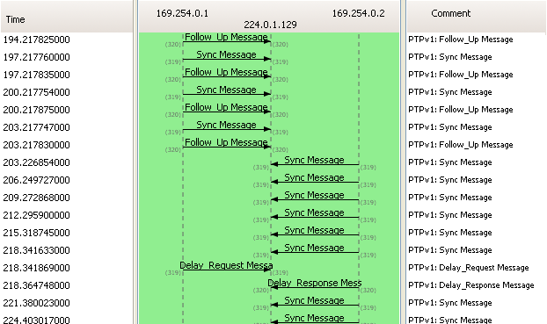
Testing and Results
Ethernet Packet flow

Slide 13
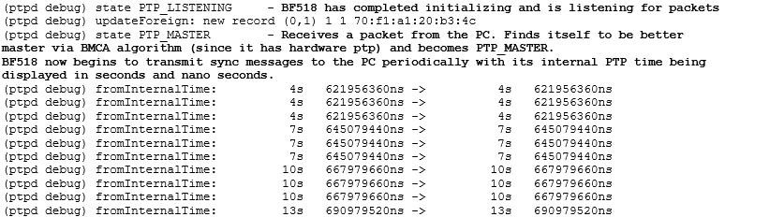
Testing and Results
ADSP-BF518 log

Slide 14
Testing and Results
PC log

Slide 15
Conclusions
Founding base for a complete Ethernet based audio amplifier
Establishes a common precise time reference across multiple nodes.
Media streaming protocols such as IEEE Std 1722 can harness the common time reference to implement schemes for media clock.
IEEE Std 802.1 Qat and IEEE Std 802.1 Qav complete the system.
Proves the capability of Analog Devices Blackfin processor in the Ethernet AVB space.
Currently supported processors include ADSP-BF51x, ADSP-BF60x and ADSP-CM408.

Slide 16
Acknowledgements
Faculty at Birla Institute of Technology, Pilani.
Vijaykumar N – Supervisor and mentor.
Sivaramakrishnan S – Additional examiner and mentor.
Colleagues at Analog Devices India Pvt. Ltd.
Steven Kreuzer and George Neville-Neil for the open source ptpd implementation.
Parents who have always been there to support me.

Slide 17
Questions?
With thanks
Mohan Karthik P (2011HZ12013)

