Slide 1
Emanuel & Peter
Who we are:
We take care of your needs – No problem is too big.
Slogan: Money well spent

Slide 2

What our client wanted us to do:
Make the site responsive
One page
Menu on site instead of pdf

Slide 3

What we did
and how
Started by viewing our objectives
→ Setting up a template for the site (<header>,<nav>,<section>, etc.)
→ Filling in content
→ Styling content
Used GitHub throughout the process for easy collaboration

Slide 4

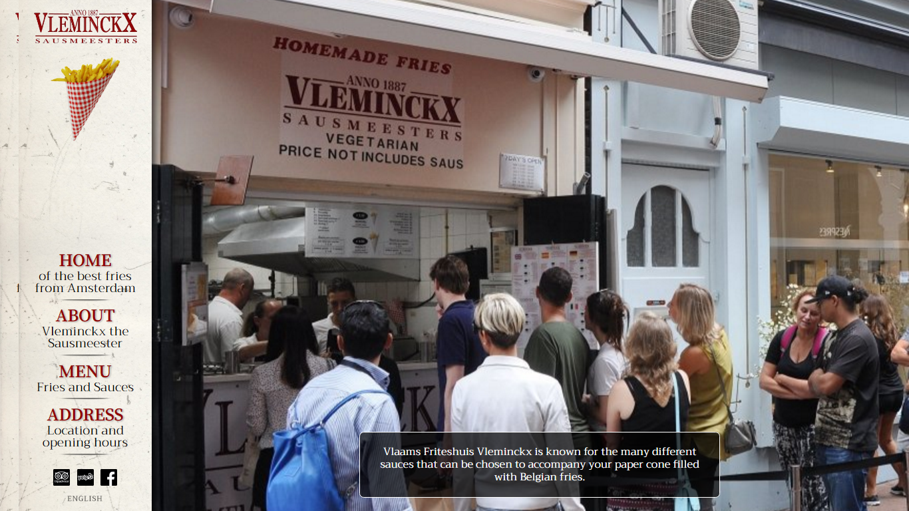
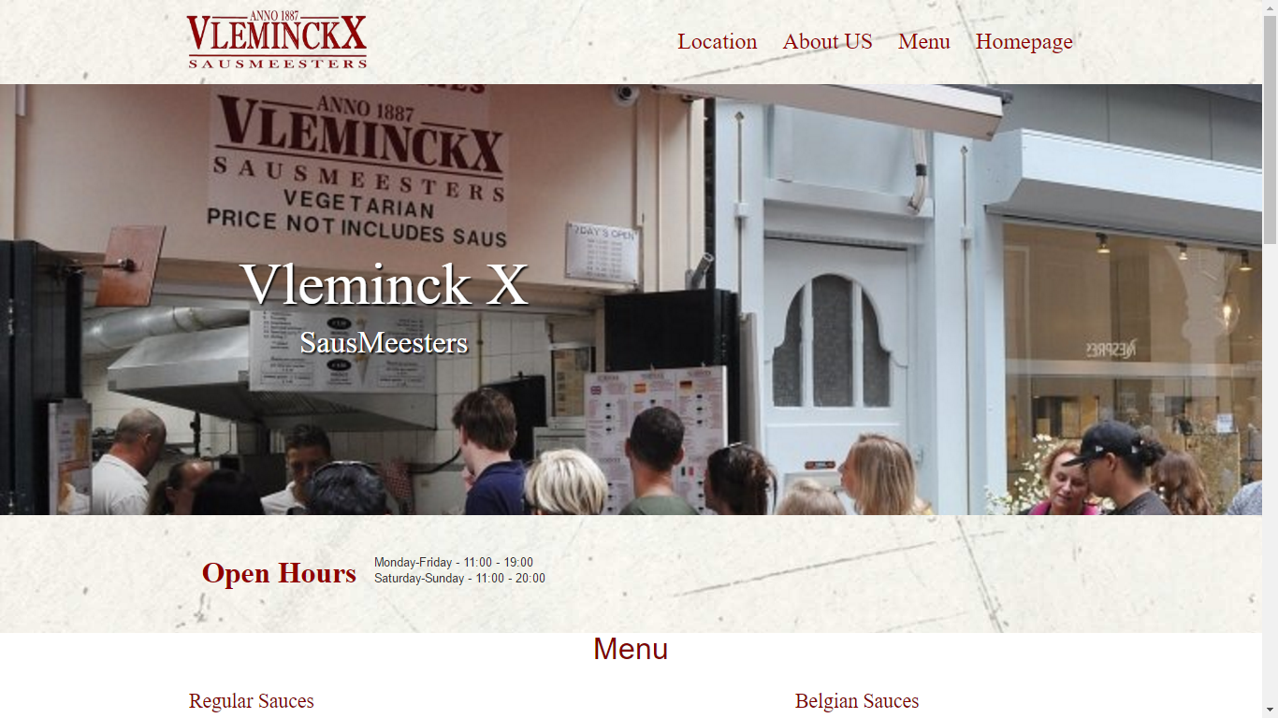
Emanuel & Peter
Demo
How it was before
How it is now
https://github.com/Pederytter/vleminck

