Slide 1


Implementation of Non-Standard Digital Signature Method in V2X Environments
Matteo Pedone

Slide 2
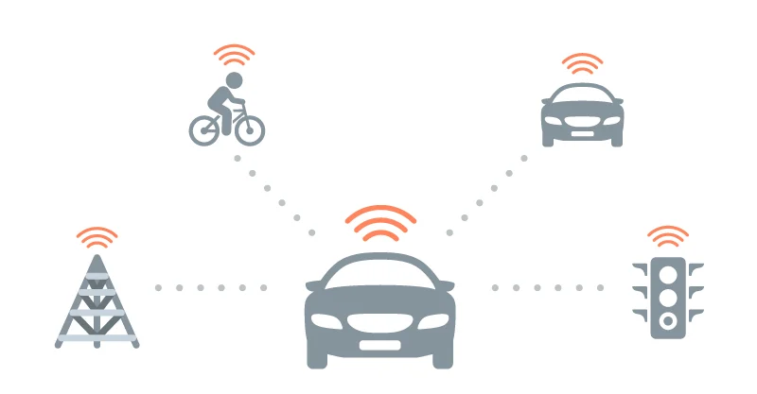
V2X communication
V2X communication
The V2X communication is a node-to-node communication, where each node exchanges information with the others in a short timeframe.
The entities involved in the vehicular network are OBU, RSU, TA.
Vehicular communication can operate at two different levels: Short-range communications where the main standards are DSRC (Dedicated Short-Range Communications) and C-ITS (Cooperative Intelligent Transport Systems). Long-range communications, where the primary standard is LTE V2X (Long-Term Evolution Vehicular to Everything), later renamed C-V2X (Cellular Vehicular to Everything)
The message set adopted in V2X communications comprises CAM, DENM, CPM, MAPEM, SPATEM, ext.

Slide 3
PKI infrastructure
V2X technology relies on PKI architecture, defined in ETSI TS 102 940
RCA: issues, renews, distributes and revokes certificates for EA and AA.
EA: authenticates the ITS-Station and issues a proof of identity (Enrolment Credential).
ITS-S: uses Enrolment Credential to request authZ for services from an AA.
AA: grants permissions to ITS-S through AT.
AT: certificates used to authenticate and authorize the entities for specific actions or communications within the V2X network
Fig.1 - V2X PKI infrastructure

Slide 4
Public-key-based systems at risk from Quantum attacks
For message integrity and authN, the ECDSA (Elliptic Curve Digital Signature Algorithm) is required to generate digital signatures and verificate keys ETSI TS 103 097.
The growing capabilities of quantum computers in recent years present serious threats to the security of current computer systems, particularly those based on public-key algorithms.
Since 2012, the National Institute of Standards and Technology (NIST) has been leading a standardization effort to select post-quantum cryptography(PQC)
Among the signature algorithms advancing to the fourth round of evaluations are CRYSTALS-Dilithium, Falcon, and SPHINCS+.

Slide 5
Thesis purposes
A point of convergence between V2X and Post-Quantum Cryptography:
Integrating PQC APIs to extend the standard followed for inter-vehicle communication.
Extending the structure and fields of the certificates of the entities involved in the V2X PKI infrastructure.
Sending new non-standard CAM messages, appending the new digital signature, over the network interface.
Conducting a comparative analysis of message size and signing times between the existing standard method of signing CAM and the method implemented in this thesis.

Slide 6
Tools used during the study
Proprietary solution:
- Cohda Wireless Virtual Machines
Open-source solution:
- Docker container
- Wireshark
- FsMsgGen open-source tool
- ItsCertGen open-source tool
Libraries involved: FitSec, PCAP, liboqs

Slide 7
Generation of V2X-Dilithium certificates and key pairs
<? AT Certificate profile ?>
<EtsiTs103097Certificate>
<version>3</version>
<type> <explicit/> </type>
<issuer name="CERT_IUT_A_AA_Dilithium">
<sha256AndDigest/>
</issuer>
<toBeSigned>
. . . .
<encryptionKey>
<supportedSymmAlg> <aes128Ccm/>
</supportedSymmAlg>
<publicKey>
<eciesNistP256>
<compressed-y-0/>
</eciesNistP256>
</publicKey>
</encryptionKey>
<verifyKeyIndicator>
<verificationKey>
<dilithium2>
<publicKey/>
</dilithium2>
</verificationKey>
</verifyKeyIndicator>
</toBeSigned>
<signature>
<dilithiumSignature>
<signatureValue/>
</dilithiumSignature>
</signature>
</EtsiTs103097Certificate>
ItsCertGen tool:
Change the public verification key and signature fields of certificate profiles
Extension of the definitions of ASN.1 module files, generating updated C source code containing structures for Dilithium signatures and key pairs.
Generation of Dilithium verification key pair using OQS_SIG_dilithium_2_keypair, a liboqs API.
Computation of the joint hash of the certificate ( toBeSigned hash + signer hash)
Computation of Dilithium certificate signature using OQS_SIG_dilithium_2_sign, a liboqs API.
Outputs are new certificates and key pairs for RCA, AA, and AT.

Slide 8
Non-standard CAM generation
FsMsgGen tool:
Initialization of CAM parameters.
Installation of certificates in fsmsggen framework.
Signing and injection of messages.

Slide 9
Installation and verification of new certificates
Integration of certificates and keys into the fsmsggen framework
Processing each certificate with a designed function for performing the supposed operations of a FitSec method, which code is not available:
Passing as parameters the certificate sequence of bytes, the keys, and some flags;
Parsing of this raw sequence of bytes in a well-designed structure, which follows both the ETSI TS 103 097 standard and the new implementations for verification key and signature.
verifying the signature of the certificate to guarantee integrity and authenticity, using OQS_SIG_dilithium_2_verify, a liboqs API.

Slide 10
Signing and injection of message
Signing the message means signing its hash, in particular the hash of the unsecured data that comprises: CommonHeader, TSBP, BTP-B, ItsPduHeader and CamPayload
The function used is OQS_SIG_dilithium_2_sign.
The CAMs are injected every 100ms, and, once each second, the message must include the whole certificate. In the other messages, the certificate digest is present.
Fig.2 – unsecuredData to sign in a standard CAM

Slide 11
Observations
Significant size difference between standard and non-standard messages
The messages with the Dilithium certificate are 17 times larger than those standards.
The messages with the digest of Dilithium certificate are 13 times larger than those standards.
Fig.3 - Standard CAMs captured
Fig.4 - Non-standard CAMs captured

Slide 12
Observations
Time of signing messages.
Dilithium is faster than the PQC competitor algorithms but is slightly slower than the Ecdsa solution. Average times in a sampling window of 2000 measurements are:
• Ecdsa: 0.110 ms;
• Dilithium: 0.302 ms;
• Falcon: 0.584 ms;
• Shpincs: 599.014 ms.
Fig.5 – Signature times graph
Benchmark: a PC with Intel(R) Core(TM) i7-8565U CPU

Slide 13
Conclusions
The significant size difference can lead to a higher load of the communication channel or OBU with larger storage.
The signing times are comparable with the standard version.

Slide 14
Future developments
Addressing the larger size of non-standard CAM messages, with operations such as fragmentation, segmentation, caching, compression.
Emulating a real-world scenario.
Implementation of the reception phase.
Studying the network traffic bandwidth.
PQC extensions for different types of messages.
PQC for encryption and decryption of CAM.
Analyzing how the size differs with different PQC algorithms.

Slide 15
Thanks for the attention!
email: m.pedone2000@gmail.com
Linkedin: linkedin.com/in/matteo-pedone
GitHub: PedoneMatteo

