Slide 1
2012-09-06: 1st Team Meeting
Agenda

Slide 2
Agenda
Introduction Round Robin
Team & Vehicle Name
CRF’s Proposed Architecture
Work Packages & Schedule
Administrative Stuff

Slide 3
Agenda
Introduction Round Robin
Team & Vehicle Name
CRF’s Proposed Architecture
Work Packages & Schedule
Administrative Stuff

Slide 4
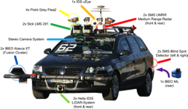
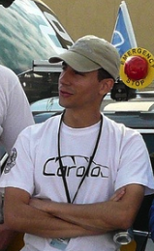
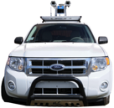
Christian Berger
„Caroline“:
AGV@Berkeley:
Juror of 2011‘s CaroloCup
General risk: Getting all artifacts working in the required quality and in time.

Slide 5
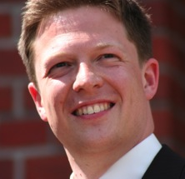
Olaf Landsiedel
About:
Assistant Professor at Chalmers
Distributed Systems, Computer Networks, Cyber Physical Systems
Skills:
Build stuff + hack + organize ≈ research
Risk:
Need a well designed base system

Slide 6
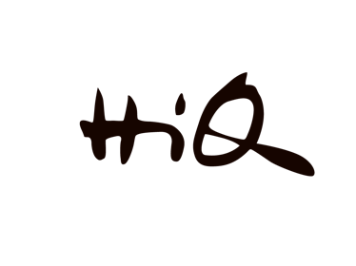
HiQ sponsors Chalmers team
HiQ is built on values
Results
Simplicity
Responsibility
JOY ☺
HiQ is active in
IT
Automotive
HiQ can provide advisory expertise in
Artificial Intelligence
Control Systems
Embedded systems
Having lots of fun!!

Slide 7
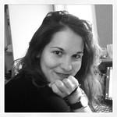
Communication & Relations
+
Time & task organization
+
Creativity
for constructions
Sofia Charalampidou
=
…my contribution
Requirements
Information gathering
Software design & development
…threads of success
Loss of excitement & motivation
Problem management

Slide 8
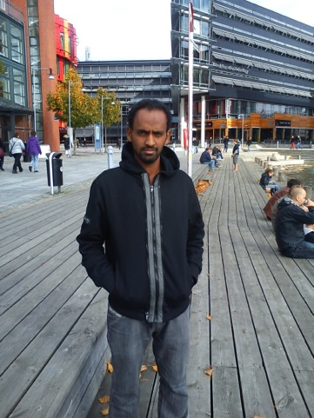
Munir Fetewi
Software engineering(Master program)
Technical
Programming, Analysis data and
System design, …
Social
Team work ,
Discussion &
Communication
Contribution
generally in any software parts such as :
Data transimission,
Data processing ,
Coding if necessary
...
Challenges
Image processing,
This all how to get precise data from the camera and sensor.

Slide 9

Mahsa Mirtalebi
hard working, flexible in group team work and motivated to finish everything that start
I want to be in part of moving without something in the way just find the right direction
Time is always is risky but we can prepare some plan and schedule to overcome lack of time
After that it is better to do some research before start to make functionality in order to make sure about everything

Slide 10
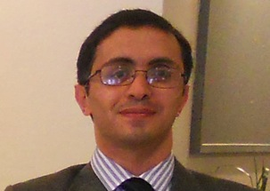
Seyed Ehsan Mohajerani
Usually I am adaptable with the group and after a while I feel I am in the leading position at the group.
I am familiar with Electronics in Embedded systems.
I would like to participate in the motor driving and controlling task.
I think the general risk threating the overall project is to adjust and calibrating the vehicle internally and externally to work properly in desired conditions.

Slide 11
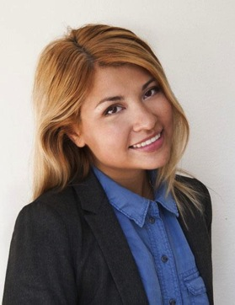
Anna Orazova
As 50% of my programme is about IT management, I am good in team work and in planning and organizing group work.
All last term I've been studying design and development of embedded systems (was working with IRs, sonars and pressure sensors).
As I was working with sensors before, I could help with those, but I would like to discuss the project more closely and apply myself in those areas I would be able to contribute the most.
My experience shows, that usually general risk threatening the overall project's success is poor planning.

Slide 12
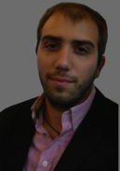
Paschalis Tsolakidis
Problem solving nature
Project management methodologies
Java programming & Model-based engineering
CONTRIBUTION
I would like to contribute to any of the 3 dynamic tasks of the autonomous
vehicle. Mostly by helping with the design and implementation of the software
part.
THREATS & RISKS
The integration of the hardware and software components comes late and
introduces changes.
People from different areas, gathering together for the first time, need more
effort in the earlier stage of the project(until the group picks up its pace).

Slide 13
Agenda
Introduction Round Robin
Team & Vehicle Name
CRF’s Proposed Architecture
Work Packages & Schedule
Administrative Stuff

Slide 14
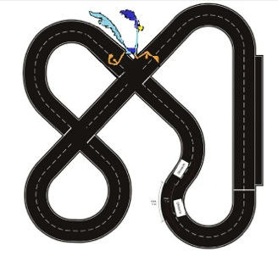
Team & Vehicle Names
3C Team (Chalmers Carolo Cup Team)
go:Carolo
SWETOPIA
FCS = First Carolo Cup Sweden
Vikings
Polar Bears
Aurora
CRR-13
(Chalmer’s Road Runners 2013)

Slide 15
Agenda
Introduction Round Robin
Team & Vehicle Name
CRF’s Proposed Architecture
Work Packages & Schedule
Administrative Stuff

Slide 16
Rules & Regulations – Selected Requirements
Most important: Don‘t harm anybody!
Electrical drive
Battery-based power supply
Vehicle dimensions:
1:10 scale, four-wheeled model
Two axles
Wheelbase: >= 200mm
Track width: >= 160mm & < 400mm
Height (fixed superstructures without antennae): <= 300mm
Steering on front axle (additional rear axle steering possible)
No GPS (changed for 2013 competition)

Slide 17
Rules & Regulations – Selected Requirements
Continued...
No data transfer from/to the vehicle during a competition (except for RC mode)
Components must ensure protection degree IP 11 (EN 60529):
Solid particle protection:
Objects of this size are protected: > 50mm
Effective against: Any large surface of the body, such as the back of a hand, but no protection against deliberate contact with a body part
Liquid particle protection:
Protected against: Dripping water
Testing for: Dripping water (vertically falling drops) shall have no harmful effect. RC mode must not interfere with 2.4 GHz range
Lights:
Three brake lights (red) at the rear side
Turn signals (yellow/orange)
Blue RC-mode activation light

Slide 18
Sensor Setup
Camera: IDS uEye UI-1220-LE-M-HQ or Logitech C525 HD
Ultra sonic: SRF08, 30°, 0.03-6m, 20Hz
Infra red: GP2D120, 0.04-0.3m, 20Hz
Accelerometer & Gyro: Razor 9DoF
Odometer: Built-in
Ultra sonic
Vehicle
Camera
L
ODO
L
Infrared
L
A&G
L
Ultra sonic
L
Ultra sonic
L
Infrared
Infrared
L
L

Slide 19
Hardware Architecture
Camera
Braking
Ultra sonic rear
Ultra sonic front
Ultra sonic front/right
Acc & Gyro
Flashing left
PandaBoard
7.4V / 4,500 mAh
Sensor Board
STM32F4-Discovery
Flashing right
Infra red rear
Infra red rear/right
Infra red front/right
Motor Controller
Emer-gency
Steer
Motor
Power
I²C
USB
PWM
UART
A-I/O
3bit con.

Slide 20
Agenda
Introduction Round Robin
Team & Vehicle Name
CRF’s Proposed Architecture
Work Packages & Schedule
Administrative Stuff

Slide 21


Schedule – At Large
August 15, 2012 Kick Off Event
October 31, 2012 Hardware Freeze
November 16, 2012 Software Feature Freeze
December 04, 2012 Local Demonstration
December 23, 2012 Official Application to Competition
February 04, 2013 Training
February 05, 2013 Competition
February 06, 2013 Award Ceremony

Slide 22
Team Member’s Availability Until 02/’13
Mohajerani, Ehsan
Fetewi, Munir
Orazova, Anna
Mirtalebi, Mahsa
Charalampidou, Sofia
Tsolakidis, Paschalis

Slide 23
Work Packages
Integration & Testing
Anna & Paschalis
Lane Following Algorithm
Munir & Sofia
Stationary & Moving Obstacle Passing Algorithm
Anna & Munir
Intersection Handling Algorithm
Sofia & Paschalis
Parking Algorithm
Mahsa & Ehsan
Hardware
Mahsa & Ehsan

Slide 24
Agenda
Introduction Round Robin
Team & Vehicle Name
CRF’s Proposed Architecture
Work Packages & Schedule
Administrative Stuff

Slide 25
Thank you.

