Slide 1
Agile Development Processes (DIT191 / EDA397)
Eric Knauss
<eric.knauss@cse.gu.se>

Slide 2

Agenda today
Groups
Version control systems
Android

Slide 3

About groups
https://flic.kr/p/ffDMHK

Slide 4
About Groups
First: Thank you for your feedback!
Should I assign groups or you?
Pro: self-grouping
Faster
Established groups might work better (?)
Contra: self-grouping
Unbalanced groups
Hard to introduce new guys in established groups
Unfair disadvantage for some (?)
Meta-aspect: What supports learning most?
Realism argument: “You cannot choose your group in industry”
Social dynamic part of the beauty of agile methods

Slide 5
Groups: Towards a Compromise
Work with new people!
Expand your network
Increase the diversity in your team
A chance to learn
People are different
“You are all individuals!”
Realism revisited
Cannot choose your group?
Different profiles, different careers
Example
SW engineer
Senior SW engineer
Project lead
Technical leader
Expert

Slide 6
?
What do you want to do in 5 years?
…in 10 years?
Where are the future Project leaders?
…the future chief architects?
…the future experts (in QA, HCI, UX, KM, …)

Slide 7
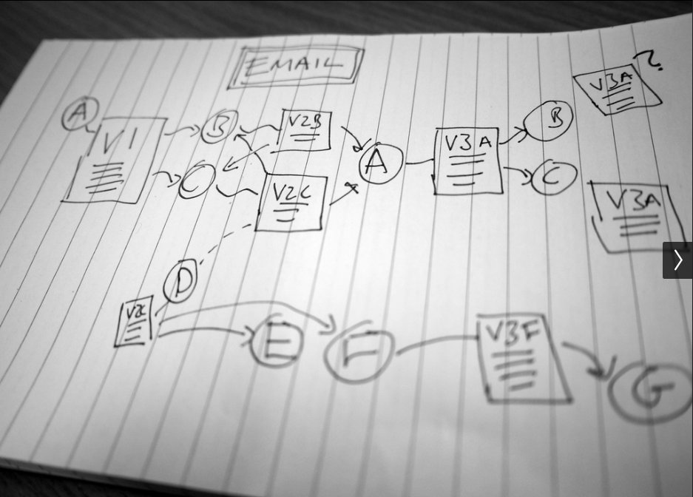
Version Control
https://flic.kr/p/eqH7ym

Slide 8
Version Control
Part of Software Configuration Management
Used to manage changes to the source code
tracks revisions, with timestamps and users
allows control (rollback, branching, etc)
many allow concurrent work (sane)
“Essential” for multi-developer projects

Slide 9
Important Concepts
Repository / Working Copy
Change (List)
Commit
Trunk / HEAD
Conflict / Merge
History

Slide 10
?
Why is version control so important?
Why is configuration management so important?
What is the difference between the two?

Slide 11
Git
Distributed version control
Developed by Linus for Linux Development
Distributed
Strong support for non-linear development
Efficient for large projects

Slide 12
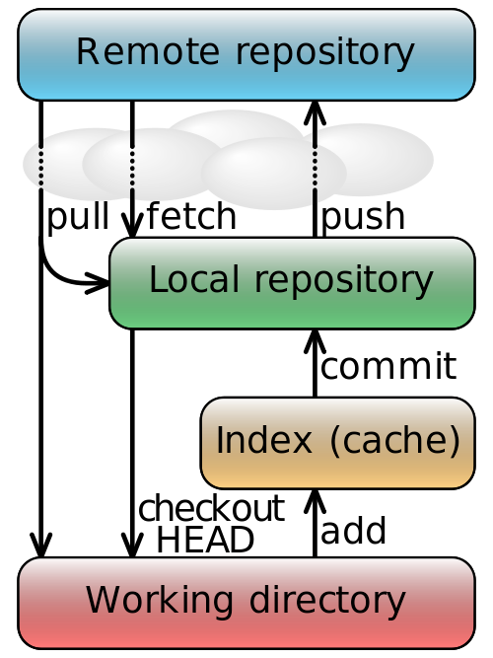
Workflow / Concepts

Slide 13
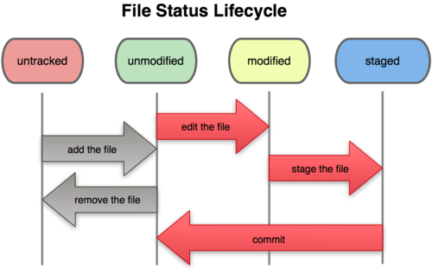
Workflow / Concepts

Slide 14

Android
https://flic.kr/p/jPnPwv

Slide 15
Android SDK
From our perspective
Java-based API
XML-based layout
Tools to build/install/simulate
Two options for today:
Let’s get started!!!
Get some overview first
?

Slide 16
Android-Architecture
Application
layer
Android-applications
Third-party-applications
Your own applications
Application frame
Activity Manager
Content Provider
Location Manager
Notification Manager
Package Manager
Resource Manager
Views
Connectivity Manager
Telephony Manager
Window Manager
Libraries
Android Runtime Environment
Grafic
DB
Android Runtime Library
Media
SSL
libc
WebKit
DVM (Dalvik Virtual Machine)
UI-Manager
Linux Kernel
HW Drivers (Screen, Camera, WiFi, Keyboard, etc.)
Energy mgnt
Process mgnt
Memory mgnt
IPC-Driver (Binder)
[BP10]

Slide 17
Architecture of Android App
Distinguish 4 Types of components
Activity
View / Presentation layer
Show and manage UI
Service
Controller / Application layer
Allows operations to run in background
Example:
Musicplayer is controlled through Activities
Music is played as Service in background
Even after the UI is closed
Content Provider
Model / Persistence layer
Manage data and persistence layer
Can provide data to a specific app or even to many apps
Broadcast Receiver
Receives system messages
Allows App to react on changes in state of system
Example
Problems with network connection
Empty battery

Slide 18
The Context Class
The class Context represents the application context
Establishes relationship between app and system
Allows to access Manager classes
How to use this:
Activity and Service classes are derived from abstract class Context → access via this.*
Broadcast Receiver get Context during initialisation as a parameter
Content Provider can access the Context via getContext method
Your own applications
Context
Application frame
Activity Manager
Content Provider
Location Manager
Notification Manager
Package Manager
Resource Manager
Views
Connectivity Manager
Telephony Manager
Window Manager

Slide 19
Connect Components: Intents
Goal: Connect components of different apps
With a standardized mechanism
…that does not require changes of source code
…that is easy to document
A component can use another component or replace it
By using Intents
Explicit Intent: Receiving component is known at design time
Intent i = new Intent(this, PositionSender.class);
startActivity(i);
Implicit Intent: No receiver specified, components of installed apps are responsible to react
Intent i = new Intent(Intent.ACTION_DIAL, Uri.parse(„tel:(031)772 10 80“);
startActivity(i);
For your components you can define Intent-Filter in central configuration file

Slide 20
Examples for implicit Intents
Call a number
Intent i = new Intent(Intent.ACTION_CALL, Uri.parse(„tel:(031)772 10 80“);
startActivity(i);
Show position on map
Uri uri = Uri.parse(„geo:52.382201,9.717450?z=19“);
// uri = Uri.parse(„geo:0.0?q=Welfengarten%201,%20Hannover“);
Intent i = new Intent(Intent.ACTION_VIEW);
i.setData(uri);
startActivity(i);
Google Street View
Intent i = new Intent(Intent.ACTION_VIEW, Uri.parse(„google.streetview:cbll:0.0?52.382201,9.717450“);
startActivity(i);
Show webpage
Intent i = new Intent(Intent.ACTION_VIEW, Uri.parse(„http://oerich.github.io/EDA397/“);
startActivity(i);
DIAL requires user to confirm

Slide 21
Processes, Threads, Services
App starts in UI-Thread
Various code is executed in UI-Thread Example: Hook method onClick()
Not suitable for long running tasks → Android stopsApps that do not react
Process vs. Thread
In one Process you can start several Threads
When the process terminates, all its Threads end as well
Processes are expensive (especially starting them)
Consequence 1: First start of app takes long time
Consequence 2: Android does not stop process when user quits the App → only when resources run out
Service
Can be run in its own process (Remote Service)
Can run in same process as component (Local Service)

Slide 22
Services
Do not replace Threads
Start a new Thread for long-running tasks!
Communicate with Services
Local: Remote Procedure Calls (RPC) → simple
Remote: Inter Process Communication (IPC) → a bit more complex
PID = 1
PID = 2
Activity
Local Service
Remote Service
RPC
Thread 1
Thread 2
Thread 3
IPC
[BP10]

Slide 23
Services: Binder and Handler
Each Android Service has a Binder
Provides the Interface of the Service
A Service needs a Callback function to return data
Android provides a Message-Queue
You can insert Messages (Data container) or Runnables via a Handler
Inter Process Communication
Messages are formulated in Android Interface Definition Language (AIDL)
Operating system needs to interprete messages
This allows to call C-libraries

