Slide 1
Agile Principles and Practices
Emil Alégroth

Slide 2
In administrive news
Groups on the course wiki:
https://github.com/oerich/EDA397/wiki
If you have not signed up, please do so in the break!
Note that there are 11 groups! You have to scroll down to see 11. Sorry.

Slide 3
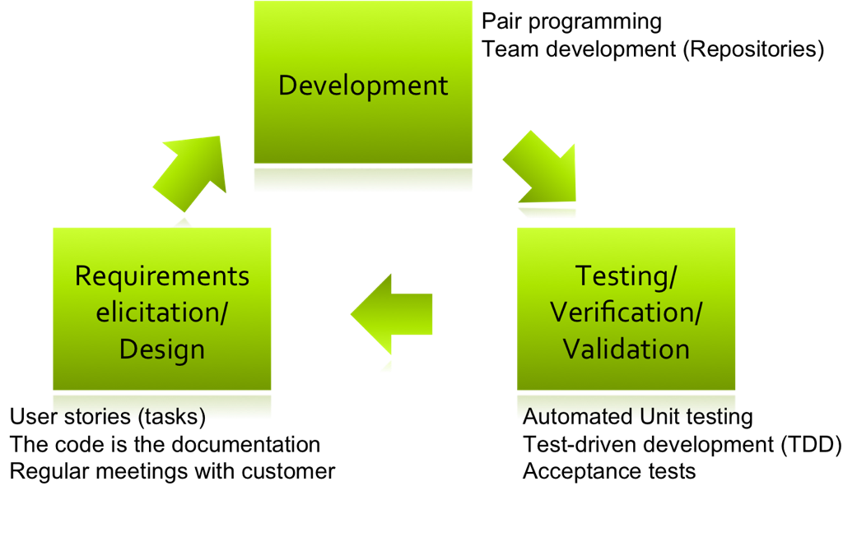
Recap from Tuesday
Efficient software development requires a development process
Traditional processes
Not efficient when requirements change
Agile software development
Processes for efficient
software development in
the context of change.

Slide 4
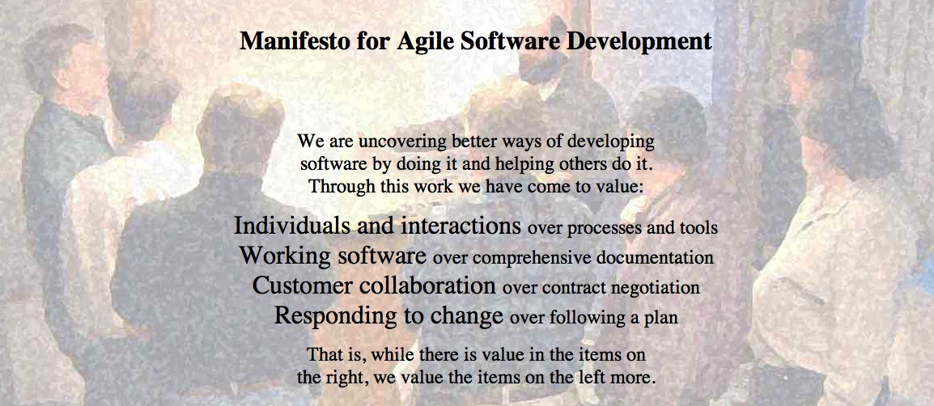
Agile Manifesto
http://agilemanifesto.org
Began as a provocation: Plan-driven development did not safe the Software world…
Now a very serious movement, well adapted in industry.
There are a couple of established agile methods: How to integrate these values in everyday software development

Slide 5
Agile Principles
Early and continuous delivery of valuable software
Welcome changing requirements, even late
Deliver working software frequently
Business people and developers must work together
Build projects around motivated individuals
Face-to-face communication is most effective and efficient
Working software is the primary measure of progress
Sustainable development
Continuous attention to technical excellence and good design
Simplicity is essential
Self-organizing teams
Regular reflection
Notes:
Take two minutes to discuss with your neighbour: Which are easy, which are hard to follow in your project?

Slide 6
eXtreme Programming practices
The 12 practices of XP

Slide 7
Planning Game
Release planning (Customer and developers)
Create storycards with most important requirements
Commit to development and set deadline (1 week)
If required: adjust, add or change included requirements
Iteration planning (Developers)
Break requirements into tasks
Assign tasks to developers and estimate time (Planning poker)
Integrate tasks and verify conformance to original storycard
Aims to steer the project rather than to set a fixed delivery

Slide 8
Small releases
Every release
… should be as small as possible
… should contain the most valuable business requirements
… has to make sense as a whole
… should (in a real project) be delivered every 4-8 weeks (rather than 6-12 month)
Provide customer with confidence in the progress of the project.

Slide 9
Metaphor
A story that captures the use of the system.
Used for naming conventions and to provide domain knowledge.
Example: Library system
Books can be borrowed: class borrowBook()
A book can be overdue: private bool overdue = false;
If a book is returned: returnedBook(Book name){name.setAvailable()}

Slide 10
Simple Design
Every time new code is added ask yourself
Can this added functionality be developed in a simpler way?
If yes: Refactor the code and test that new code behaves as old code
Possible changes:
Reduce line-count/modularize code
Reduce/change classes and methods
Lower the ordo-complexity
Keep It Simple Stupid (KISS method)
By keeping the code simple it becomes easier to maintain and update, i.e. Change!

Slide 11
Testing
All classes/methods that are productive and could possibly break should be tested automatically!
Unit testing: A test that tests a specific component through input to which there is an expected output
Visual GUI Testing: A test that executes against the graphical user interface to test the features of the system.
Test first (Test-driven development)
Unit tests can be written before the code
Requires you to think carefully about the functionality
Provides test coverage

Slide 12
Refactoring
Modify the code to improve its qualities
Simplicity of design
Readability
Modifiability
Testability
Performance
Etc.
Requires good test coverage in order to ensure that changes did not break the system
Investment for future development (Has occurred in the course in previous years)
Counteracts the lack of rigorous system design

Slide 13
Pair Programming
Work in pairs
Driver: Writes the code
Navigator: Does real-time code review, provides strategic assistance regarding the solution, e.g. how to KISS it ;)
Pairs should change often
Spread knowledge of code among the team
Experience/knowledge-sharing
The most experienced person should be the navigator!
Often costly but an investment!

Slide 14
Collective Code Ownership
Everyone is responsible for the code!
If you see a possible improvement, change the code!
No such thing as HIS/HER code OR HIS/HER responsibility!
You work as a team
Barriers (Experience from previous years)
Culture
Knowledge/experience

Slide 15
Continuous Integration
Integrate code often! Every few hours (1 day at the most)
After each integration regression test! (Run the automated tests)
Automated integration helps
However, you are working with GIT
Different branches at once
Merge problems
Must be handled before integration

Slide 16
Sustainable pace (aka 40h week)
In practice: 40 hours every week
Prevents exhaustion and thereby lack of motivation
Overtime not permitted!
Could be used in the course if you can plan hours where you all sit and work together.

Slide 17
On-Site Customer
Real customer in the room
Answer questions quickly (..might revise the answer later)
If no customer available: Customer proxy
Quick answers are more important than correct answers!
Keep development moving
In the course (and in reality) this practice is hard to achieve!
However, frequent acceptance tests!

Slide 18
Coding Standards
Different people in different constellations working with the same code… MAYHEM!
Coding standards makes sure your code is consistent
Makes it easier to
Maintain/refactor the code
Find possible improvements
Etc.
Example:
Public class{}
Or
Public class
{}

Slide 19
XP Practices
Feedback
Pair Programming
Continuous process
Onsite-Customer
Small releases
Test-first
Continuous integration
Planning game
Refactoring
Shared understanding
Programmer welfare
Coding standards
Sustainable pace
Collective Code Ownership
System metaphor
Simple design

Slide 20
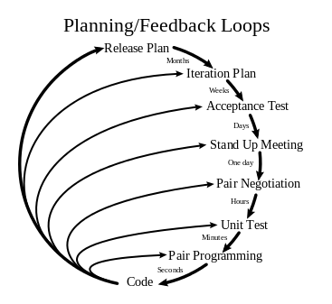
XP:

Slide 21
XP Principles
Core
Less central
Rapid feedback
Assume simplicity
Incremental change
Embracing change
Quality work
Teach learning
Small initial investment
Play to win
Concrete requirements
Open, honest communication
Work with people’s instincts, not against them
Accepted responsibility
Local adaptation
Travel light
Honest measurement

Slide 22
SCRUM
Roles
Product manager
Development team
Scrum master
Events
Sprint
Meetings
Sprint planning meeting
Daily scrum meeting
End meetings
Artifacts
Product backlog
Spring backlog
Burndown chart

Slide 23
Scrum Roles
Product owner (Customer representative)
Communicator
Voice of customer – Face of development team
Ensures that value is developed
Product owner != Scrum master
Development team
3-9 people
Self-organizing
Cross-functional
Scrum master
Not a project manager!
Ensures the process is followed
Educate, support, plan
Bring coffee! Dry-cleaning, etc.

Slide 24
Events
Sprint (Iteration)
One to two weeks
Sprint planning meeting – Sprint retrospective meeting
End of sprint: Work/Activities are DONE!
Sprint planning meeting
Select work to be done (Sprint backlog)
Allocate work time, etc.
Daily scrum (stand-up meeting)
15 minutes max!!!
What did I do yesterday?
What will I do today?
What are my problems?
End meetings
Sprint review meeting
Sprint retrospective meeting

Slide 25
Artifacts
Product backlog (Product)
Ordered list of
Features, bugs, technical work, etc.
Requirements!
Different formats (usually stories)
Each requirement has a cost (sometimes Fibonacci)
Managed by Product owner
Sprint backlog (Iteration)
Subset of product backlog
No changes are allowed to the sprint backlog during a sprint!
Burndown charts (Sprint and release)
Visualize how items from the backlog(s) are taken care of

Slide 26
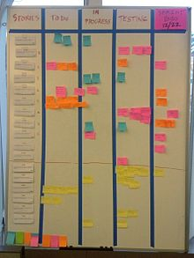
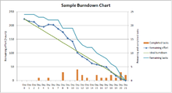
Scrumboard and burndown chart

Slide 27
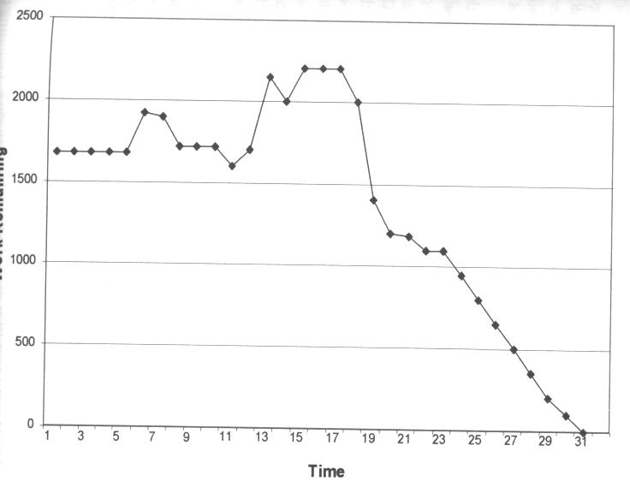
Assess Sprint Progress A possible trajectory
Frustration; Reduce scope wiht SCRUM-Master
Forgot to update after weekend: no change
More and more tasks appear
Good progress
c.f. Schwaber, Ken; Beedle, Mike (2002):
Agile Software Development with Scrum. Prentice Hall.
Notes:
An den Kurven kann man einiges ablesen. Sie werden täglich erstellt und zeigen, wie sich die geschätze Restarbeit entwickelt.
Es gibt einige typische Muster, die man häufig sieht.

Slide 28
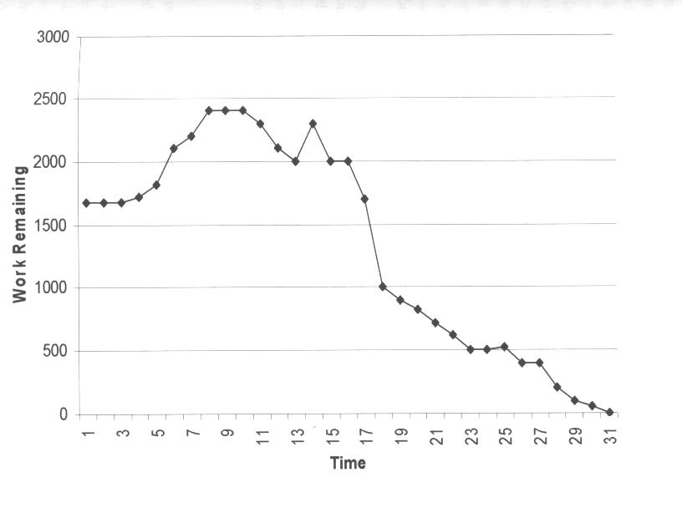
Assess Sprint Progress a typical trajectory for a new SCRUM-Team
Joint effort after week-end results in some progress
Frustration; Reduce scope wiht SCRUM-Master
Slow task, more and more effort appears
C.f. Schwaber, Ken; Beedle, Mike (2002):
Agile Software Development with Scrum. Prentice Hall.
Notes:
Hier zum Beispiel wieder die Bitte an den SCRUM-Master, mit dem Kunden auszuhandeln, dass die Aufgabe verkleinert wird.
Dadurch sinkt dann die Restarbeit auf einen Schlag.
Am Anfang steigt der geschätze Restaufwand, weil man durch die beginnenden Arbeiten erst mitbekommt, was noch alles fehlt und was davon wieder abhängt. Man entdeckt also immer mehr Konsequenzen und immer mehr Arbeit.

Slide 29
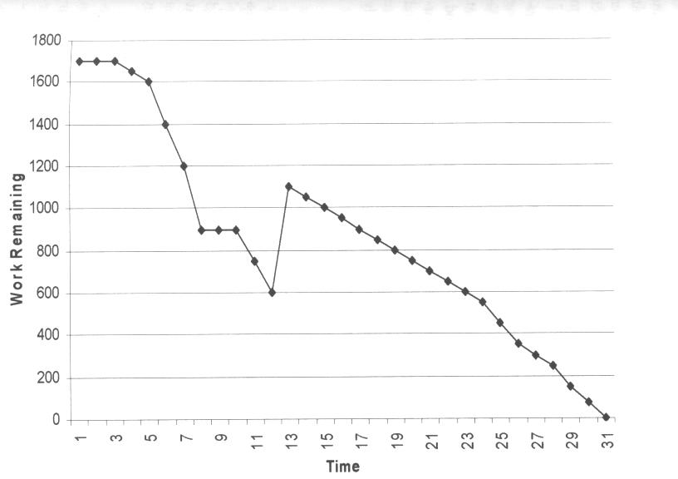
Assess Sprint Progress another typical trajectory
After slow start the team speeds up
Increase scope with Prod. Owner/ Scrum Master
On this foundation: Good progress
This way, the sprint goal would be reached too early
C.f. Schwaber, Ken; Beedle, Mike (2002):
Agile Software Development with Scrum. Prentice Hall.
Notes:
Das ist der andere Fall, in dem das Team in der Mitte noch mehr Arbeit nachholt, weil es sonst viel zu früh fertig würde.

Slide 30
Scrum
Others
SCRUM Master
Product Owner
SCRUM team 7+/-2
SCRUM
Room
Increment
Product
Backlog
(prioritized)
SPRINT
Backlog
Daily SCRUM 15 min.
SPRINT: 30 days
Notes:
Hier sieht man auf einem Bild alle wesentlichen Elemente von SCRUM.
Der Product Owner (ein Kunde) hütet den Product Backlog. Er darf ihn jederzeit verändern, insbesondere die Reihenfolge von Einträgen verändern.
Wenn ein Sprint beginnt, wird soviel oben vom Product Backlog genommen, dass es für den Sprint langt. Dann schließt sich die Kapsel, in den nächsten 30 Tagen darf niemand dem SCRUM-Team hineinreden oder den Sprint-Backlog ändern.
Intern werden jeden Tag SCRUM-Meetings statt finden, am Ende des Sprints wird Software erzeugt.
Der SCRUM-Master erinnert an den Projektleiter, ist es aber nicht. Denn ein SCRUM-Team ist selbstorganisierend. Die Hauptaufgabe des SCRUM-Masters ist es, Schwierigkeiten auszuräumen, die im Daily SCRUM geäußert werden.
Andere dürfen zusehen, im Dails SCRUM aber nichts sagen.

Slide 31
Why does SCRUM work?
Self-organizing teams
Ownership
Multi-Learning
Between group, organization, and individual
Subtle control
Constant learning
Experienced developers in new teams
Risk management
Risk: Customer unhappy
Show working system often
Risk: Incomplete feature set
Prioritize: If something is missing, it is not important
Risk: Bad estimation
Daily updates during SCRUM
Risk: Lack of experience with Development cycle
Test early and execute repeatedly
Risk: Changes in performance estimation
No impact on Sprint
c.f. Schwaber, Ken; Beedle, Mike (2002):
Agile Software Development with Scrum. Prentice Hall.
Notes:
SCRUM funktioniert also auch, weil es mit den genannten Risiken sinnvoll umgeht.

Slide 32
SCRUM vs. XP
XP is often hard to introduce
SCRUM is easy to introduce (according to Schwaber)
Best-practice: Combine!
SCRUM organizational shell: Day-to-day management
XP method of implementation
Shared values with XP
Quickly generate executable code
Facilitate communication
Notes:
„Crossbreed“: www.xbreed.net

Slide 33
Summary SCRUM
SCRUM is a management process
Can be used around XP
Or other approaches
Overlap with XP, but differences exist
Similar values
Different practices
Partly complement each other
Management of development
Not as much impact as XP, easier to introduce
Strengths
Information flows not only in one direction
Multiple feedback cycles stabilize system development (project)

Slide 34
Scrum Principles
Reflection
Stop and review product & process
Self-correction
Based on reflection
Visibility
Everything is visible (=known) for all stakeholders, e.g. plans, schedules, issues, …

Slide 35
Kanban core practices
Visualize
Visualization of workflow allows to understand and improve it
Limit Work-in-Progress
Limit the amount of workitems for each step
Introduce a pull-system
Manage flow
Measure how workitems flow through the process and understand, if a change improves the situation
Make policies explicit
Ways of working, organization, etc
Implement feedback loops
Understand (as a team) how good the process is working
Improve collaboratively, evolve experimentally
Whole team needs to share a theory on why (small) change helps

Slide 36
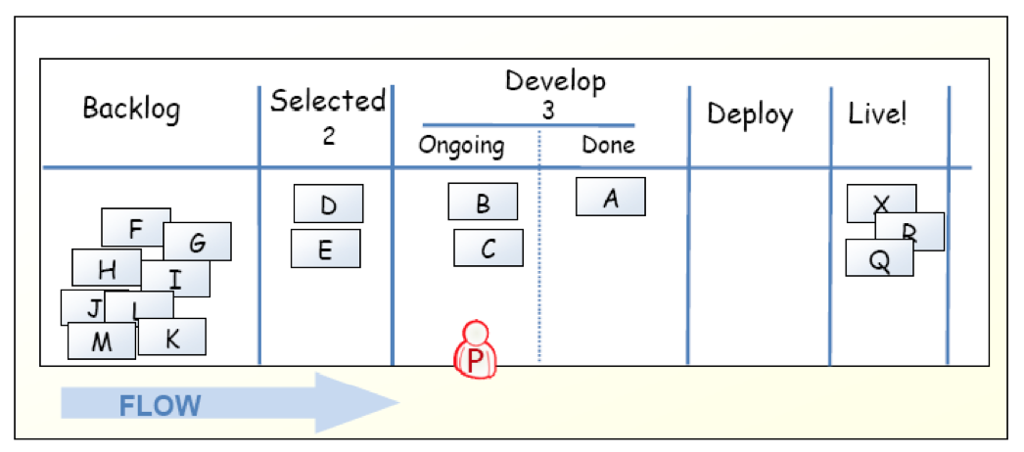
Kanban-Board

Slide 37
Limit work in progress
Prevent context switching
Reduce multi-tasking
Perform tasks sequentially yields results sooner
From requirement to working feature!
Maximize throughput
A fewer number of completed functions is better than many half-finished functions.
Enhance teamwork
Promotes working together to get things done
Increases cross-functionality

Slide 38
WIP Strategy
Start with some initial value
Small constant (1-3)
number of developers
number of testers
Measure the cycle time
Average time of one piece full cycle flow
Change limit to decrease cycle time

Slide 39
Idle Members
Can you help progress in existing work? – Work on that.
Don’t have the right skills? – Find the bottleneck and work to release it.
Don’t have the right skills? – Pull in work from the queue.
Can’t start anything in the queue? – Check if there is any lower priority to start investigating.
There is nothing lower priority? – Find other interesting work (refactoring, tool automation, innovation).

Slide 40
Metrics
Stories in progress (SIP)
When story enters stories queue set entry date (ED)
When story enters first process step set start processing date (SPD)
When story is done set finish date (FD)
Cycle time (CT) = FD – SPD
Waiting time (WT) = SPD – ED
Throughput (T) = SIP / CT

Slide 41
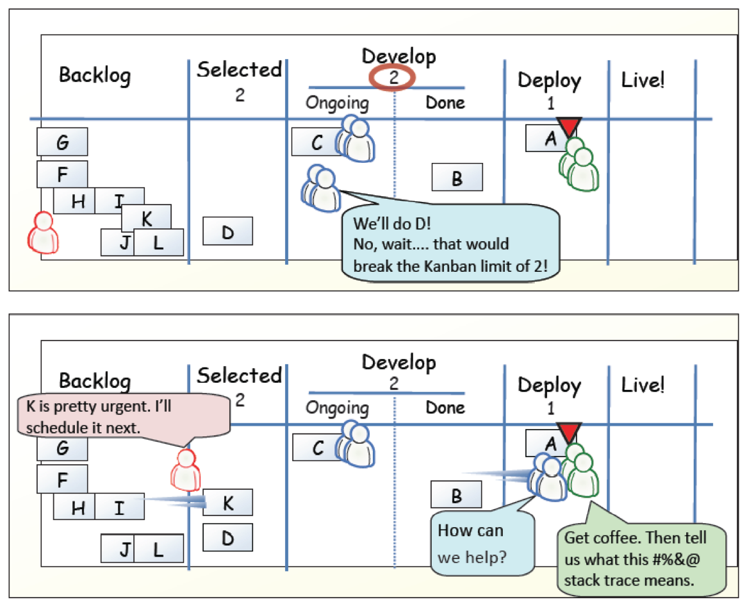
Example

Slide 42
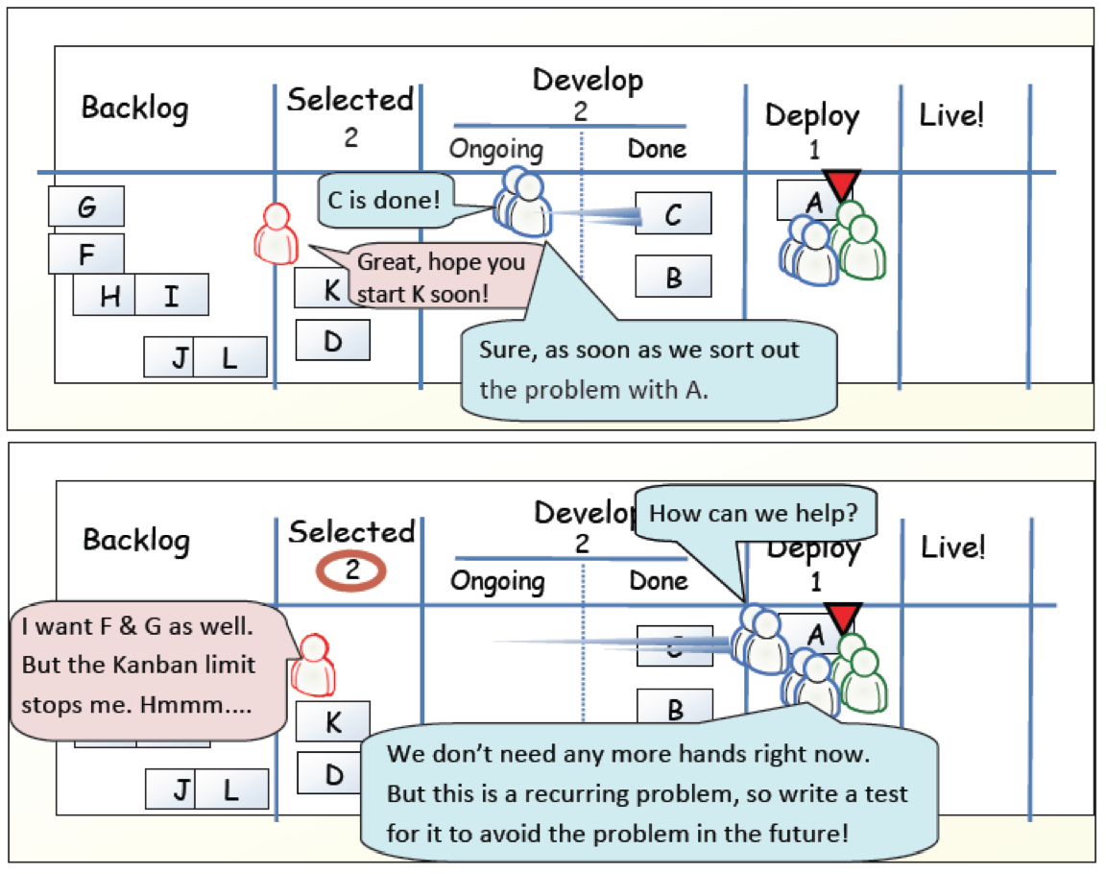
Example

Slide 43
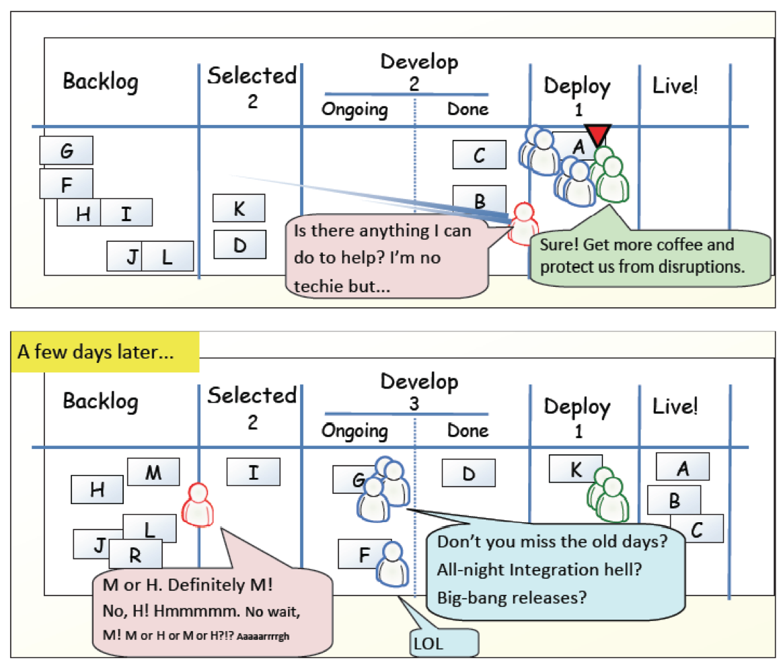
Example

Slide 44
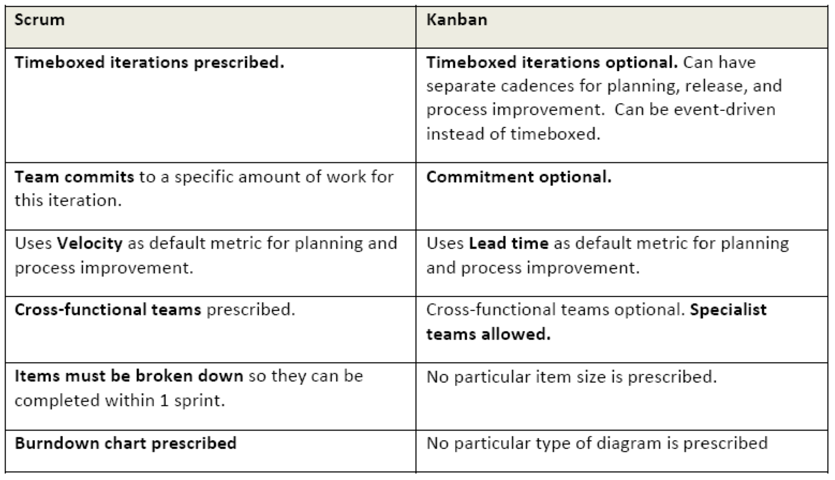
Scrum vs. Kanban

Slide 45
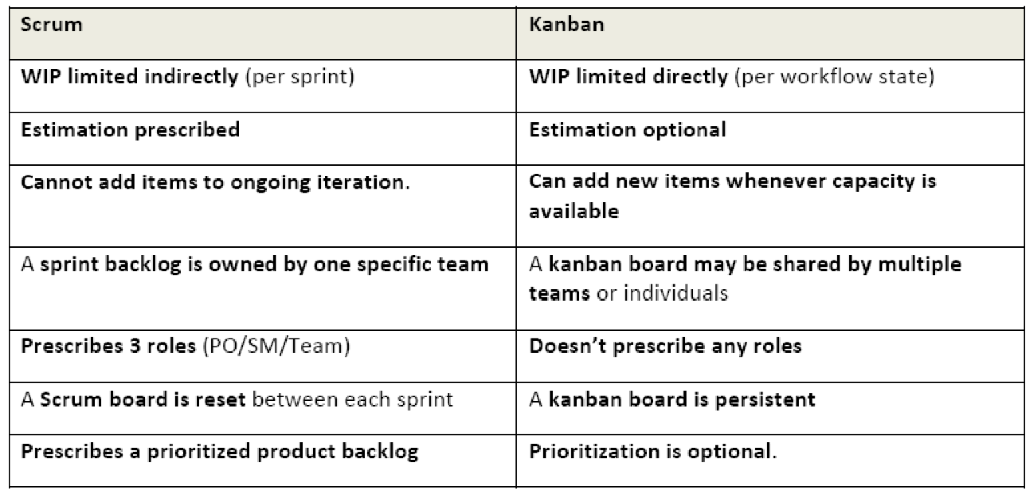
Scrum vs. Kanban

Slide 46
Kanban principles
Start with what you do now
Agree to pursue incremental, evolutionary change
Respect the current process, roles, responsibilities and titles
Leadership at all levels

Slide 47
Agile Principles
Early and continuous delivery of valuable software
Welcome changing requirements, even late
Deliver working software frequently
Business people and developers must work together
Build projects around motivated individuals
Face-to-face communication is most effective and efficient
Working software is the primary measure of progress
Sustainable development
Continuous attention to technical excellence and good design
Simplicity is essential
Self-organizing teams
Regular reflection
Notes:
Take two minutes to discuss with your neighbour: Which are easy, which are hard to follow in your project?

