Slide 1
Hot research topics around agile
Agile Development Processes
Eric Knauss

Slide 2
Organizational
Please send me slides with your project presentation no later than Thursday, 11am
Avoid switching time!
Try to stay below 10min!
Present what is cool about your solution
May present challenges / lessons learnt

Slide 3
Outline
Agile maturity and information flows
Information and knowledge flows already discussed
Lucas Gren: Agile maturity models
Continuous Integration and Deployment
Current work in Software Center #1
Agile and Architecture
ICSE 15 paper
Caffea model
Other topics (discussed, no slides)
Agile engineering
Measure effectivity / efficiency of agile methods

Slide 4
Continuous Integration (CI) Continuous Deployment (CD)
dev
Quality gate
Quality gate
team
Quality gate
Quality gate
main
Release / Deliver
customer

Slide 5
Defining CI and CD
dev
Quality gate
Quality gate
team
Continuous Integration = frequent integration on main branch to obtain feedback.
Quality gate
Quality gate
Continuous Delivery = Ability to always deliver newest software to customer.
main
Continuous Deployment = Ability to always deploy (deliver and install into running system) to customer.
customer

Slide 6
CI and CD challenges
Mindset. Integrate, whenever it is valuable (depending on context: several times a day), not when it is finished!
dev
Prioritize capabilities. Continuous planning game in large-scale development → How to speed up reaction time?
Quality gate
Quality gate
team
Adequate testing strategy. Majority of testing needs to be automated. →How to select best test-suites for each level?
Automated end2end testing. How do capabilities fit together? Provide automated test on Business case / Use case level.
Quality gate
Quality gate
Performance regressions. Quality attributes will continuously change. → How to manage quality goals?
Track capabilities. Integrating partial features. → What can be sold to customers at any time?
main
Manage customer relationship. → Pull or push updates? How to get feedback? How to sync with their development/their customers?
customer

Slide 7
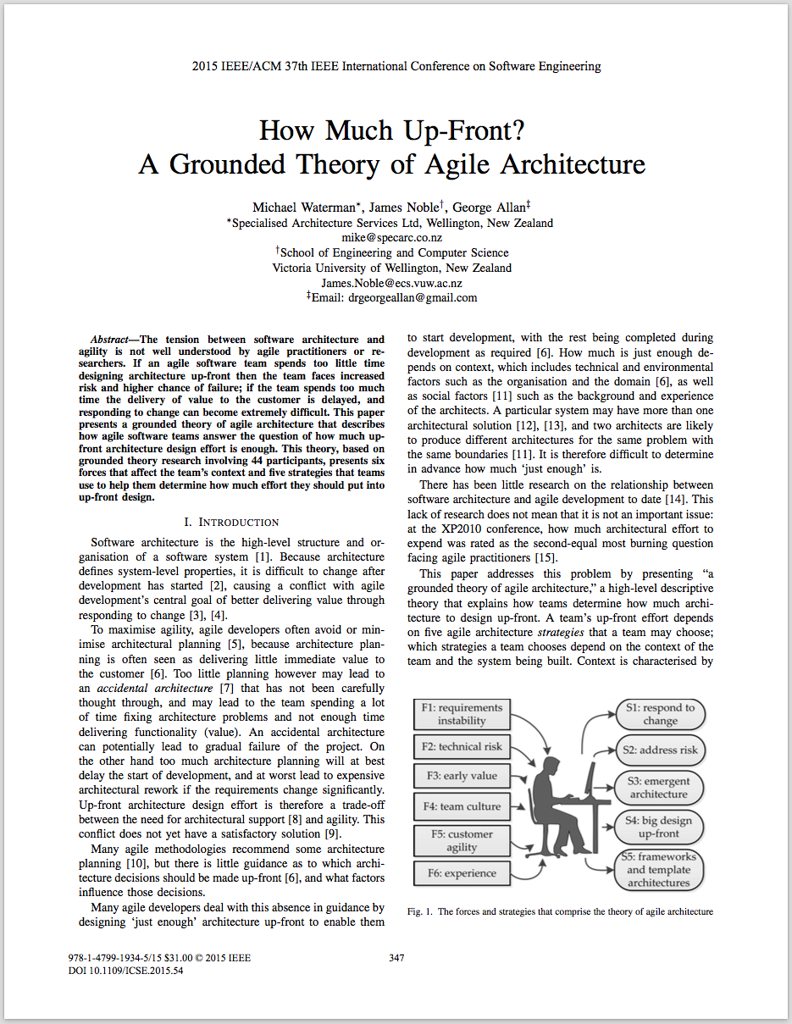
Agile and Architecture
Michael Waterman, James Noble, George Allan: How Much Up-Front? A Grounded theory of Agile Architecture. In: Proc. of Int. Conf. on Software Engineering, pg. 347-358, Florence, Italy, 2015

Slide 8
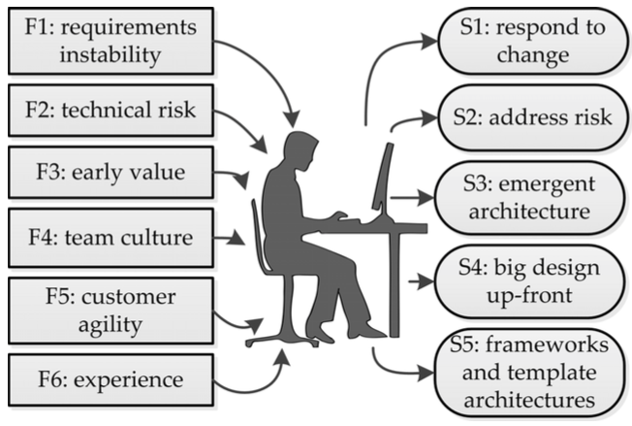
Agile Architecture: Context and Strategies
Michael Waterman, James Noble, George Allan: How Much Up-Front? A Grounded theory of Agile Architecture. In: Proc. of Int. Conf. on Software Engineering, pg. 347-358, Florence, Italy, 2015

Slide 9
Tradeoff
Long up-front analysis
Delays in feedback, not agile
Reduced number of changes later
Short up-front analysis
Quick first version
Value creation hindered by required changes

Slide 10
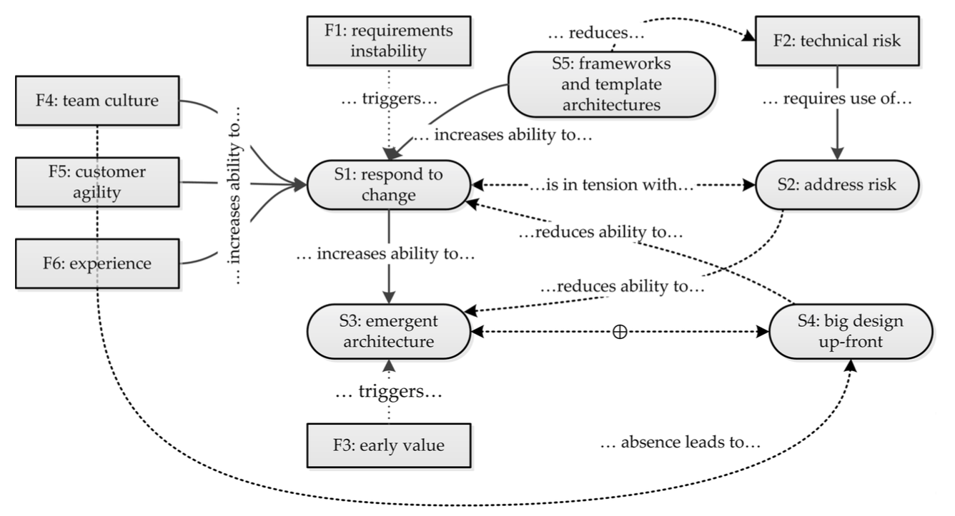
Michael Waterman, James Noble, George Allan: How Much Up-Front? A Grounded theory of Agile Architecture. In: Proc. of Int. Conf. on Software Engineering, pg. 347-358, Florence, Italy, 2015

