Slide 1
Lean Software Development
Agile Development Processes
Eric Knauss

Slide 2
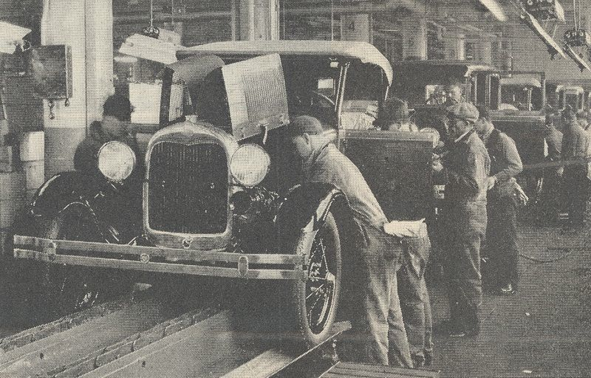
Lean History
Toyota (1980s): of "Lean Manufacturing“, revolutionize the automotive industry
eliminate waste
streamline the value chain (even across enterprises)
produce on request (just in time), and
focus on the people who add value.
Mary and Tom Poppendieck: transferred principles and practices from manufacturing to the software development
http://en.wikipedia.org/wiki/Fordism
Picture of their book

Slide 3
Lean Mindset
Most errors are of a systemic nature → Development system must be improved.
You must respect your people in order to improve your system.
Doing things too early causes waste.
Do things just before you need to do them
This is called “Just-In-Time,” or JIT.
Focus on shortening time-to-market by removing delays in the development process
using JIT methods to do this is more important than keeping everyone busy.
Lean-Agile Software Development: Achieving Enterprise Agility, by Alan Shalloway, Guy Beaver, and Jim Trott. Chapter 1.

Slide 4
LSD: 7 Principles, 22 Tools
Eliminate Waste – Seeing Waste, Value Stream Mapping
Amplify Learning – Feedback, Iterations, Synchronization, Set-Based Development
Decide as Late as Possible – Options Thinking, The Last Responsible Moment, Making Decisions
Deliver as Fast as Possible – Pull Systems, Queuing Theory, Cost of Delay
Empower the Team – Self-Determination, Motivation, Leadership, Expertise
Build Integrity In – Perceived Integrity, Conceptual Integrity, Refactoring, Testing
See the Whole – Measurements, Contracts
Cristoph Steindl (IBM), Lean Software Development, 2004 (Presentation)

Slide 5
Principle #1: Eliminate Waste
... does not mean to throw away all documentation
spend time only on what adds real customer value.
Eliminating waste is the most fundamental lean principle.
Thus, the first step to implementing lean development is learning to see waste.
The second step is to uncover the biggest sources of waste and eliminate them.
Uncover Waste
Eliminate Waste
Cristoph Steindl (IBM), Lean Software Development, 2004 (Presentation)

Slide 6
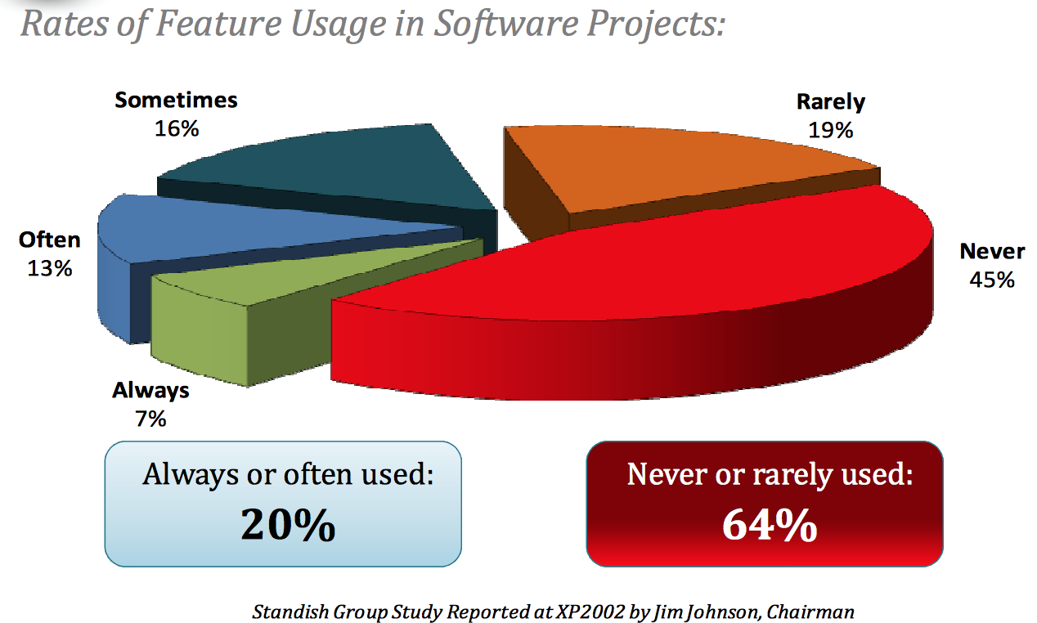
Rates of Feature Usage in Software Projects

Slide 7
#1: Eliminating Waste Tool #1: Seeing Waste
Inventory
Partially done work
Extra processing
Paperwork
Over production
Unused features
Transportation
Task switching
Waiting
For staffing,
For approval,
For review,
For exessive requirements,
For testing,
For deployment
Motion
Handovers, finding answers for questions
Defects
Waste produced by defect = impact x time
Cristoph Steindl (IBM), Lean Software Development, 2004 (Presentation)

Slide 8
#1: Eliminating Waste Tool #2: Value Stream Mapping
Pretend you are a customer request
Imagine yourself going through each step of your process
Don’t ask people; walk around, look at data, find out yourself.
Go to the start
I.e. where a customer request comes into your organization.
Draw a chart
Average customer request, from arrival to completion.
Work with people involved in each activity
Sketch all the process steps necessary to handle the request,
Capture average amount of time it spends in each step.
Draw Timeline (at the bottom of the map)
Show how much time the request spends in value-adding activities.
Show how much time it spends waiting or in non-value adding activities.
Cristoph Steindl (IBM), Lean Software Development, 2004 (Presentation)

Slide 9
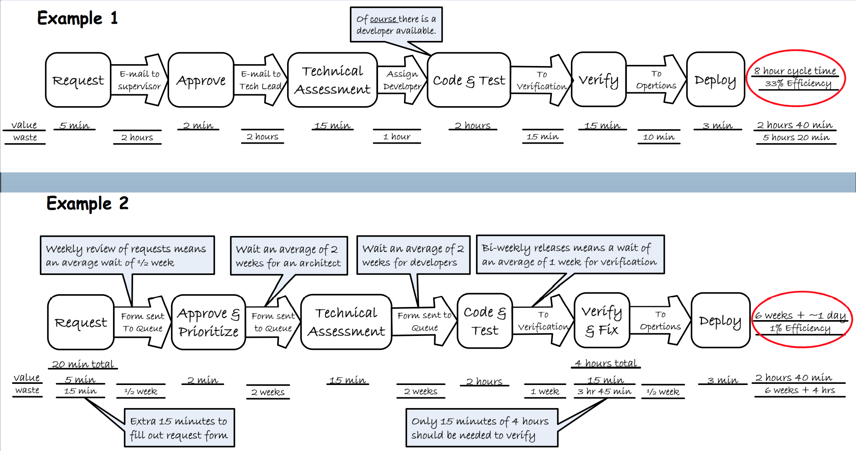
Examples: Value-Stream Mapping
Mary & Tom Poppendieck: Lean Software Development Workshop 2008

Slide 10
#Principle 2: Amplify Learning
Imagine a company with SW development challenges
Usual reaction: Increase discipline / control
Specify requirements more completely
All agreements with customer are written
Changes are controlled more carefully
More tracing
…
As control theory predicts, this generally makes a bad situation worse
Cristoph Steindl (IBM), Lean Software Development, 2004 (Presentation)

Slide 11
#2: Amplify Learning Tool #3: Feedback
If a problem develops:
Make sure that all feedback loops are in place
Increase the frequency of feedback loops in problem areas
Instead of… | …focus on
Gather more requirements | Discuss UI prototypes
Accumulate defects | Test as soon as code is written
More documentation and detailed planning | Check out ideas by writing code
Study carefully which tool to use | Bring top 3 candidates in house and test them
Cristoph Steindl (IBM), Lean Software Development, 2004 (Presentation)

Slide 12
#2: Amplify Learning Tool #4: Short iterations
Short iterations
Increase control,
Help synchronizing developers and customer
Force decisions to be made
------------------------------------------------------------------------
Waterfall Process
X
Increment 1
Increment 2
Increment 3
X
Cristoph Steindl (IBM), Lean Software Development, 2004 (Presentation)

Slide 13
#2: Amplify Learning Tool #5: Synchronisation
Sync individuals that work on the same thing
Fundamental for every complex development process
Daily within the team
Daily Scrum
Daily Build
Daily System Test
Weekly within several teams
Push to master at least weekly
Weekly meetings (e.g. Scrum-of-Scrum)
Cristoph Steindl (IBM), Lean Software Development, 2004 (Presentation)

Slide 14
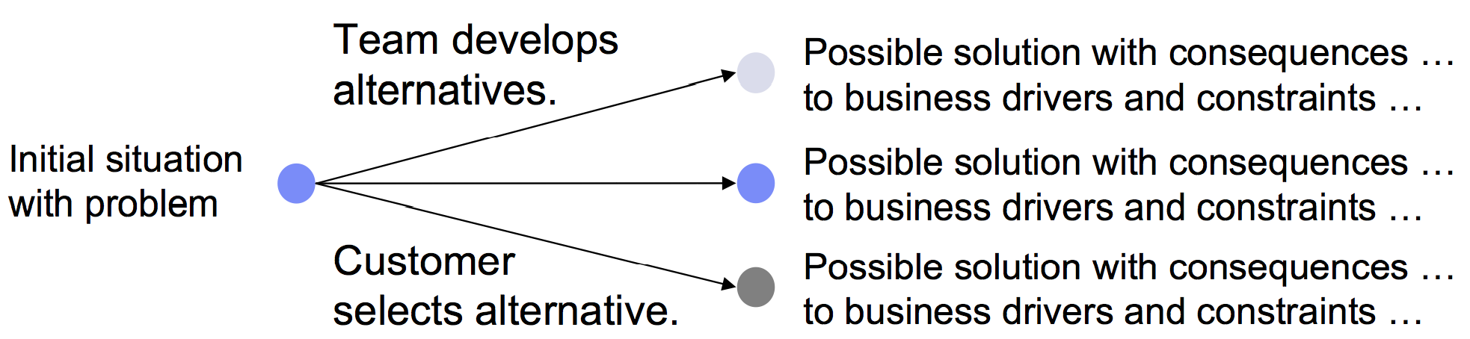
#2: Amplify Learning Tool #5: Set based development
Communicate about constraints, not choices
Use less data to convey more information
Defer making choices until they have to be made

Slide 15
Principle #3: Decide as late as possible
…does not mean to procrastinate,
but to keep your options open as long as practical,
but no longer
Reason
Most common problem: Drill down to details too fast
In the presence of the risk to make big mistakes: survey the landscape and delay detailed decisions
Wait: Is that not equal to sequential development (analyze requirements up-front)?
Sequential development implies depth-first
Breadth-first is far better to manage risk!

Slide 17
Lean principles
Eliminate waste
Unnecessary code, delays, unclear requirements, bureaucracy, …
Amplify learning
Introduce feedback cycles
E.g. iteration retrospective
Meetings of customer representatives and team
Shorter iterations, more reflection
E.g. prototypes for requirements
Decide as late as possible
Reduce waste resulting from wrong decisions
Deliver as fast as possible
Empower the team
Build integrity in
Let customer experience integrity of system – not only quality of the system but also of the way you build it
See the whole
Respect people
Eliminate waste
Defer commitment
Create knowledge
Deliver fast
Build quality in
Optimize the whole
Yasuhiro Monden (1998), Toyota Production System, An Integrated Approach to Just-In-Time, Third edition, Norcross, GA: Engineering & Management Press
Mary Poppendieck, Tom Poppendieck (2003), "Lean Software Development: An Agile Toolkit", Addison-Wesley Professional

Slide 18
See the Whole
This area | Must attend this work
Business | Continuously prioritize and decompose incremental needs across the organization Manage a portfolio of business needs Do release planning
Management | Organize cross-functional teams that can deliver incremental, end- to-end features Manage the value stream Bring visibility to impediments
Delivery team | Work together, every day, and deliver fully tested and integrated code Learn how to deliver business needs incrementally Become proficient at acceptance test-driven development and refactoring
Lean-Agile Software Development: Achieving Enterprise Agility, by Alan Shalloway, Guy Beaver, and Jim Trott. Chapter 1.

Slide 19
Lean practices
Seeing waste
Value stream mapping
Set-based development
Pull systems
Queuing theory
Motivation
Measurements
…

Slide 20
Agile vs. Lean
Agile tends to emphasize communication at the local level
Lean advocates a holistic view of the delivery chain
XP: Decide now, change later
Lean: Defer commitment
Lean-Agile Software Development: Achieving Enterprise Agility, by Alan Shalloway, Guy Beaver, and Jim Trott. Chapter 1.

Slide 22
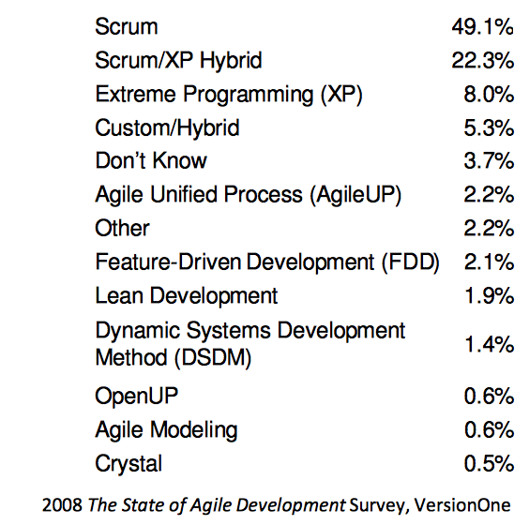
For later use

