Slide 1
Testing tutorial
Agile Development Processes 2014
Eric Knauss and Emil Alégroth

Slide 2
Background to Testing
Why do we test?
Check that the system under test (SUT) works!
Check that the requirements are fulfilled
Check that the SUT works as the customer expects
Verification
Verify that the system works
Ex: Code review, unit testing, integration testing
Validation
Verify that the system works according to the customer expectations
Ex: System testing and Acceptance testing

Slide 3
System representation
NOT ONE TEST TECHNIQUE TO RULE THEM ALL!
System levels
Example test technique
High-level
Graphical User Interface (GUI)
Manual testing
Visual GUI testing
GUI components
Record and Replay
System components
Unit Testing
Low-level
System code
Code review
Notes:
Systems are hierarchal
For each level there are different ways of performing testing
Currently, GUI-based system and acceptance testing is still manual
This is where VGT comes in

Slide 4

Automation
Unit tests
(Low level testing)
Record and Replay
(High level testing)
U
U
OK
U
Color: Gray
Size: 50x100px
Label: “OK”
Bug
U
U
U
U
U
OK
U
U
U
Bug
Notes:
Unit tests: Test individual components. Good at finding low level bugs. However, GUI interaction may stimulate many components at once. Therefore a unit test would have to stimulate all these components, also in chronological order, which makes the test cases complex and therefore costly to maintain.
Record and replay: High-level tests that emulate human user behavior. There are two types. The first based on coordinates, which break easily if the GUI is changed. The second is based on properties of components of the SUT. However, these can also break from changes to the GUI components properties, the source code or connected APIs.
This leaves a need for further research into GUI-based testing.

Slide 5
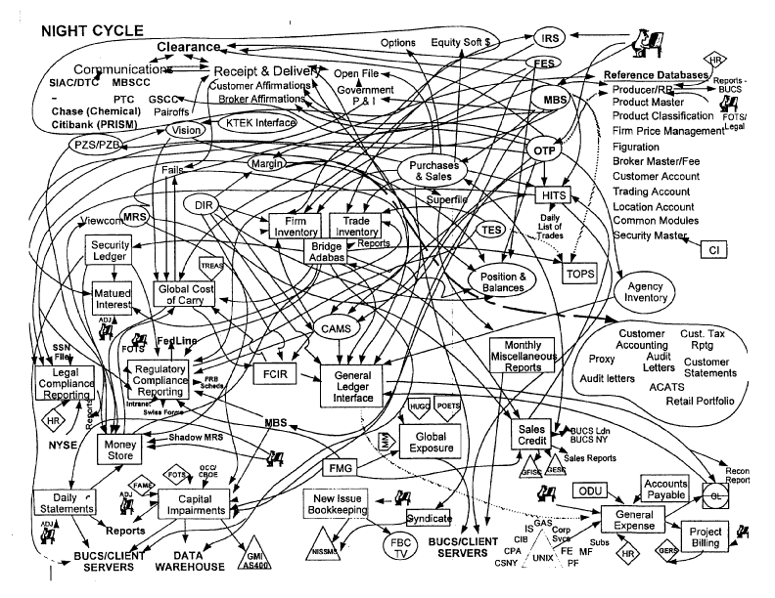
How do you perform effective testing?
A good test process
Code review
Unit/Component tests
Commit code
Integration tests
System tests
Manual
Automated
Acceptance tests
Customer
What practices are there for testing in Agile Development?
Random picture! Not actual process!

Slide 6
TestFirst
If testing is good, then testing more often / always is even better
We want to embrace change – Regression testing
Idea: Write test early, even before implementation
Write test
Let test fail
Do we really test non-existing functionality?
Implementing, until test is green
As simple as possible!
Refactoring

Slide 7
Principle of TestFirst: a Dialogue
Task: Java method len(int) returns number of digits of an int.
Test starts
„len(5) should be 1!“
assertEquals(1, len(5));
JUnit
COMPILER-ERROR! What is the meaning of “len”?
Program: That is easy:
public int len (int zahl) { return 1; }
JUnit: ok. Testcase fulfilled.
Test: Just you wait! „len(321) should be 3!“
assertEquals(3, len(321));
JUnit: Error! 1 instead of 3
Program: No problem … if zahl<10 then return 1 else return 3
JUnit: ok.
Test: I don’t believe this!
“len(12345678) should be 8!“
assertEquals(8,len(12345678));
JUnit: Error!
3 instead of 8
Program: … ok, I see a pattern here: for (i=…

Slide 8
Test-Driven Development
Testcases and automatic regression tests for every class in product
The automated tests are the design. The on-site customer makes the acceptance tests.
After doing design and prototypes, we create a few testcases
6 As soon as the code is done, we create thorough unit tests, only after that goes the code to the test team.
We have heard about JUnit. Never tried it though.
Our system test phase always runs out of time: There are many errors!
0 We do not test explicitly. Sometimes a customer tells us when there is a problem.
c.f.: Krebs, William (2002):
Turning the Knobs: A Coaching
Pattern for XP through Agile
Metrics. Springer, Lecture Notes
on Computer Science 2418
Notes:
Zu Test First beachten Sie bitte unbedingt die Übungsaufgaben zu diesem Thema (römische Zahlen und GUI-Programmierung).

Slide 9
?
Are those tests Blackbox or Glassbox?
Traditionally, programmers and testers are supposed to be different persons.
Why?
Does that not kill the testfirst idea?

