Slide 1
Agile Software Development (DIT191 / EDA397)
Lecture 3: Agile methods crash course
Eric Knauss
<eric.knauss@cse.gu.se>

Slide 2
Organisatorial
Teams have been assigned and are online
Guest lecture by Thomas Lüvo confirmed “Scaling agile”
Hunt for larger rooms ongoing
Notes:
Agile hour today?

Slide 3
TODO for next week
Organize your groups
Choose an agile coach / scrum master / team spokesperson and make it known to Emil and me
Create a wiki page on https://github.com/oerich/EDA397
Link to your group’s project on github
Get accounts for Pivotal Tracker for each group member
Prepare for customer interview

Slide 4
Course Objectives
Knowledge and understanding | Skills and ability | Judgement and approach
Compare agile and traditional softw. dev, | Forming a team organically | Explain: people/commun. centric dev.
Relate lean and agile development | Collaborate in small software dev. teams | Apply fact: people drive project success
Contrast different agile methodologies | Interact and show progress continuously | Describe: No single methodology fits all
Use the agile manifest and its accompanying principles | Develop SW using small and frequent iterations | Discuss: methodology needs to adopt to culture
Discuss what is different when leading an agile team | Use test-driven dev. and automated tests
 | Refactor a program/design
 | Be member of agile team
 | Incremental planning using user stories
Sprint 3
Sprint 1
Sprint 2

Slide 5
Examination
Written exam, individual, 3.0 credits
60 points, 24 required to pass
Project, 4.5 credits
Grades: Fail/Pass but gives bonus on written exam
Grades
Chalmers:
[0-49%] → Fail,
[50-64%] → 3,
[65-79%] → 4,
[80-100%] → 5
GU
[0-49%] → Fail,
[50-79%] → G,
[80-100%] → VG

Slide 6

Where are we coming from?
Requirements
Design
Programming
Test
http://commons.wikimedia.org/wiki/File:Waterfall_katoomba.JPG

Slide 7
Systematic sequential development
Requirements
Design
Programming
Test
Advantages
Simple
Controllable
Cost efficient
Problems
Time-to-market
What about change?

Slide 8
Towards concurrent development
Requirements
Design
Programming
Test
What can we do if time to market and robustness against late changes are more important than cost-efficiency?
Requirements
Design
Programming
Test
Time-to-market
Time-to-market

Slide 9
Iteration Models
System requirements always evolve during a project
Iterations are part of larger development projects
Iterations can be applied to any generic development process model

Slide 10
Incremental delivery
Customer value can be delivered with each increment so system functionality is early available for customer’s feedback
Early increments act as prototype to help elicit requirements for later increments
Reduced risk of project failure
The highest priority system services tend to receive the most testing

Slide 11
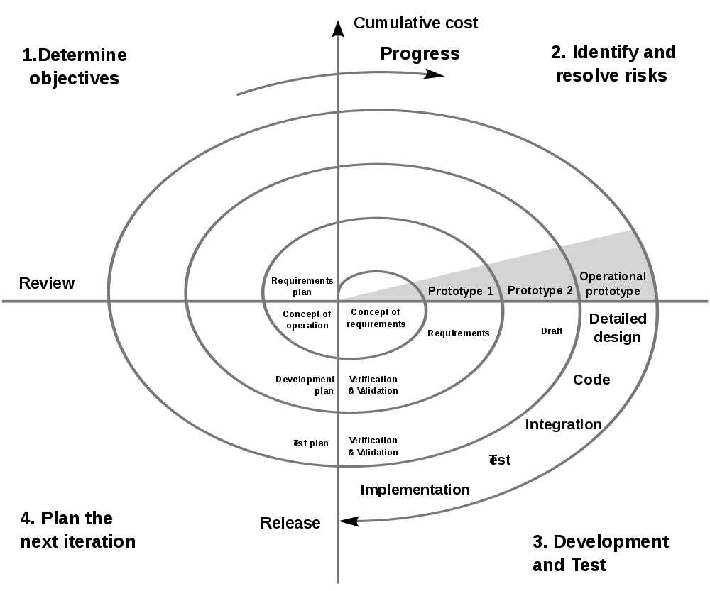
Spiral Model [Boehm]
Rather quadrants than axis
Distance to center: Progress
Utility
Iteration: Risk reduction
Spiral: Time, Process
Source: http://upload.wikimedia.org/wikipedia/commons/thumb/e/ec/Spiral_model_%28Boehm%2C_1988%29.svg/1000px-Spiral_model_%28Boehm%2C_1988%29.svg.png
Notes:
Das Spiralmodell hat Barry Boehm ein „risiko-orientiertes“ Vorgehensmodell genannt.
Es ist nämlich das Ziel, zunächst das größte Risiko zu identifizieren und auszuräumen - und dann das zweitgrößte und so weiter. Risiken können technischer Natur sein (wir können die API nicht nutzen; die Datenbank ist nicht schnell genug), aber auch ganz anderer Art (die Kunden finden das Produkt langweilig; Sicherheitsaspekte; Marketingrisiken).
In allen Fällen wir man damit beginnen, die Ziele zu überprüfen (linker oberer Quadrant) und auch zu untersuchen, welche Möglichkeiten, Einschränkungen und Risiken es dabei gibt.
Dann werden (oben rechts) die Risiken identifiziert, die diese Ziele am ehesten bedrohen könnten (Risk Exposure). Hier versucht man, mit einem Prototypen zu zeigen, dass das Risiko lösbar (akzeptabel) ist. Wenn das geklappt hat, wird im rechten unteren Quadranten die Erkenntnis aus den Prototypen bzw. anderen Versuchen in das Produkt eingebaut, das Produkt also erweitert.
Die eingezeichneten Aktiviäten und der Mini-Wasserfall in der äußersten Windelung der Spirale sind Beispiele: man kann auch mit einem Wasserfall den Entwurf bzw. die Umsetzung vorantreiben. Aber bestimmend waren immer die Risiken, womit sich dieser Wasserfall dann beschäftigt.
Durch die Spiralbewegung entsteht Aufwand, aber auch Fortschritt. Denn der Umfang (und die Nützlichkeit) steigen.
Nach der Idee des Spiralmodells wird das Budget stets für eine Umdrehung bewilligt (oder mehrere). Man weiß aber vorher nicht genau, welche Risiken davon betroffen sein werden.
Das ist ein Stückchen Unsicherheit, das viele Manager stört.

Slide 12
Spiral development
Objective setting
Specific objectives for the phase are identified
Risk assessment and reduction
Risks are assessed and activities put in place to reduce the key risks
Development and validation
A development model for the system is chosen which can be any of the generic models
Planning
The project is reviewed and the next phase of the spiral is planned

Slide 13
?
Is the Spiral model agile?
What kind of prototypes will be developed in the Spiral model?
Is consecutive prototyping agile?

Slide 14
What is a prototype?
Why was it constructed?
Presentation- PT
Actual PT
Laboratory sample
Pilot system
Explorative
Experimental
Evolutionary
Horizontal
Vertical
How do end-users/colleagues/you like the PT?
What was learnt or experienced during construction / presentation of prototype?
+/-
What is the contribution of the prototype?
What is (only) infrastructure?
Technical knowledge during the process that can be valuable somewhere else
Notes:
Die Folie weist darauf hin, dass es auch noch andere Klassifikationen nach anderen Kritierien gibt.
So spricht man von horizontalen Prototypen, wenn „die Breite“ der meisten Funktionen abgedeckt, diese aber nur relativ oberflächlich umgesetzt werden. Vertikales Prototyping geht in einem eingeschränkten Funktionsumfang in die Tiefe.
Die mittlere Klassifikation stand ja schon auf der letzten Folie.
Die letzte Klassifikation ist interessant, weil sie operativ nützlich ist. Ein Präsentationsprototyp wird weder ganz horizontal noch ganz vertikal sein. Er wird einen Teilbereich so weit umfassen, wie für eine Veranschaulichung für Kunden oder entscheidenden Vorgesetzten erforderlich ist.
Ein eigentlicher PT umfasst dagegen fast das ganze System, spart aber Fehlerbehandlung und Sonderfälle aus.
Ein Labormuster ist ein typischer vertikaler Prototyp, der eine spezifische technische Frage in der Tiefe untersucht.
Ganz etwas anderes ist ein Pilotsystem: Es beginnt als Prototyp und soll sich zu einem produktiven System entwickeln. Diese Vorstellung trifft man oft. Problematisch ist, dass Qualitätssicherung usw. im Prototypen-Stadium oft vernachlässigt wird – und später nicht nachgeholt.
Wenn jemand von einem „Prototypen“ spricht, vergewissern Sie sich, dass Sie dieselbe Ausprägung darunter verstehen wie er/sie.

Slide 15
Prototyping approaches
Explorative
Goal: Identify requirements
Show alternatives, capture feedback
Experimental
Goal: Assess technical alternatives
Test feasibility and implementation
Evolutionary
Goal: Fitting system despite changing requirements
Adjust running system constantly to changing requiremetns and constraints
Reqt.
Technic
Reqt.
Technic
Notes:
Das Spiralmodell enthält einen Teil, in dem Prototypen eine Rolle spielen.
Das Konzept des Prototyping ist inzwischen in verschiedene Richtungen entwickelt worden. Daher ist es sinnvoll, verschiedene Arten von Prototypen zu unterscheiden. Hier eine Klassifikation.
Die Symbole deuten an, in welcher Dimension die Prototypen nach neuen Erkenntnissen suchen: Richtung Anforderungen oder Richtung technischer Umsetzung. Beim evolutionären Ansatz werden beide Dimensionen untersucht.

Slide 16
Evolutionary Development
Applicability
Small to midsize projects
Parts of larger systems (e.g. user interface)
Short lifetime projects
Restrictions
Process visibility for the customer (what is finally delivered?)
Risk that systems are only poorly structured
Special skills in rapid prototyping languages are necessary

Slide 17
?
What is your position about the following statements:
“When a customer accepts our prototype, we polish it a bit more and deliver it as product.”
“We write our prototypes in a different programming language to discourage copy&paste to the main product.”

Slide 18
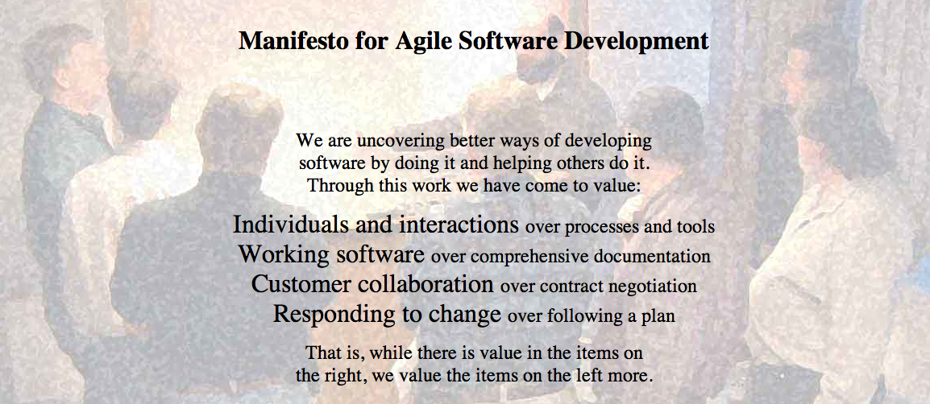
Agile Manifesto
http://agilemanifesto.org
Began as a provocation: Plan-driven development did not safe the Software world…
Now a very serious movement, well adapted in industry.
There are a couple of established agile methods: How to integrate these values in everyday software development

Slide 19
?
Can the following projects be agile?
App development
Online shop
Mission controller for Airplane
Controller for nuclear plant

Slide 20
Agile Methods: eXtreme Programming (XP)
Extreme programming:
An approach based on the development and delivery of very small increments of functionality
No fine grained process description, but 12 practices arranged around short development circles (4-6 weeks)
“Turn-to-ten” metaphor (refers to volume setting of older amplifiers):
Reviewing is good? → Review continuously: Pair Programming
Early Tests are good? → Write tests before code: Test-First
Customer interaction is good? → Have Onsite-Customer
…

Slide 21

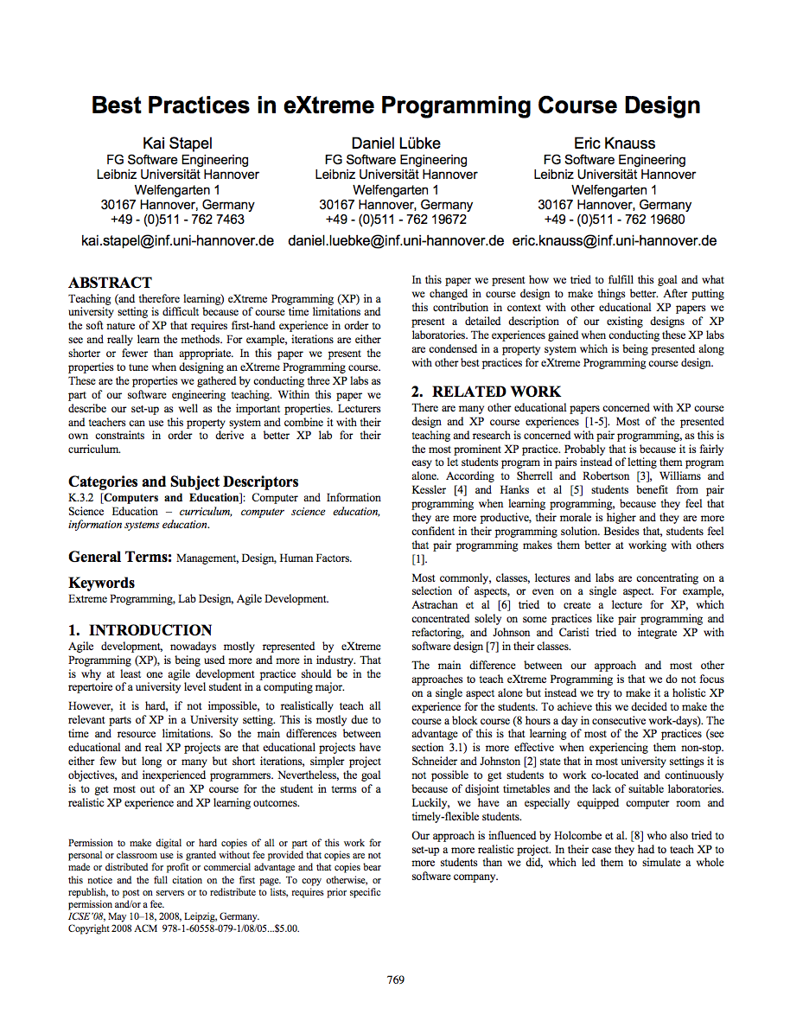
Planning Game
Business people need to decide
Scope, Priority, Composition of release, dates of release
Technical people need to decide
Estimates, Consequences, Process, Detailed scheduling
“Students learn how to divide requirements into User Stories and how to prioritize and estimate the costs of these stories. While such tasks seem to be easy in theory, dealing with dependencies in the planning game is normally a challenge for inexperienced developers like students.”
(+) More iterations, small teams, customer interested, technical support, progress feedback
(-) Longer iterations

Slide 22
Small releases
Every release
… should be as small as possible
… should contain the most valuable business requirements
… has to make sense as a whole
… should be delivered every 4-8 weeks (rather than 6-12 month)
“Students learn the benefits of small releases that already offer value to the customer and how to technically put a system into production including packaging.”
(+) More iterations, progress feedback

Slide 23
Metaphor
Examples
Naïve: “Contract management system deals with contracts, customers, and endorsements”
“Computer should appear as a desktop”
“Pension calculation is a spreadsheet”
Align team thinking
“Students learn how to develop a metaphor that helps every team member to better understand how the whole system works.”
(+) Technical support, technical feedback

Slide 24
Simple Design
The right design at any given time
Runs all the tests
Has no duplicated logic
States every intention important to the programmers
Has the fewest possible classes and methods
“Students learn the benefits of simple software design which improves their ability to change the system quickly and accommodate it to changing requirements.”
(+) More iterations, technical support

Slide 25
Testing
Any feature without automated test does not exist
Don’t write a test for every method
Write a test for every productive method that could possibly break
“Program becomes more and more confident over time”
“Students learn how to use unit test frameworks and the test-first approach to build high quality software and to recognize the advantages of well-tested code when making changes.”
(+) More iterations, technical support, technical feedback

Slide 26
Refactoring
Is there a way of changing the program to make it easier to add a new feature?
After adding the feature: Can we simplify the design?
Important investment!!!
“Students learn to refactor the software to remove duplication, improve communication and simplify the code base. Especially refactoring large systems can be troublesome and is a worthy experience that can only be made in long lasting projects.”
(+) More iterations, customer interest, technical support

Slide 27
Refactoring
Is there a way of changing the program to make it easier to add a new feature?
After adding the feature: Can we simplify the design?
Important investment!!!
“Students learn to refactor the software to remove duplication, improve communication and simplify the code base. Especially refactoring large systems can be troublesome and is a worthy experience that can only be made in long lasting projects.”
(+) More iterations, customer interest, technical support

Slide 28
Pair Programming
Driver: Has the keyboard, writes the code
Navigator: Thinking strategically
Will this work? Which test cases might not work? Can we simplify?
“Students learn and experience the principles of pair programming, the advantages of writing software with a partner and the social challenges that are associated.”
(+) Block course, small team size, technical support
(-) Long iterations

Slide 29
Collective Code Ownership
“Anybody who sees an opportunity to add value to any portion of the code is required to do so at any time.”
No code ownership → Chaos
Individual code ownership → Stable but slow
“Students get to know the advantages of collective code ownership and the challenges that arise with parallel updates and changes to their own code by other team members. ”
(+) Block course, small team size

Slide 30
Continuous Integration
Integrate and test code every few hours (1 day at the most)
Dedicated machine helps
If Machine is free: pair sits down, integrates their changes, tests, and does not leave before 100% of tests run
“To counter conflicting updates to the code base, students learn to integrate and build the software frequently. ”
(+) Block course, longer iterations, more iterations, small team size
(discovered later: technical feedback)

Slide 31
Sustainable pace (aka 40h week)
Be fresh every morning, tired every night
One week of overtime must not be followed by another one
“In contrast to normal life in university, students experience to work continuously for 40-hours per week in a designated team room.”
(+) Block course

Slide 32
On-Site Customer
Real customer in the room
Answers all questions now (…and can revise answer later)
Customer proxy
Answer now more important than answer correct
“Students have to interact with a designated On-Site Customer who is available full-time to answer questions.”
(+) Block course, customer interest

Slide 33
Coding Standards
Swapping partners, changing concurrently all parts of the code…
Your code should better look consistently!
Once and only once rule
Emphasize communication
Adopted by whole team
“Students experience the importance of uniform coding conventions throughout the team especially when combined with collective code ownership. ”

Slide 34
XP Practices
Feedback
Pair Programming
Continuous process
Onsite-Customer
Small releases
Test-first
Continuous integration
Planning game
Refactoring
Shared understanding
Programmer welfare
Coding standards
Sustainable pace
Collective Code Ownership
System metaphor
Simple design

Slide 35
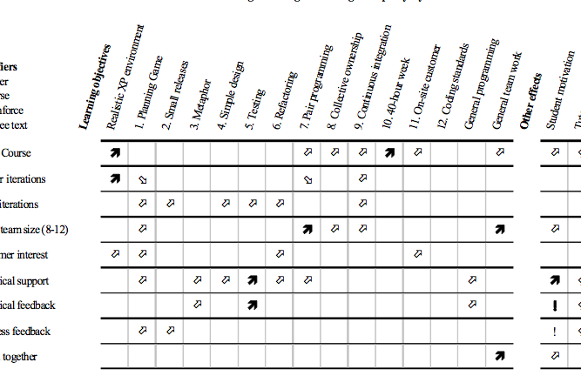
Overview: XP in Teaching

Slide 36
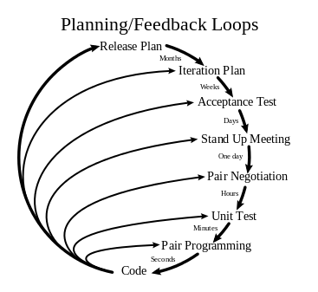
XP:
http://en.wikipedia.org/wiki/File:Extreme_Programming.svg

Slide 37
?
Why is it not a good idea to show XP as an activity diagram?
Why do people want to do that?

Slide 38
SCRUM Approach
Basic idea:
Bundle requirements, do not forward continuous changes of requirements to team
Changes: often and appreciated – but put a Baseline in between
SCRUM-Master is a buffer between interal and external stakeholders
Daily meetings facilitate direct communication
After initial phase: Project flows
Self-facilitating on informational and psychological level
SCRUM focusses on essential aspects
Everything not essential can be decided by the team

Slide 39
SCRUM Practices Hints
SCRUM Meetings
SCRUM Master minds the time (2-3 min./Person)
Standup-meeting: faster
Replace status meetings – safe time
Important: Always same time and place!
(not important: where)
Daily / frequent meetings avoid long/quiet crisis
Content
What was done since the last meeting?
What is planned to be done before the next meeting?
Found obstacles? Write on whiteboard!
Useful: Share information and facilitate social aspects
Schedule further meetings to follow up on things (e.g. obstacles)

Slide 40
SCRUM Practices Hints
Sprint
During sprint: Autonomous team: Pioneers
No new requirements / no changes
No external influences
Only sprint goal
Fixed: Time (approx. 30 Tage), Cost (Developers etc.), Quality
Variable: Functionality
Team can adjust details and scope of functionality based on the time-cost-quality frame and with respect to the sprint goal
Sprint can be cancelled
After Sprint: 4h Sprint-Meeting
Avoid long preparation (max. 2h)
Avoid slides
Often very informal
Adjust SCRUM (longer Sprints, other Meetings…)
Okay, after being successful with the traditional setup
Only based on experiences – never without experience
Notes:
Während die Aussenwelt nicht in den SCRUM eindringen darf, darf das SCRUM-Team durchaus mit der Außenwelt in Kontakt treten. Zum Beispiel, wenn das Sprint-Backlog doch zu viel Arbeit ist – oder zu wenig.

Slide 41
Scrum
Others
SCRUM Master
Product Owner
SCRUM team 7+/-2
SCRUM
Room
Increment
Product
Backlog
(prioritized)
SPRINT
Backlog
Daily SCRUM 15 min.
SPRINT: 30 days
Notes:
Hier sieht man auf einem Bild alle wesentlichen Elemente von SCRUM.
Der Product Owner (ein Kunde) hütet den Product Backlog. Er darf ihn jederzeit verändern, insbesondere die Reihenfolge von Einträgen verändern.
Wenn ein Sprint beginnt, wird soviel oben vom Product Backlog genommen, dass es für den Sprint langt. Dann schließt sich die Kapsel, in den nächsten 30 Tagen darf niemand dem SCRUM-Team hineinreden oder den Sprint-Backlog ändern.
Intern werden jeden Tag SCRUM-Meetings statt finden, am Ende des Sprints wird Software erzeugt.
Der SCRUM-Master erinnert an den Projektleiter, ist es aber nicht. Denn ein SCRUM-Team ist selbstorganisierend. Die Hauptaufgabe des SCRUM-Masters ist es, Schwierigkeiten auszuräumen, die im Daily SCRUM geäußert werden.
Andere dürfen zusehen, im Dails SCRUM aber nichts sagen.

Slide 42
Scrum: organization
Project-goals: Project Backlog
Coord. of
multiple
Teams
Multiple SCRUM-Teams sprint in parallel. Master-SCRUMs
SPRINT
With Backlog andGoal
Project of
SPRINTS
SPRINT creates a Product-Increment
SPRINT
Review 3h
Planning
SPRINT im
30 SCRUM-Takt
Dailiy SCRUM Post-
Build (15 min.) discuss.
A workday:
SCRUM to SCRUM
Workday
Or alternatively:
Notes:
Dies ist die „Seitenansich“, in der man die Zeiteinteilung sieht.
Die untere Ebene ist jeweils ein Zoom in die obere.
Der Arbeitstag kann unterschiedlich gegliedert sein, solange nur jeden Tag ein Daily SCRUM und ein Daily Build stattfinden. Die sollen dann immer zur gleichen Tageszeit durchgeführt werden.

Slide 43
SCRUM vs. XP
XP is often hard to introduce
SCRUM is easy to introduce (according to Schwaber)
Best-practice: Combine!
SCRUM organizational shell: Day-to-day management
XP method of implementation
Shared values with XP
Quickly generate executable code
Facilitate communication
Notes:
„Crossbreed“: www.xbreed.net

Slide 44
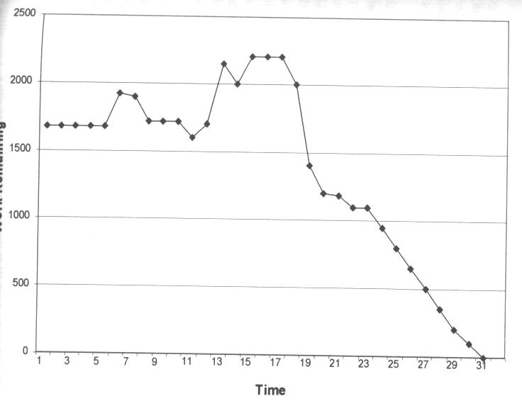
Assess Sprint Progress A possible trajectory
Frustration; Reduce scope wiht SCRUM-Master
Forgot to update after weekend: no change
More and more tasks appear
Good progress
c.f. Schwaber, Ken; Beedle, Mike (2002):
Agile Software Development with Scrum. Prentice Hall.
Notes:
An den Kurven kann man einiges ablesen. Sie werden täglich erstellt und zeigen, wie sich die geschätze Restarbeit entwickelt.
Es gibt einige typische Muster, die man häufig sieht.

Slide 45
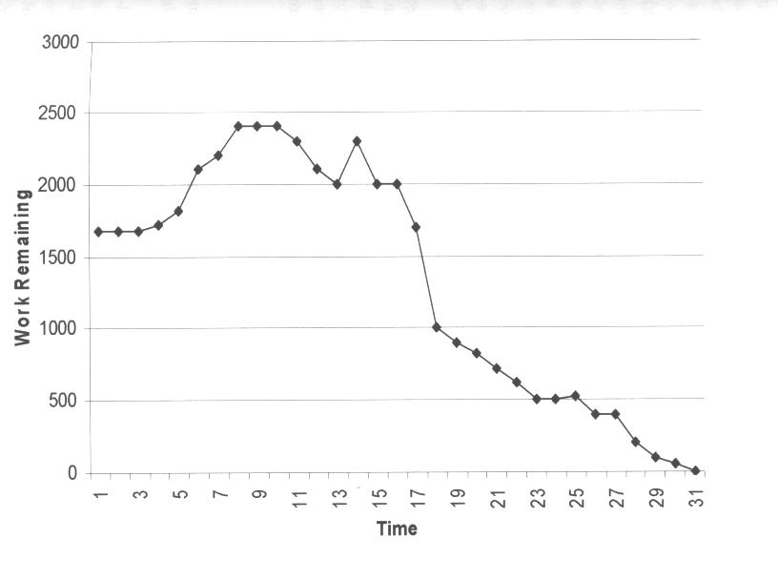
Assess Sprint Progress a typical trajectory for a new SCRUM-Team
Joint effort after week-end results in some progress
Frustration; Reduce scope wiht SCRUM-Master
Slow task, more and more effort appears
C.f. Schwaber, Ken; Beedle, Mike (2002):
Agile Software Development with Scrum. Prentice Hall.
Notes:
Hier zum Beispiel wieder die Bitte an den SCRUM-Master, mit dem Kunden auszuhandeln, dass die Aufgabe verkleinert wird.
Dadurch sinkt dann die Restarbeit auf einen Schlag.
Am Anfang steigt der geschätze Restaufwand, weil man durch die beginnenden Arbeiten erst mitbekommt, was noch alles fehlt und was davon wieder abhängt. Man entdeckt also immer mehr Konsequenzen und immer mehr Arbeit.

Slide 46
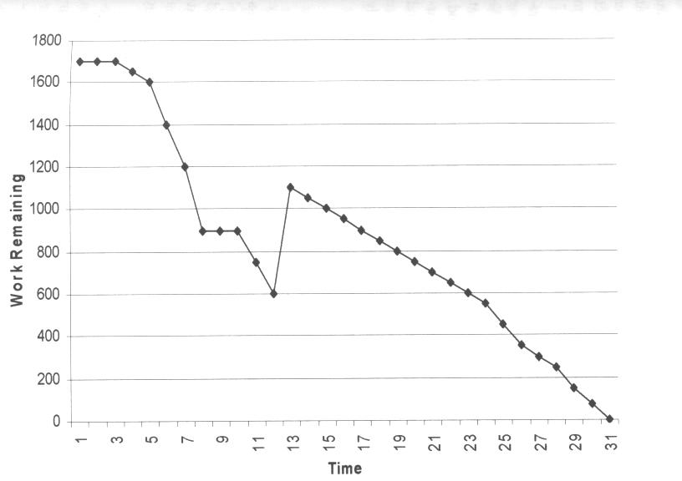
Assess Sprint Progress another typical trajectory
After slow start the team speeds up
Increase scope with Prod. Owner/ Scrum Master
On this foundation: Good progress
This way, the sprint goal would be reached too early
C.f. Schwaber, Ken; Beedle, Mike (2002):
Agile Software Development with Scrum. Prentice Hall.
Notes:
Das ist der andere Fall, in dem das Team in der Mitte noch mehr Arbeit nachholt, weil es sonst viel zu früh fertig würde.

Slide 47
Why does SCRUM work?
Integrated instability
Not too smoothly
Self-organizing teams
Take ownership
Multi-Learning
Between functions
Between group, organization, and individual
Subtle controll
Constant learning
Experienced developers in new teams
Risk management
Risk: Customer unhappy
Show working system often
Risk: Incomplete feature set
Prioritize: If something is missing, it is not important
Risk: Bad estimation
Daily updates during SCRUM
Risk: Lack of experience with Development cycle
Test early and execute repeatedly
Risk: Changes in performance estimation
No impact on Sprint
c.f. Schwaber, Ken; Beedle, Mike (2002):
Agile Software Development with Scrum. Prentice Hall.
Notes:
SCRUM funktioniert also auch, weil es mit den genannten Risiken sinnvoll umgeht.

Slide 48
Summary SCRUM
SCRUM is a management shell
Around XP
Or other approach: Even waterfall possible
Overlap with XP, but differences exist
Similar values
Different practices
Partly complement each other
Not as much impact as XP, easier to introduce
Strength
Information flows not only in one direction
Multiple feedback cycles stabilize system

Slide 49
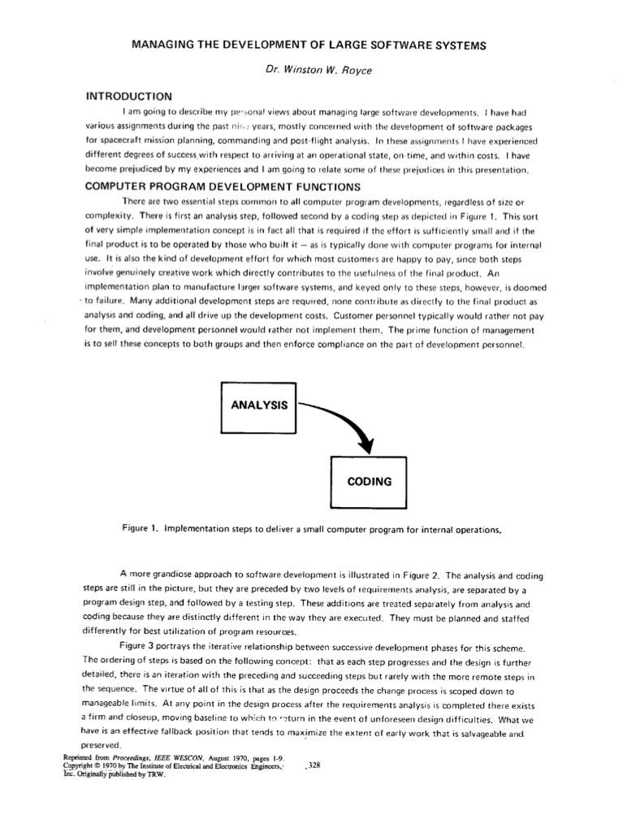
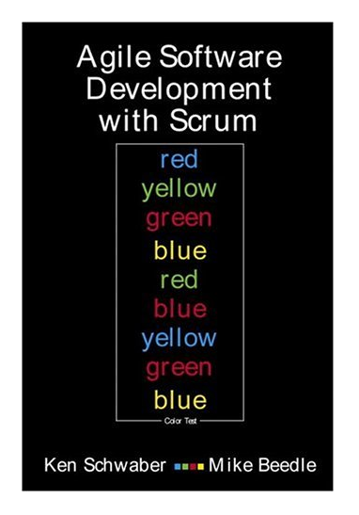

Thanks! (…and optional further reading)
Winston W. Royce: Managing the Development of Large Software Systems. In: Proceedings of IEEE WESCON, pages 1-9, 1970
Kent Beck: Extreme Programming Explained. Addison-Wesley, 2000
Ken Schwaber and Mike Beedle: Agile Software Development with Scrum, Prentice Hall, 2002

