Slide 1

Dart Programming Language

Slide 2
Names, Bindings and Scopes
1

Slide 3
Names
Name forms
Special words

Slide 4
Name forms
All names (variables, functions, classes and special words) are case sensitive.
There is no length limit on names and names can contain alphanumeric (a-z, A-Z, 0-9) characters, underscore (_) and dollar sign ($) but the first character must be a non-digit character.
Underscore as the first character marks the variable, function or class as a private one.
Special character such as #, @, ^, &, * ,space as well as Unicode characters and mathematical symbols except $ and _ are not allowed.

Slide 5
Special words
Reserved Words : assert, break, case, catch, class, const, continue, default, do, else, enum, extends, false, final, finally, for, if, in, is, new, null, rethrow, return, super, switch, this, throw, true, try, var, void, while, with
Contextual Keywords (These Keywords have meaning only in specific places and they are valid identifiers everywhere.): async, hide, on, show, sync, await, yield
Built-in Identifier Words (These are used to simplify the task of porting JavaScript code to Dart, these keywords are valid identifiers in most places, but they cannot be used as class or type names, or as import prefixes.): abstract, as, covariant, deferred, dynamic, export, extension, external, factory, function, get, implements, import, interface, library, mixin, operator, part, set, static, typedef

Slide 6
Variables
Address and value
Type and alias

Slide 7
Address and value
Garbage collection is an automatic memory management feature in many modern programming languages, such as Java and languages in the .NET framework. Languages that use garbage collection are often interpreted or run within a virtual machine like the JVM. In each case, the environment that runs the code is also responsible for garbage collection and since Dart applies garbage collection and its DartVM this process is automated.

Slide 8
Alias and Types
There is only one alias per variable (the one defined during the definition of the variable) and there cannot be multiple aliases for a single variable.
Numbers (Integer and Double), Boolean, String, Maps and dynamic

Slide 9
Binding
Type binding
Storage bindings

Slide 10
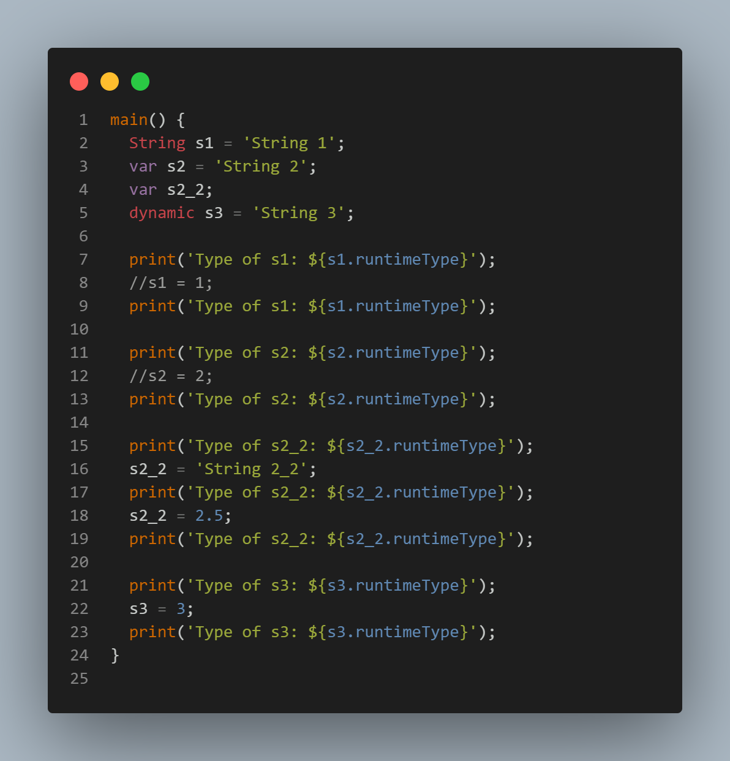
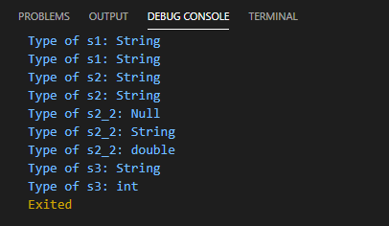
Type binding
In Dart dynamic and var (with no initialization) keywords are used to create variables with runtime bindings and other data types like int, String, double as well as var (with initialization) are static.
Dart uses a combination of static type checking and runtime checks to ensure that a variable’s value always matches the variable’s static type, sometimes referred to as sound typing. Although types are mandatory, type annotations are optional because of type inference.

Slide 11
Storage Bindings and Lifetime
There are no static variables in Dart and static keyword is only used for class variables or class functions.
Stack is used for tracing variables in heap and it points to the heap memory.
Dart objects that are dynamically allocated live in the heap. An object allocated from the heap is freed (eligible for garbage collection) when nothing points to it, or when the application terminates.

Slide 12
Scopes
Local and global variables

Slide 13
Local and global variables
A local variable is a type of variable declared inside programming blocks(i.e., for loop, if else, switch and many more) or functions and its lifetime is from the definition of the variable till the end of the scope.
It can only be used inside that particular code of block or function in which it is declared or defined.
Global variables are defined outside the function and used to access from anywhere.
The scope of global variable is limited from the start of the program to the end of the program.

Slide 14
Named constant
Const and Final

Slide 15
Const and Final
The final keyword is used to hardcode the values of the variable and it cannot be altered in future, neither any kind of operations performed on these variables can alter its value (state).
The Const keyword in Dart behaves exactly like the final keyword. The only difference between final and const is that the const makes the variable constant from compile-time only. Using const on an object, makes the object’s entire deep state strictly fixed at compile-time and that the object with this state will be considered frozen and completely immutable.
Consts and Finals, are implicitly static members of classes.

