Slide 1
Database Security

Slide 2
Security Threats
Data tampering
Eavesdropping and data theft
Falsifying User’s identities
Password related threats
Unauthorized access to data
Lack of accountability

Slide 3
Project analysis slide 2
Security Overview
Integrity
Implementation
Security
Overview
Confidentiality
Testing
Availability
Administration

Slide 4
Security Objectives
Secrecy
Prevent/detect/deter improper Disclosure of information (also known as Confidentiality)
Prevent/detect/deter Improper modification of information
Integrity
Availability
Prevent/detect/deter improper Denial of access to services

Slide 5
Integrity
Integrity contributes to maintaining a secure database by preventing the data from becoming invalid and giving misleading results. It consists of following aspects :
System and object privileges control access to applications tables and system commands so that only authorized users can change the data.
Integrity constraints are applied to maintain the correctness and validity of the data in the database.
Database must be protected from viruses so firewalls and anti-viruses should be used.
Ensures that access to the network is controlled and data is not vulnerable to attacks during transmission across network.

Slide 6
Confidentiality
Data confidentiality is about protecting data against unintentional, unlawful, or unauthorized access, disclosure, or theft.
Access control : Access to data is controlled by means of privileges, roles and user accounts.
Authenticated users : Authentication is a way of implementing decisions of whom to trust. It can be employ passwords, finger prints etc.
Secure storage of sensitive data : It is required to prevent data from hackers who could damage the sensitive data.
Privacy of communication : The DBMS should be capable of controlling the spread of confidential personal information from unauthorized people such as credit cards etc.

Slide 7
Availability
Availability is often thought of as a continuity of service assuring that database is available. Denial of service attacks are attempts to block authorized users ability to access and use the system when needed. It has number of aspects :
Ease of use – Resources managed by users for working with databases should be effectively managed so that it is available all the time to valid users.
Flexibility – Administrators must have all the relevant tools for managing user population.
Scalability - System performance should not get affected by the increase in number of users or processes which require services from system.
Resistance – User profiles must be defined and the resource used by any user should be limited.

Slide 8
Project analysis slide 4
Security Practice
Implementation
Testing
Administration

Slide 9
Defense Levels
Physical security
Human factors
Operating system
Database system

Slide 10
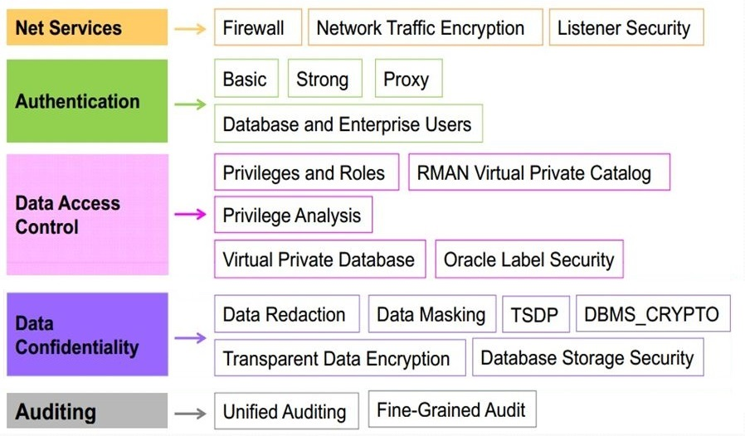
Implementation

Slide 11
(Penetration) Testing
Penetration Testing Techniques :
SQL Injection
Privilege Elevation in Database
Denial of Service
Unauthorized Access to data
Identity Spoofing & Password Cracking
Data Manipulation
Some Tools :
Zed Attack Proxy, Paros, Social Engineer Toolkit, Skipfish, Vega, Wapiti, Web Scarab

Slide 12
Administration
Database administration refers to the whole set of activities performed by a database administrator to ensure that a database is always available as needed. Some administrator responsibilities are :
Installation, configuration and upgrading of Database server software and related products.
Backup and recovery establishment
Implementation and maintenance of database security (create and maintain users and roles, assign privileges)
Performance monitoring
General technical troubleshooting
Database recovery

Slide 13
Privileges in SQL
GRANT INSERT, DELETE, UPDATE, SELECT
ON employees, departments
TO smith;
REVOKE INSERT, DELETE, UPDATE, SELECT
ON employees, departments
FROM smith;

Slide 14
Thank You

