Slide 1
Kernel exploration outputs
Jiaqi Yu

Slide 2
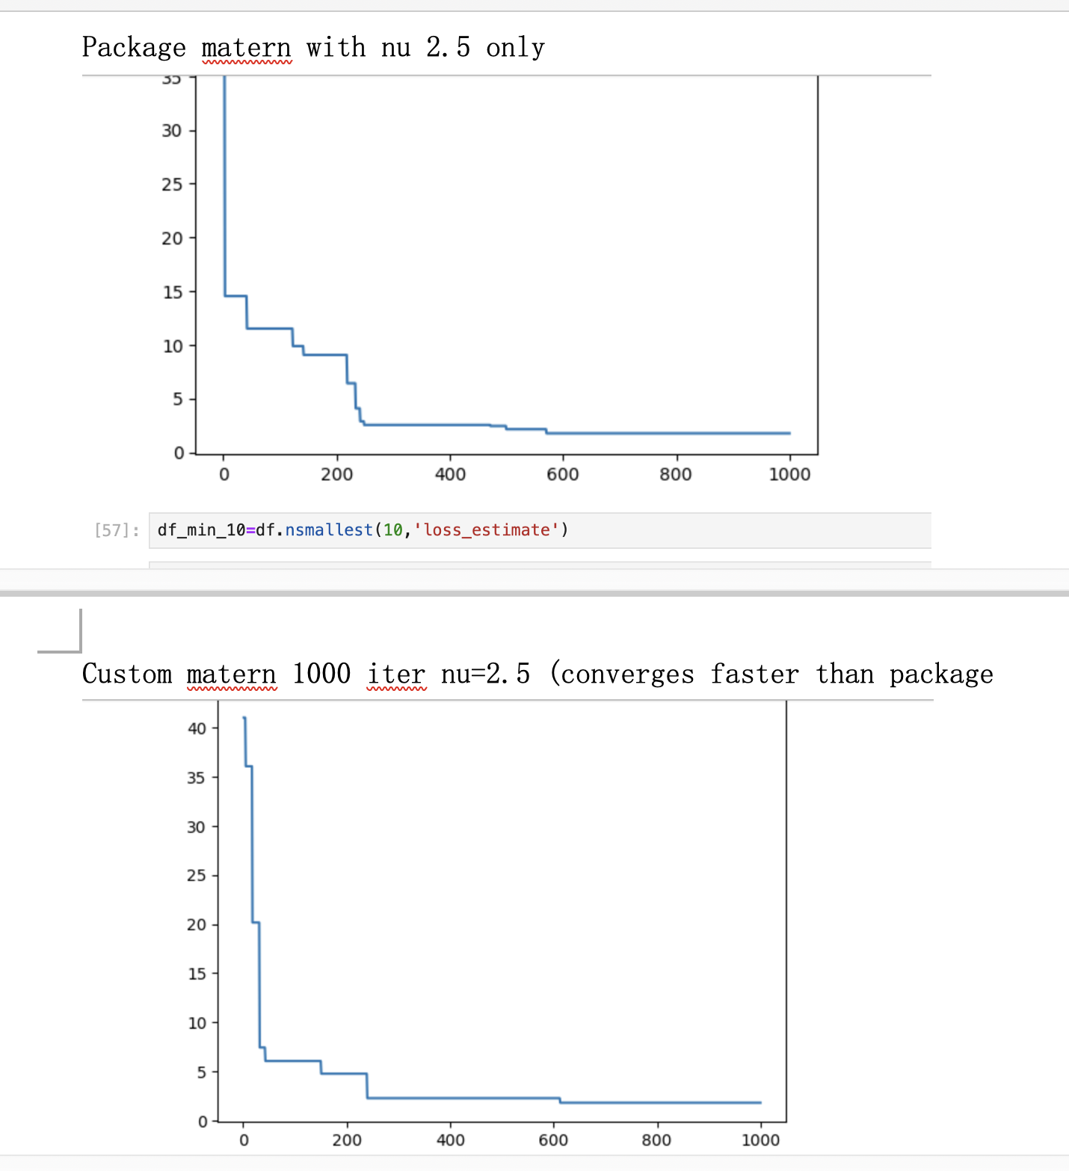
Custom Matérn kernel vs package Matérn kernel
As shown, the two have similar outputs. Both have only nu=2.5 as hyperparameter. With custom matern converging slightly faster
Randomization from the SUMO seed and different sobol initial points may vary the results.

Slide 3
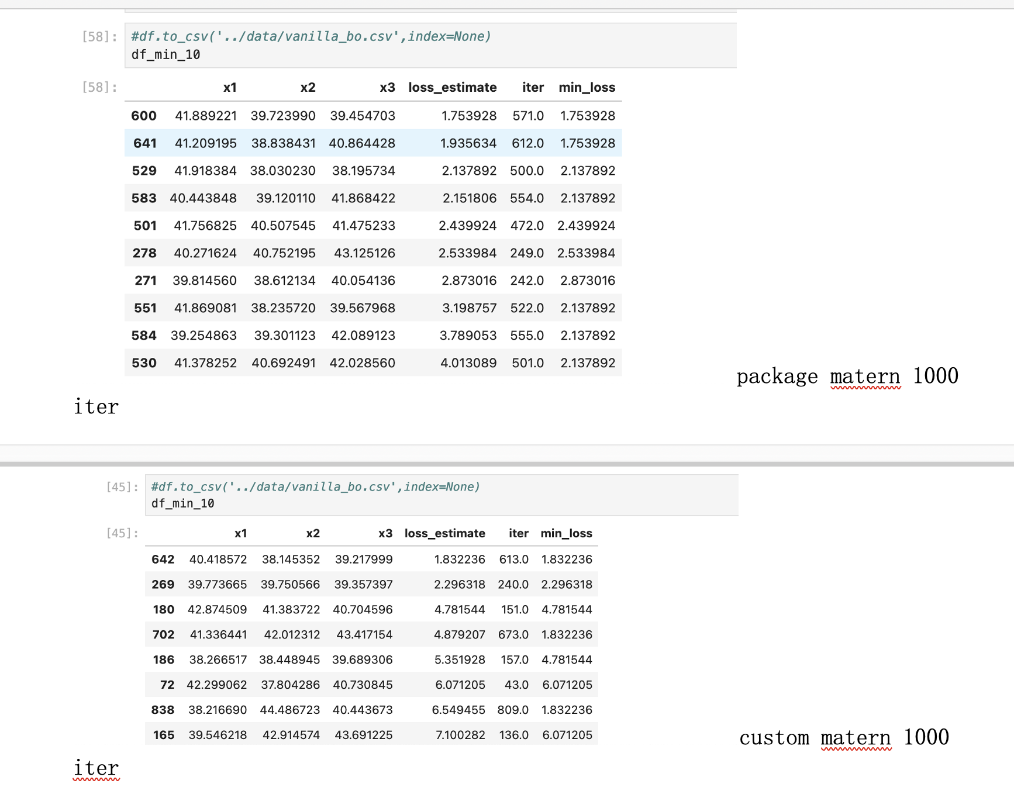
Custom Matérn kernel vs package Matérn kernel
Top 10 minimum loss X values as above.
This is to make sure without the custom component, the custom matern part works and it does

Slide 4
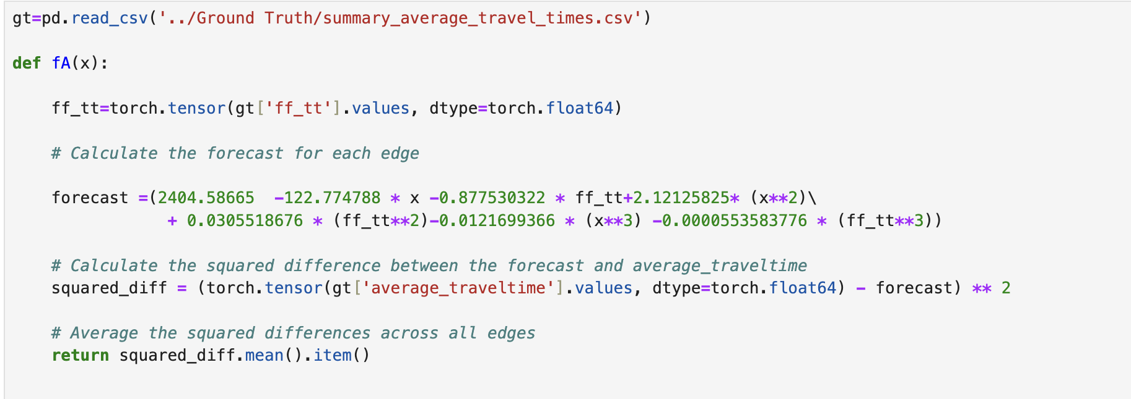
fA()
After investigating the different steps and inputs that kernels are called on, I changed the fA function to be an element-wise
Transformation that will be applied with the x._apply(fA) so it retains the same shape and only each element
is mathematically changed according to the polynomial function

Slide 5
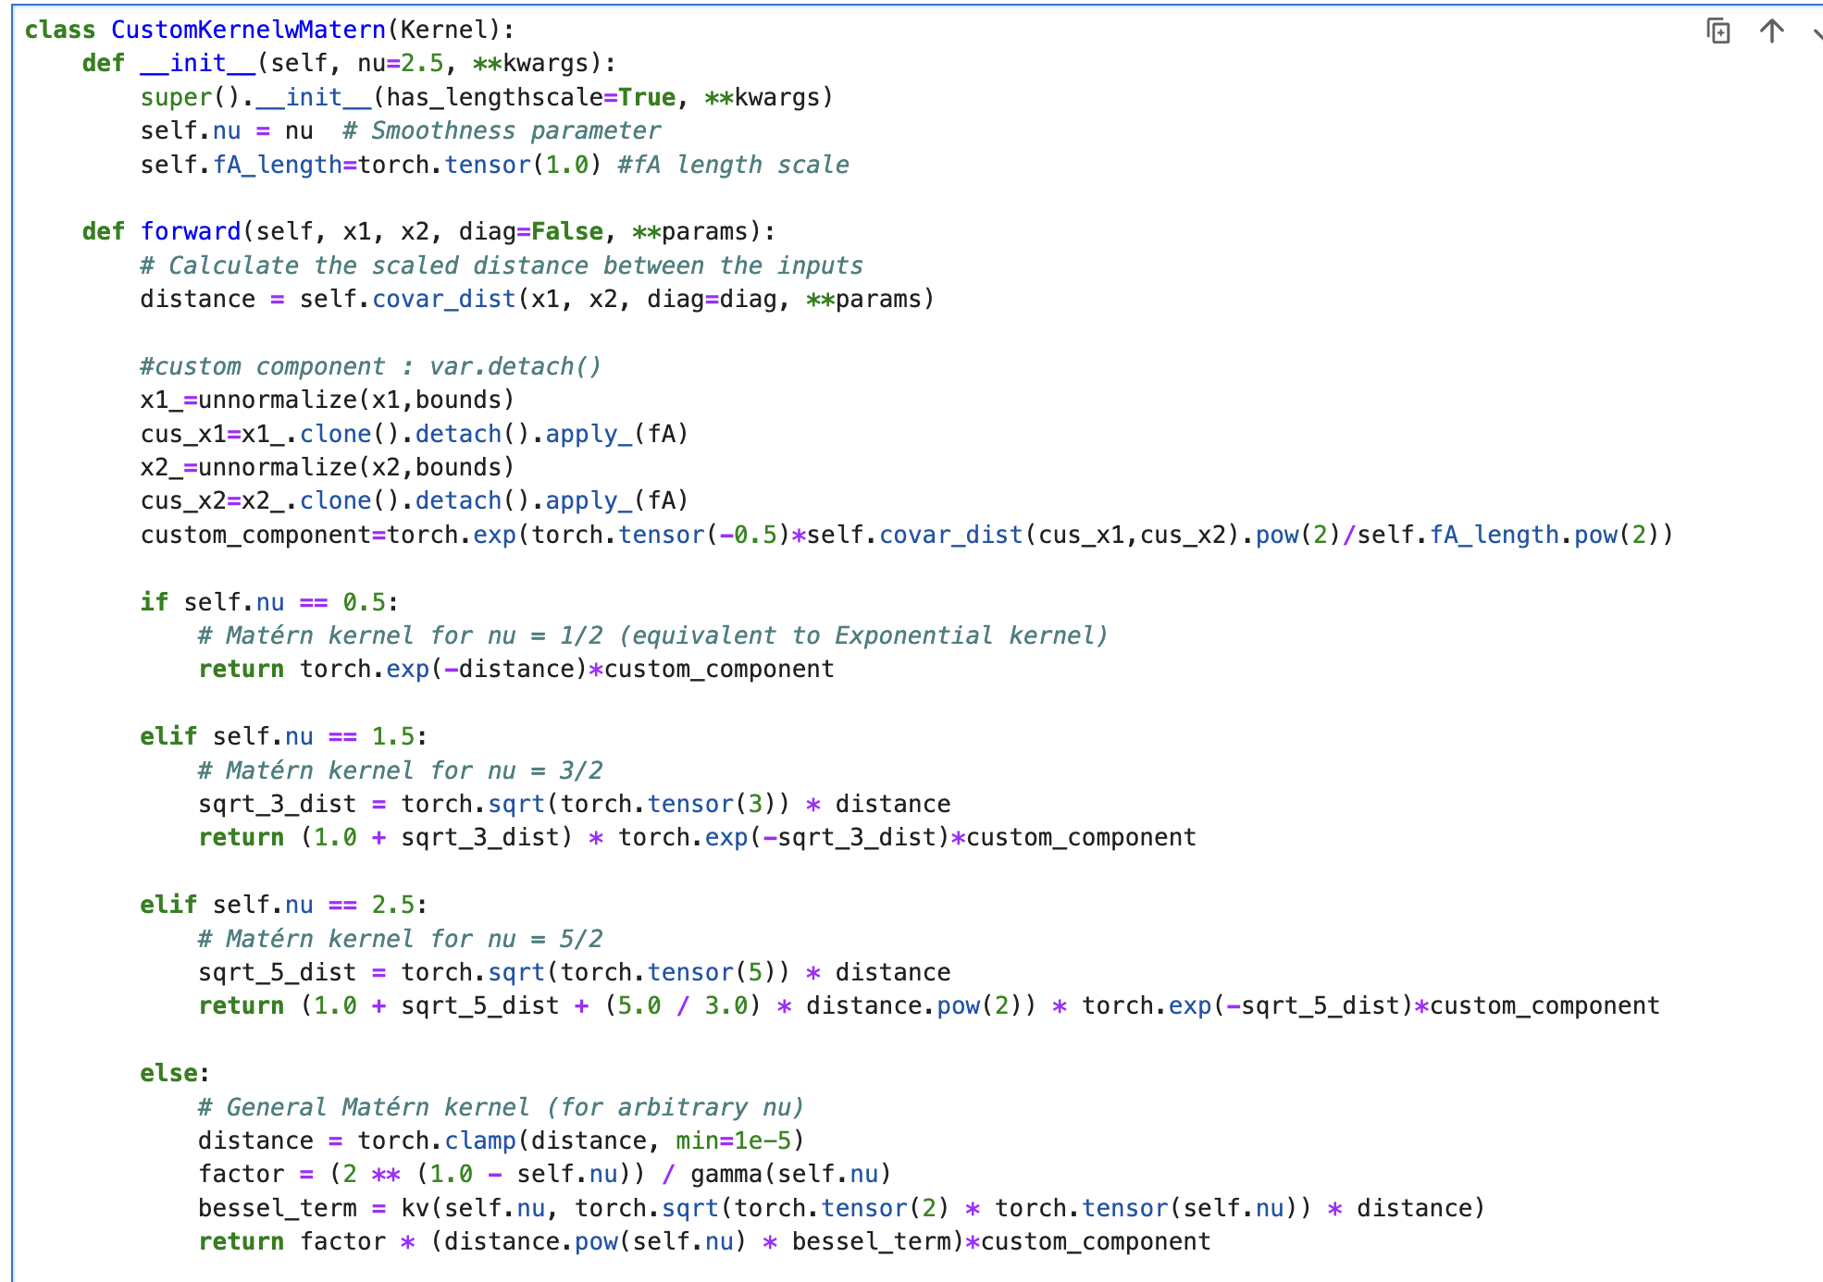
Custom Matern* Custom fA component-updated
Again, the multiplying kernel looks like this
The x values were in [0,1] scale and I
unnormalized them to be in the space [20,60]

Slide 6
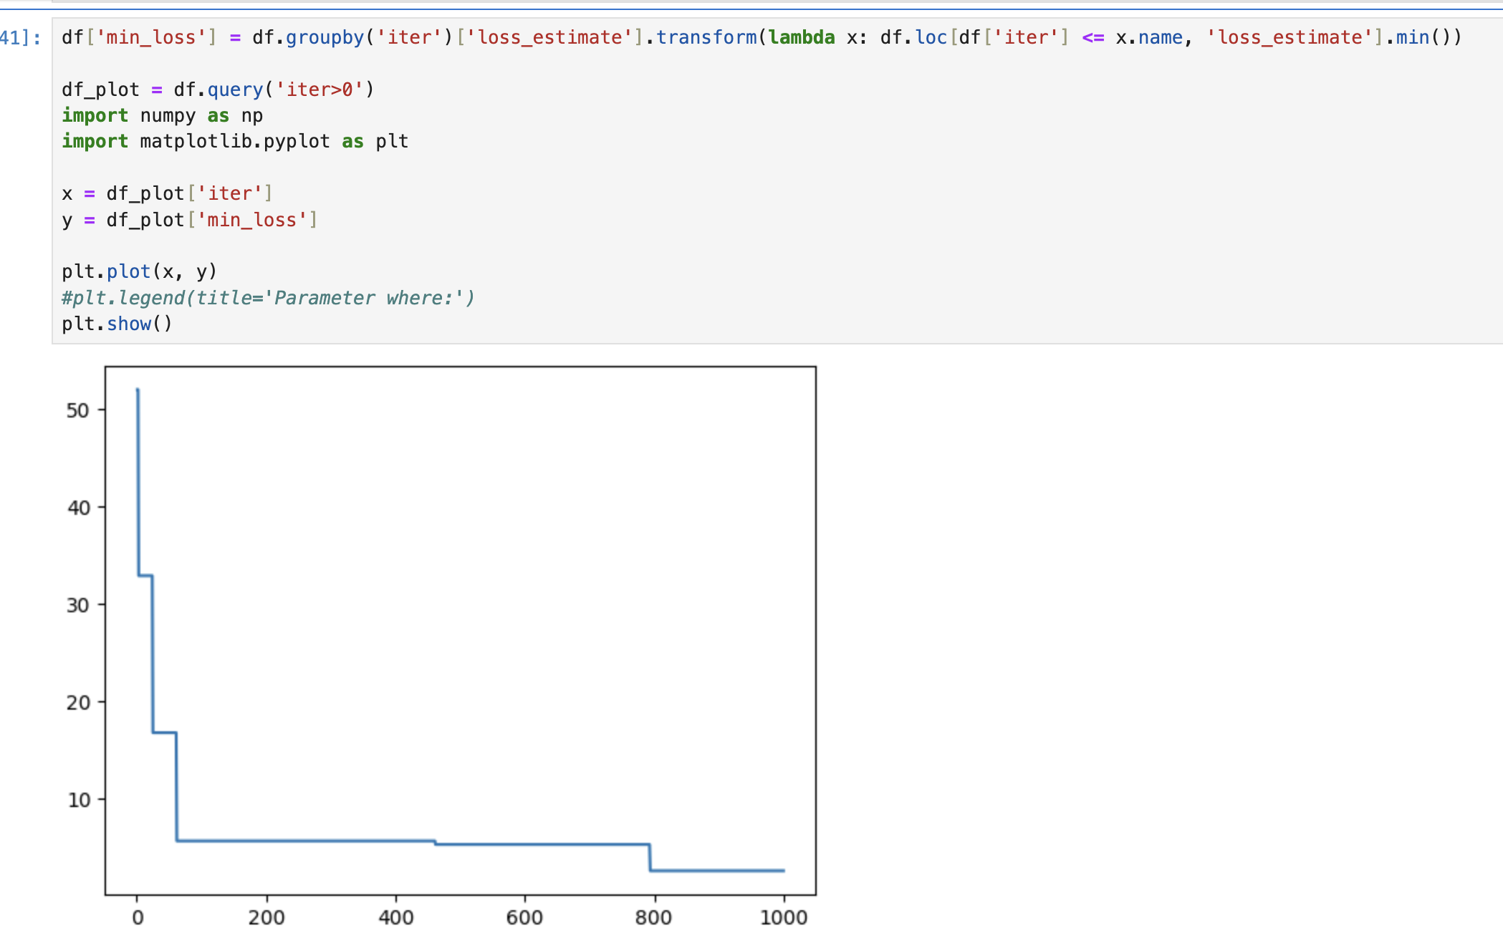
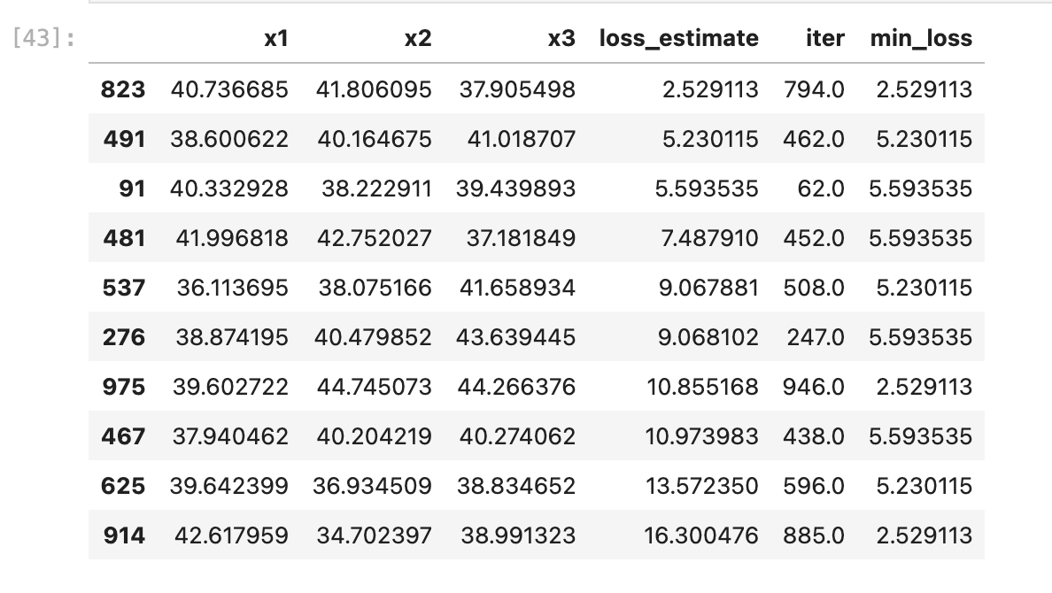
Multiplying kernel output - updated
The convergence initially is faster than the simple matern kernels,
but later takes more iterations to get to a small loss

Slide 7
Use fA in the matern covariance distance
I tried to plug fA for the x1 x2 of the original matern covariance distance function, and also tried to normalize them, but there are issues either ways. I think after the mathematical transformation, the algorithm fails to understand the relationship between green times and edge travel time. I can share more details in tomorrow’s meeting.

