Slide 1
Phishing email detection through linguistic patterns and sentiment analysis
Daniel Nascimento Pedrinho
João Rafael Duarte de Almeida
Sérgio Guilherme Aleixo de Matos
With the wide usage of e-mail as a communication tool, phishing attacks
have become increasingly common and sophisticated. This dissertation aims to
explore the use of linguistic patterns and sentiment analysis to detect
phishing emails. By analyzing the emotional tone and language used in
emails, we may be able to identify potential phishing attempts and improve email
security.

Slide 2
Motivation
Email as Critical Infrastructure:
  Over 4 billion users and 347 billion emails exchanged daily
Escalating Email Security Threats:
  Attacks lead to data breaches and financial losses
Increased Sophistication of Attacks:
  Employs usage of social engineering, paired with AI generation
  Emotional manipulation disregards technical prowess
Novel Defense Approach:
  Leverage emotion detection as a defense mechanism
Notes:
Attacks lead to data breaches and financial losses: According to the FBI IC3 Report over USD 70 Million in phishing related losses

Slide 3
State Of The Art
Evolution of Detection Systems:
  Rule-based and Blacklist Systems
  Classical Machine Learning
  Deep Learning and Transformer Models
Emerging Role of Sentiment Analysis:
  Studies show sentiment-aware features can improve detection
Dataset Landscape:
  Large-scale datasets exist, providing binary labels
  Fine-grained emotional datasets are mostly absent
Notes:
Rule-based and Blacklist Systems: System that relied on manually set rules and known malicious senders and url blacklists
Classical Machine Learning: Uses supervised machine learning models trained on manually engineered features
Deep Learning and Transformer Models: Automatically learn semantic representations from raw email content. These models achieve state-of-the-art accuracy and are especially effective at capturing contextual meaning

Slide 4
Research Gap
Phishing Remains Fundamentally Psychological:
  Emotional manipulation is a primary success factor
Lack of Fine-Grained Emotional Annotations:
  No publicly available large-scale datasets with emotional labels
  Imposes limit on supervised learning for emotional patterns
Underexplored Role of Emotion Detection:
  Often treated as a secondary feature
  Remains peripheral in state-of-the-art systems

Slide 5
Dataset Requirements
No existing datasets fit our research requirements
Objective: Create sizeable, emotion-annotated phishing email dataset
Dataset Characteristics:
  Fine-grained emotional annotations
  Balanced emotional category distribution
Dataset should support:
  Emotion-Aware Phishing Detection
  Supervised machine learning and evaluation

Slide 6
Dataset Creation
Methodology:
  Use pre-existing curated dataset with 480 entries as baseline
  Generated large dataset with 10,000 entries using LLM
Post-Processing:
  Remove any generated text not part of the email
  Replace placeholders with fake generic information
Validation:
  Dataset is evenly distributed across 14 emotions
  Linguistic coherence preserved

Slide 7
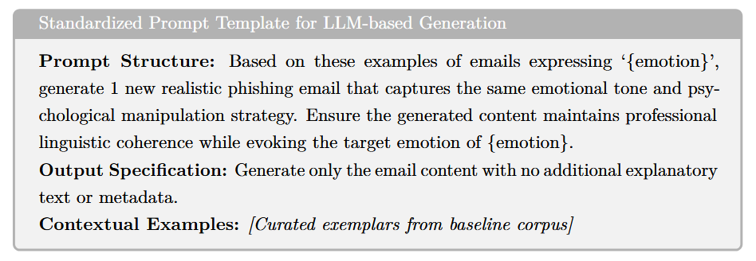
Prompt Example

Slide 8
Dataset Annotation
Objective: Create Fully Annotated Dataset
  Each entry can have more than one label
  Emotion labels derived from existing literature
Annotation Procedure:
  Emails are reviewed individually
  Annotator chooses one or more emotions present in the email
Quality Assurance:
  Guidelines created to ensure consistency between annotators
  “UNSURE” label prevents ambiguous labeling

Slide 9
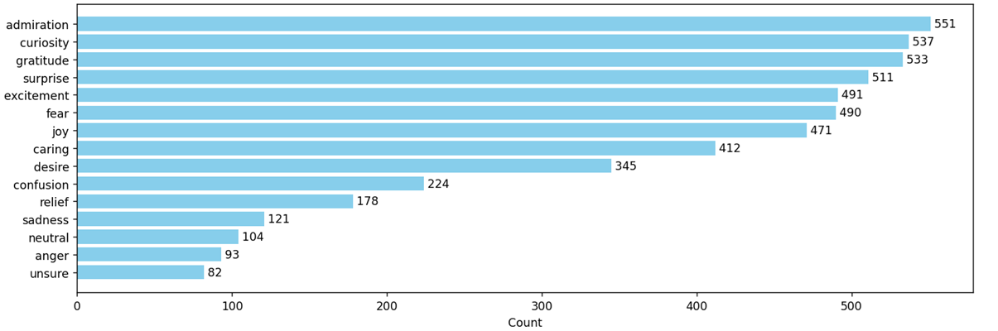
Preliminary Results
Dataset Creation Process Completed
Annotation Process Underway:
  1843 entries annotated so far

Slide 10
Work Plan Proposal
Phase 1: Phishing Detection Model Development
  Model selection, training and evaluation
  Parameter optimization
Phase 2: Sentiment Analysis Model Development
  Capable of identifying emotions with high scoring metrics
Phase 3: Web Application Development
  Develop RESTful API that integrates models
Phase 4: Review and Quality Assurance

Slide 11


Thank You!

