Slide 1
Phishing email detection through linguistic patterns and sentiment analysis
Daniel Pedrinho Nº 107378
João Rafael Duarte de Almeida
Sérgio Guilherme Aleixo de Matos
With the wide usage of e-mail as a communication tool, phishing attacks
have become increasingly common and sophisticated. This dissertation aims to
explore the use of linguistic patterns and sentiment analysis to detect
phishing emails. By analyzing the emotional tone and language used in
emails, we may be able to identify potential phishing attempts and improve email
security.

Slide 2
Objectives / Work done / Results
Objectives:
  Use LLM to generate phishing emails based on an existing annotated dataset
  Annotate newly generated dataset using Doccano
  Use dataset to generate pre-annotated phishing emails
Results:
  Generated dataset with 10,000 emails, evenly split across emotions
  Doccano plataform deployed and ready, with annotation guidelines
  User creation + Email automation script ready

Slide 3
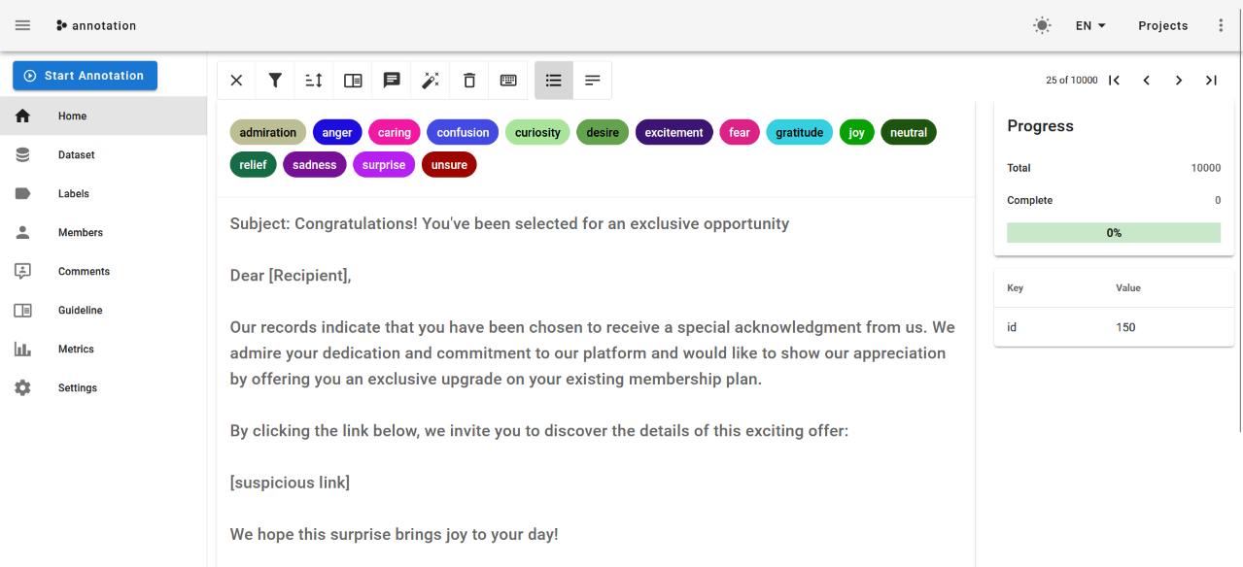

Slide 4

Next Steps / Challenges / Bottlenecks
Next Steps:
  Annotate the dataset
  Use the annotated dataset to generate non-phishing emails
Bottlenecks:
  Annotation speed of volunteers

