Slide 1
ST8003 Linear Regression, 2023-24
Final Project
Lorenzo Pedrini
Student number: 20337113
Date: 14/04/2024

Slide 2
Burn Injury Case Study
With this report we would like to assess the problematic of an unusual high rate of fatalities per burn injuries. Inefficient hospital care is considered a possible responsible for the problem. The investigation is necessary to identify risk factors in order to correctly allocate patients to emergency care when needed in order to avoid fatalities.
Logistic regression model
$\log\left(\frac{π}{1−π}\right)= −10.924+0.121∗ age+0.273∗race+0.151∗area+6.801∗inhal −0.054∗race∗area−0.074∗age∗inhal−0.045∗area∗inhal$
As the result of this statistical analysis, we can see the most relevant influence factor that explains the fatality of a burn accident is the inhalation of fumes. Immediate medical attention should be given for patients presenting this risk factor. Increasing age and increasing burn area are both correlated to an increased probability of fatality. Priority medical attention should be given to older patients and to patients with a high percentage area of the body covered by burns.
Model Performance: Performance was evaluated using the confusion matrix.
Forecasting accuracy of 91%.

Slide 3
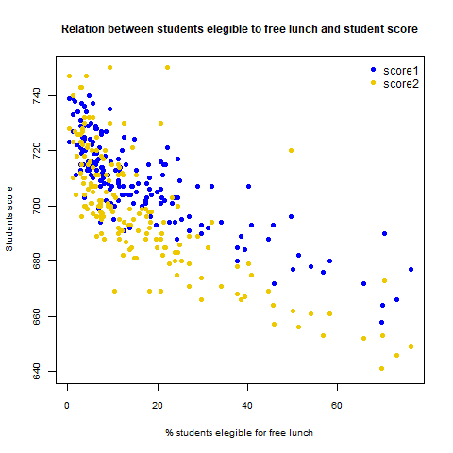
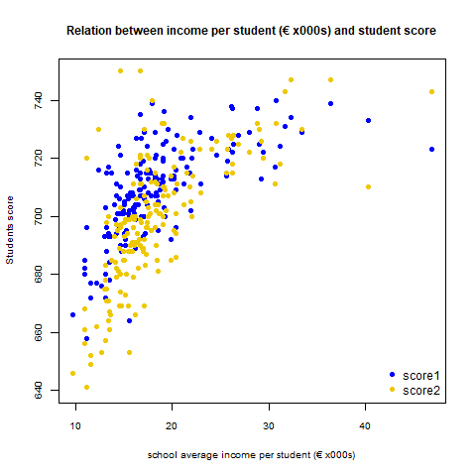
School score case study
This report is to answer the inquiry of the Prime Minister to review the allocation of the budget for the schools in Ireland, in particular we investigated how current budget allocation has been influenced student performance and suggested improvements to boost student achievements.
Linear Regresion Models:
score1 = 716.596 - 0.423 special - 0.478 free - 0.675 stratio - 0.55 noteng + 1.057 income
score2 = 676.930 + 1.799 income - 0.738 free
Summary of the results
The result of the statistical analysis analysed two separate models, one analysing the scores of 11 years old students and the other one analysing the score of 16 year old students. Those results highlight that the most influent predictors that explains both the scores is the income of the school per students. It means that schools that have more money to invest per student have a high average value for both the scores. The amount of students eligible for free lunch is indicative of the presence of economically disadvantaged students in the school. This has a negative influence on the scores. Budget that is allocated for computers and teachers stipends doesn’t have a statistical influence on the scores.
In summary it would be advisable to redistribute the budget, in the form of investing more of it into schools with a low income per student. This money can potentially be financed by a lowering in teacher’s stipends and from a reduced investment on computers.
MAPE (score 1) = 1.1% very high forecast ability
MAPE (score 2) = 1.6% very high forecast ability

