Slide 1

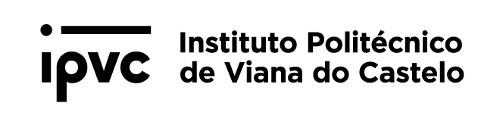
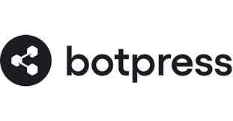
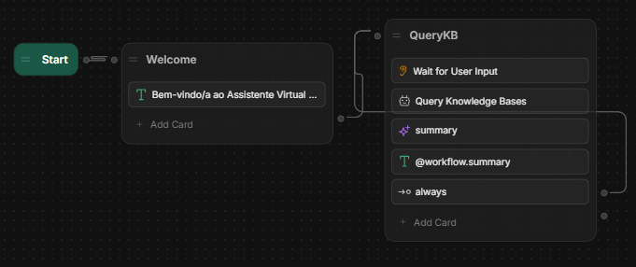
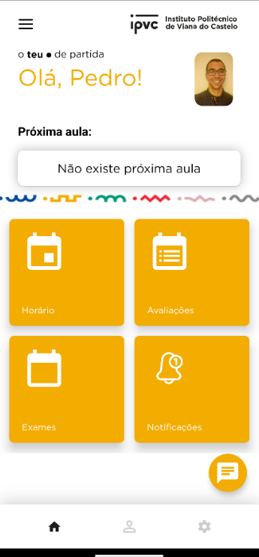
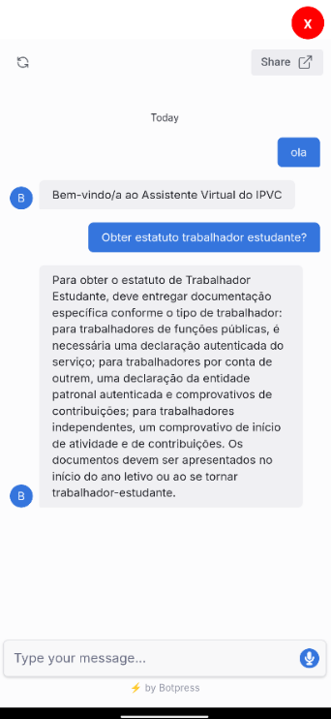
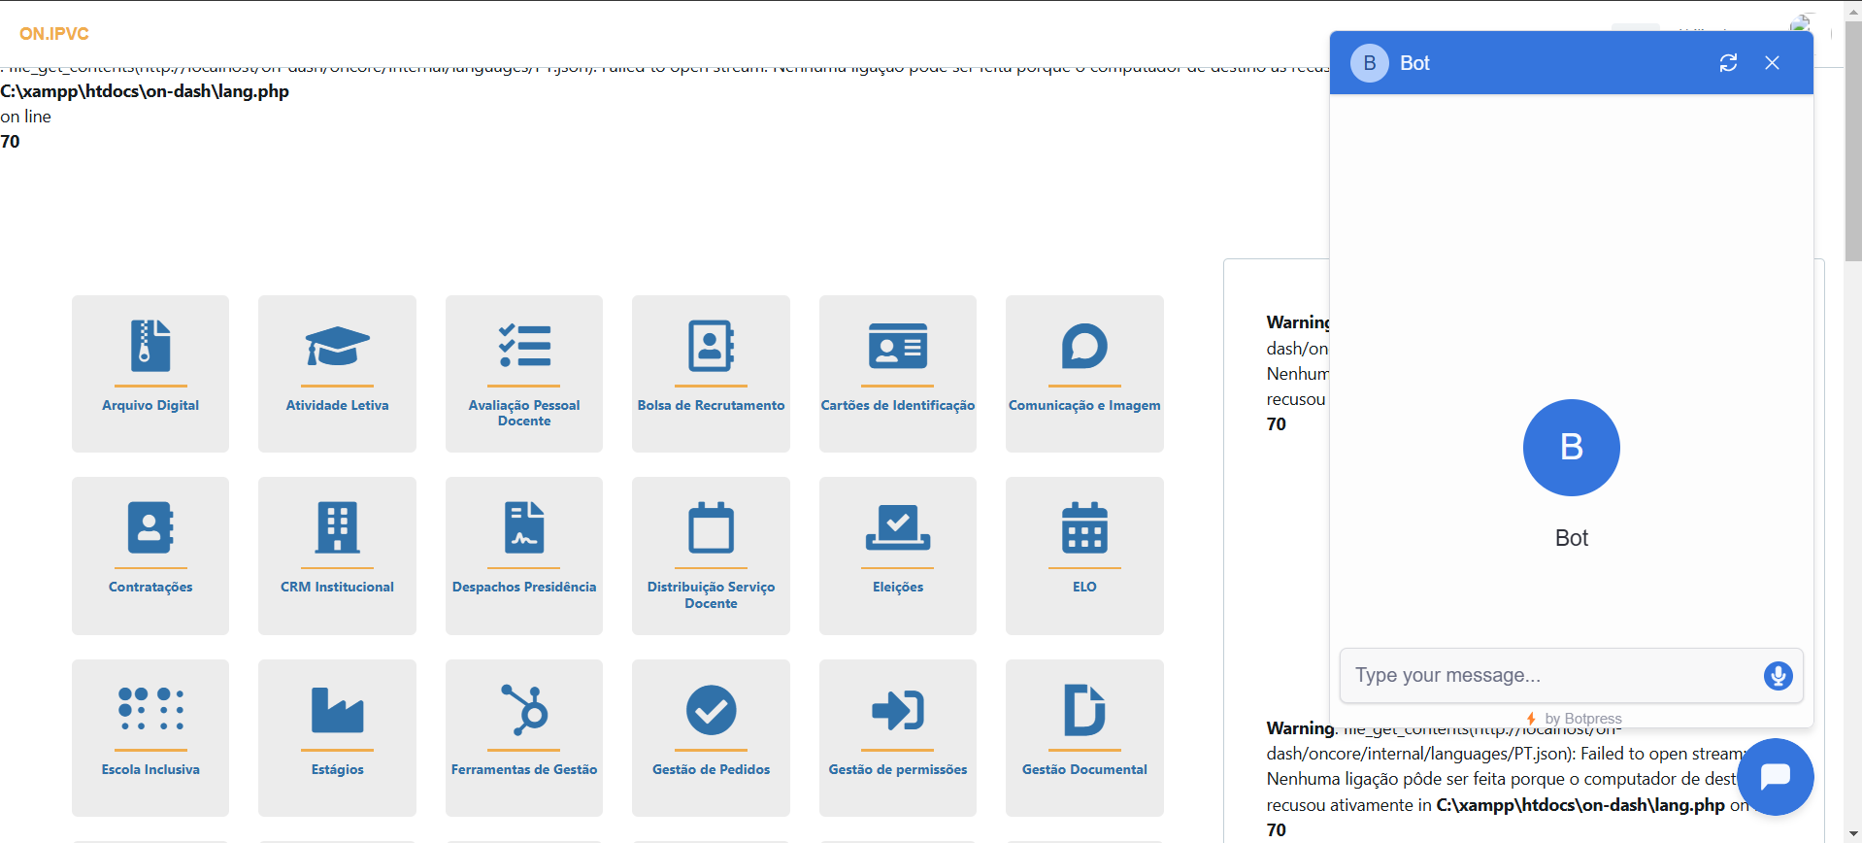

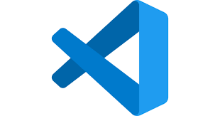
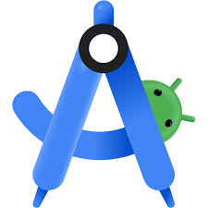



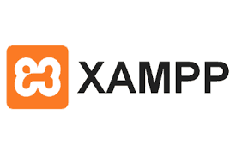

Indroduction
Bot Incorporation
^{Pedro Soares Poças}
Degree in
INFORMATICS ENGINEERING
Instituto Politécnico de Viana do Castelo;
Curricular Unit: Project III
In today's digital era, dynamic interaction between businesses and consumers has become essential. This project addresses the implementation of an advanced chatbot solution developed using Botpress, an open-source software specifically designed for chatbot development.
Fig.1 - ChatBot Plataform
Fig.2 – Chatbot workflow
Objective
The main objective of this project is to implement a chatbot within the myipvc mobile application, which is developed using React Native. As the chosen platform for developing the bot is standalone, this has opened up the possibility of integrating the chatbot into the ON platform, developed in PHP, and into the portal platform, developed using WordPress.
Fig.5 – Chatbot on ON
Fig.3,4 – Chatbot on myipvc
Discussion/Conclusion
Tools and Technologies Used
In this project, an advanced chatbot was successfully implemented in the myipvc mobile app, showcasing Botpress versatility in handling real-time interactions within a React Native environment. It was also possible to test the integration on a test dashboard of the ON platform. Unfortunately, the integration on the portal platform was not possible, because a paid plan was required and it did not arrive in time to integrate. Going forward, this experience highlights the importance of flexible and cost-effective solutions in digital communication strategies, underlining the potential for future integrations and expansions across multiple platforms.
Professora Doutora Sara Paiva
ANO LETIVO 2024/2025;
References
Guidance
BotPress:https://botpress.com/
Support
ESTG-IPVC | Escola Superior de Tecnologia e Gestão

