Slide 1
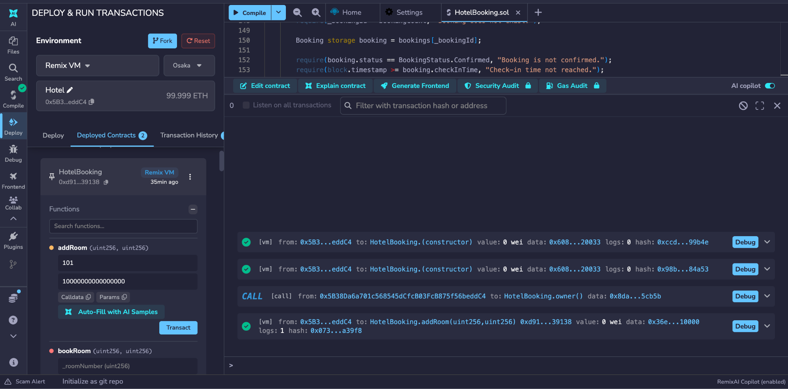
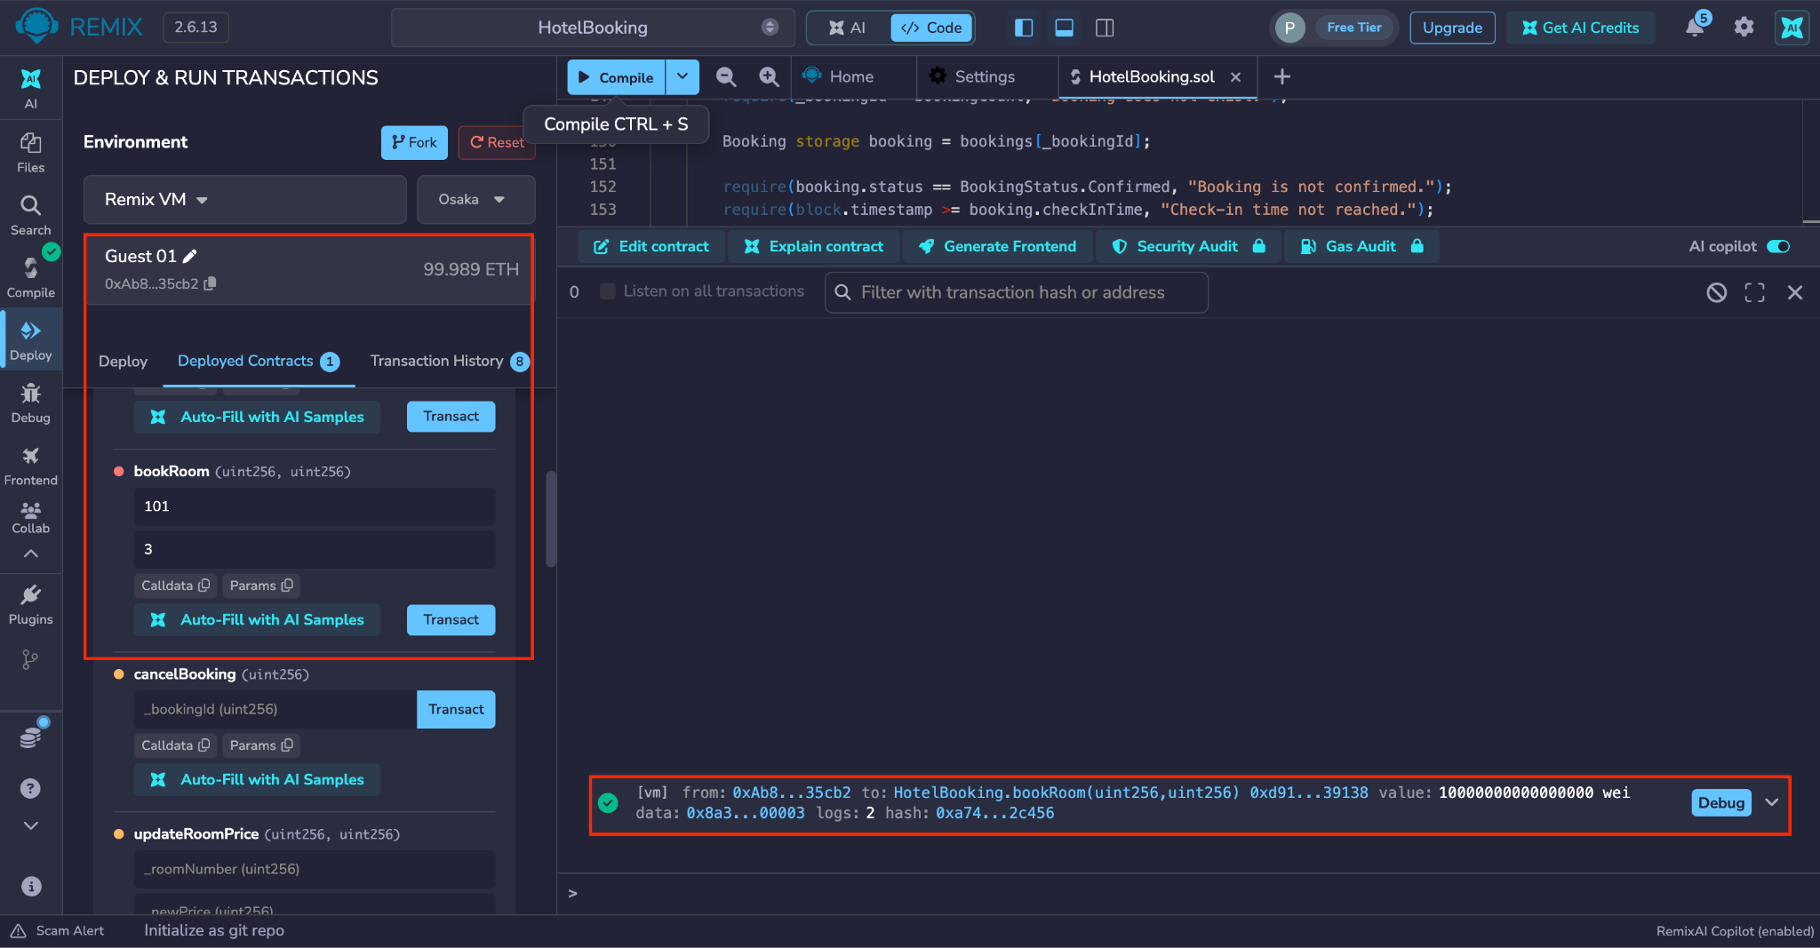
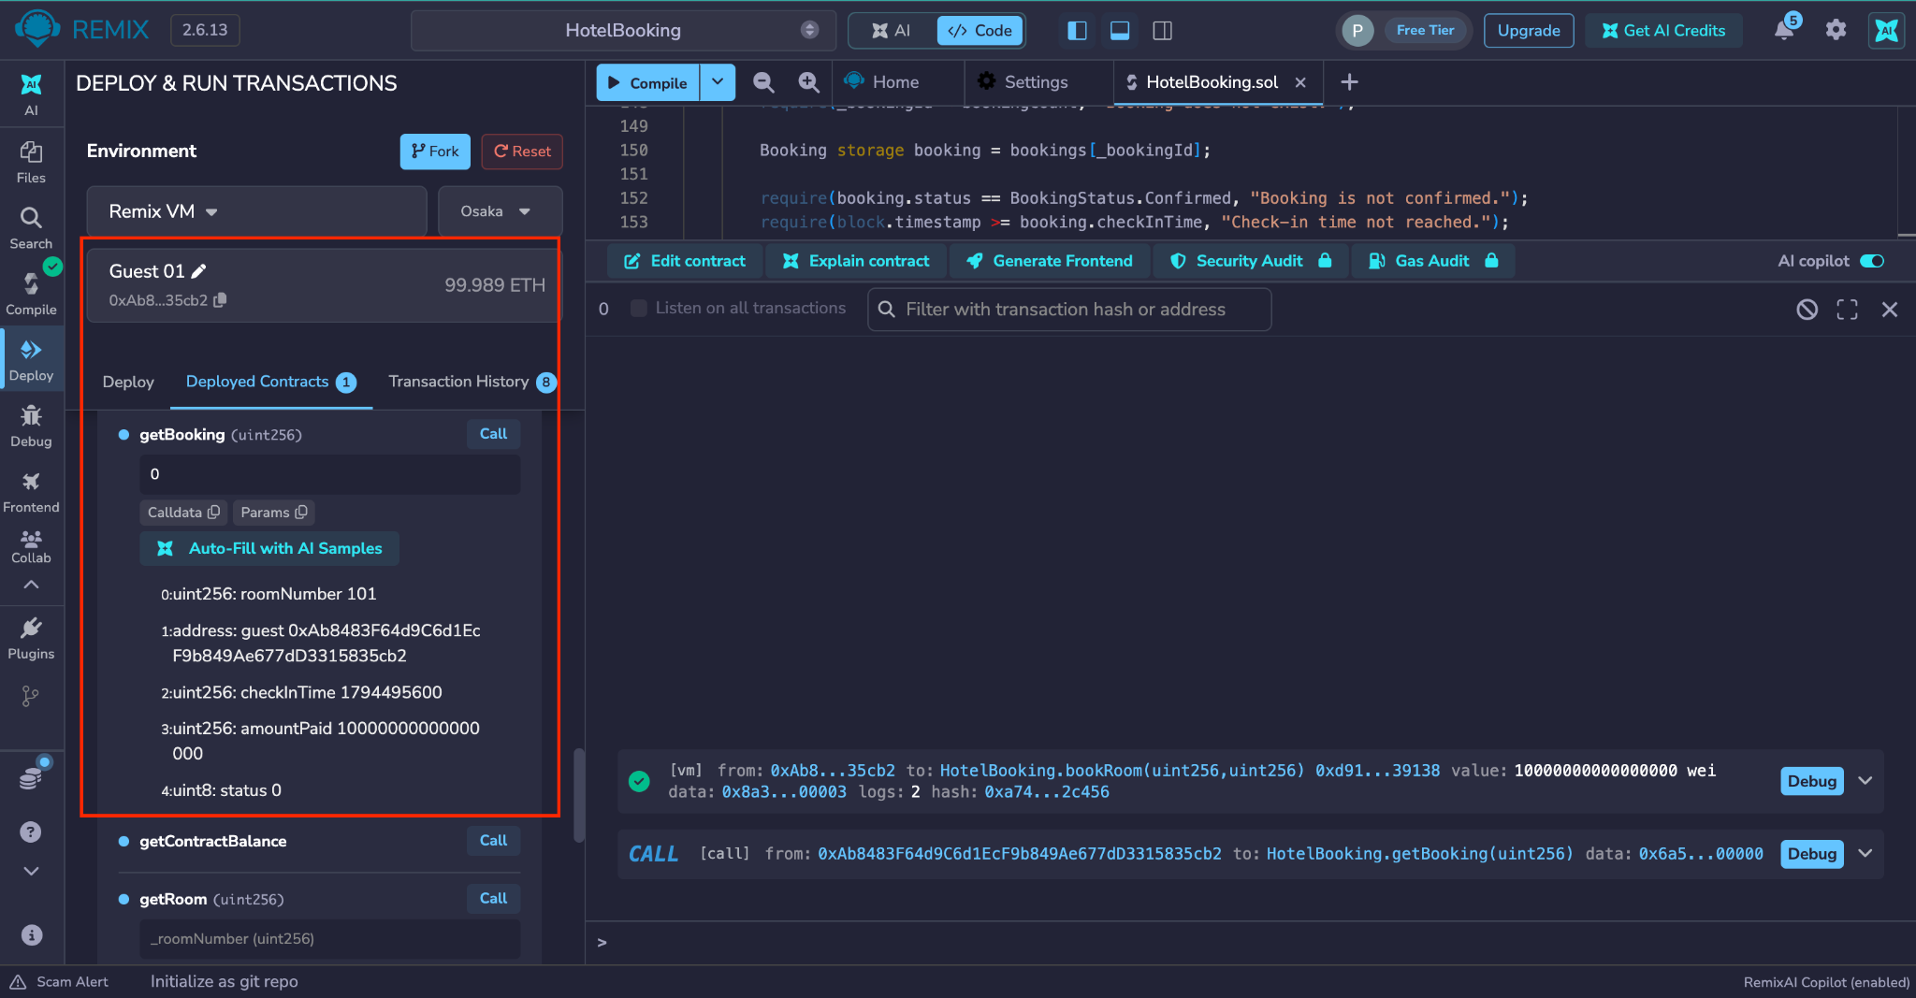
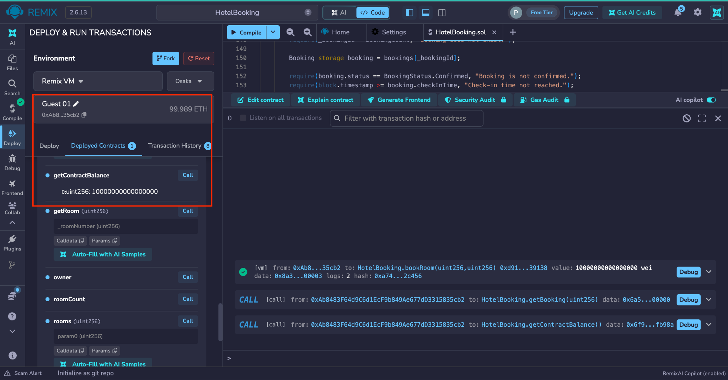
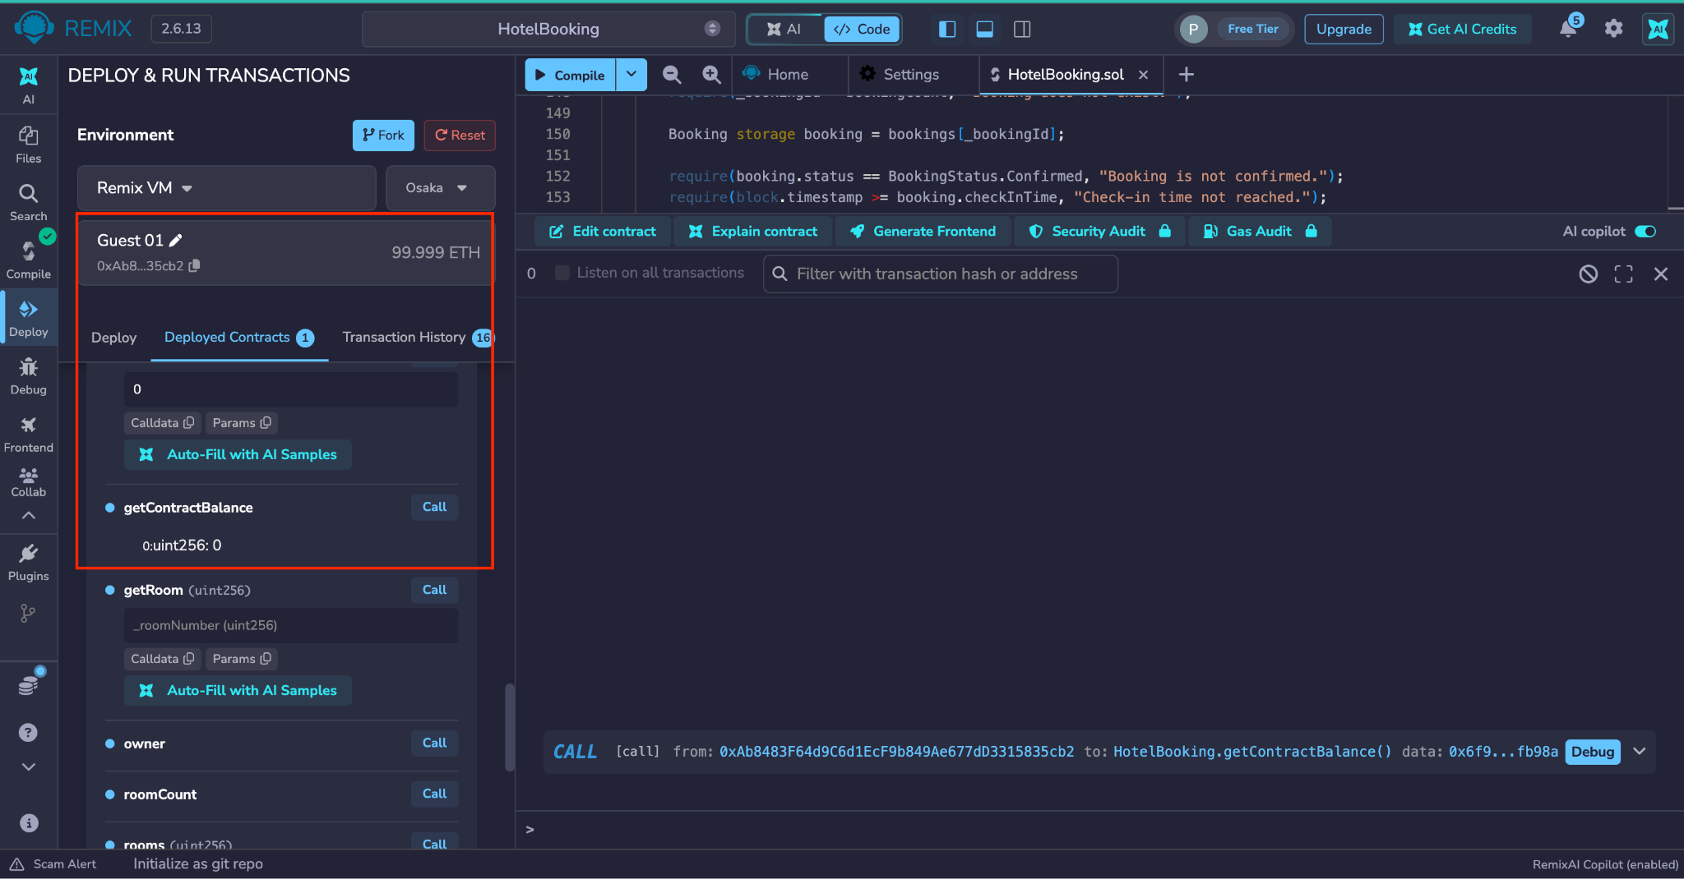
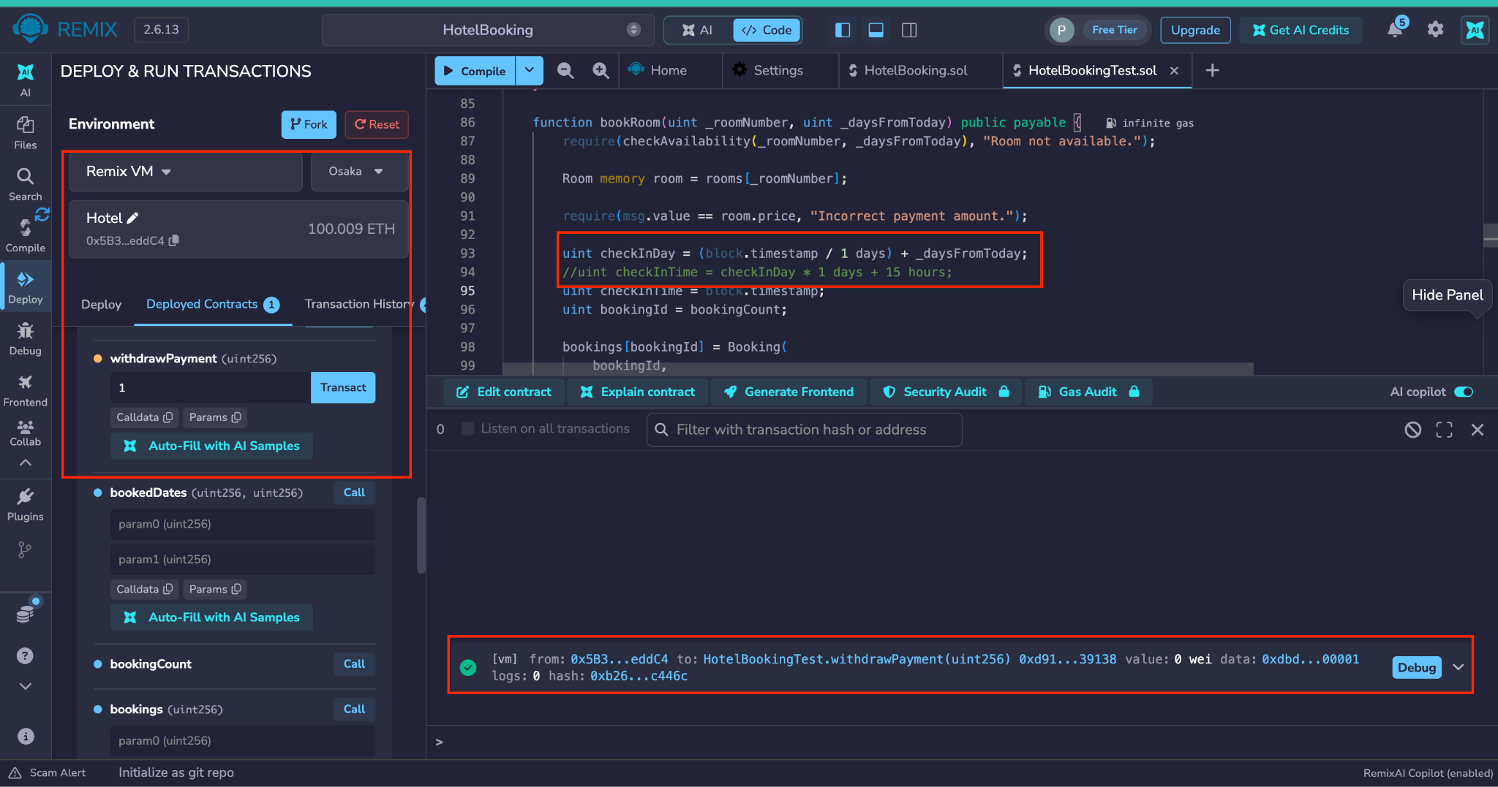
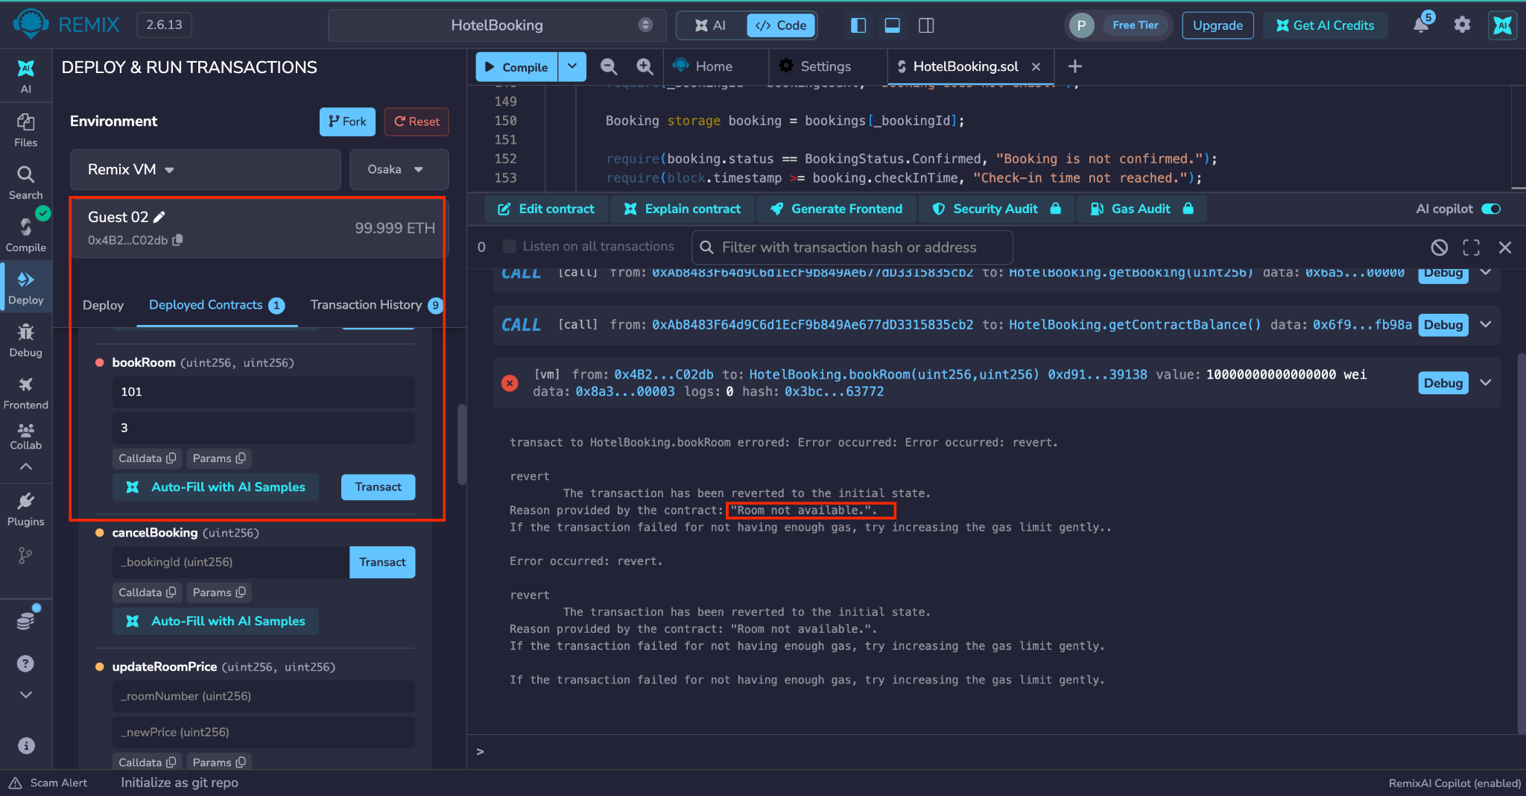
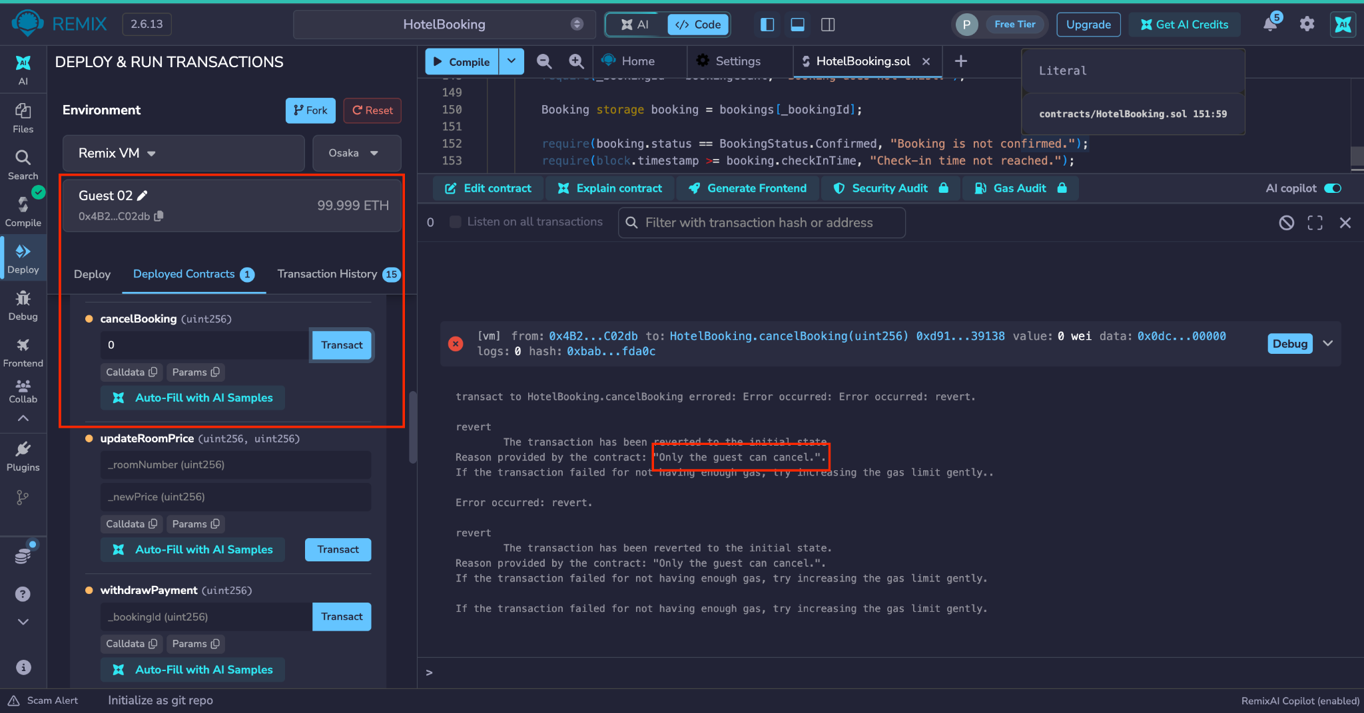
A Blockchain Booking System Using Smart Contract
Pedro Henrique Firmino dos Santos (2024244)
Video:https://drive.google.com/file/d/1eILa5Gp-S4Seiy0PMEiVdLXYgDASJgdy/view?usp=sharing
Github: https://github.com/Pedro-henrique-fir/CA1-Distributed-Digital-Transactions
1
Problem and Solution
2
Use Cases and Implementation
3
Smart Contract Design
4
Cryptography: ECDSA
In a normal hotel booking, the customer depends on other parties for almost everything. The hotel keep the records and decides about refunds, and the payment goes through a booking website or a bank. My idea is to use the blockchain as the middle layer between the guest and the hotel.
Trust and transparency: every booking is saved on the blockchain, so both sides can check it at any time.
Refunds: cancelling at least 24 hours before check-in gives an automatic refund.
Payments: the money stays in the contract and the hotel can only withdraw it after the check-in time.
Hotel
Guest
HotelBooking contract
I chose ECDSA (Elliptic Curve Digital Signature Algorithm), the method Ethereum already uses, because it covers most of my security needs.
Authentication: every transaction is signed with the sender's private key, so nobody can cancel or withdraw in someone else's name (Ethereum Community, 2026b).
Non-repudiation: the guest cannot later deny that they booked or cancelled.
Integrity: data is stored with Keccak-256 hashes, so any change to a booking is detected (Ethereum Community, 2026c).
Confidentiality: ECDSA does not encrypt data, so names and emails stay in the hotel's private system, linked by the booking id.
WHY ECDSA?
With a symmetric method like AES, guest and hotel would share the same key, so it would be impossible to prove who signed. With ECDSA, only the private key can sign, but anyone can check the signature (Ethereum Community, 2026b).
Add room
Check availability
DATA
Rooms: price and active flag
Bookings: guest wallet, room, check-in time, amount paid and status
Booked dates of each room
Update room price
Book room and pay
Withdraw payment
Cancel booking (refund)
FUNCTIONS
Hotel only: addRoom, updateRoomPrice, withdrawPayment
Guest: bookRoom (payable), cancelBooking
Anyone (view): getRoom, checkAvailability, getBooking, getContractBalance
HOW THE CONTRACT WORK
View booking
View booking
1. Guest books and pays (bookRoom)
2. Confirmed: the contract holds the money
RULES
Only the hotel adds rooms, sets prices and withdraws
One room, one night: no double booking
The guest must pay the exact price
Only the guest who booked can cancel, up to 24 h before check-in
The hotel withdraws only after the check-in time
I wrote the contract in Solidity with structs, an enum and mappings (Soliditylang, 2025b). It uses msg.sender to check who calls each function and block.timestamp to control the deadlines (Soliditylang, 2025c). The booking status changes before any ETH is sent, following the Checks-Effects-Interactions pattern against re-entrancy attacks (Soliditylang, 2025a).
3a. Cancelled
guest cancels 24 h before: full refund
3b. Completed
hotel withdraws after check-in
5
Testing in Remix
6
Benefits, Challenges, Advances
BENEFITS
Fewer intermediaries: the contract holds the payment, so the hotel can sell directly to the guest. This is the disruptive part: the business model changes from depending on a booking platform to paying only network fees.
Same rules for everyone: the hotel cannot refuse a valid refund, and the guest cannot cancel after the deadline.
CHALLENGES
Real world events: smart contracts cannot access information outside the blockchain (Ethereum Community, 2026d), so the hotel is still trusted for the check-in. Blockchain reduces trust in the middle, but it does not remove it.
Personal data: it should not be stored on a blockchain (EDPB, 2025). Even a wallet address could be linked to a person, so the contract stores as little as possible.
Costs and adoption: gas fees, ETH price changes, and many guests have no wallet.
RECENT ADVANCEMENTS
A real version of my system would run on a rollup and charge in a stablecoin, which helps with the cost challenges:
Rollups: group transactions off-chain and are cheaper since the Dencun upgrade in March 2024 (Ethereum Community, 2026e).
Stablecoins: keep a fixed value, so the room price stays the same (Ethereum Community, 2026f).
Account abstraction: applications can pay the gas for users (Ethereum Community, 2026a).
1. Hotel deploys the contract and adds room 101
2. Guest books room 101 and pay
3. getBooking: booking saved, status Confirmed
4. The contract holds the ETH
5. Guest cancels in time refund sent, balance 0
6. Hotel withdraws after check-in (test copy check-in set to now)
Error: same room and date, “Room not available”
Error: another guest cancels, “Only the guest can cancel”
REFERENCES
CONCLUSION
EDPB (2025). EDPB adopts guidelines on processing personal data through blockchains and is ready to cooperate with AI Office on guidelines on AI Act and EU data protection law. [online] European Data Protection Board. Available at: https://www.edpb.europa.eu/news/edpb-adopts-guidelines-on-processing-personal-data-through-blockchains-and-is-ready-to_en [Accessed 6 Nov. 2026].
Ethereum Community (2026a). Account abstraction. [online] ethereum.org. Available at: https://ethereum.org/roadmap/account-abstraction/ [Accessed 6 Nov. 2026].
Ethereum Community (2026b). Ethereum accounts. [online] ethereum.org. Available at: https://ethereum.org/developers/docs/accounts/ [Accessed 5 Nov. 2026].
Ethereum Community (2026c). Merkle Patricia Trie. [online] ethereum.org. Available at: https://ethereum.org/developers/docs/data-structures-and-encoding/patricia-merkle-trie/ [Accessed 5 Nov. 2026].
Ethereum Community (2026d). Oracles. [online] ethereum.org. Available at: https://ethereum.org/developers/docs/oracles/ [Accessed 6 Nov. 2026].
Ethereum Community (2026e). Scaling Ethereum. [online] ethereum.org. Available at: https://ethereum.org/roadmap/scaling/ [Accessed 6 Nov. 2026].
Ethereum Community (2026f). Stablecoins. [online] ethereum.org. Available at: https://ethereum.org/stablecoins/ [Accessed 6 Nov. 2026].
Soliditylang (2025a). Security considerations. [online] Solidity documentation. Available at: https://docs.soliditylang.org/en/latest/security-considerations.html [Accessed 9 Nov. 2026].
Soliditylang (2025b). Types. [online] Solidity documentation. Available at: https://docs.soliditylang.org/en/latest/types.html [Accessed 9 Nov. 2026].
Soliditylang (2025c). Units and globally available variables. [online] Solidity documentation. Available at: https://docs.soliditylang.org/en/latest/units-and-global-variables.html [Accessed 9 Nov. 2026].
A smart contract can be the middle layer between guest and hotel. it records bookings, holds payments and applies refunds automatically. The oracle problem, GDPR and usability still need more work.

