Slide 1
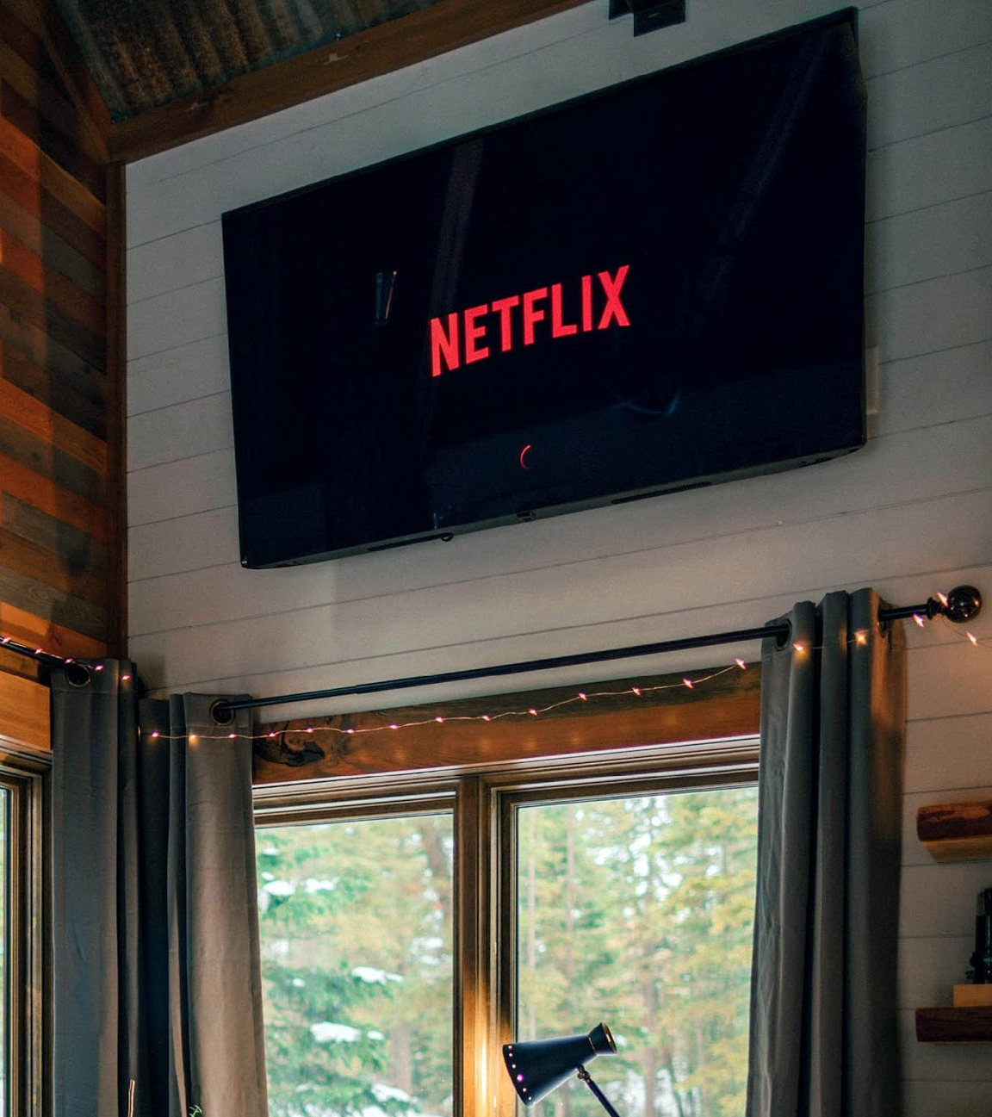




Introduction to Machine Learning,
Personal Project
What will I Binge
this Summer?
Notes:
Ladies and gentlemen, get ready to see what has been a caffeine-induced dance with my sanity, and how I think I was the one to win in the end

Slide 2
Clean Data
Create Clustering of Users
Recommend Movies
Make a Nice PowerpoinT
Outline next steps
Deliverables

Slide 3
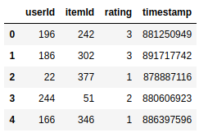
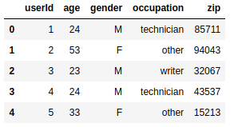
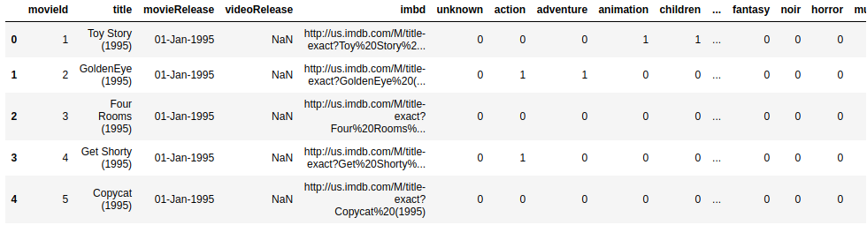
Issues with Data

Slide 4

Original Approach
Input
Relu
Sigmoid
Output
16
32
64

Slide 5





Quote Slide
“Dear God why is this not working?”
~ Pedro @4am outside library

Slide 6
This is a Map*
Paris?
I am Here
*This slide no longer bears any relevance to the project

Slide 7
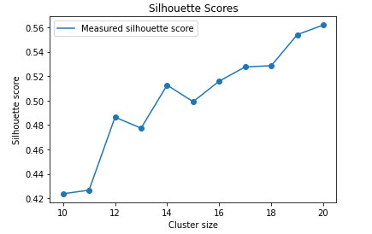
Creating Clusters
Silhouette score: measure of how similar objects are to their own cluster
Maybe even more than 20 clusters would be ideal

Slide 8
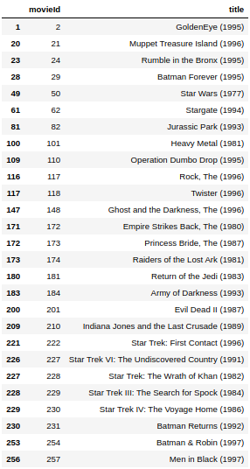
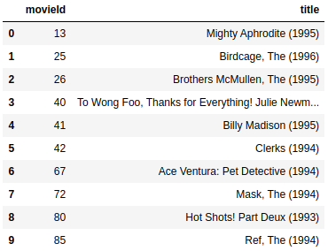
Results for User 494
Star Wars, Jurassic Park, and INdiana Jones clustered together
This is his/Her favorite cluster, more movies can be generateD

