Slide 1
Boosting Eventus ID
Name Entity Recognition, Real Entity Tagging, and Entity Relationship Extraction using NLP (with Machine Learning)

Slide 2
Opportunity
More than 2 million news articles are published every year on the web
Lack of centralization (hundreds of thousands of sites and formats, hundreds of languages, etc.)
How to synthesize that volume of information for decision making
Unstructured information sources
Notes:
Finance, public security, demographics

Slide 3
Previous research
CAMEO: Conflict and Mediation Events Observations
GDETL: Global Database of Events, Language and Tone
Eventus ID: GDETL for Spanish (Javier Osorio Label Data)
Notes:
CAMEO
Coding scheme to catalog autors and events, specialized for automatized coding and the registero of sub-national authors (the previous coding schemes where capable just to deal with national level authors (not asymetrical warefares for example).
DARPA – Lockheed Martin Project: Integrated Conflict Early Warning System
GDETL
“Construct catalog of human societal-scale behavior and beliefs across all countries of the world
Monitor the world new media outlet in 65 different lenguages.
Translate and process the texts: updated every
Classified the news in 300 categories: people, places, organizations, emotions
2.5TB (just one year of records)
Eventus ID
Javier Osorio, mexican professor of University of Arizona, doctoral thesis. His idea was to catalog events for organize crime in Mexico.
Previous model: Fixed lists, exact matches
Problems doing “parts of speech taggigng”, “Entity Extraction” and “Entity Relatioship” in Spanish due to the stucture of the lenguage:
EXAMPLE of a complicated sentence in spanish pasive voice).
A member of a criminal gang was arrested yesterday by army troops

Slide 4
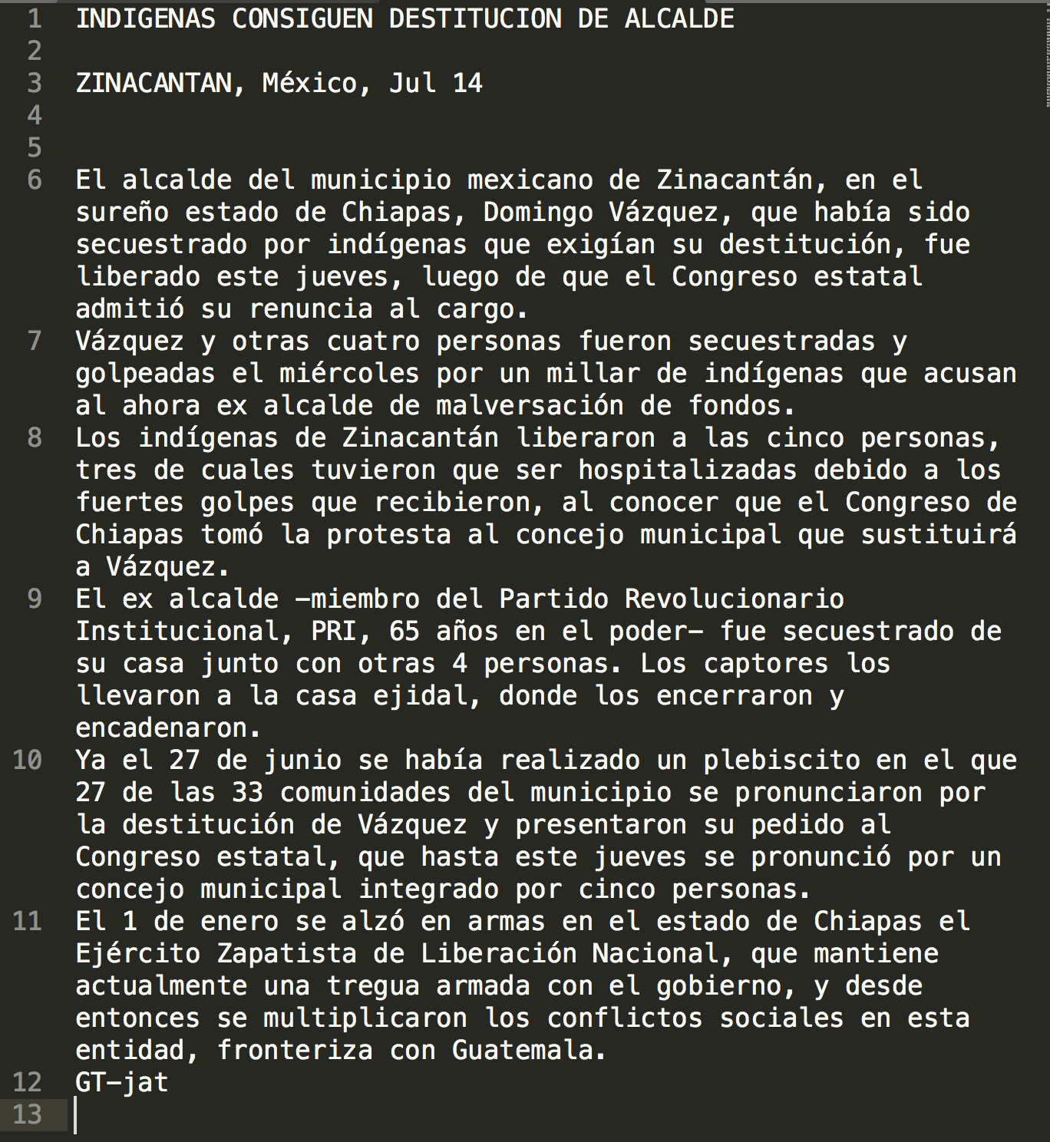
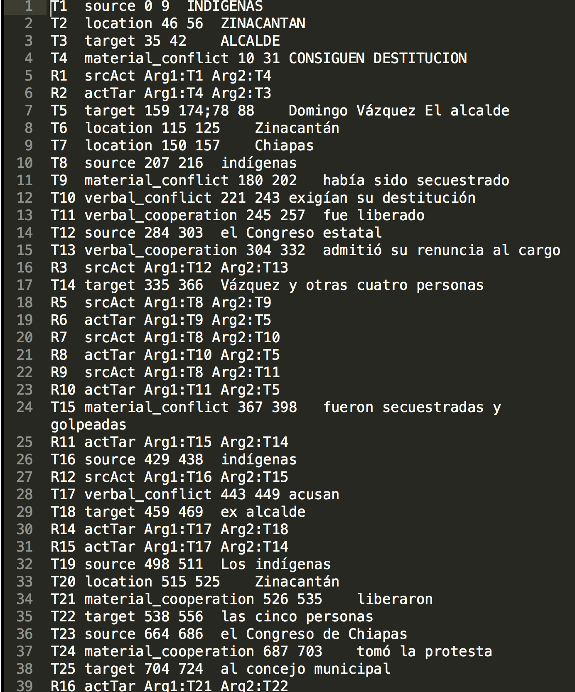
Data 724 News in spanish (came from LDC Gigaword)
Raw Label Data
Notes:
LDC – Linguistic Data Consortium

Slide 5
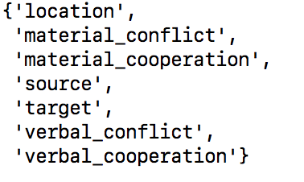
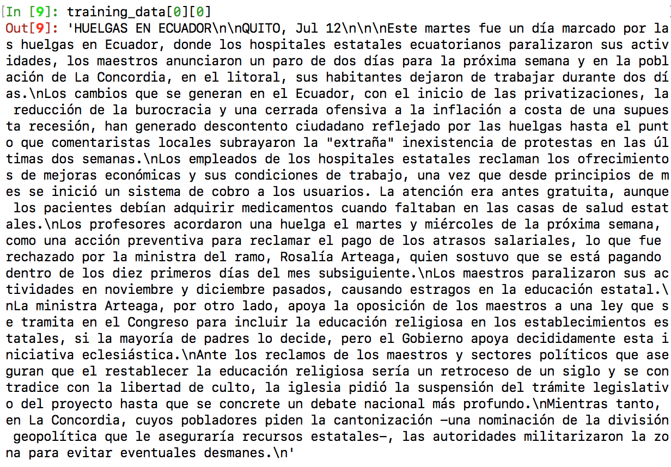
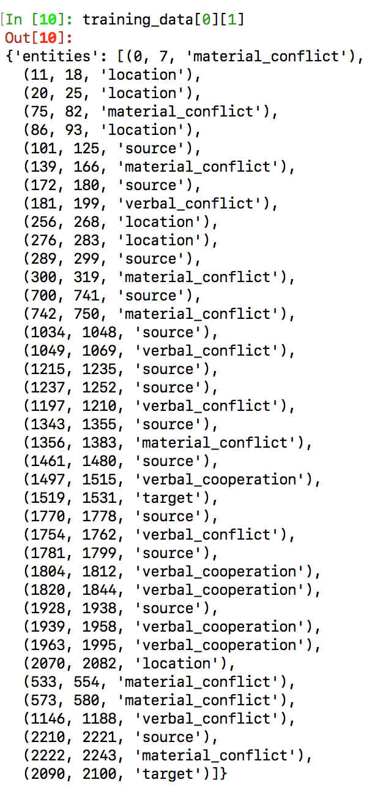
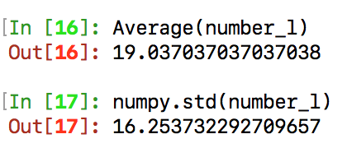
Data
Input 1
Input 2
CLASSES
UNIT OF PREDICTION
NUMBER OF CLASSES VALUES FOR EACH DOC
Sample 50 documents
Notes:
LDC – Linguistic Data ConsortiumCaptura de pantalla 2018-05-30 a la(s) 13.12.49

Slide 6
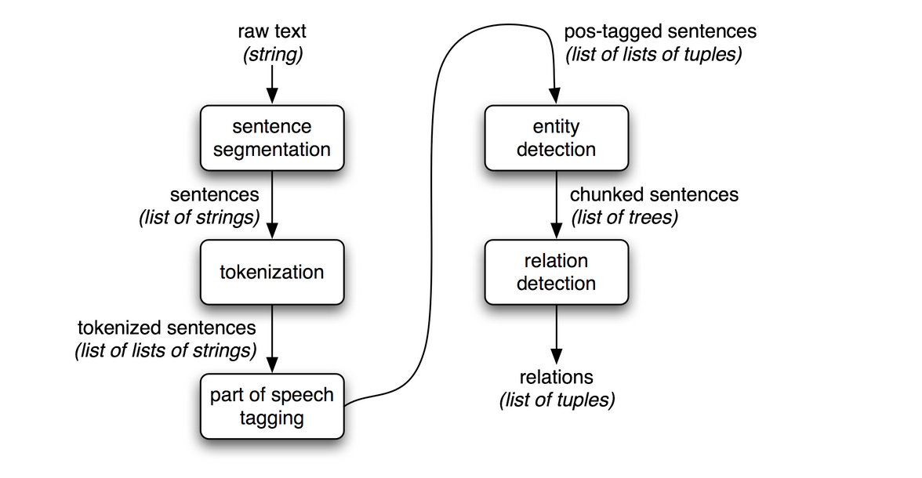
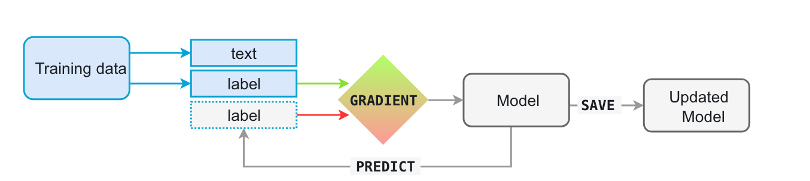
Pipeline
PREPROCESSING
SPLITTING
TRAINING
TESTING
Coming soon
Source: NLTK
Source: SpaCy
Notes:
Translate from Spanish to English
Google API
Convert Text into Structured Dataframe
Apply NLP Pipeline
Use HW2 for part of speech tagging
nltk/chunk/named_entity.py
Translate from English to Spanish
- Convert each Row
Apply performance metrics
- See following slide

Slide 7
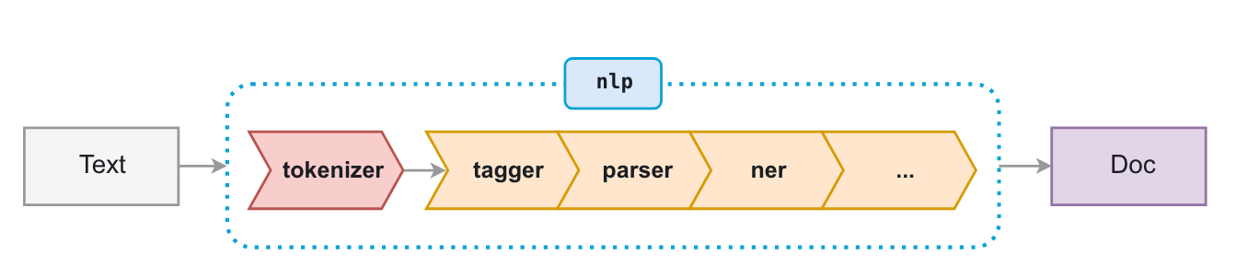
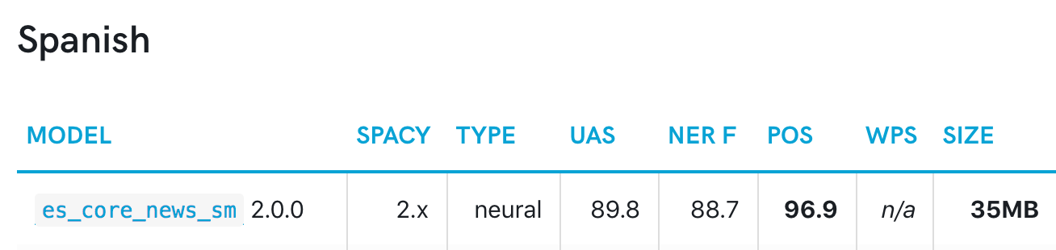

Pipeline
TRAINING
PREPROCESSING
SPLITTING
TRAINING
TESTING
Source: SpaCy
Using predictions for POS, Dependency parser (UAS) and Entity Recognition (the features)
TESTING
ACCURACY: exact match (start, end, class)
Notes:
UAS
POS – Parts-Of-Speech
NER – Name entitity recognition
UAS – Metric of performance for dependency parser
Example of input array:
{ 'entities': [(0, 4, 'ORG')], 'heads': [1, 1, 1, 5, 5, 2, 7, 5], 'deps': ['nsubj', 'ROOT', 'prt', 'quantmod', 'compound', 'pobj', 'det', 'npadvmod'], 'tags': ['PROPN', 'VERB', 'ADP', 'SYM', 'NUM', 'NUM', 'DET', 'NOUN'], 'cats': {'BUSINESS': 1.0} }

Slide 8
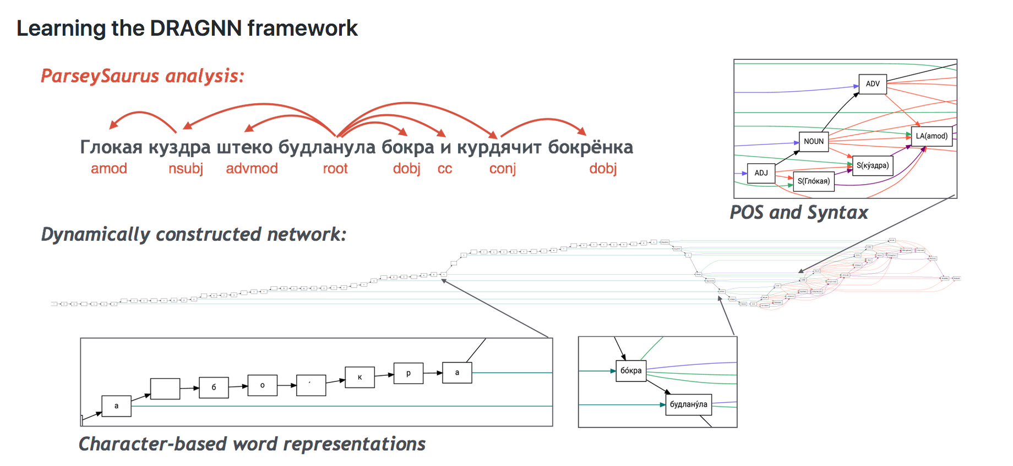
MODEL: SIMILAR TOO DRAGNN: (Dynamic Recurrent Acyclic Graphical Neural Networks)
Source: https://github.com/tensorflow/models/tree/master/research/syntaxnet

Slide 9
MODEL: Training
Iteration
Notes:
Baseline: - Benchmark
Best of Market (93% in entity recognition): Human analyst 97%
Accuracy Metric
What is accuracy in this context:
What are going to be measuring

Slide 10

Performance: ACCURACY
Notes:
Baseline: - Benchmark
Best of Market (93% in entity recognition): Human analyst 97%
Accuracy Metric
What is accuracy in this context:
What are going to be measuring

Slide 11
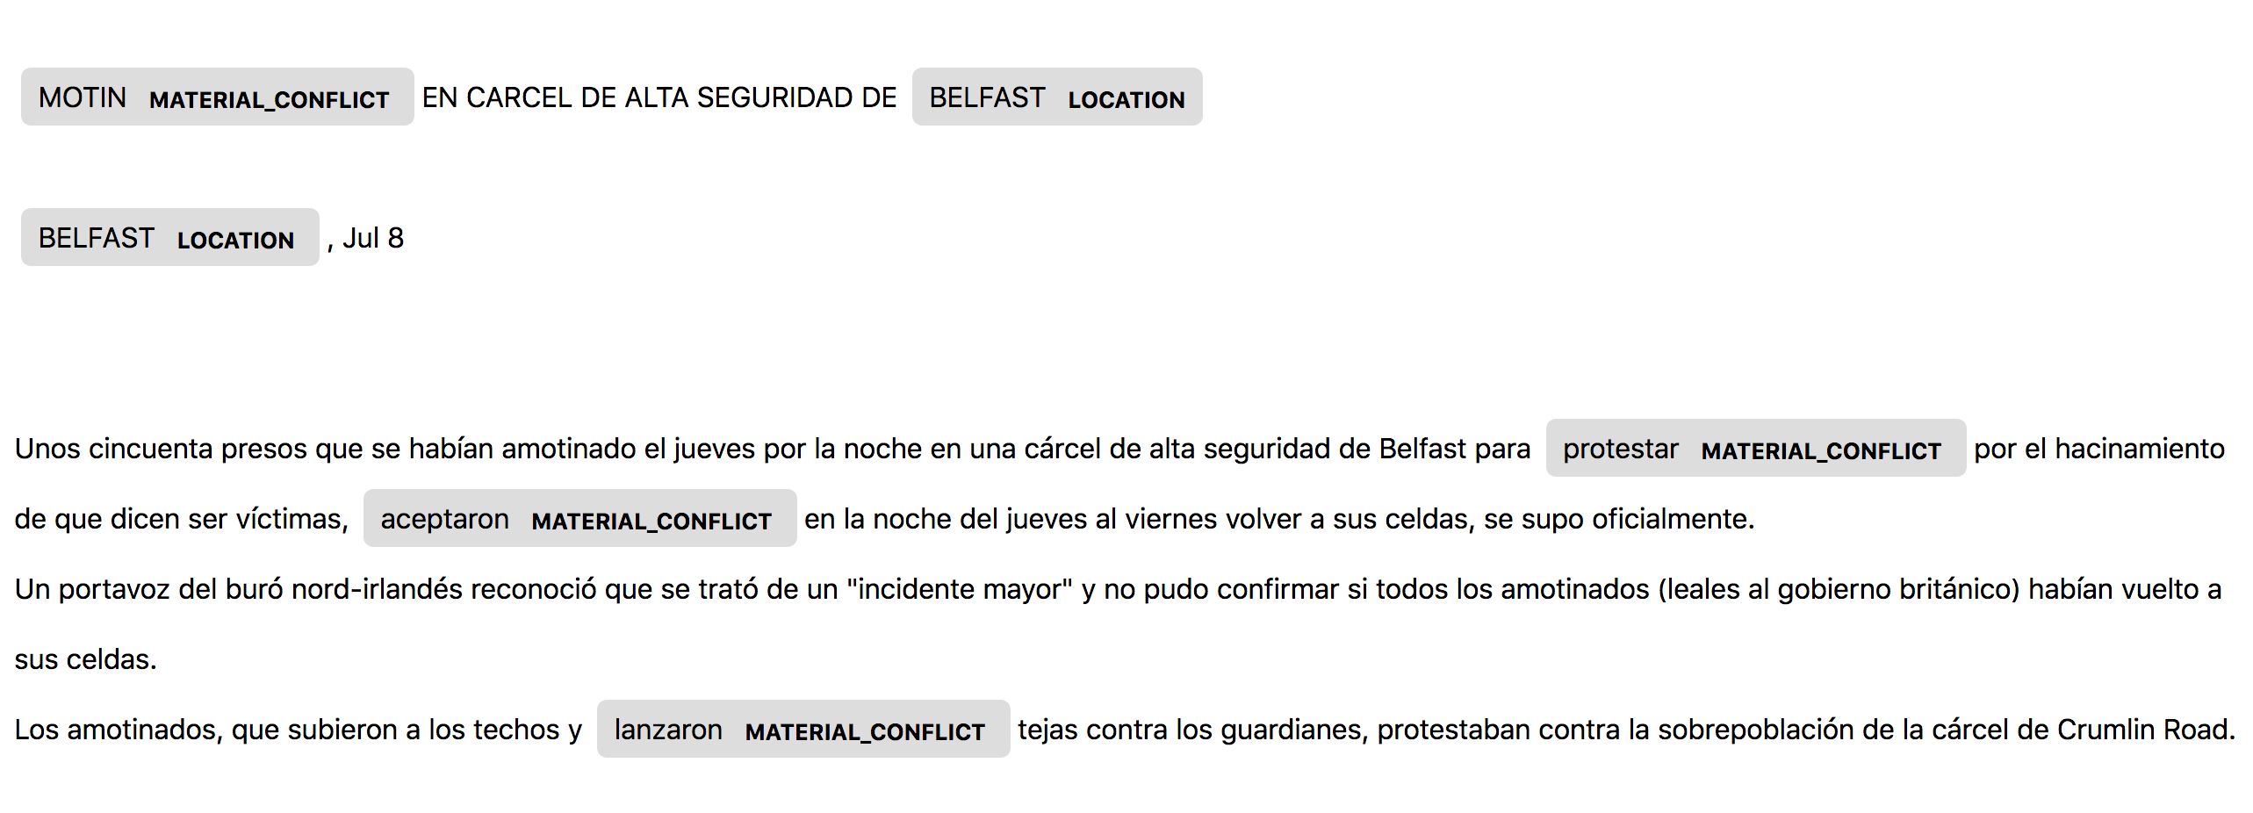
Example 1

Slide 12
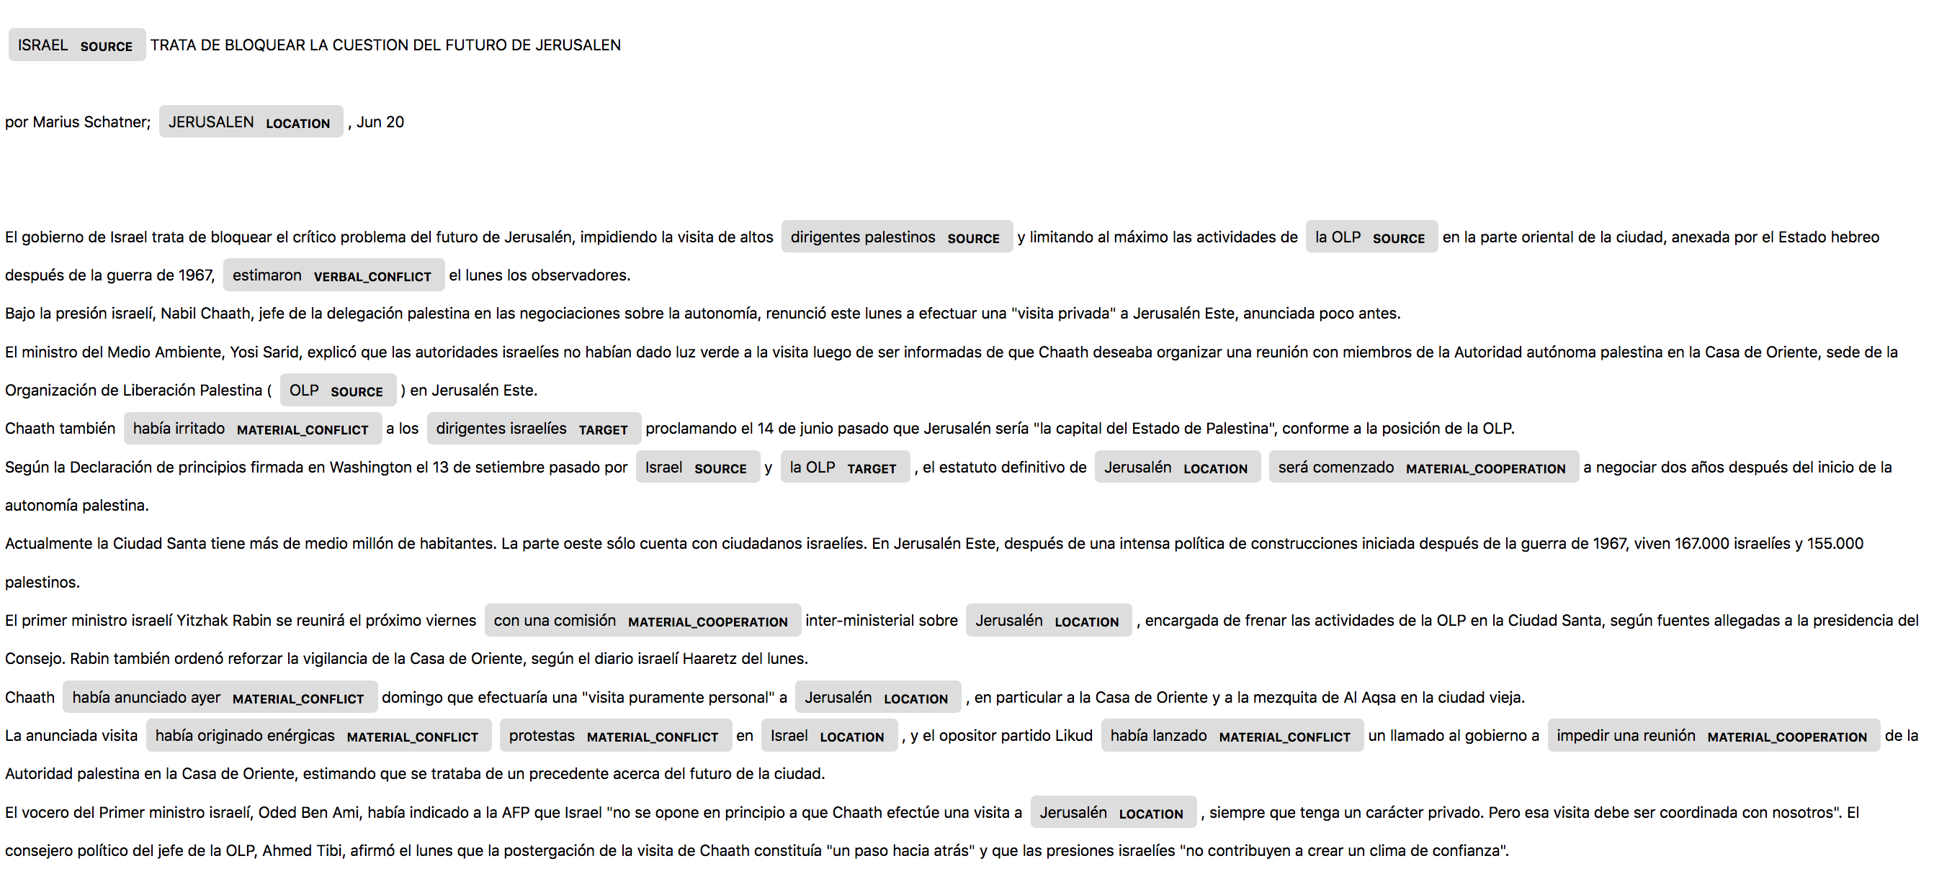
Example 2

Slide 13
To Do
Entity Extraction
Correct minor bugs (training with zero labels)
Run on ”production” mode: use whole sample (minibatch strategy)
Play with model parameters: Number of Iterations and Drop-out rate
Extend the vector of features (BILUO tags, other corpus components *NLTK?)
Relationship Extraction
There is label data available
Notes:
BILUO Tags: function already implemented in SpaCy
Drop-Out parameter: make harder to memorize data

